Slide 1
BHARATH
TEAM DETAILS
INNOVATE HACKATHON 2026
Team Sparsha
BIH2026 | PROJECT PRESENTATION
RV University, Mysuru
SparshaGuard
Mentor: Dr. Shruthi P
A safety smartwatch where a stranger's touch raises the alarm
EMATIX • Connecting Today, Tomorrow
github.com/Bhajanth13/SparshaGuard

Slide 2
BHARATH INNOVATE HACKATHON 2026
02
Problem Statement
Problem definition
Who is affected?
Every personal safety alert today (SOS apps, panic buttons) needs the victim to act first.
An attack rarely allows that.
No wearable raises an alarm on its own when another person touches her.
Women walking alone at night
Commuters in crowded buses and metros
Women riding cabs and autos
The families waiting for them
Current limitations
Evidence
SOS apps and panic buttons need a deliberate action
Fall and heart-rate alerts on wearables can't tell a stranger's grab from daily movement
Crimes against women registered
18.7 %
2021
4,28,278
were assaults on a woman's modesty
2022
4,45,256
+4 % in one year: about 51 every hour
share of all 4,45,256 cases
Source: NCRB, Crime in India 2022
Innovate | Build | Solve | A Stronger Bharat
Team Sparsha • RV University

Slide 3
BHARATH INNOVATE HACKATHON 2026
03
Proposed Solution
Solution overview
Key innovation
Touch-detecting smartwatch: senses another person's touch on her
Normal mode: an everyday watch; touches raise no alarm
Guard Mode: a stranger's grab or a struggle starts a 15 s PIN countdown; mic on
Real PIN: cancels the alert and deletes the recording
Duress PIN: shows "Cancelled" but alerts her contact silently
No PIN: SMS + GPS + voice recording sent, 112 called
Two bodies share static charge the instant they touch. The watch feels that jump, so her own hand, a metal pole or a phone never count as a person.
KEY BENEFITS
01 Hands-free
02 Discreet
03 Grounded
No phone, no button: she only acts to cancel
A duress PIN looks like a normal cancel
Physics from 60 sources, checked with SPICE + FastCap
Innovate | Build | Solve | A Stronger Bharat
Team Sparsha • RV University

Slide 4
BHARATH INNOVATE HACKATHON 2026
04
Architecture & Technology
SYSTEM FLOW
SENSE
DETECT
DECIDE
ALERT
→
→
→
Touch, static, motion, heart rate
Another body, pulling or struggle
PIN · duress · strap check
SMS · GPS · voice · 112
Technology stack
Why these technologies?
Sensing: Touché sweep, static channel, accelerometer, gyroscope, heart rate, mic
Model: Python (NumPy, SciPy), SVM, random forest
Checks: ngspice, MIT FastCap · Demo: HTML / JS
Low-cost parts, battery-powered
Every decision made on the watch itself
Each value traced to a published source (60 logged)
Physics cross-checked by two solvers (ngspice, FastCap)
Innovate | Build | Solve | A Stronger Bharat
Team Sparsha • RV University

Slide 5
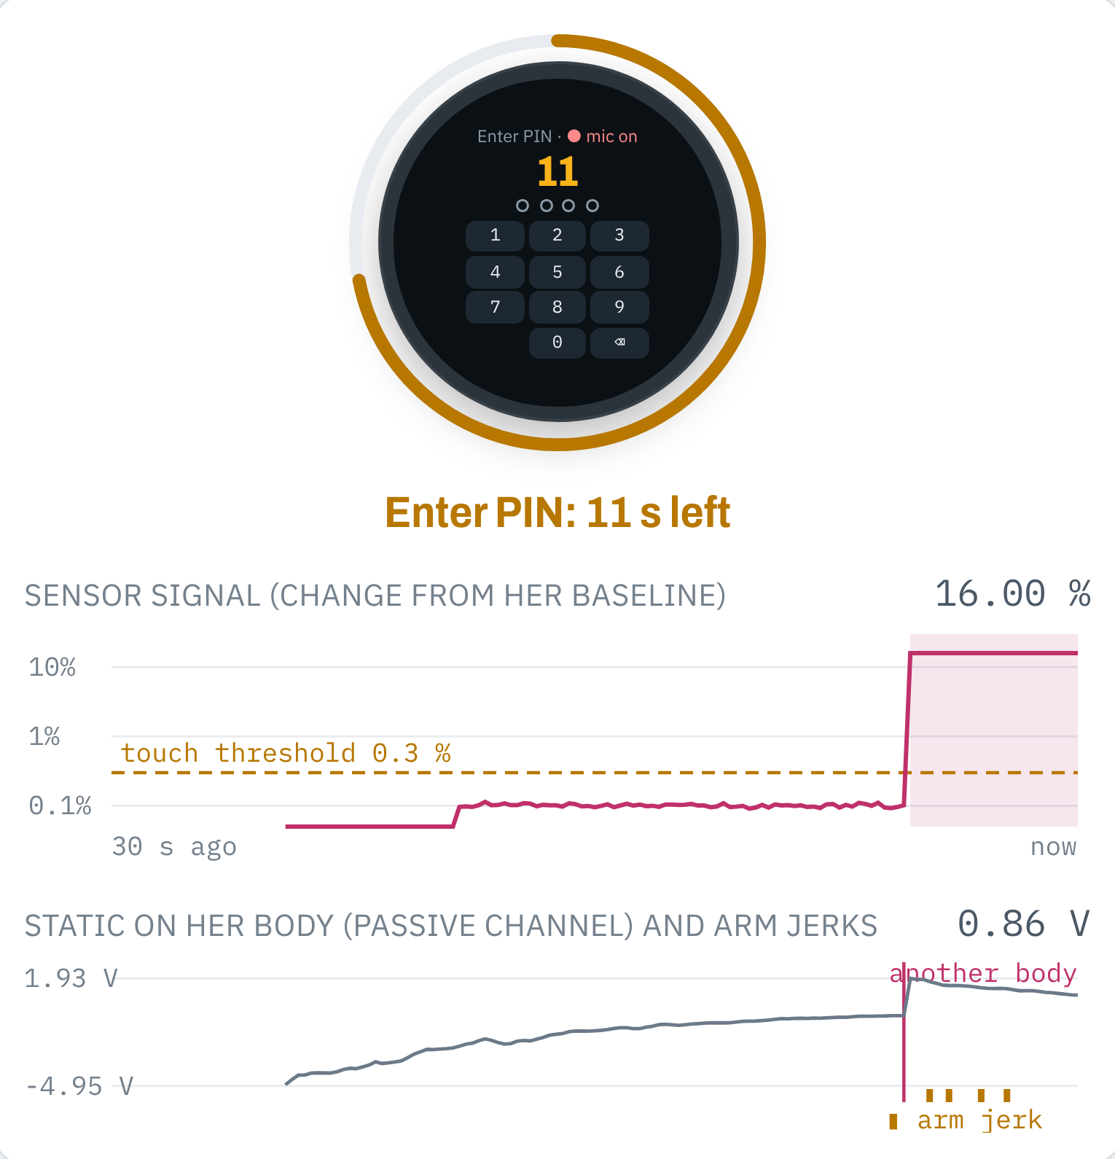
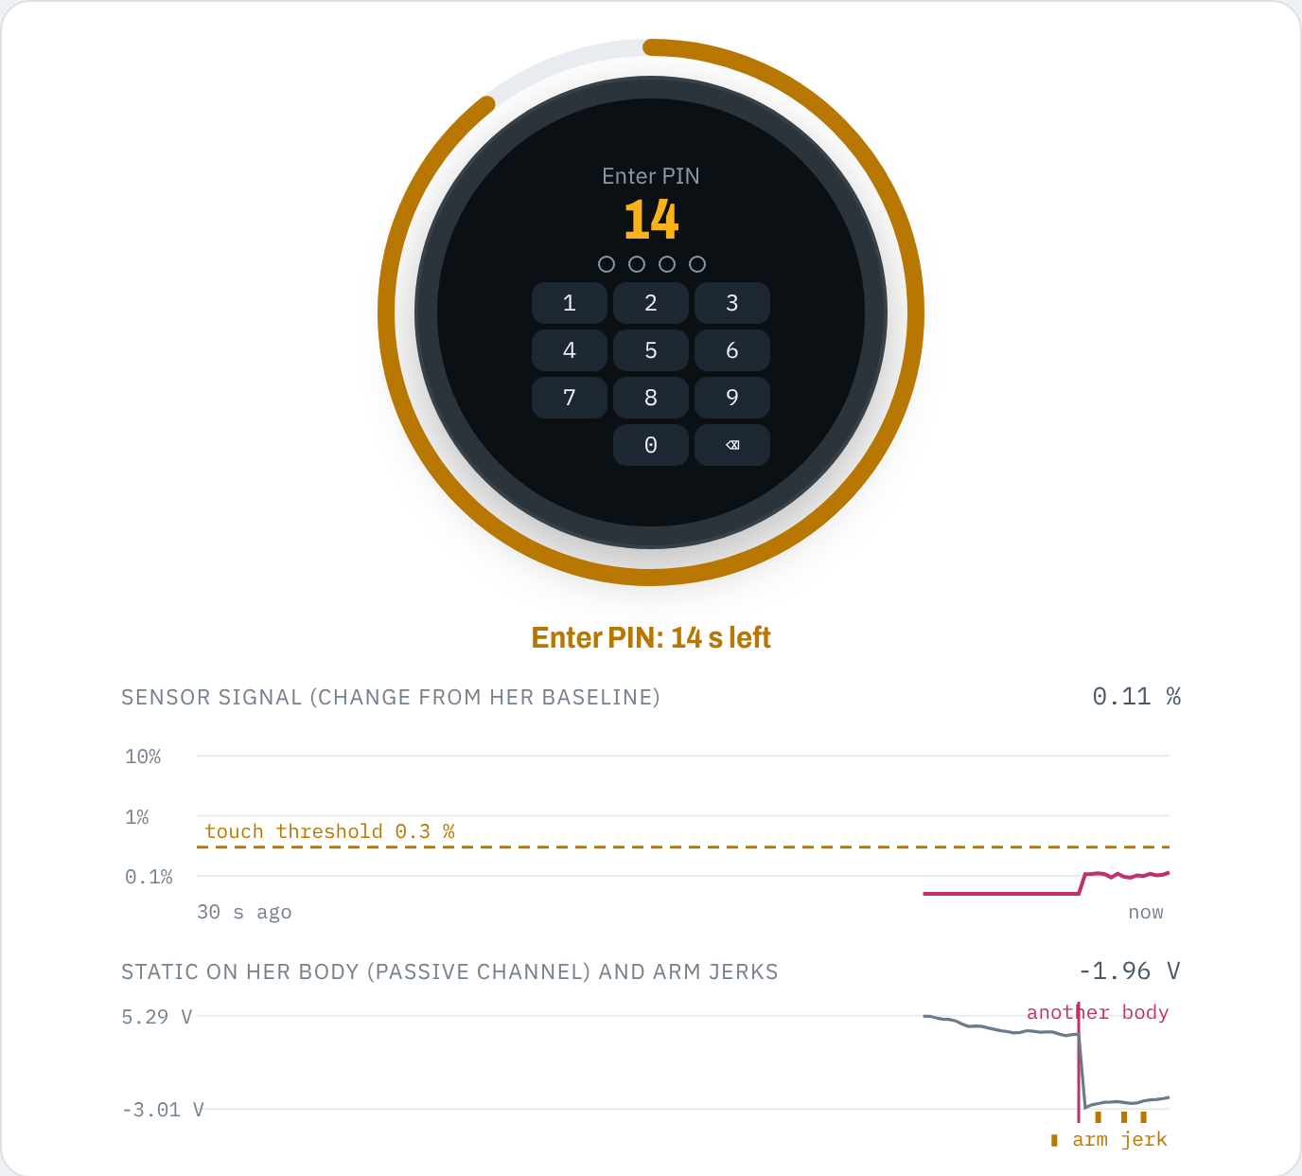
BHARATH INNOVATE HACKATHON 2026
05
Prototype & Demonstration
Feature 01 · Digital twin
The watch's own firmware on a simulated sensor
Sensors: frequency sweep, body static (500 Hz), accelerometer, gyroscope, heart rate
Guided story + try-it mode: grabs, struggle, running, PIN, duress, strap removal
Feature 02 · Validated physics
Values from 60 published sources
Circuit matches SPICE to 0.0001 %; 3D field matches MIT FastCap within 1 %
70 % of grabs over 7 body places (13 % before); 99 % of struggles
0–1 unwanted prompts in 9 simulated hours
Try it
bhajanth13.github.io/SparshaGuard
What the screenshot shows
Moment: Guard Mode on; a stranger grabs her wrist
Watch face: asks for her PIN, 11 s of 15 left; red dot = mic recording
Orange ring: the PIN countdown
Sensor signal (log scale, last 30 s): jumps from about 0.1 % to 16 %, far above the 0.3 % touch threshold (dashed); shaded = touch felt
Static on her body: the red line marks the instant another body touched her (charge shared); orange ticks = arm jerks from the pull
Decision: touch held 2 s + another body = PIN prompt; no PIN in 15 s sends the alert
SCREENSHOT · DIGITAL TWIN
Innovate | Build | Solve | A Stronger Bharat
Team Sparsha • RV University

Slide 6
BHARATH INNOVATE HACKATHON 2026
06
Feasibility & Risk Management
Technical feasibility
Operational viability
Market viability
Off-the-shelf parts: ESP32, LC tank, electrode, ADS1115, motion sensor, heart-rate sensor, mic. Detection logic is written and tested.
Battery-powered; all decisions on the watch. Alerts over 4G LTE Cat-1, since 2G is being shut down.
Women commuters, students, night-shift workers and their families. Unlike SOS apps, she needs no action.
Main risk
Mitigation / fallback
Simulated, not yet measured. Static charge on Indian floors and struggle-motion thresholds are estimates; a grab that only holds can be missed.
A battery prototype (Gate 1) measures body voltages and staged-struggle motion. The wrist sweep still catches wrist grabs; the PIN handles friendly touches.
Innovate | Build | Solve | A Stronger Bharat
Team Sparsha • RV University

Slide 7
BHARATH INNOVATE HACKATHON 2026
07
Impact, Business Model & Roadmap
Impact
Business model
Success metrics
Help is called even when she can't reach her phone. Live location and audio give family and police something to act on.
Watch sold to individuals; bulk plans for colleges, hostels and employers; optional alert-service subscription.
≥ 90 % of wrist grabs and ≥ 60 % anywhere on hardware · < 1 unwanted prompt a day · alert within 20 s
FUTURE ROADMAP
NOW
Validated model + digital twin
NEXT
Battery prototype, field tests
LATER
Audio confirm, college pilot
Innovate | Build | Solve | A Stronger Bharat
Team Sparsha • RV University

Slide 8
BHARATH INNOVATE HACKATHON 2026
08
Team & Responsibilities
MEMBER 1
MEMBER 2
Bhajanth V
Sukruth A Chinnur
Co-developer
Co-developer
Mentor / institution
Execution plan
Dr. Shruthi P, Faculty Mentor
RV University, Mysuru
Proposal → sourced physics → SPICE and FastCap checks → digital twin → static-charge fusion → Gate 1 prototype
Innovate | Build | Solve | A Stronger Bharat
Team Sparsha • RV University

Slide 9
THANK YOU
SparshaGuard
Questions • Feedback • Collaboration
Live: bhajanth13.github.io/SparshaGuard
Code: github.com/Bhajanth13/SparshaGuard
BHARATH INNOVATE HACKATHON 2026 • INNOVATE | BUILD | SOLVE

