Slide 1
BHARATH
TEAM DETAILS
INNOVATE HACKATHON 2026
Team Sparsha
BIH2026 | PROJECT PRESENTATION
RV University, Mysuru
SparshaGuard
Mentor: Dr. Shruthi P
A safety smartwatch where a stranger's touch raises the alarm
EMATIX • Connecting Today, Tomorrow
github.com/Bhajanth13/SparshaGuard

Slide 2
BHARATH INNOVATE HACKATHON 2026
02
Problem Statement
Problem definition
Who is affected?
Every personal safety alert today (SOS apps, panic buttons) needs the victim to act first.
An attack rarely allows that.
No wearable raises an alarm on its own when another person touches her.
Women walking alone at night
Commuters in crowded buses and metros
Women riding cabs and autos
The families waiting for them
Current limitations
Evidence
SOS apps and panic buttons need a deliberate action
Fall and heart-rate alerts on wearables can't tell a stranger's grab from daily movement
Crimes against women registered
18.7 %
2021
4,28,278
were assaults on a woman's modesty
2022
4,45,256
+4 % in one year: about 51 every hour
share of all 4,45,256 cases
Source: NCRB, Crime in India 2022
Innovate | Build | Solve | A Stronger Bharat
Team Sparsha • RV University

Slide 3
BHARATH INNOVATE HACKATHON 2026
03
Proposed Solution
Solution overview
Key innovation
Touch-detecting smartwatch: senses another person's touch on her
Normal mode: an everyday watch; touches raise no alarm
Guard Mode: a stranger's grab or a struggle starts a 15 s PIN countdown; mic on
Real PIN: cancels the alert and deletes the recording
Duress PIN: shows "Cancelled" but alerts her contact silently
No PIN: SMS + GPS + voice recording sent, 112 called
Two bodies share static charge the instant they touch. The watch feels that jump, so her own hand, a metal pole or a phone never count as a person.
KEY BENEFITS
01 Hands-free
02 Discreet
03 Grounded
No phone, no button: she only acts to cancel
A duress PIN looks like a normal cancel
Physics from 72 sources, checked with SPICE + FastCap
Innovate | Build | Solve | A Stronger Bharat
Team Sparsha • RV University

Slide 4
BHARATH INNOVATE HACKATHON 2026
04
Architecture & Technology
SYSTEM FLOW
SENSE
DETECT
DECIDE
ALERT
→
→
→
Touch, static, motion, heart rate
Another body, pulling or struggle
PIN · duress · strap check
SMS · GPS · voice · 112
Technology stack
Why these technologies?
Sensing: Touché sweep, static channel, accelerometer, gyroscope, heart rate, mic
Model: Python (NumPy, SciPy), SVM, random forest
Checks: ngspice, MIT FastCap · Demo: HTML / JS
Low-cost parts, battery-powered
Every decision made on the watch itself
Each value traced to a published source (72 logged)
Physics cross-checked by two solvers (ngspice, FastCap)
Innovate | Build | Solve | A Stronger Bharat
Team Sparsha • RV University

Slide 5
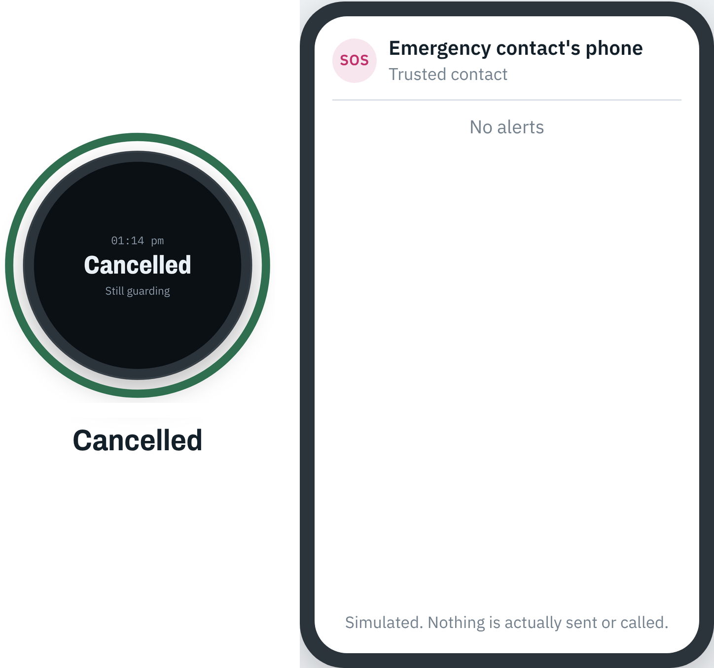
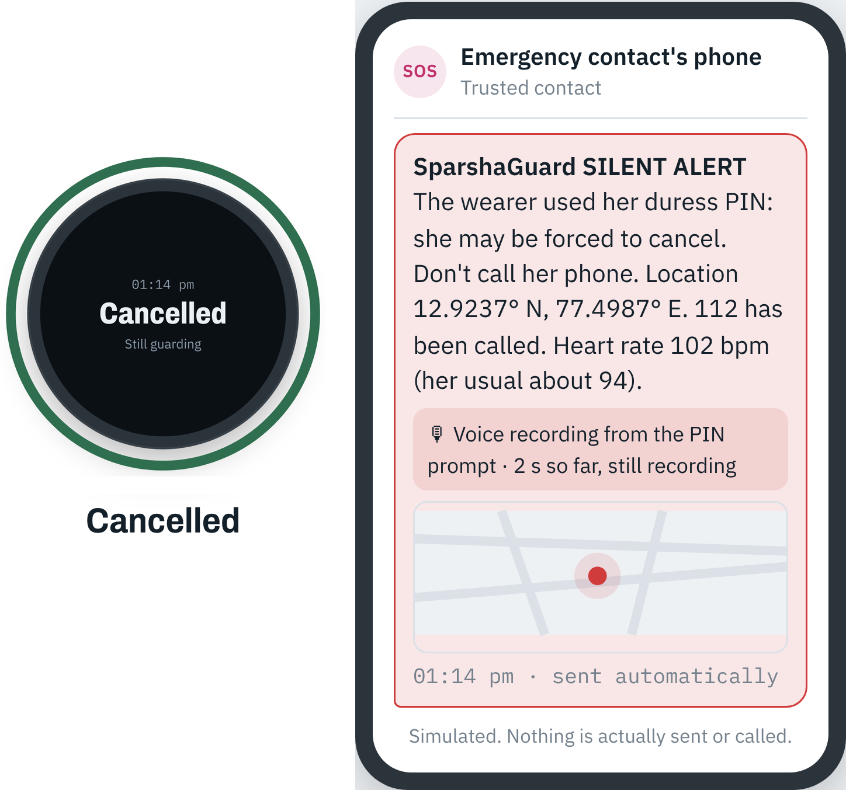
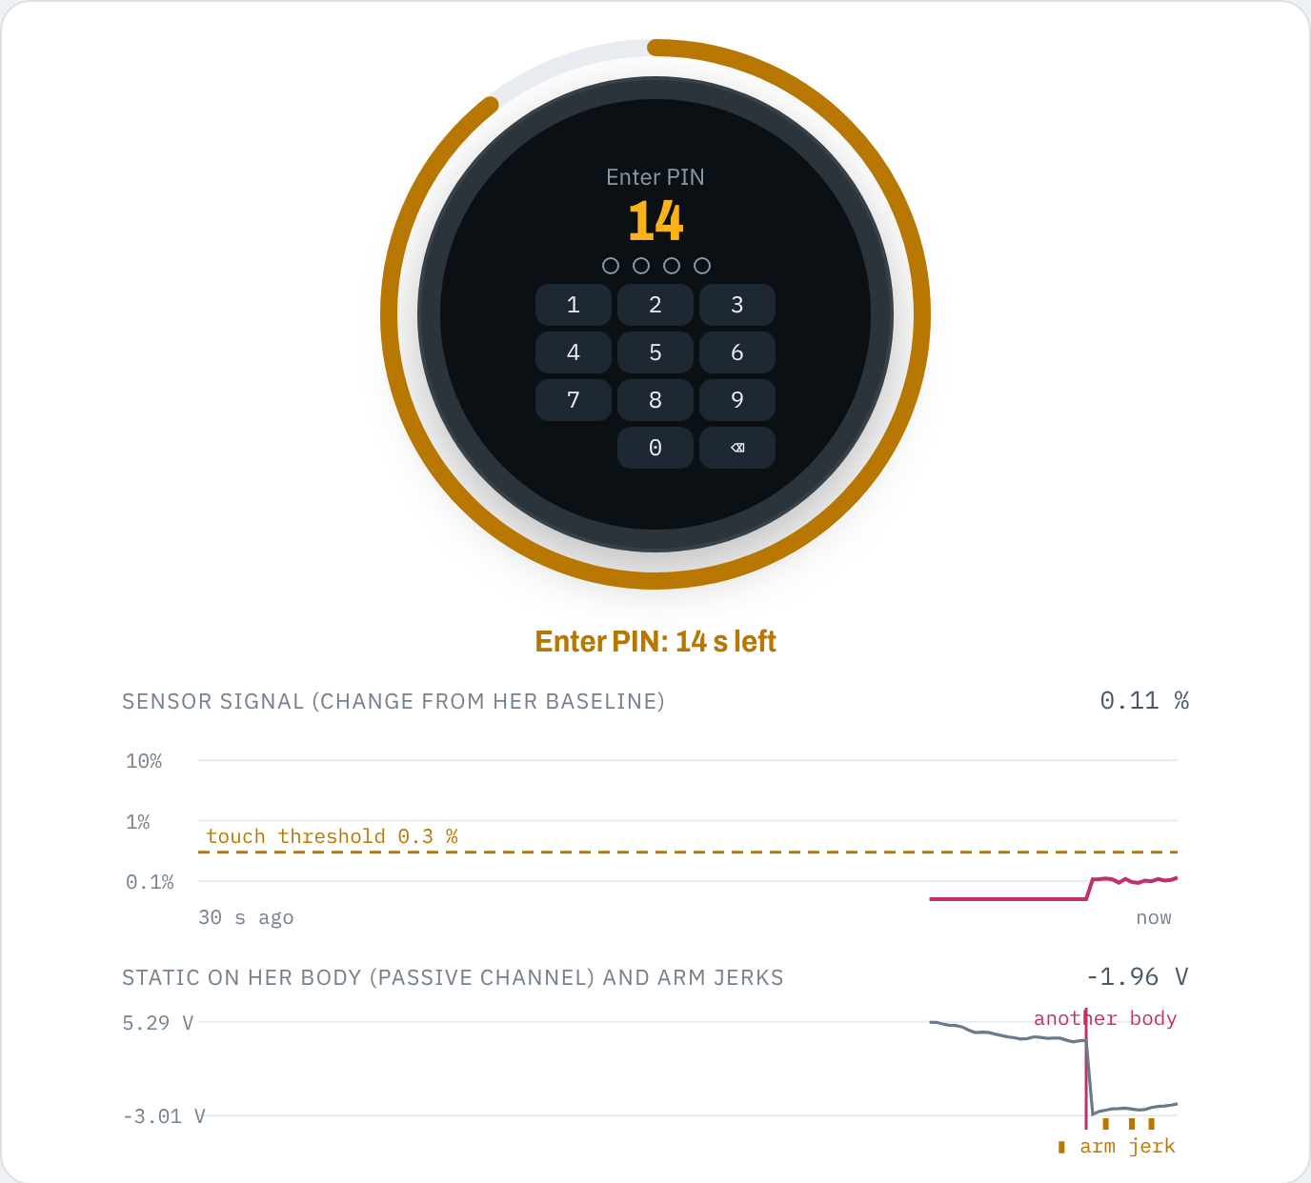
BHARATH INNOVATE HACKATHON 2026
05
Prototype & Demonstration
Feature 01 · Digital twin
Real firmware, simulated body
Sweep, static, motion, heart rate
Try grabs, struggle, PIN, duress
Feature 02 · Validated physics
72 published sources
Checked: SPICE, FastCap
Catches 90 % of grabs
Catches 100 % of struggles
2 false prompts in 9 hours
Try it
bhajanth13.github.io/SparshaGuard
NORMAL PIN · 1234
DURESS PIN · 9999
Cancelled · no alert sent
Looks cancelled · silent alert sent
Innovate | Build | Solve | A Stronger Bharat
Team Sparsha • RV University

Slide 6
BHARATH INNOVATE HACKATHON 2026
06
Feasibility & Risk Management
Technical feasibility
Operational viability
Market viability
Effective: 90 % of grabs caught
Usable: hands-free, PIN to cancel
Efficient: all on-watch, on battery
Reliable: 2 false alarms in 9 h
Trustworthy: 72 cited sources
Battery-powered; all decisions on the watch
Alerts over 4G VoLTE, own SIM (2G is being shut down)
Women commuters: bus, metro, cab
Students, night-shift workers
Families wanting peace of mind
Edge: no SOS button to press
Main risk
Mitigation / fallback
Simulated, not yet measured on hardware
Static charge on Indian floors and struggle thresholds are estimates
A grab that only holds, away from the wrist, can be missed
Gate 1 battery prototype measures body voltages and staged struggles
The wrist sensor still catches wrist grabs on its own
The PIN settles friendly touches
Innovate | Build | Solve | A Stronger Bharat
Team Sparsha • RV University

Slide 7
BHARATH INNOVATE HACKATHON 2026
07
Impact, Business Model & Roadmap
Impact
Business model
Success metrics
Help is called even when she can't reach her phone
Family and police get her live location and a voice recording
Forced to cancel? The duress PIN still alerts silently
Watch sold to individuals
Bulk plans for colleges, hostels and employers
Alert-service subscription
Bar = today's simulation | = Gate 1 goal
Wrist grabs caught
97 % (goal 90 %)
Grabs anywhere
90 % (goal 60 %)
Unwanted prompts
2 in 9 h
goal < 1 a day
Alert sent
after the 15 s PIN
goal ≤ 20 s
FUTURE ROADMAP
NOW
Validated model + digital twin
NEXT
Battery prototype, field tests
LATER
Audio confirm, college pilot
Innovate | Build | Solve | A Stronger Bharat
Team Sparsha • RV University

Slide 8
BHARATH INNOVATE HACKATHON 2026
08
Team & Responsibilities
MEMBER 1
MEMBER 2
Bhajanth V
Sukruth A Chinnur
Co-developer
Co-developer
Mentor / institution
Execution plan
Dr. Shruthi P, Faculty Mentor
RV University, Mysuru
Proposal → sourced physics → SPICE and FastCap checks → digital twin → static-charge fusion → Gate 1 prototype
Innovate | Build | Solve | A Stronger Bharat
Team Sparsha • RV University

Slide 9
THANK YOU
SparshaGuard
Questions • Feedback • Collaboration
Live: bhajanth13.github.io/SparshaGuard
Code: github.com/Bhajanth13/SparshaGuard
BHARATH INNOVATE HACKATHON 2026 • INNOVATE | BUILD | SOLVE

