Slide 1
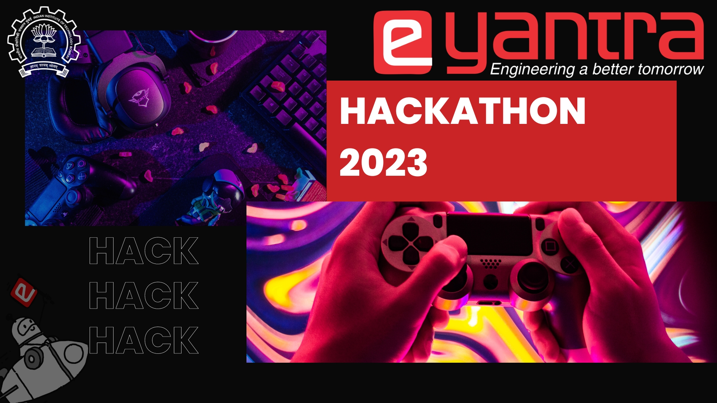
Hackathon - 2023

Slide 2

Guidelines
Do NOT change the template headings, title slide, logos etc.
Make a copy of this template and name it as eYHT23_<TeamName>; export as PDF file while submitting on the portal.
You may add extra images in slide number 5 & 6.
You should delete this (Guidelines) slide when submitting.
Total number of slides must not exceed 6 (including Title and Thank You Slide).
You may add more subsections within the provided slides.
Try using bullets instead of paragraphs; keep it clean and concise.
Follow:- Font Style: “Old Standard TT”, Font Size: “14”
All logos, templates etc. provided during the hackathon are solely e-Yantra’s property and not reproducible.
e-Yantra reserves the right to modify the rules at any time.

Slide 3
Team and Project Details
Team Name:
Team Member 1: Ankit Chawla
Team Member 2: Bhajneet Singh Bedi
Team Member 3:
Institute Name:
Project Domain: Indoor Mapping and Navigation
Project Idea Title:

Slide 4
Project Idea Details
Detailed Problem Idea:
Dealing with sight loss is a mere challenge when living life.
Blind or low vision individual requires assistance in any kind of normal day activity.
Certainly decreases chances and sectors where they can work.
Even they struggle in making their own life easier.
Considering this it might signify, often living in isolation.
Technology Stack: Linux, ROS(Robot Operating System), Rviz, Gazebo, Intel Realsense d435i, raspberry pi.

Slide 5
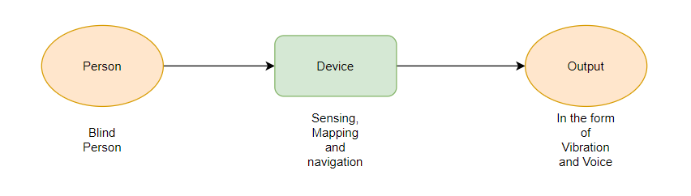
Solution Description
Literature Survey / Idea / Solution Novelty:
An assistant which directs the person using RGBD camera.
ROS, SLAM helps in navigation and mapping.
Making it easier for a person to do daily basis tasks.
Vibration sensors on hands keeps him away from obstacles.
Voice assistant provides navigation and instructions.
Software and Hardware to be used:
Linux, ROS(Robot Operating System), Rviz, Gazebo, Intel Realsense d435i, raspberry pi.

Slide 6
Solution Description
Describe your solution/idea here:
The blind person will wear the headset which would have RGBD camera (Intel realsense d435i) which is used to measure RGB values in addition with depth, which further helps us to get an overview of distance of any object.
Now using ROS the camera will map the area around it and will guide the wearer to move around the area avoiding any obstacles. Using SLAM technique a map will be created and saved for future use.
The voice assistant and vibration band will help the wearer moving around and giving instructions.
Further object detection can be implemented for helping the person in doing day to day tasks effortlessly.
Applicability of the solution:
The device will give the person an ability near to seeing the object or at least knowing about his surrounding.
It can be useful for the person to do his chores. He might also be able to do jobs in some sectors where the job might fit him after getting that ability.
This will make the person independent and able to do this work on his own without anybody’s help.

Slide 7
THANK YOU

