Slide 1
Winning Space Race with Data Science
Miss. Bhakti Balavant Kulkarni
23-03-2024
https://github.com/BhakteeKulkarni/Applied_Data_Science_Capstone_Assignments

Slide 2
Outline
Executive Summary
Introduction
Methodology
Results
Conclusion
Appendix

Slide 3
Executive Summary
Gathered information from the SpaceX Wikipedia page and the public SpaceX API. a labels column called "class" was created to categorise successful landings. used dashboards, folium maps, SQL, and visualisation to explore data. compiled pertinent columns for the features. one hot encoding was used to convert all category data to binary. To determine the ideal parameters for machine learning models, standardised data was utilised together with GridSearchCV. Display each model's accuracy score visually.
The following four machine learning models were created: K Nearest Neighbours, Decision Tree Classifier, Support Vector Machine, and Logistic Regression. All yielded comparable outcomes, with an accuracy percentage of almost 83.33%. Every model overestimated the number of successful landings. To improve the determination and accuracy of the model, more data are required.

Slide 4
Introduction
Background
Commercial Space Age is Here
Space X has best pricing ($62 million vs. $165 million USD)
Largely due to ability to recover part of rocket (Stage 1)
Space Y wants to compete with Space X
Problem
Space Y tasks us to train a machine learning model to predict successful Stage 1 recovery

Slide 5
Methodology

Slide 6
Methodology
Data collection methodology:
Combined data from SpaceX public API and SpaceX Wikipedia page
Perform data wrangling
Classifying true landings as successful and unsuccessful otherwise
Perform exploratory data analysis (EDA) using visualization and SQL
Perform interactive visual analytics using Folium and Plotly Dash
Perform predictive analysis using classification models
Tuned models using GridSearchCV

Slide 7
Data Collection Overview
Data collection process involved a combination of API requests from Space X public API and web scraping data from a table in Space X’s Wikipedia entry.
The next slide will show the flowchart of data collection from API and the one after will show the flowchart of data collection from webscraping.
Space X API Data Columns:
FlightNumber, Date, BoosterVersion, PayloadMass, Orbit, LaunchSite, Outcome, Flights, GridFins,
Reused, Legs, LandingPad, Block, ReusedCount, Serial, Longitude, Latitude
Wikipedia Webscrape Data Columns:
Flight No., Launch site, Payload, PayloadMass, Orbit, Customer, Launch outcome, Version Booster, Booster landing, Date, Time

Slide 8
Data Collection – SpaceX API
Request(SpaceX API)
.JSON file + Lists(Launch Site, Booster Version, Payload Data)
Json_normalize to DataFrame data from JSON
Dictionary relevant data
Cast dictionary to a DataFrame
Filter data to only include Falcon 9 launches
Imputate missing PayloadMass values with mean
GIT Hub URL
https://github.com/BhakteeKulkarni/Applied_Data_Science_Capstone_Assignments/commit/78c625f9b667e0697c73c702b1ca6d7a3faa2b53#diff-a6b5d3a61e47bfdf850524cbf3a86a9dc48dc2dde600523dd183c1bce0c6ce0b

Slide 9
Data Collection –Web Scraping
Request Wikipedia
html
BeautifulSoup
html5lib Parser
Find launch info html table
Create dictionary
Iterate through table cells to extract data to dictionary
Cast dictionary to DataFrame
GIT Hub URL
https://github.com/BhakteeKulkarni/Applied_Data_Science_Capstone_Assignments/blob/main/Week1/Data%20Collection%20with%20Web%20Scraping.ipynb

Slide 10
Data Wrangling
Create a training label with landing outcomes where successful = 1 & failure = 0.
Outcome column has two components: ‘Mission Outcome’ ‘Landing Location’
New training label column ‘class’ with a value of 1 if ‘Mission Outcome’ is True and 0 otherwise.
Value Mapping:
True ASDS, True RTLS, & True Ocean – set to -> 1
None None, False ASDS, None ASDS, False Ocean, False RTLS – set to -> 0
GIT Hub URL
https://github.com/BhakteeKulkarni/Applied_Data_Science_Capstone_Assignments/blob/main/Week1/Data%20wrangling%20.ipynb

Slide 11
EDA with Data Visualization
Exploratory Data Analysis performed on variables Flight Number, Payload Mass, Launch Site, Orbit, Class and Year.
Plots Used:
Flight Number vs. Payload Mass, Flight Number vs. Launch Site, Payload Mass vs. Launch Site, Orbit vs. Success Rate, Flight Number vs. Orbit, Payload vs Orbit, and Success Yearly Trend
Scatter plots, line charts, and bar plots were used to compare relationships between variables to
decide if a relationship exists so that they could be used in training the machine learning model
GIT Hub URL
https://github.com/BhakteeKulkarni/Applied_Data_Science_Capstone_Assignments/blob/main/Week2/EDA%20with%20Visualization.ipynb

Slide 12
EDA with SQL
Loaded data set into IBM DB2 Database.
Queried using SQL Python integration.
Queries were made to get a better understanding of the dataset.
Queried information about launch site names, mission outcomes, various pay load sizes of customers and booster versions, and landing outcomes
GIT Hub URL
https://github.com/BhakteeKulkarni/Applied_Data_Science_Capstone_Assignments/blob/main/Week2/EDA%20with%20SQL.ipynb

Slide 13
Build an Interactive map with Folium
Folium maps mark Launch Sites, successful and unsuccessful landings, and a proximity example to key locations: Railway, Highway, Coast, and City.
This allows us to understand why launch sites may be located where they are. Also visualizes successful landings relative to location.
GIT Hub URL
https://github.com/BhakteeKulkarni/Applied_Data_Science_Capstone_Assignments/blob/main/Week3/Interactive%20Visual%20Analytics%20with%20Folium.ipynb

Slide 14
Build a Dashboard with Plotly Dash
Dashboard includes a pie chart and a scatter plot.
Pie chart can be selected to show distribution of successful landings across all launch sites and can be selected to show individual launch site success rates.
Scatter plot takes two inputs: All sites or individual site and payload mass on a slider between 0 and 10000 kg.
The pie chart is used to visualize launch site success rate.
The scatter plot can help us see how success varies across launch sites, payload mass, and booster version category.
GIT Hub URL
https://github.com/BhakteeKulkarni/Applied_Data_Science_Capstone_Assignments/blob/main/Week3/spacex_dash_app.py

Slide 15
Predictive Analysis (Classification)
Split the column Class from dataset
Fit and Transform Features using StandardScalar
train_test_split data
GridSearchCV(cv=10) to find optimal parameters
Use GridSearchCV on LogReg, SVM, Decision Tree, and KNN models
Score models on split test set
Confusion matrix for all models
Barplot to compare scores of models
GIT Hub URL
https://github.com/BhakteeKulkarni/Applied_Data_Science_Capstone_Assignments/blob/main/Week4/Machine%20Learning%20Prediction.ipynb

Slide 16
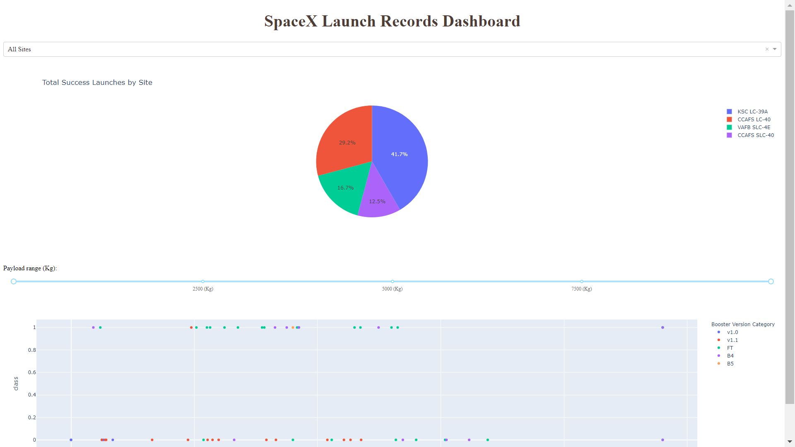
Results
This is a preview of the Plotly dashboard. The following sides will show the results of EDA with visualization, EDA with SQL, Interactive Map with Folium, and finally the results of our model with about 83% accuracy.

Slide 17
EDA with Visualization

Slide 18
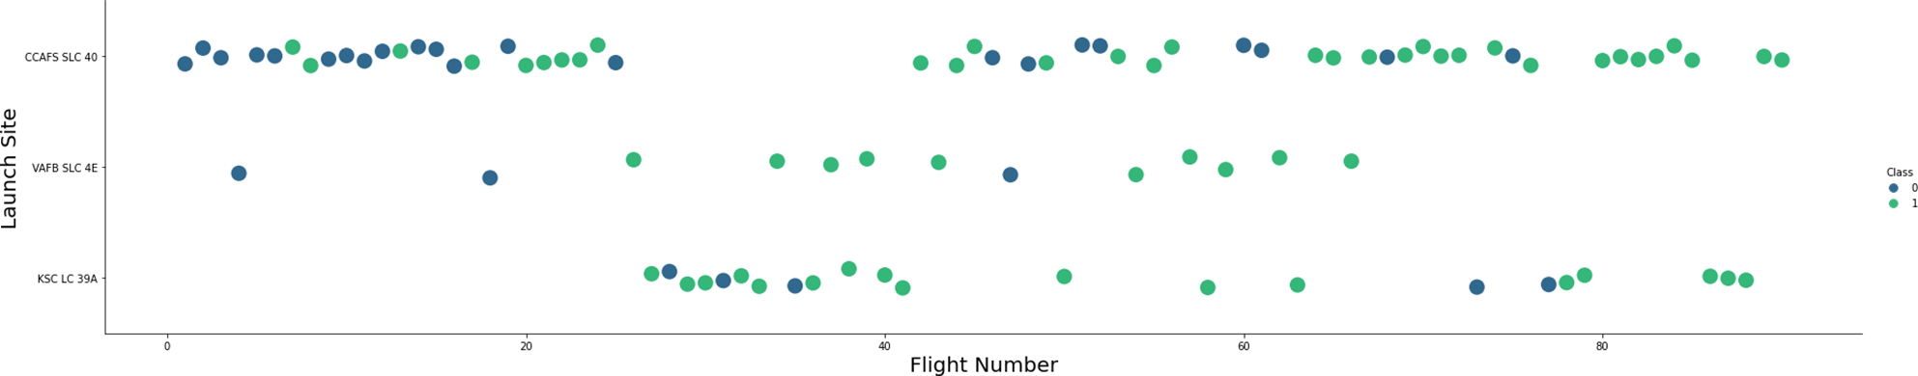
Flight Number vs LaunchSite
Green indicates successful launch; Purple indicates unsuccessful launch

Slide 19
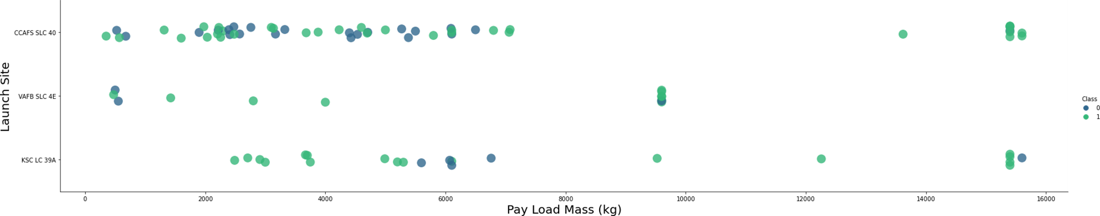
Payload vs Launchsite
Green indicates successful launch; Purple indicates unsuccessful launch

Slide 20
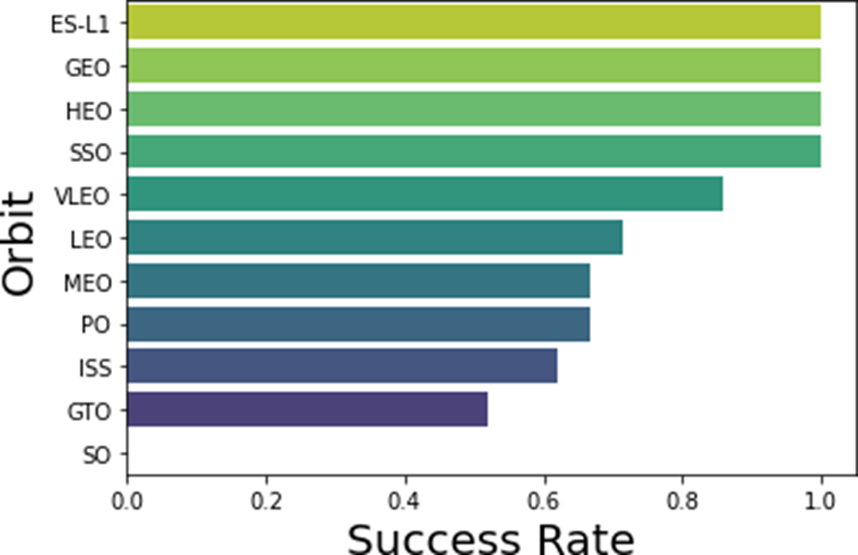
Success Rate vs Orbit type
Success Rate Scale with 0 as 0%
0.6 as 60% 1 as 100%

Slide 21
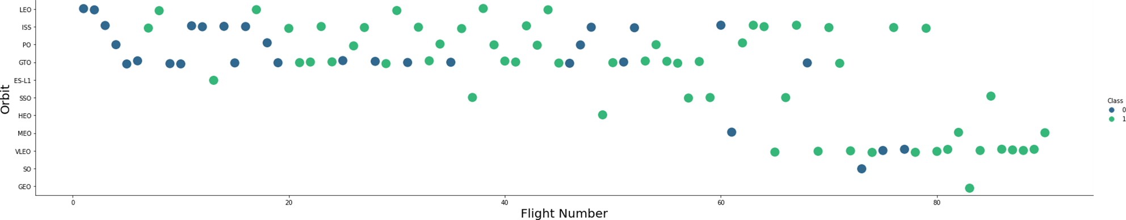
Fight Number vs Orbit type
Green indicates successful launch; Purple indicates unsuccessful launch.

Slide 22
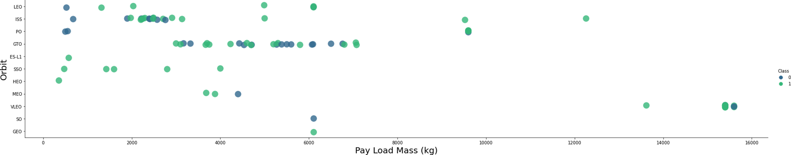
Payload vs Orbit type
Green indicates successful launch; Purple indicates unsuccessful launch.

Slide 23
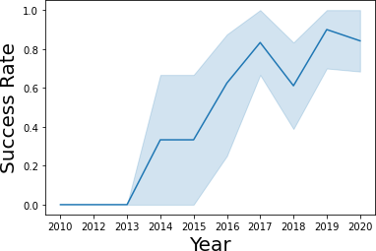
Launch Success vs Yearly trend
95% confidence interval (light blue shading)

Slide 24
EDA with SQL

Slide 25
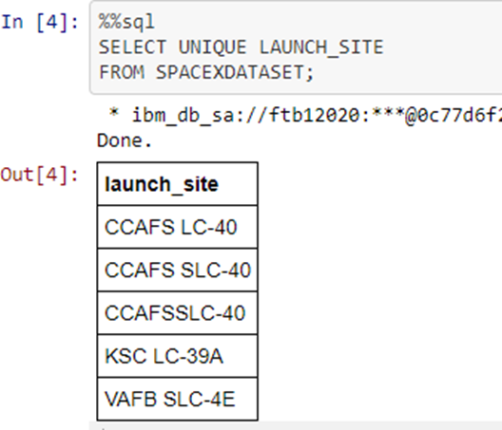
All Launch Site Names
Query unique launch site names from database.
CCAFS SLC-40 and CCAFSSLC-40 likely all represent the same launch site with data entry errors.
CCAFS LC-40 was the previous name.
Likely only 3 unique launch_site values: CCAFS SLC-40, KSC LC-39A, VAFB SLC-4E

Slide 26
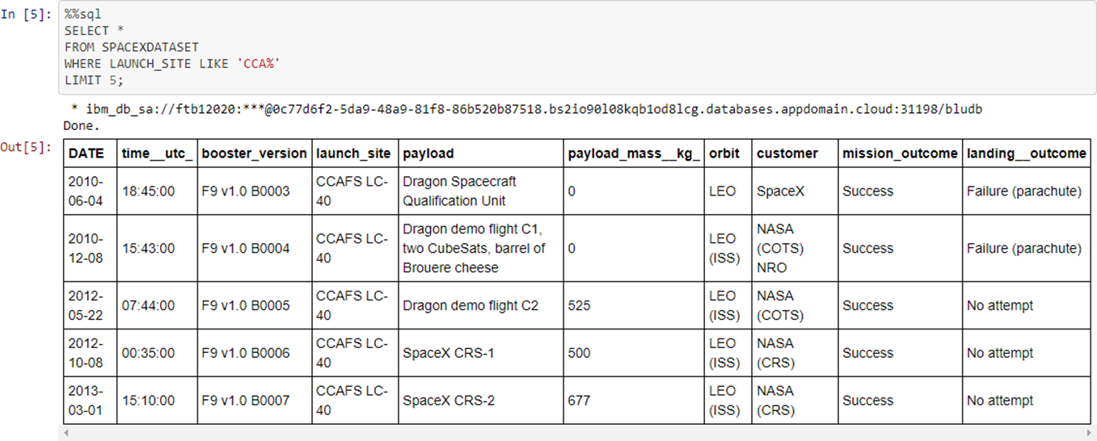
Launch site names beginning with ‘CCA’
First five entries in database with Launch Site name beginning with CCA.

Slide 27
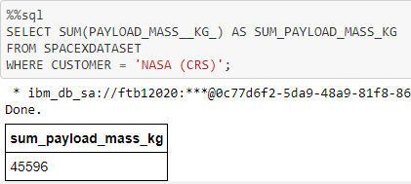
Total payload mass from NASA
This query sums the total payload mass in kg where NASA was the customer.
CRS stands for Commercial Resupply Services which indicates that these payloads were sent to the International Space Station (ISS).

Slide 28
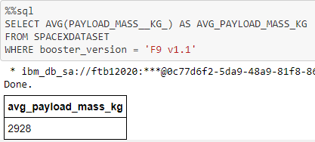
Average payload mass by F9v1.1
This query calculates the average payload mass or launches which used booster version F9 v1.1
Average payload mass of F9 1.1 is on the low end of our payload mass range

Slide 29
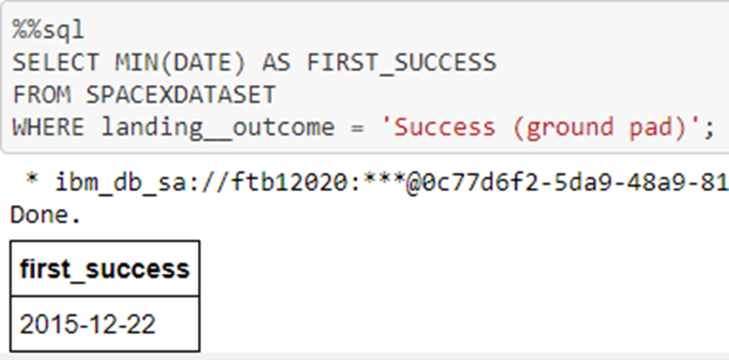
First successful Ground Pad Landing Date
This query returns the first successful ground pad landing date.
First ground pad landing wasn’t until the end of 2015.
Successful landings in general appear starting 2014.

Slide 30
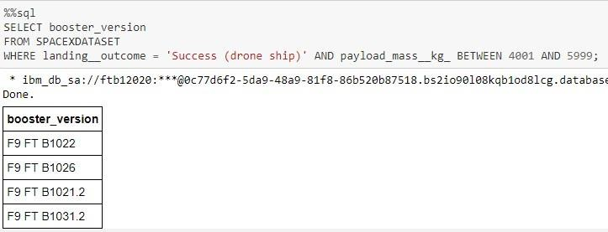
Successful Drone ship landing with payload between 4000 and 6000
This query returns the four booster versions that had successful drone ship landings and a payload mass between 4000 and 6000 noninclusively.

Slide 31
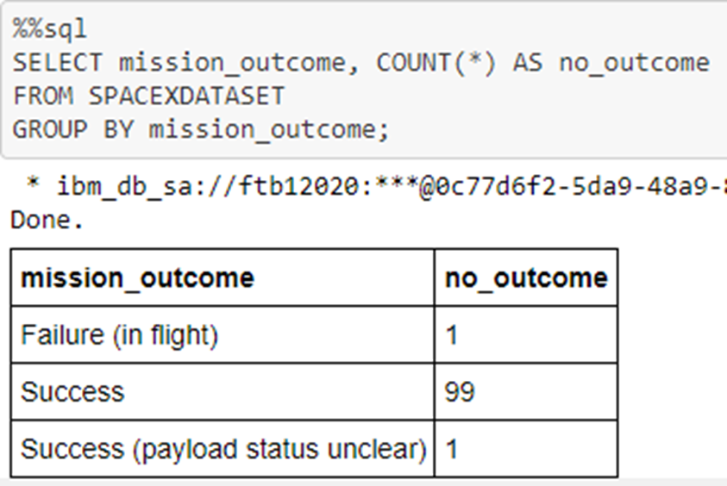
Total Number of Each mission outcome
This query returns a count of each mission outcome.
SpaceX appears to achieve its mission outcome nearly 99% of the time.
This means that most of the landing failures are intended.
Interestingly, one launch has an unclear payload status and unfortunately one failed in flight.

Slide 32
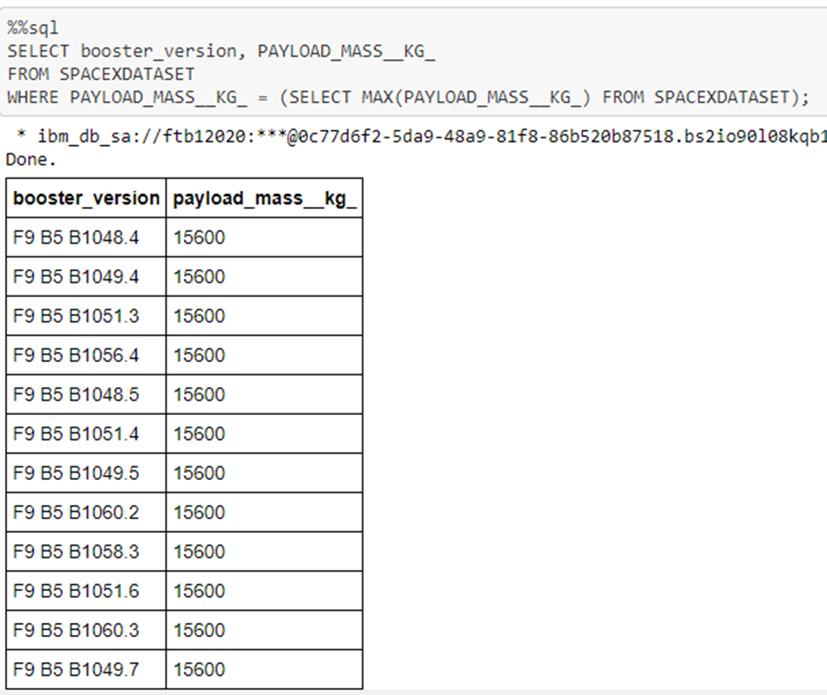
Boosters that carried maximum payload
This query returns the booster versions that carried the highest payload mass of 15600 kg.
These booster versions are very similar and all are of the F9 B5 B10xx.x variety.
This likely indicates payload mass correlates with the booster version that is used.

Slide 33
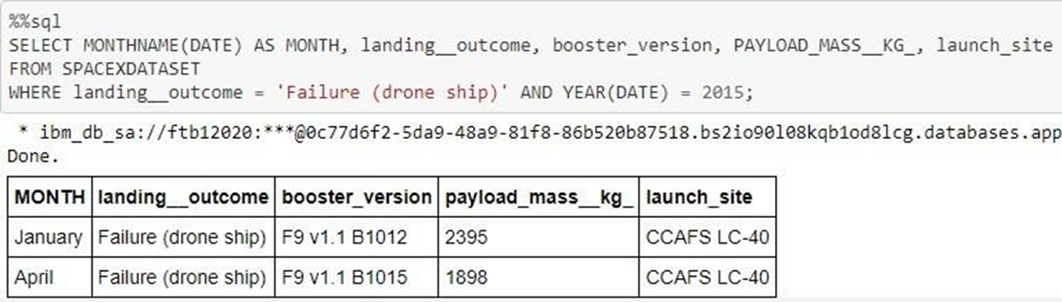
2015 failed drone ship landing
This query returns the Month, Landing Outcome, Booster Version, Payload Mass (kg), and Launch site of 2015 launches where stage 1 failed to land on a drone ship.
There were two such occurrences.

Slide 34
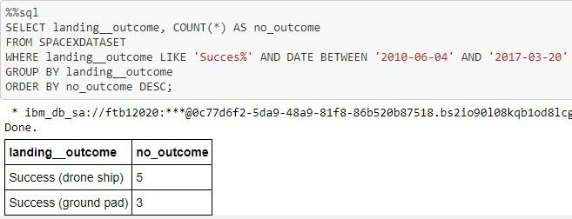
Ranking Counts of Successful Landings Between 2010-06-04 and 2017-03-20
This query returns a list of successful landings and between 2010-06-04 and 2017-03-20 inclusively.
There are two types of successful landing outcomes: drone ship and ground pad landings.
There were 8 successful landings in total during this time period

Slide 35
Interactive Mao with Folium

Slide 36
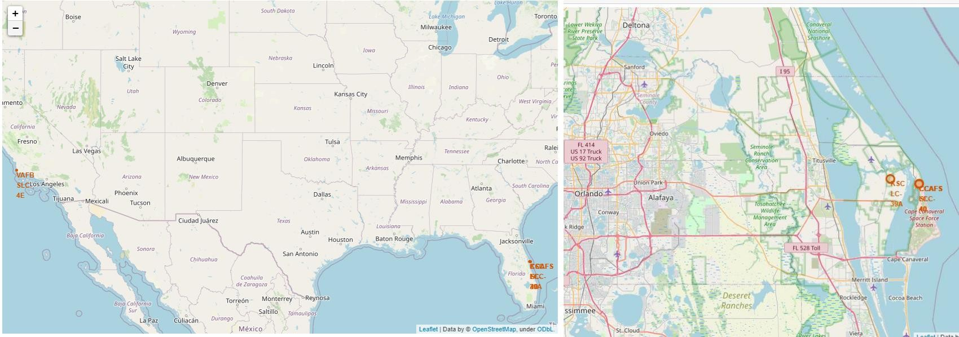
Launch Site
The left map shows all launch sites relative US map. The right map shows the two Florida launch sites since they are very close to each other. All launch sites are near the ocean.

Slide 37
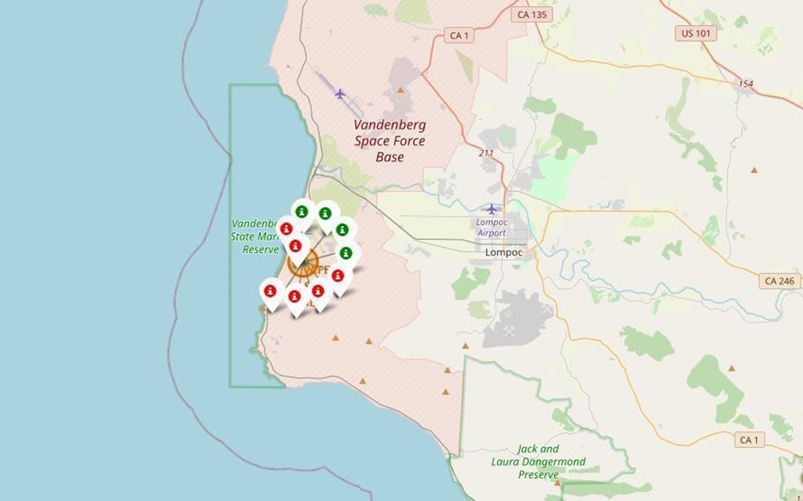
Color coded Launch Markers
Clusters on Folium map can be clicked on to display each successful landing (green icon) and failed
landing (red icon). In this example VAFB SLC-4E shows 4 successful landings and 6 failed landings.

Slide 38
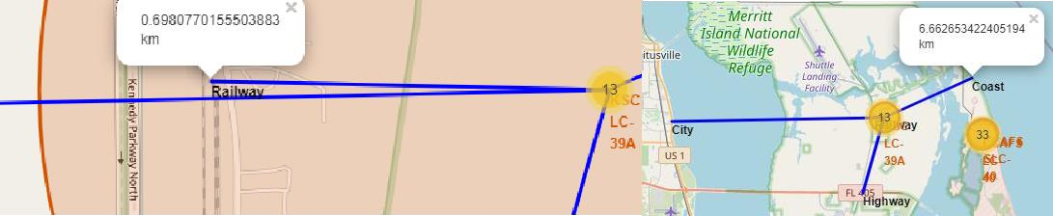
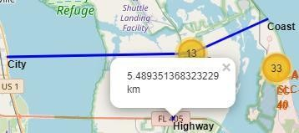
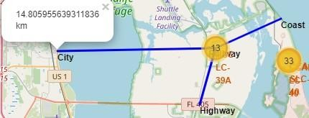
Key Location Proximities
Using KSC LC-39A as an example, launch sites are very close to railways for large part and supply transportation. Launch sites are close to highways for human and supply transport. Launch sites are also close to coasts and relatively far from cities so that launch failures can land in the sea to avoid rockets falling on densely populated areas.

Slide 39
Build a Dashboard with Plotly Dash

Slide 40
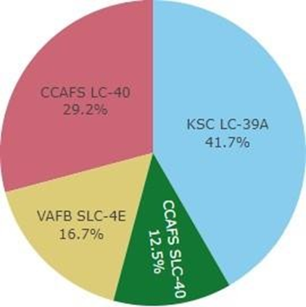
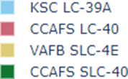
Successful launches across Launch Sites
This is the distribution of successful landings across all launch sites. CCAFS LC-40 is the old name of CCAFS SLC-40 so CCAFS and KSC have the same amount of successful landings, but a majority of the successful landings where performed before the name change. VAFB has the smallest share of successful landings. This may be due to smaller sample and increase in difficulty of launching in the west coast.

Slide 41
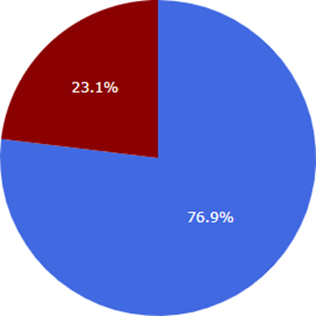

Highest Success Rate Launch Site
KSC LC-39A has the highest success rate with 10 successful landings and 3 failed landings.

Slide 42
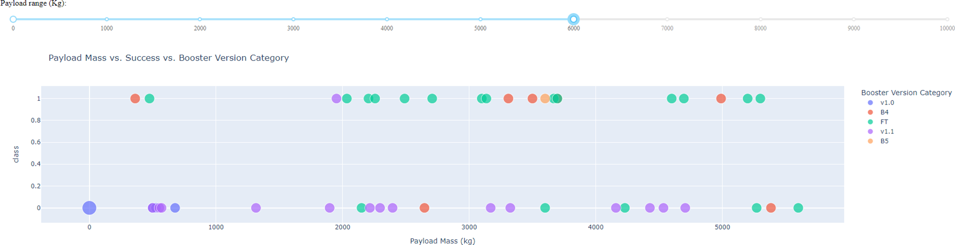
Payload Mass vs Success vs Booster Version Category
Plotly dashboard has a Payload range selector. However, this is set from 0-10000 instead of the max Payload of 15600. Class indicates 1 for successful landing and 0 for failure. Scatter plot also accounts for booster version category in color and number of launches in point size. In this particular range of 0-6000, interestingly there are two failed landings with payloads of zero kg.

Slide 43
Predictive Analysis (Classification)

Slide 44
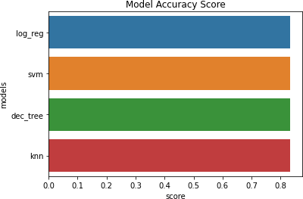
Classification Accuracy
All models had virtually the same accuracy on the test set at 83.33% accuracy. It should be noted that test size is small at only sample size of 18.
This can cause large variance in accuracy results, such as those in Decision Tree Classifier model in repeated runs.
We likely need more data to determine the best model

Slide 45
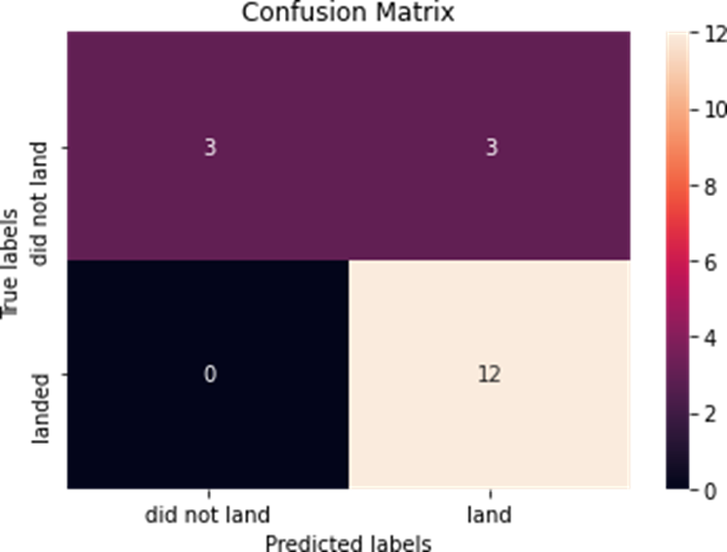
Confusion Matrix
Since all models performed the same for the test set, the confusion matrix is the same across all models. The models predicted 12 successful landings when the true label was successful landing.
The models predicted 3 unsuccessful landings when the true label was unsuccessful landing.
The models predicted 3 successful landings when the true label was unsuccessful landings (false positives). Our models over predict successful landings.

Slide 46
Conclusion
For Space Y, who wishes to compete against SpaceX, our aim is to create a machine learning model whose objective is to forecast when Stage 1 will successfully land in order to save around $100 million USD.
used information retrieved from the SpaceX Wikipedia page and a public SpaceX API.
made data labels, put data in a DB2 SQL database, and made a visualisation dashboard.
We developed an 83% accurate machine learning model.
Using this model, Allon Mask of SpaceY may forecast, with a fair degree of accuracy, if a launch will result in a successful Stage 1 landing prior to launch, hence enabling the determination of whether or not the launch is warranted.

Slide 47
Appendix
GIT Hub Repository URL
https://github.com/BhakteeKulkarni/Applied_Data_Science_Capstone_Assignments
Instructors:
Instructors: Rav Ahuja, Alex Aklson, Aije Egwaikhide, Svetlana Levitan, Romeo Kienzler, Polong Lin, Joseph Santarcangelo, Azim Hirjani, Hima Vasudevan, Saishruthi Swaminathan, Saeed Aghabozorgi, Yan Luo
https://www.coursera.org/professional-certificates/ibm-data-science?#instructors

Slide 48
Thank YOU !

