Slide 1
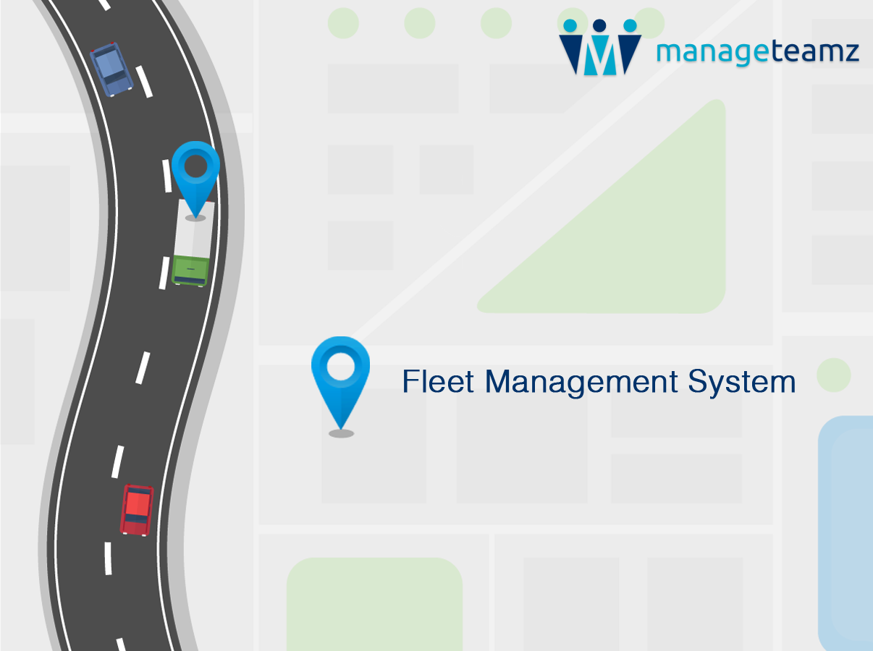

Slide 2
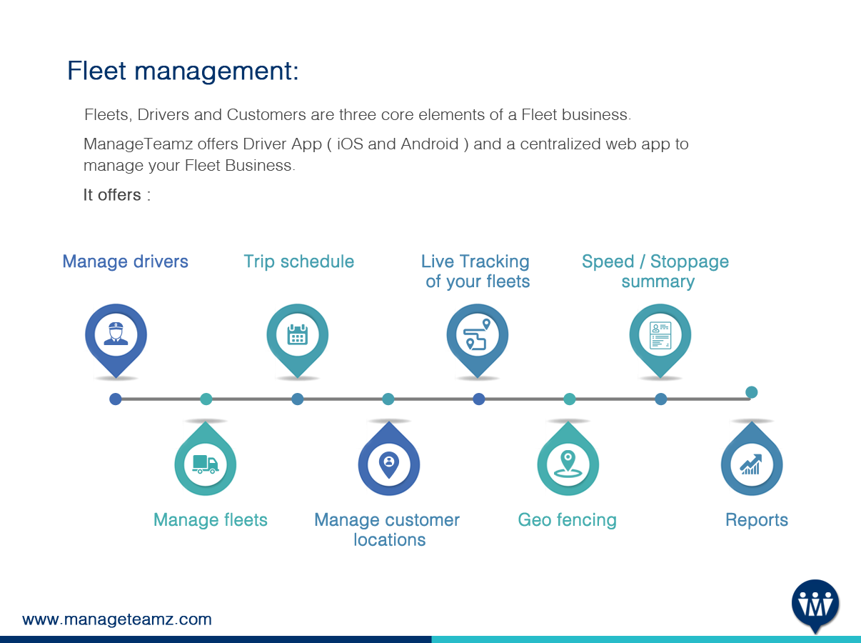
Fleet Management:

Slide 3

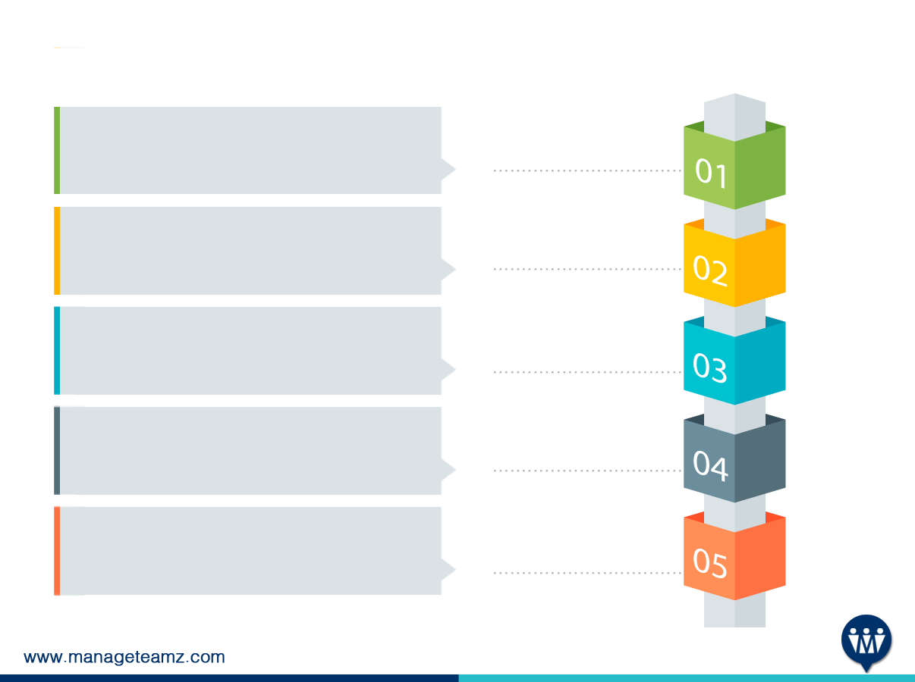
How it Works:
Owner logs in web panel, creates driver,
Fleet and customer delivery location.
Owner creates a trip by assigning
customer locations to a driver and his fleet.
Driver logs into smartphone and view his
schedule for the day.
Driver starts the day and app automatically
picks up the first location. App navigates
to customer location.
Fleet movement is monitored through the
mobile app and data's are stored in web
server.

Slide 4

How it works:
How it Works:
Owner shall view live Information of their
fleets, current speed, stoppage and distance
to travel to customer location in web panel.
Driver reaches the customer location and
delivers the goods.
Driver mentions that goods are delivered
and get a Proof of Delivery from customer.
Driver picks up the next assignment and
travels to customer’s location.
Owner shall view reports and take
performance improvement decisions.

Slide 5


Web Admin Panel:
Manage Drivers :
Drivers
GPS Tracking
Driver Status
List view of all drivers. You shall edit or create a new one. Add Driver allows you to add a Driver along with required details.
If it’s ON, Driver can not turn off GPS Tracking from his app. If it's set as OFF, Driver has the option to turn ON or OFF the tracking from his device.
Can be activated or deactivated using Status dropdown.

Slide 6
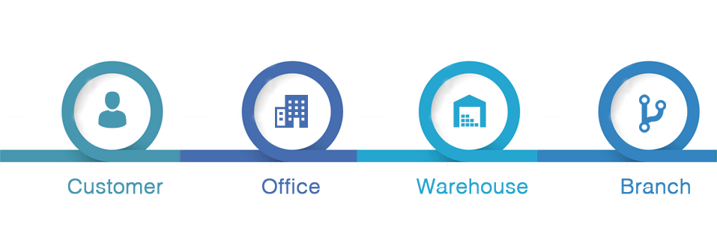

Web Admin Panel:
Manage locations :
Location is your customer's pickup or drop off address. It is classified as
Geofence radius :
It allows you to mention the geofencing distance. If a fleet enters into specific radius, web panel will be notified and driver will get notification through mobile app.

Slide 7
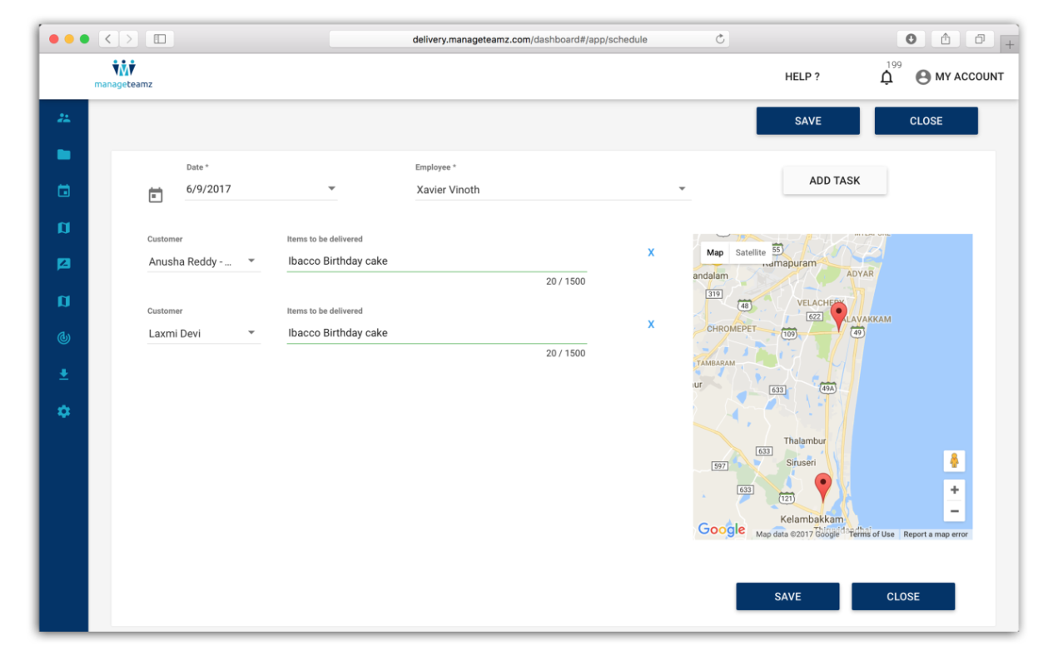
Web Admin Panel:
Manage fleets:
Fleets more Info such as Vehicle Number, Color, Make can be maintained here.
Manage trip schedule:
Owner shall connect Drivers and fleets to customer location. This will be the route map that driver will follow in his mobile app.

Slide 8

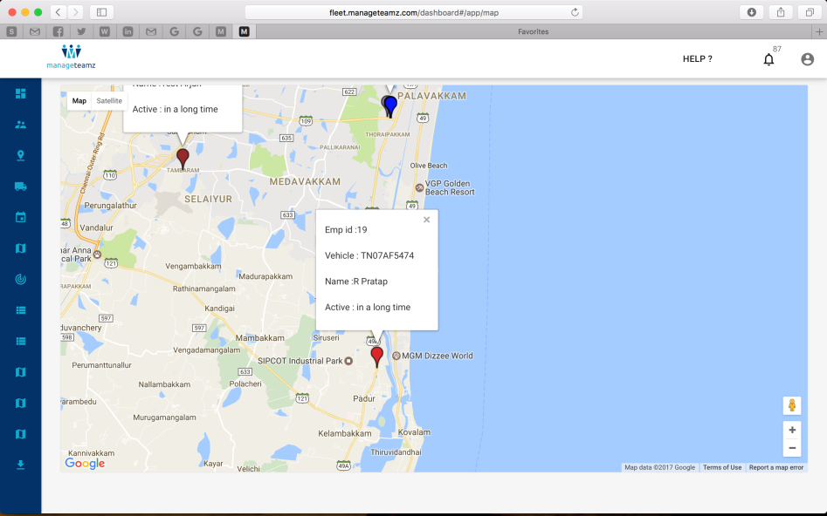

Web Admin Panel:
Live tracking:
Shows live tracking of all your
Current fleets!
GPS history:
Manager should be able to track their travel history and customer locations travelled before.

Slide 9
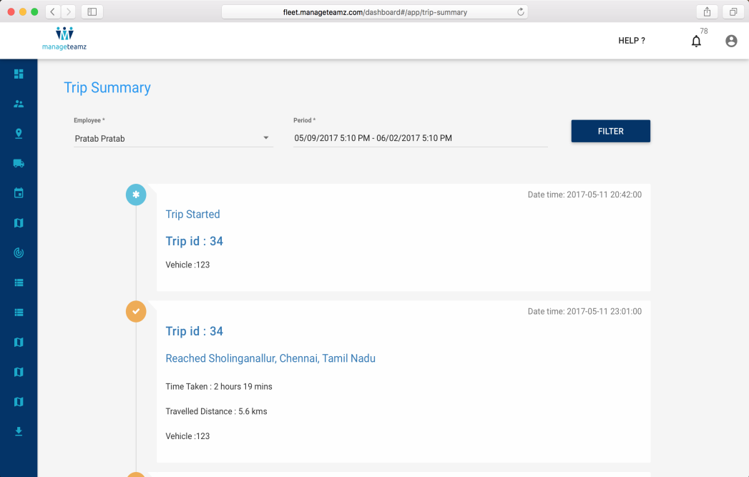

Web Admin Panel:
Geo fence:
Mention a fence area and if
your fleets enter into the zone,
you will get an alert.
Trip summary:
Shows report of your trips.
Reporting:
Stoppage, Odometer reading and many more features.

Slide 10
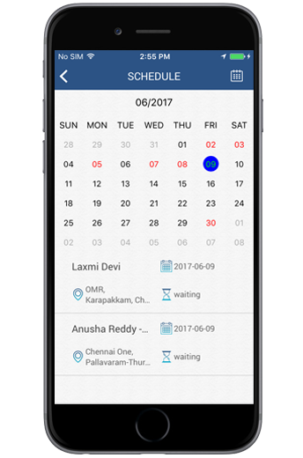
Driver App:
Driver shall view his schedule for the day and start.
Driver shall navigate to customer location and deliver the goods.

Slide 11
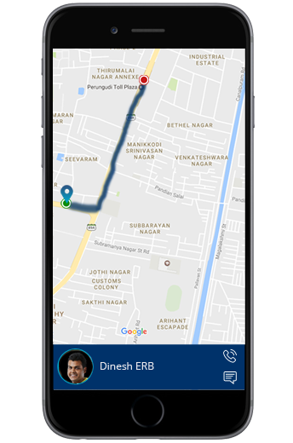
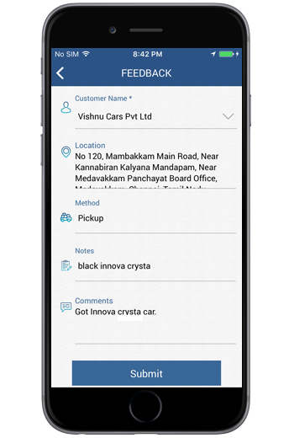
Driver App:
Driver shall get Proof of Delivery when item is
delivered.
Driver shall view all customers, feedback of the
deliverables from the dashboard.

Slide 12
Company Profile:
We are a team of Designers, Engineers and Full Stack Developers.
We build successful mobile apps, web apps that are unique, that always makes
Money and people will love to use it.
We Help:
Entrepreneurs: Love new ideas, work with creative minds and build their idea into execution
Enterprise Mobility: Understand the need of SMEs. We build apps to increase their revenue, operational efficiency and customer engagement.
Branding Apps: We work together with brands to build compelling products.

Slide 13

Core Techies:

Slide 14
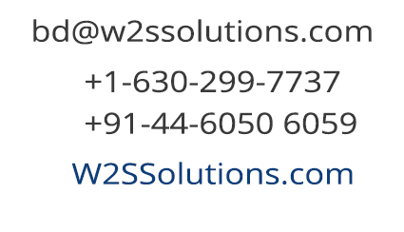


Thanks and Reach us @
www.manageteamz.com

