Slide 1
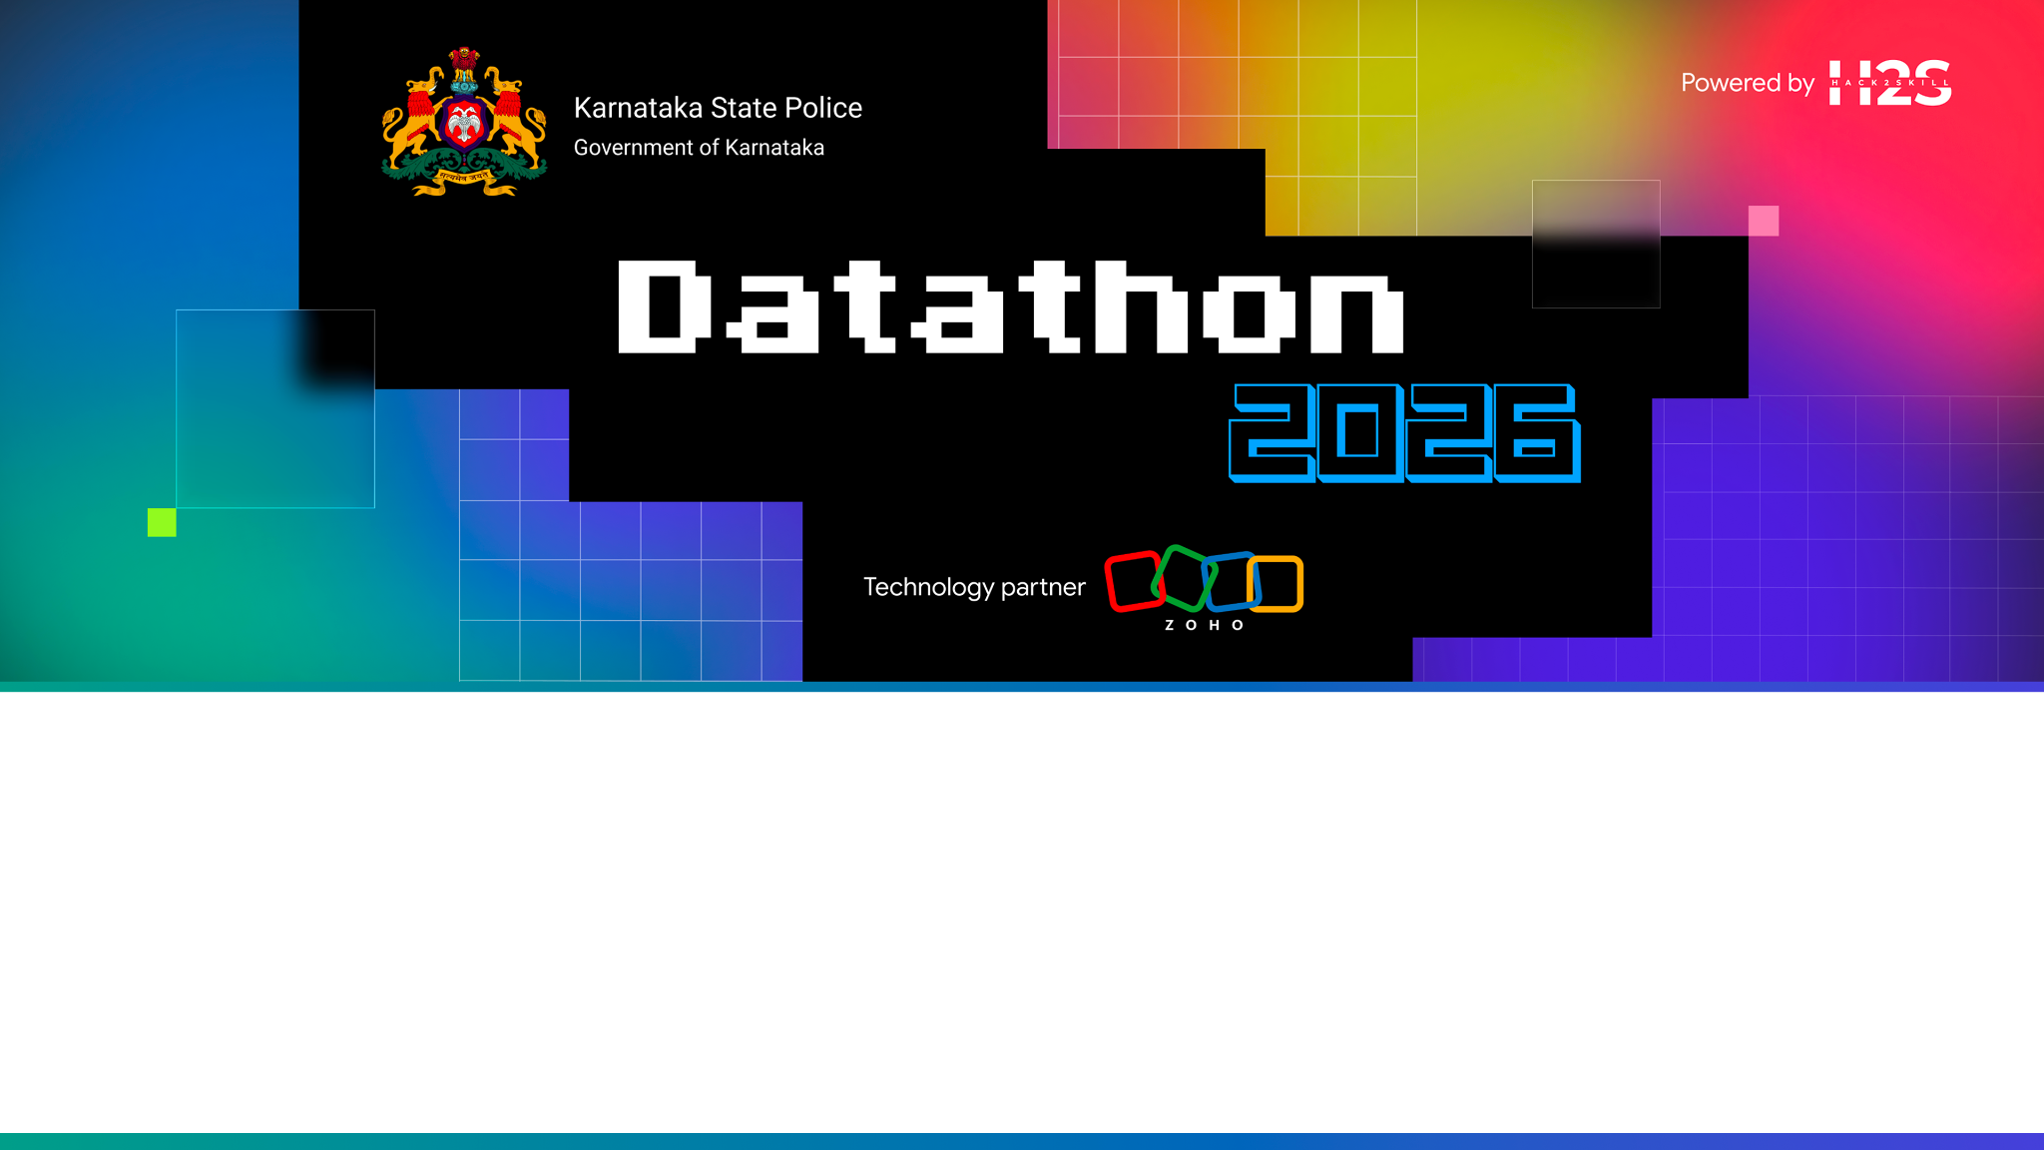
Team Details
• Team Name: Avighna
• Team Leader Name: Bhakti Parulekar
• Team Size: 2 Members
Problem Statement: Intelligent Conversational AI and Crime Analytics Platform for Karnataka State Police (KSP Datathon 2026)

Slide 2

Brief About Solution — Ibha (ಇಭ · Elephant / Strength)
Ibha is an LLM-Augmented, Security-First Crime Intelligence Copilot built for Karnataka State Police officers across 8 districts and 20 police stations.
Key Innovations:
Natural Language Interface: Supports English and Kannada queries via text or speech (STT/TTS).
100% Parameterized SQL Guardrail: The LLM extracts intent JSON; query_builder.py constructs safe SQL. The LLM NEVER writes raw SQL.
Transparent Evidence Trail: Every answer displays redacted SQL parameters, row counts, and RLS jurisdiction badges.
Advanced Analytics: Sociological crime insights, multi-factor offender risk scoring, linear trend projections, and precedent case matching.

Slide 3
Opportunities & Unique Selling Proposition (USP)
How is it different from existing solutions? • Most LLM platforms allow the model to generate SQL directly, risking prompt injection and schema hallucinations. Ibha separates intent extraction from SQL execution completely. How will it solve the problem? • Police officers can query complex databases using plain voice/text in their regional language, while security automatically enforces Row-Level Security (RLS) based on jurisdiction. USP of Ibha: • Zero-Trust Evidence Trail & Audit Panel on every message. • Data-grounded criminology summaries with zero identity or ethnic proxy bias. • Multi-factor risk score heuristic (capped priors, recency decay, violent flag, degree centrality).

Slide 4
List of Features Offered (Mapped to KSP's 10 Pillars)
1. Pillar 1 (Conversational AI): Multi-turn chat in English & Kannada. 2. Pillar 2 (Network Analysis): Co-accused topology graph with degree centrality tooltips. 3. Pillar 3 (Crime Trends): Station hotspot rankings and monthly crime breakdowns. 4. Pillar 4 (Sociological Insights): Time-of-day, occupation, age, and income distributions. 5. Pillar 5 (Offender Profiling): Transparent multi-factor risk score heuristic. 6. Pillar 6 (Decision Support): Executive case summaries & precedent matching. 7. Pillar 7 (Financial Crime): Suspicious transaction flagging (structuring, round-trips). 8. Pillar 8 (Forecasting & Early Warning): OLS 3-month trend projection & alert cards. 9. Pillar 9 (Explainability & Audit): Inspectable SQL skeleton & RLS scope badges. 10. Pillar 10 (Accessibility & Export): Web Speech API STT/TTS & printable PDF reports.

Slide 5
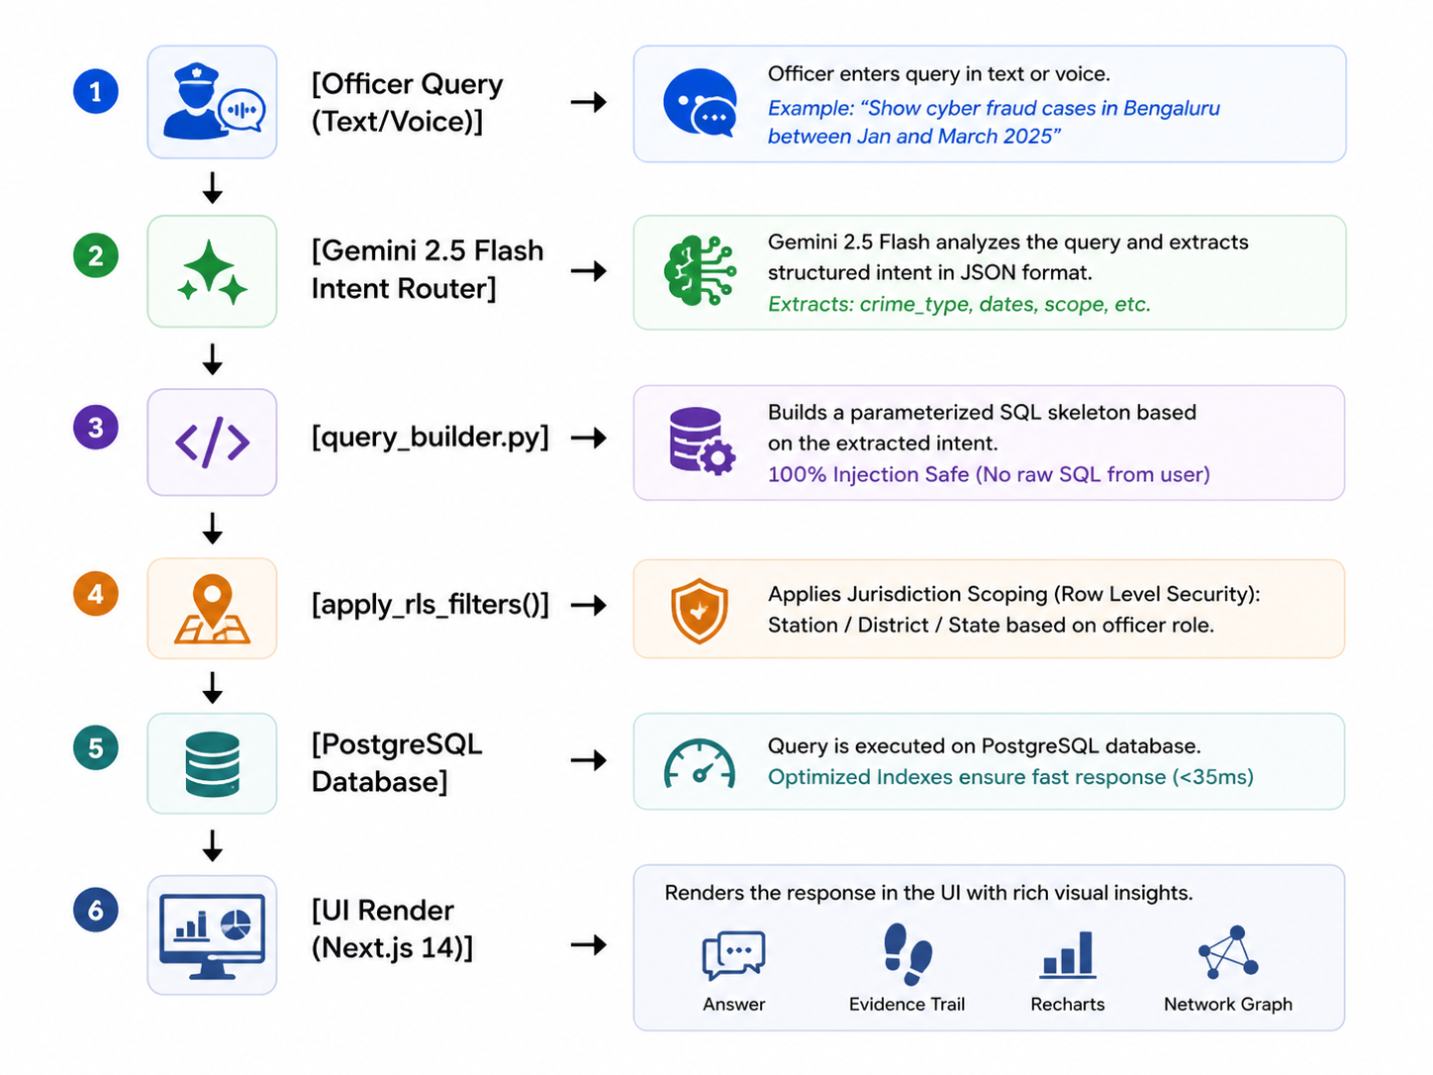
Process Flow Diagram

Slide 6
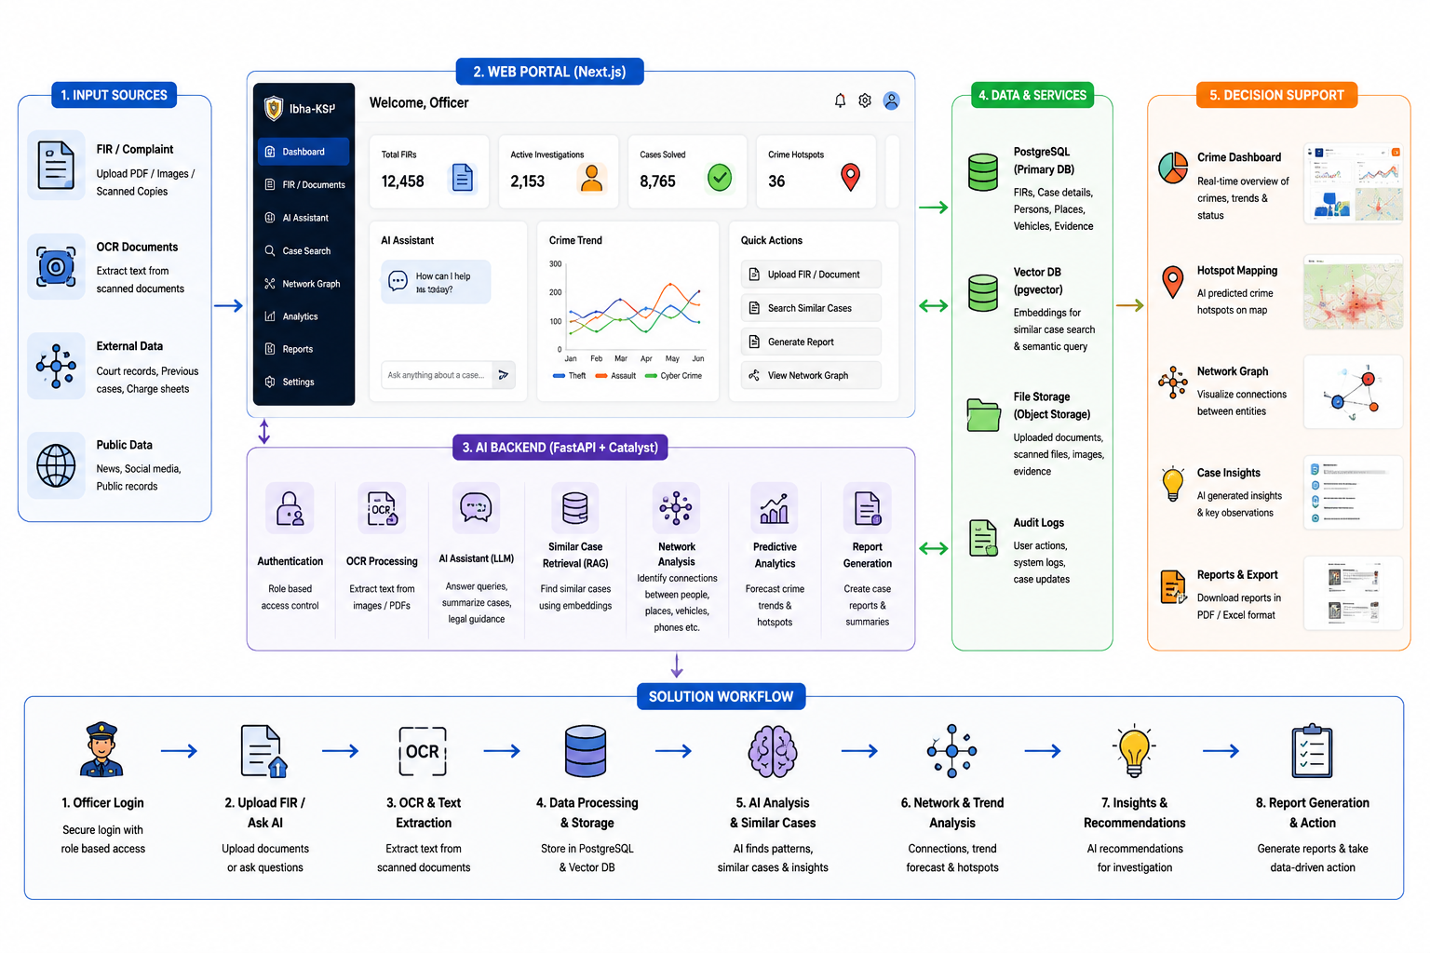
Wireframes/Mock diagrams of the proposed solution

Slide 7
Architecture Diagram of Ibha Solution
Client Layer: Next.js 14 (App Router), Tailwind CSS, Recharts, Cytoscape.js, Self-hosted Noto Sans Kannada.
Security & Governance Layer: JWT Auth (auth.py), Parameterized Query Builder (query_builder.py), RLS Jurisdiction Filter (auth_utils.py), Audit Logger (audit_logs).
API & Application Layer: Python 3.10 Flask (local_server.py) / Zoho Catalyst Serverless Functions.
AI Core: Google Gemini 2.5 Flash API (Structured JSON tool-use intent extraction).
Database Layer: PostgreSQL 14+ with pgvector support.

Slide 8
Technologies Used in Solution
Frontend: Next.js 14, React 18, Tailwind CSS, Recharts, Cytoscape.js, Lucide Icons.
Backend: Python 3.10+, Flask, psycopg2-binary, Pydantic v2.
AI Engine: Google Gemini 2.5 Flash (Structured JSON tool-use output).
Security & Audit: PyJWT, PostgreSQL RLS, Parameterized Query Builder.
Database: PostgreSQL 14+ with pgvector extension.
Accessibility: Web Speech API (STT/TTS), Self-hosted Noto Sans Kannada font.

Slide 9
Zoho Catalyst Services Integrated
Catalyst Serverless Functions: Target runtime for backend handlers (health, chat, audit, insights, support, trends, network).
Catalyst API Gateway: Route mapping via OpenAPI 3.0 specification (catalyst/api/openapi.yaml).
Catalyst Web Client Hosting: Optimized deployment hosting for the Next.js frontend application.
Catalyst Data Store / Relational Bridge: Managed database adapter connecting serverless functions to PostgreSQL.

Slide 10
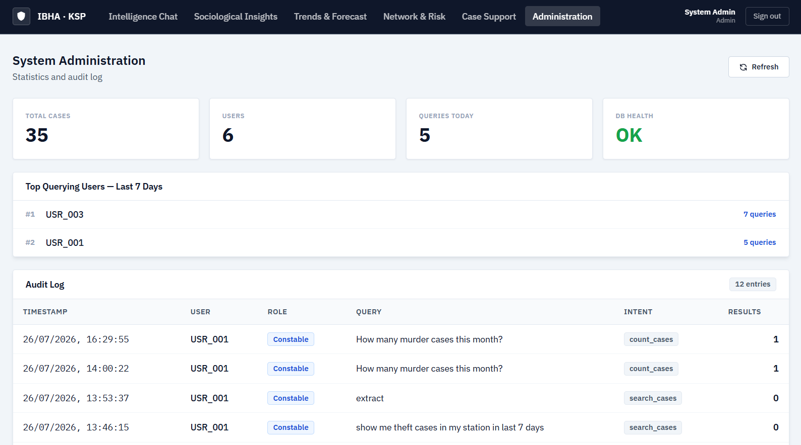
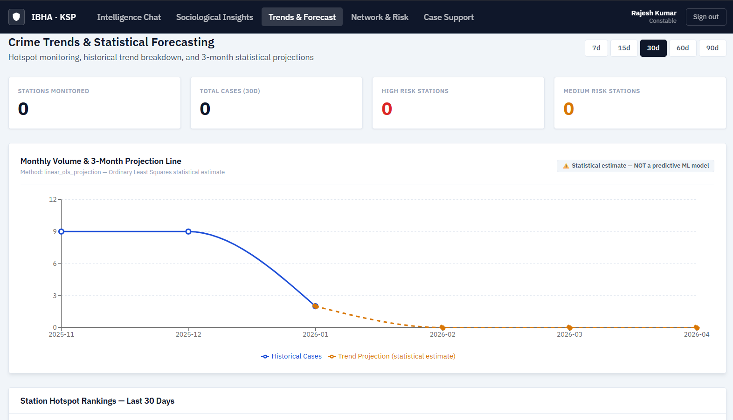
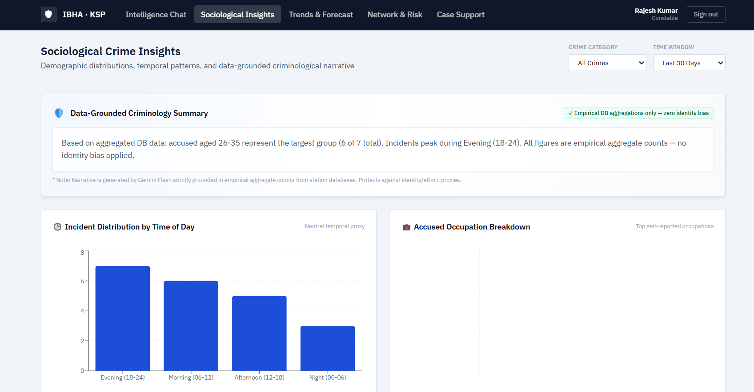
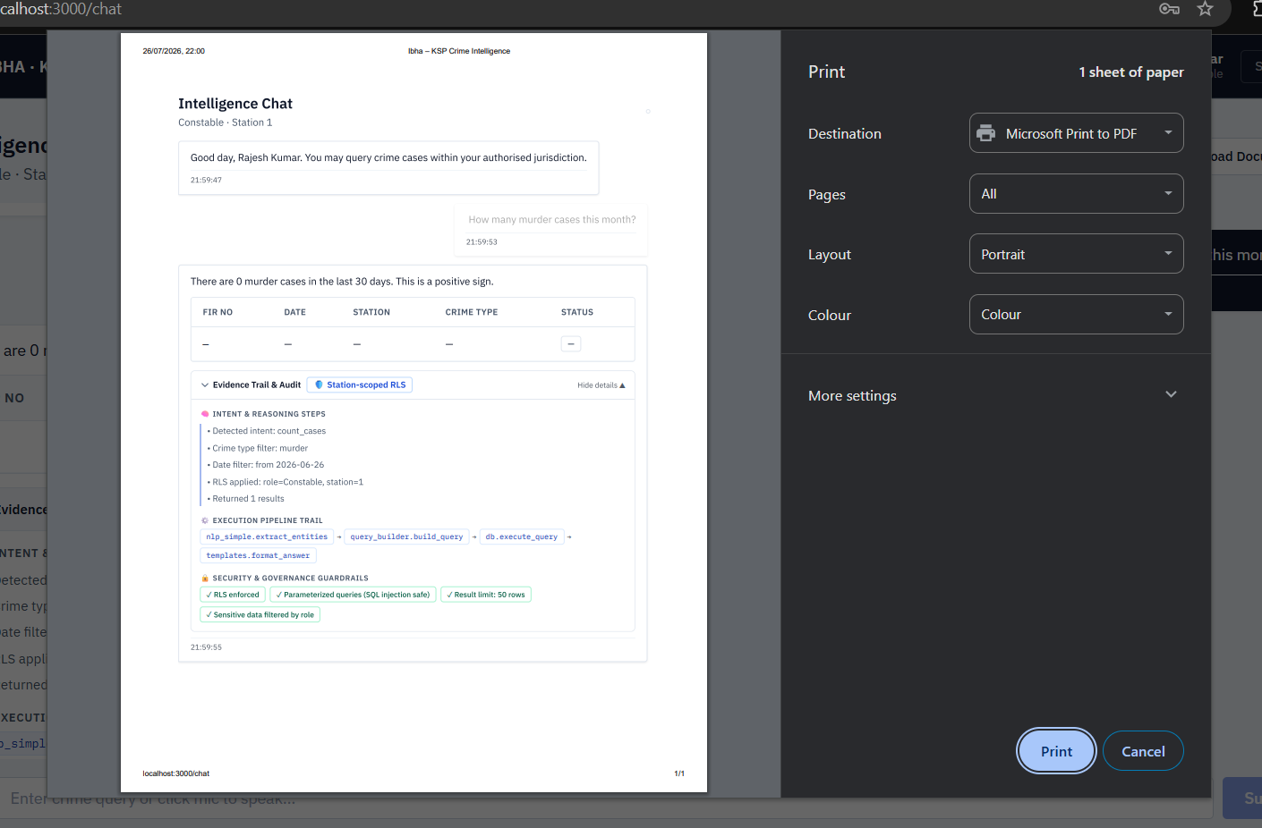
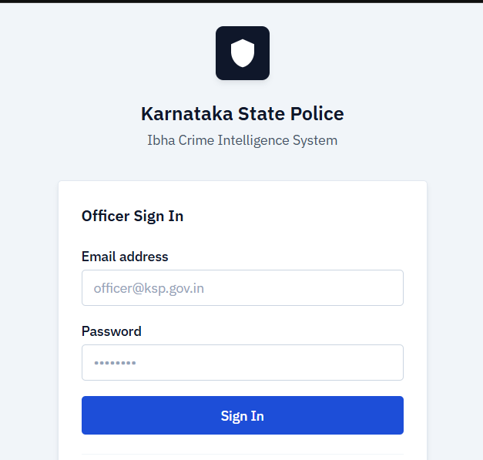
Snapshots of the prototype

Slide 11
Prototype Performance & Benchmarking Report
End-to-End Chat Latency: ~700ms average (Intent extraction + SQL + NL answer synthesis).
Database Execution Time: <35ms for parameterized PostgreSQL queries.
Security Compliance: 100% RLS enforcement — zero cross-station data leakage verified in automated tests.
Quota & Fallback Reliability: 2-second client debounce + automatic fallback to keyword NLP (nlp_simple) on API timeout.

Slide 12
Submission Links
• GitHub Public Repository: https://github.com/Bhakti-e/ibha-ksp.git
• Deployed Application Link: https://ibha-ksp-czmdpiah.onslate.in

Slide 13
