Slide 1



Bhakti Atul Pradhan
Notes:
Most of you are already familiar with SQL database, and have a good knowledge on either MySQL, Oracle, or other SQL databases. In the last several years, NoSQL database is getting widely adopted to solve various business problems.

Slide 2

Agenda

Slide 3
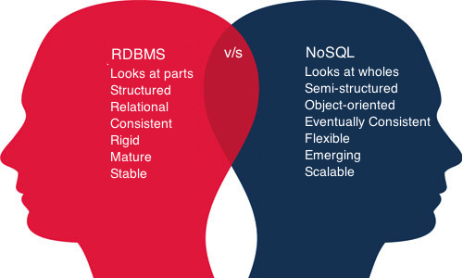
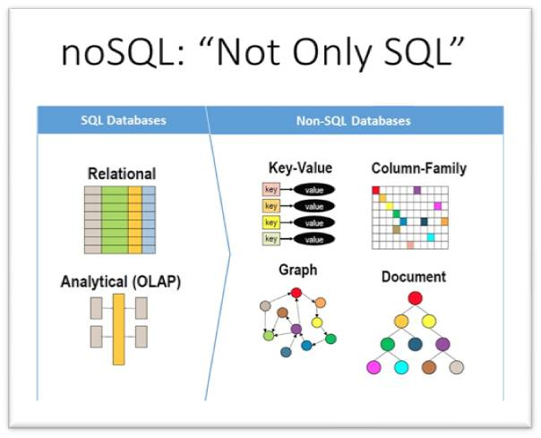
NO SQL (Not Only SQL)
A NoSQL database provides a mechanism for storage and retrieval of data that is modeled in means other than the tabular relations used in relational databases.
Notes:
MongoDB is a free and open-source cross-platform document-oriented database program. Classified as a NoSQL database program, MongoDB uses JSON-like documents with schemas. MongoDB is developed by MongoDB Inc., and is published under a combination of the GNU Affero General Public License and the Apache License.

Slide 4

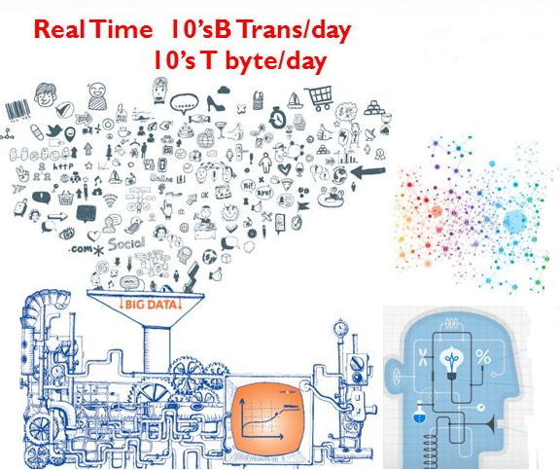

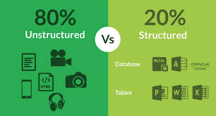
Why NoSQL / MongoDB
Notes:
NoSQL encompasses a wide variety of different database technologies that were developed in response to the demands presented in building modern applications:
Developers are working with applications that create massive volumes of new, rapidly changing data types — structured, semi-structured, unstructured and polymorphic data.
Long gone is the twelve-to-eighteen month waterfall development cycle. Now small teams work in agile sprints, iterating quickly and pushing code every week or two, some even multiple times every day.
Applications that once served a finite audience are now delivered as services that must be always-on, accessible from many different devices and scaled globally to millions of users.
Organizations are now turning to scale-out architectures using open source software, commodity servers and cloud computing instead of large monolithic servers and storage infrastructure.
Relational databases were not designed to cope with the scale and agility challenges that face modern applications, nor were they built to take advantage of the commodity storage and processing power available today.
Factors Driving Modern Applications
Mobile
2 Billion smartphones in 2015
Mobile now>50% internet use
26 billion IOT devices yby 2020
Social
72% of internet use is social media
2 billion active users monthly
93% of business use social media
Data
90% data created in last 2 years
80% enterprise data is unstructured
unstructured data is growing 2X rate of structured data
Cloud
Compute Costs decling
Storage cost decling
network cost decling

Slide 5
What / Who MongoDB
MongoDB is a free and open-source cross-platform document-oriented database program. Classified as a NoSQL database program, MongoDB uses JSON like documents with schema.
Developed by 10 gen in 2007, later renamed to MongoDB Inc in 2013.
It is published under a combination of the GNU ( General Public License) and the Apache License.

Slide 6
MongoDB Features
Document oriented
High performance
High availability — Replication
High scalability – Sharding
Dynamic — No rigid schema.
Flexible – field addition/deletion have less or no impact on the application
Heterogeneous Data
No Joins
Distributed
Data Representation in JSON or BSON
Geospatial support
Easy Integration with BigData Hadoop
Document-based query language that’s nearly as powerful as SQL
Cloud distributions such as AWS, Microsoft, RedHat,dotCloud and SoftLayer etc:-. In fact, MongoDB is built for the cloud. Its native scale-out architecture, enabled by ‘sharding,’ aligns well with the horizontal scaling and agility afforded by cloud computing.

Slide 7
When MongoDB?
High performance (1000’s – millions queries/sec)
Need flexible schema
Rich querying with any number of secondary indexes
Need for replication across multiple data centers globally
Need to deploy rapidly and scale.
99.99999% availability
Real Time Analysis
Geospatical Querying
Processing in real time vs batch
Agile Project
Need Strong Data consistency
Advance Security
Building Next Gen Solution

Slide 8
When/Where MongoDB?
You Expect a High Write Load
You need High Availability in an Unreliable Environment (Cloud and Real Life)
You need to Grow Big (and Shard Your Data)
Your Data is Location Based
Your Data Set is Going to be Big (starting from 1GB) and Schema is Not Stable

Slide 9
How MongoDB
Installation
Mongo Shell
MongoDB CRUD
Schema Design
Indexes
Aggregation Framework
Sharding
Replication

Slide 10
Getting Started

Slide 11
SQL vs NoSQL
SQL | MongoDB
Table | Collection
Row | Document
Column | Field
Primary key | ObjectId
Index | Index
View | View
Nested table or object | Embedded document
Notes:
What Is Meant by NoSQL? • A NoSQL database provides a mechanism for storage and retrieval of data that is modeled in means other than the tabular relations used in relational databases.

Slide 12
Mongo Shell

