Slide 1
Healthcare Cost Analysis
Impact of Age, BMI, Region and Smoking Status on Insurance Charges

Slide 2
Dataset Overview
Dataset: insurance.csv
Number of records: 1338
Columns: age, sex, bmi, children, smoker, region, expenses
Key Stats:
Mean Expenses: 13270.42
Median Expenses: 9382.03
Max Expenses: 63770.43
Min Expenses: 1121.87

Slide 3
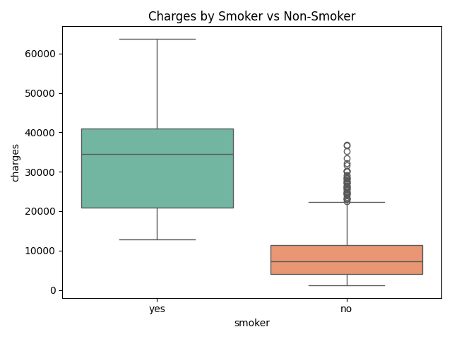
Charges by Smoker vs Non-Smoker

Slide 4
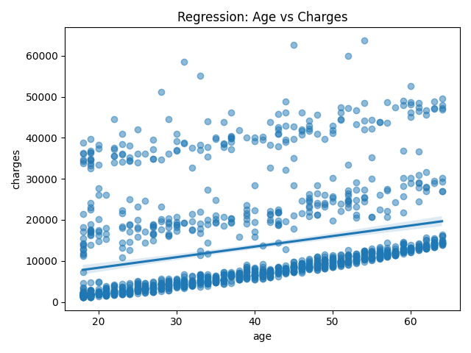
Regression: Age vs Charges

Slide 5
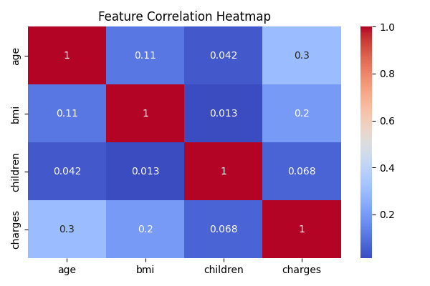
Feature Correlation Heatmap

Slide 6
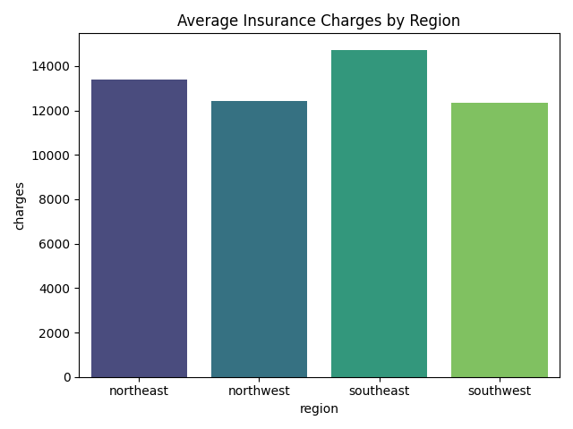
Average Insurance Charges by Region

Slide 7
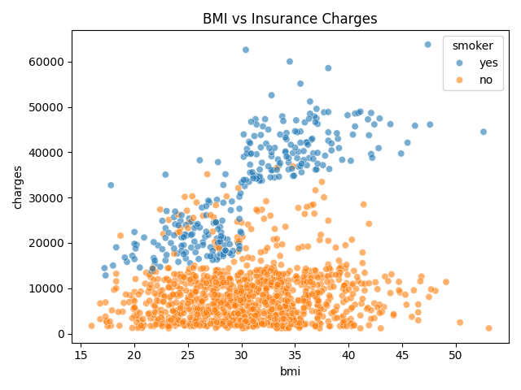
BMI vs Insurance Charges

Slide 8
Average Expenses by Region & Smoker
Region | Smoker | Avg Expenses | Count
Northeast | No | 9165.53 | 257
Northeast | Yes | 29673.54 | 67
Northwest | No | 8556.46 | 267
Northwest | Yes | 30192.0 | 58
Southeast | No | 8032.22 | 273
Southeast | Yes | 34845.0 | 91
Southwest | No | 8019.29 | 267
Southwest | Yes | 32269.06 | 58

