Slide 1
Face Detection and Recognition
Mentors:
Achintya K N
Akash S Bharadwaj
Sankarsh R
Group Members:
Amogh Umesh
Anirudh Singh Solanki
Bhakti Jayannache
P M Prasanna
Sumukh C Prakash

Slide 2
Objective
For face recognition there are two types of comparisons
Verification
Identification
We look to address identification problem
Build an attendance system for an organization which makes use of uniqueness of face of an employee.
Train a CNN model to extract features from image and compare it with a database to identify the face

Slide 3
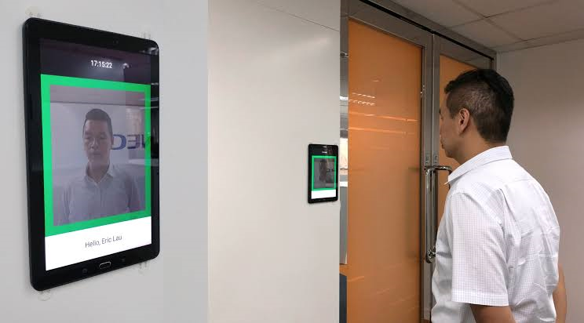
Attendance System
The live image is fed to detection algorithm.
The face is cropped and processed to match our model input requirements.
The database has face features of all working employees.
The attendance is marked based on comparison of features of the cropped face and the features in the database using certain threshold.

Slide 4
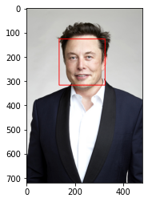
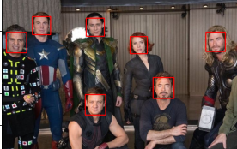
FACE DETECTION USING HAAR CASCADES
Face detection is the process of detecting the presence of a face and finding its position in the image.
Here, we used Haar Cascades to detect faces.
It is a machine learning based approach where a cascade function is trained from a lot of positive and negative images to identify the location of the faces
Once the position of faces are obtained, the faces are cropped and fed into our feature extraction model to identify each face

Slide 5
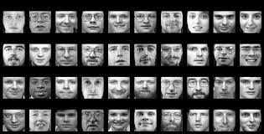
DATA DESCRIPTION
Olivetti dataset
10 different images of 40 distinct people
All images are in gray-scale
Each image is of the size 64 x 64
Each pixel is scaled to interval [0,1]

Slide 6
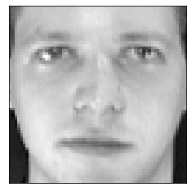
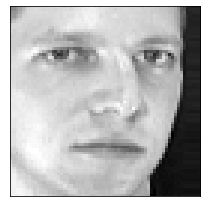
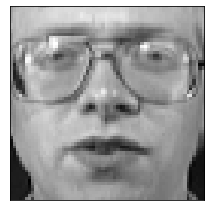
TRIPLETS
Select 5 random images of each person
3 arrays: Positive, Anchor, Negative
Images of same index form a triplet
A total of 156000 triplets
Positive Anchor Negative

Slide 7
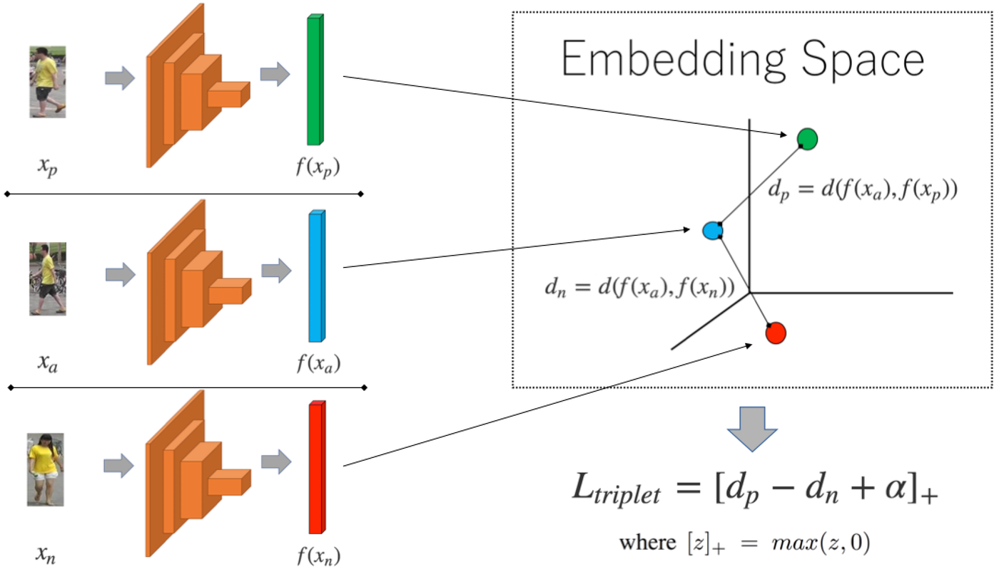
SIAMESE NETWORK

Slide 8
TRIPLET LOSS
It is a distance based loss function that operates on three inputs:
anchor (a) is any arbitrary data point
positive (p) which is the same class as the anchor
negative (n) which is a different class from the anchor
Mathematically, it is defined as: L=max(d(a,p)−d(a,n)+margin,0)

Slide 9
CNN MODEL ARCHITECTURE
Built a CNN Model for feature extraction , incorporated 4 convolutional layers and and the last layer was a dense layer with 128 number of features specified
Gave the activation function as “Relu” for the CNN layers and took the desired kernel size and strides for best the optimization
The last dense layer had activation function “Sigmoid”, so that result is between 0 and 1
For splitting the dataset in to train,validation and test we used train_test_split function from sklearn package
We chose the Learning rate =0.0001 , batch size = 32 and epochs = 30 , all these were taken to reduce overfitting of model

Slide 10
Siamese model Architecture
This model has multiple input and output capabilities
This model took three inputs at the same step ( namely - any anchor image , positive image , negative image ) in a list and output were given the corresponding anchor features , positive features , negative features in a list.
These features were obtained from the CNN Model were passed as sample output to the Siamese Model.
We Compiled the model using using Adam optimizer and added the triplet loss function to the Siamese model and trained it.

Slide 11
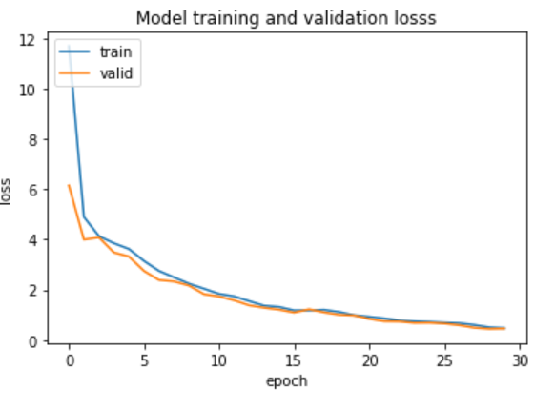
RESULTS
The triplet_loss function is add to the Siamese model and trained the model for 30 epochs
Obtained “Loss” - triplet loss , “val_loss” - validation loss for each Epoch .
And the train loss and validation loss is plot in the graph below

Slide 12
ACCURACY
After training and updating the weights of the Siamese model , we test the accuracy of model on the test dataset
Extract the features of anchor_test , pos_test, negative_test
Compare the difference between the features of (anchor_test , pos_test) with a certain threshold value .
If it is within the threshold the anchor and corresponding positive image is related and hence accurate.
This is continued for entire test data and incrementing the counter variable if found accurate

Slide 13
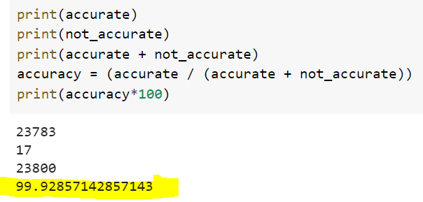
We calculated the accuracy by this formula and achieved an accuracy of
99.92 % on the test dataset

Slide 14
REFERENCE
https://www.mygreatlearning.com/blog/real-time-face-detection/
https://towardsdatascience.com/understanding-face-detection-with-the-viola-jones-object-detection-framework-c55cc2a9da14
https://www.geeksforgeeks.org/introduction-to-opencv//
https://youtube.com/playlist?list=PLZbbT5o_s2xq7LwI2y8_QtvuXZedL6tQU
https://docs.google.com/presentation/d/1KzY548vJ5xA19Kb2pGSDE8Zkvuxybf2SZVa5rrbamP4/edit?usp=drivesdk
Keras official documentation
OpenCv documentation

