Slide 1
Face Detection and Recognition
Mentors:
Achintya K N
Akash S Bharadwaj
Sankarsh R
Group Members:
Amogh Umesh
Anirudh Singh Solanki
Bhakti Jayannache
P M Prasanna
Sumukh C Prakash

Slide 2
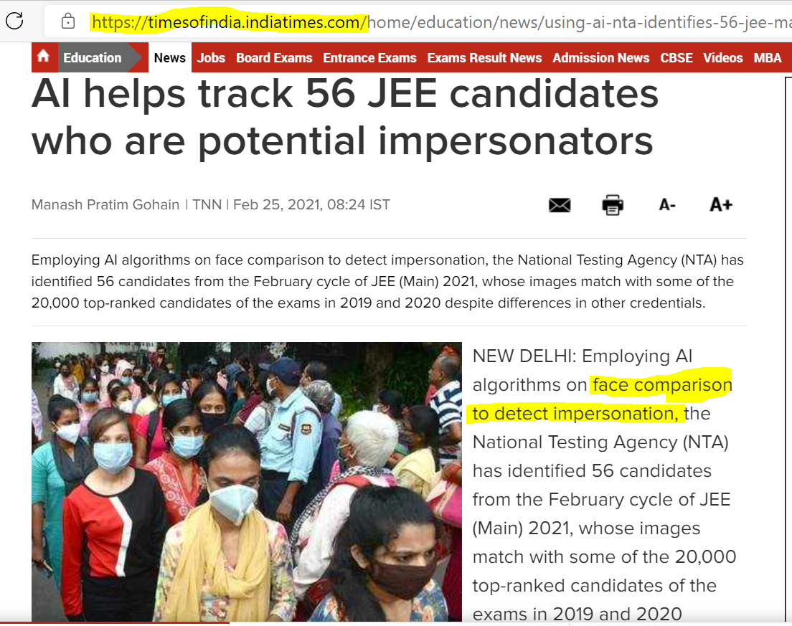

Slide 3
FACE RECOGNITION
The Face - unique part.
For face recognition there are two types of comparisons
1. Verification.
This is where the system compares the given individual with who that individual says they are and gives a yes or no decision.
2. Identification.
This is where the system compares the given individual to all the Other individuals in the database and gives a ranked list of matches.

Slide 4
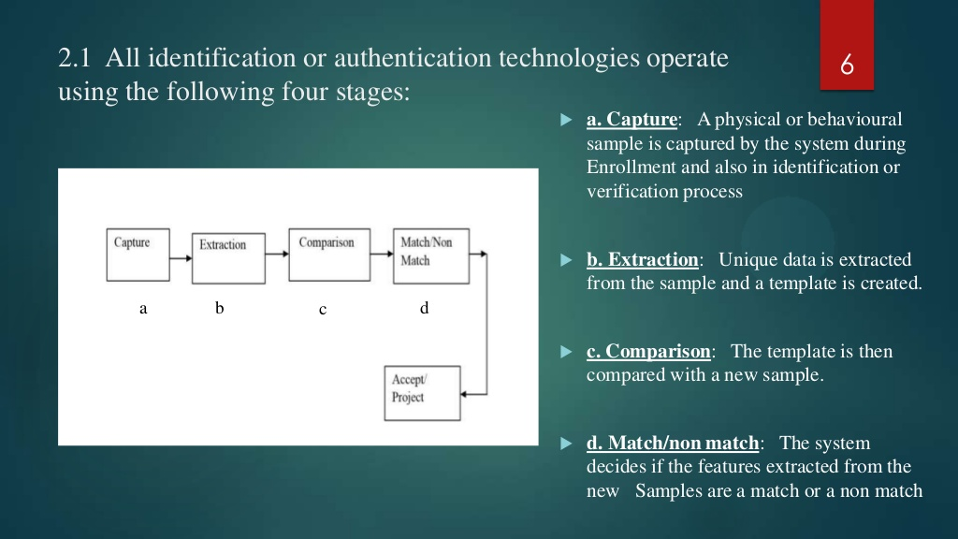
IDENTIFICATION FLOWCHART

Slide 5
All identification or authentication technologies operate using the following four stages:
a. Capture: A physical or behavioural sample is captured by the system during Enrollment and also in identification or verification process
b. Extraction: Unique data is extracted from the sample and a template is created.
c. Comparison: The template is then compared with a new sample.
d. Match/non match: The system decides if the features extracted from the new Samples are a match or a non match

Slide 6
HOW FACE RECOGNITION SYSTEMS WORK
If you look at the mirror, you can see that your face has certain distinguishable landmarks. These are the peaks and valleys that make up the different facial features.
Software defines these landmarks as nodal points.
There are about "80 nodal points" on a human face.
Here are few nodal points that are measured by the software.
distance between the eyes
width of the nose
depth of the eye socket
cheekbones
jaw line
chin

Slide 7
SCOPE AND USAGE
1) Used in ATMs
2) Identifying duplicate voters
3) Passport and visa verification,
4) Driving license verification,
5) Defense
6) Governments and private sectors

Slide 8

METHOD OF EXECUTION
1) WHEN THE TWO GIVEN IMAGES ARE SIMILAR THE ENCODING DIFFERENCE IS ALMOST ZERO
AND THE ORIGINAL PICTURE IS “ANCHOR” AND THE MATCHED PICTURE IS TERMED “POSITIVE”
2) WHEN THE TWO GIVEN IMAGES ARE DISSIMILAR THE ENCODING DIFFERENCE IS NOT ZERO AND GREATER .
AND THE ORIGINAL PICTURE IS “ANCHOR” AND THE UNMATCHED PICTURE IS TERMED “NEGATIVE”

Slide 9
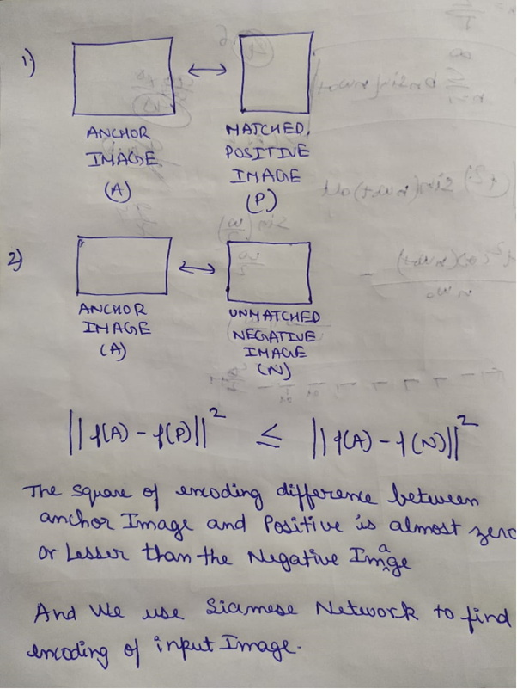

Slide 10
Progress So Far
Learning the concepts of Machine Learning and Neural Networks
Attending Python and Machine Learning KSS
Reading different online resources and books on Machine Learning
Taking online courses on Machine Learning

Slide 11
Further Plans
Learning keras
Face detection implementation
Building a Siamese network for Face recognition
Training the model
Testing with different samples

