Slide 1
CarsHuB
GROUP 4
Adwaith Korapati (002670980)
Bhakti Bharat Desai (002701264)
Shreemoy Nanda (002697142)
Project Demo

Slide 2
CONTRIBUTION
ADWAITH KORAPATI | Table initialization, insert proc, update proc, creating views, function, exception handling, reports.
BHAKTI BHARAT DESAI | Table initialization, User creation, insert proc, Role creation and User creation, exception handling, reports.
SHREEMOY NANDA | Table initialization, insert proc, creating views, sequences, exception handling, reports.
@CarsHuB

Slide 3

Objectives
Fleet deployment determined through day-to-day operations.
Centralized inventory system shows stock levels at multiple locations.
Base for analyzing and utilizing stockpiles efficiently.
Improve tracking accuracy.
Stay in control with transactional analytics.

Slide 4
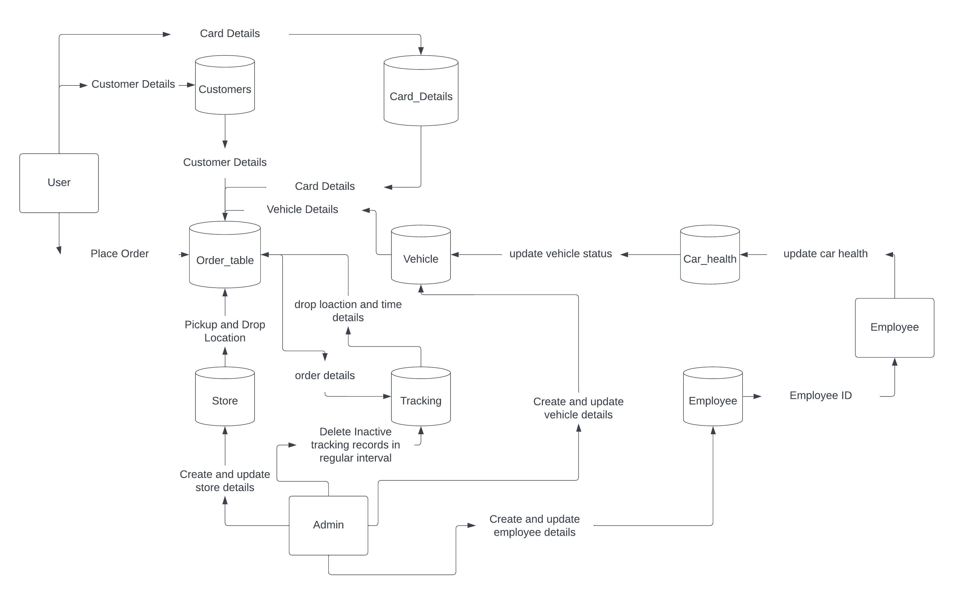
DFD diagram

Slide 5
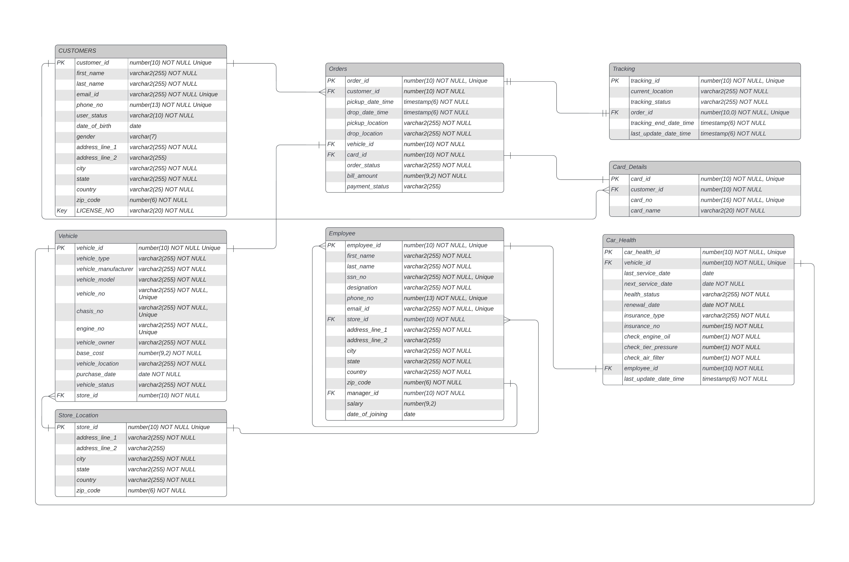
ER diagram

Slide 6
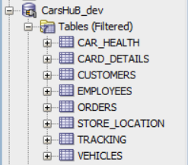
Tables

Slide 7
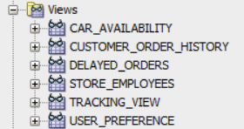
Views

Slide 8
Roles
Admin
Managers
Employees
Customers

Slide 9
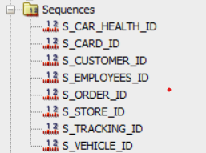
Sequences

Slide 10
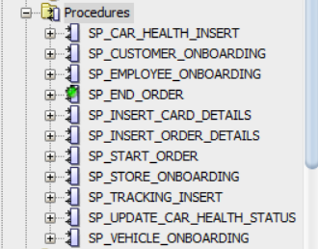
Procedures

Slide 11

Functions

Slide 12
Thankyou

