Slide 1

Tableau Project, November 2019
Avengers_(Till 2015)

Slide 2
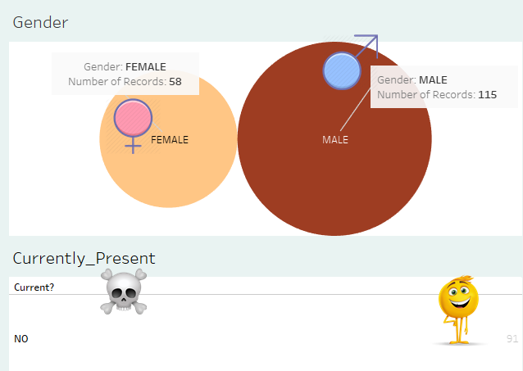
Gender Ratio and Currently Active SuperHeroes

Slide 3
The plots in Tableau represent the gender of the superheroes till 2015, as in, Male and Female.
It also shows the plot in Tableau dashboard format, the currently active and dead superheroes.
Packed bubbles illustrate the gender ratio whereas text tables illustrate the alive or dead superheroes.
Proper images have also been used to depict the required graphs and data.

Slide 4
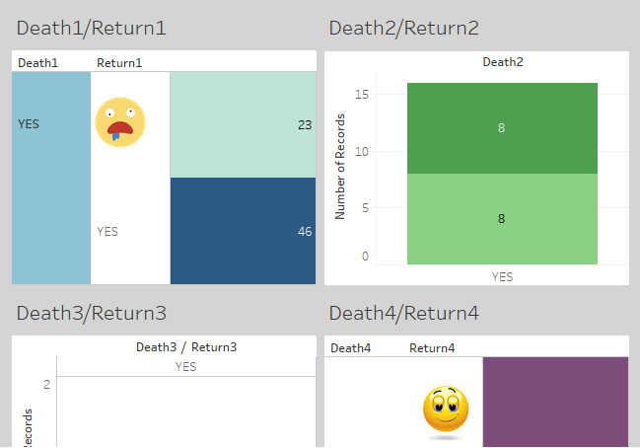
Deaths and Returns of SuperHeroes

Slide 5
The plots in Tableau represent the Deaths of the superheroes till 2015.
It also shows the plot in Tableau dashboard format, the return of the superheroes.
Different coloured representations illustrate the death and return ratio of the superheroes.
Proper images have also been used to depict the required graphs and data.

Slide 6
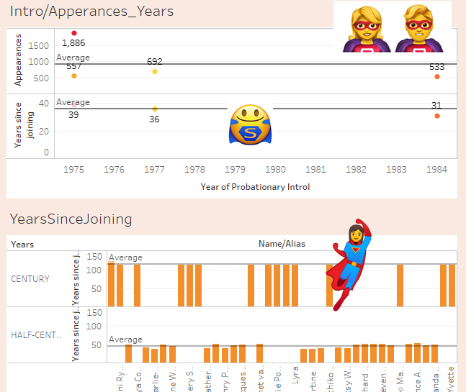
Introduction/Appearances/YearsSinceJoining

Slide 7
The plots in Tableau represent the probationary introduction of the superheroes till 2015.
It also shows the plot in Tableau dashboard format, the appearances of the superheroes.
Different coloured representations illustrate the introduction, appearances and years since joining of the superheroes.
Proper images have also been used to depict the required graphs and data.

Slide 8

Thank You and Have a Good Day !

