Slide 1
Fortran
CS361
Jeffrey Cruz – jc25427n@pace.edu
Matt Sokolovsky – ms98862n@pace.edu

Slide 2
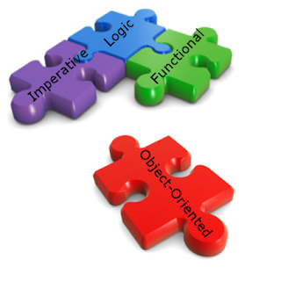
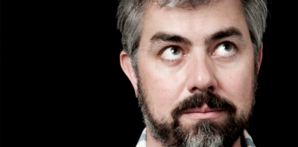

Fortran
Paradigm:
Origin:
Selling Points:
Older Versions: Imperative
Newer Versions: Multi-paradigm, Imperative, OOP (Started with FORTRAN2003), Concurrent Programming(2008),
Developed in 1957 at IBM by John Bacus and his team
machine independent, allowed “human-like” math expressions, fast execution, non-strict writability

Slide 3
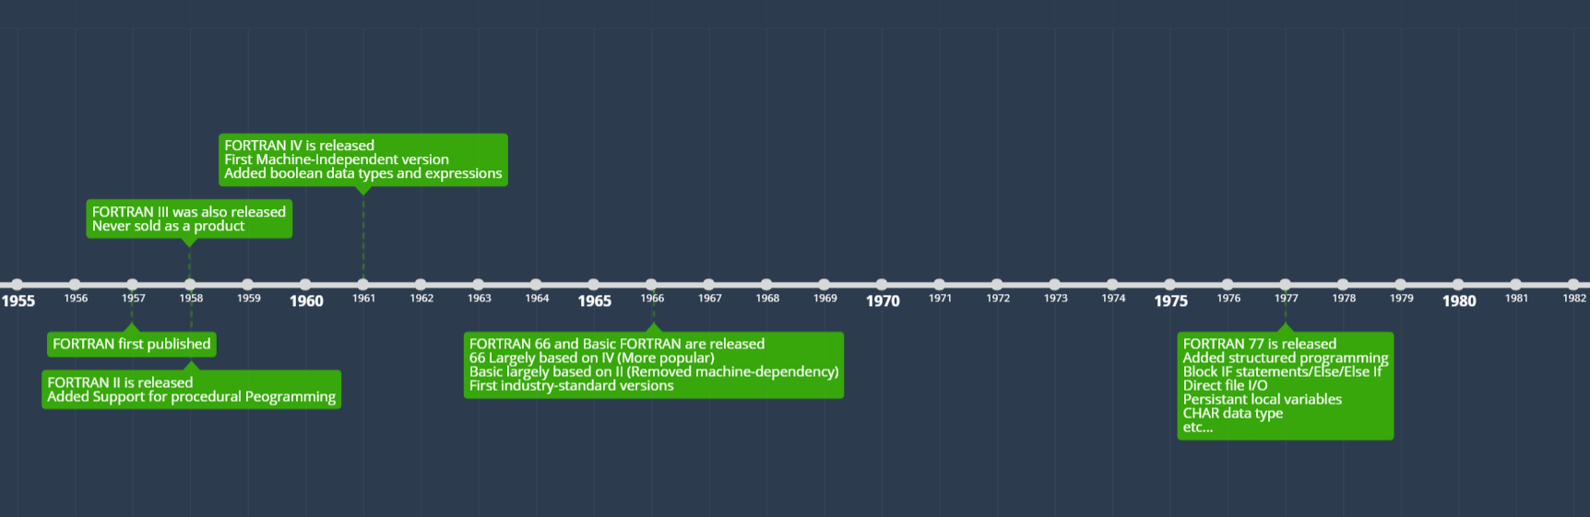

Slide 4
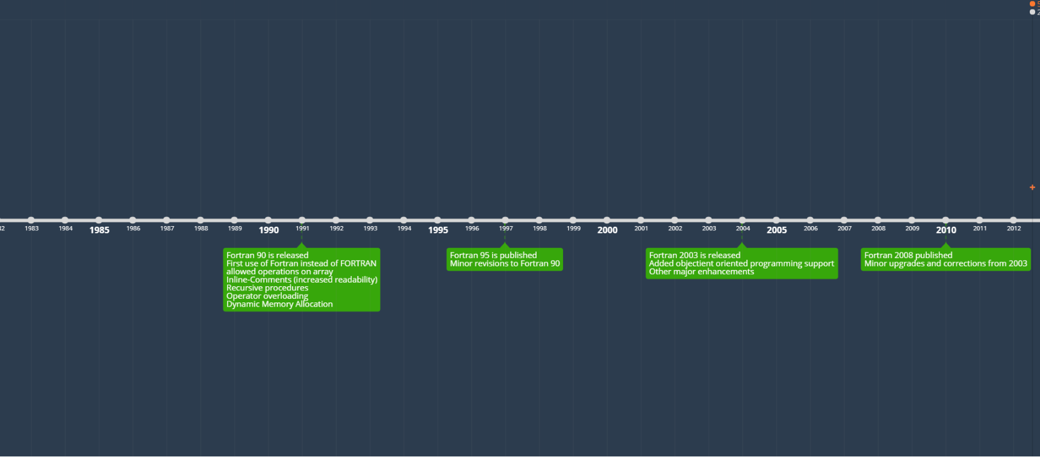

Slide 5
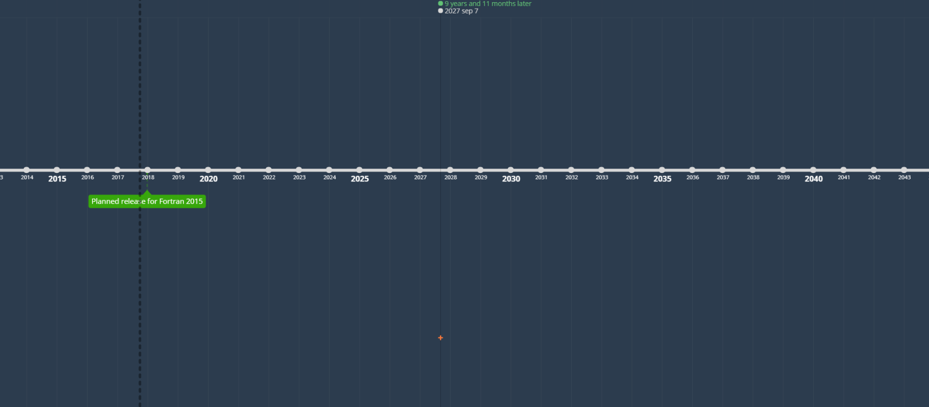

Slide 6
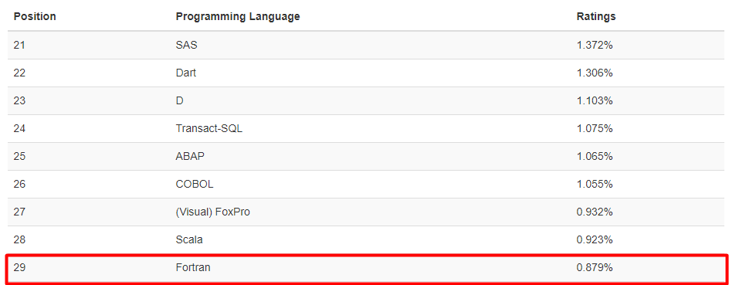
Fortran Popularity

Slide 7
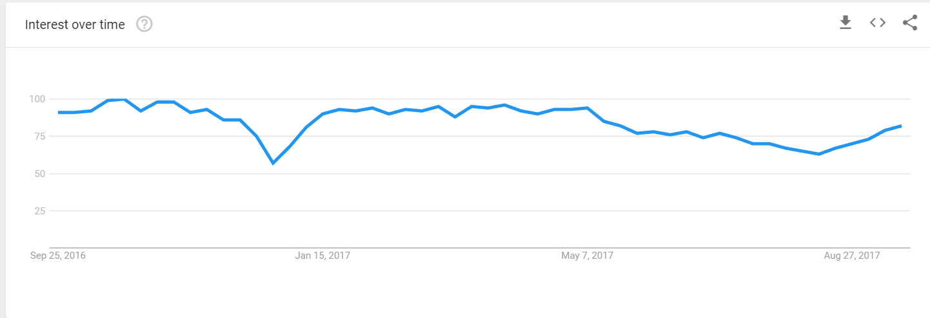
Fortran Popularity

Slide 8
How is Fortran used today?
Fortran is still majorly used for any area that requires large scale numerical computation. Its advantages fall off when it comes to small scale computations, because today there are other alternatives that are more intuitive and convenient when working at a smaller scale (Matlab, etc).
Fortran like other old languages such as COBOL, still see use in applications and companies with an older history, for the sheer fact that they already have it, and it still works tremendously well

Slide 9
How is Fortran used today?
Uses for Fortran today include
CHARMM (Molecular Dynamics)
Code_Saturne (Computational fluid dynamics)
NEMO (Oceanography)
QUANTUMESPRESSO (Materials Modeling)
SPECFEM3D (Seismic wave propogation)
WRF (Weather forcasting)

Slide 10
Fortran IDE:
https://www.jdoodle.com/execute-fortran-online (supports GNU Fortran) (Turn on interactive mode)
The GNU Fortran compiler supports the Fortran 77, 90 and 95 standards completely, parts of the Fortran 2003 and Fortran 2008 standards, and several vendor extensions

Slide 11
Fortran – Hello World
Notice the capitalization of key words

Slide 12
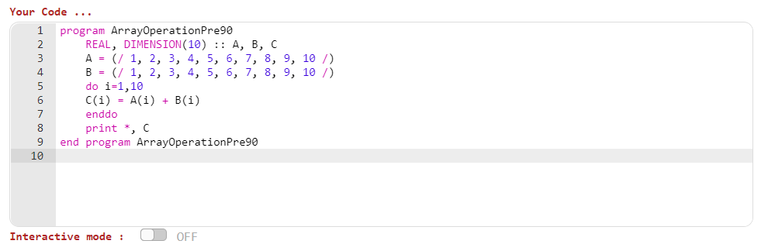
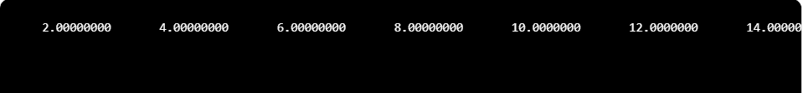
Fortran – Array Operation
Fortran 90 was one of the first programming languages to have direct operations between arrays (A result of adding operator overloading)

Slide 13
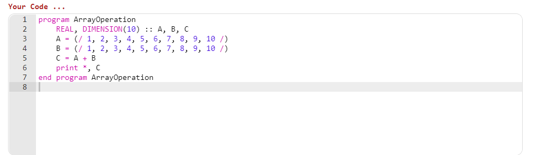
Fortran – Array Operation

Slide 14
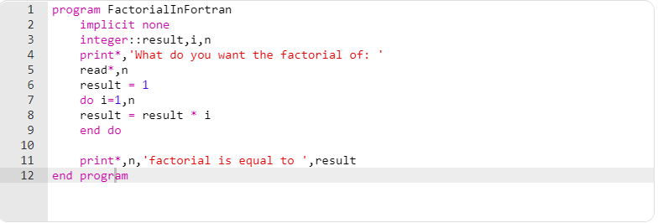
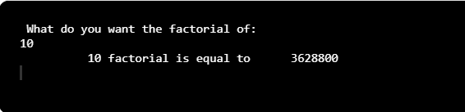
Factorial in Fortran
Key word capitalization isn’t important, all caps would of also worked (Freedom in writing).
Notice how the expressions
Look like how humans would write
Math. This is the “Human-like”
Quality that was mentioned earlier
Compare it with something like
Lisp…. ->

Slide 15
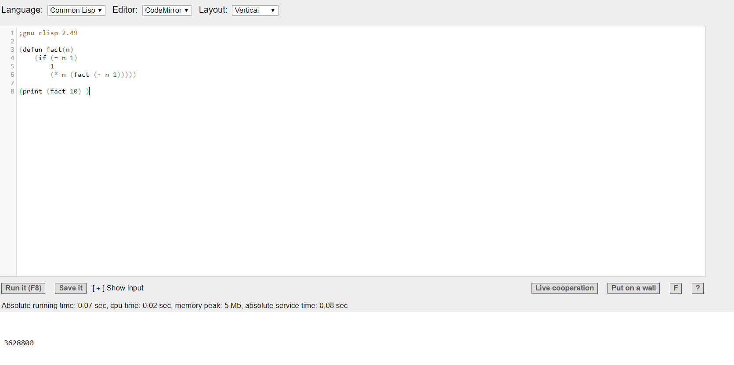
Factorial in Lisp

Slide 16
References
http://groups.engin.umd.umich.edu/CIS/course.des/cis400/fortran/fortran.html
https://gcc.gnu.org/fortran/
https://www.obliquity.com/computer/fortran/history.html
http://ieeexplore.ieee.org/document/538600/?reload=true
http://ieeexplore.ieee.org/document/728232/

Slide 17
Thank you

