Slide 1

Rust
Jeffrey Cruz – jc25427n@pace.edu
Brandon Wong - bw08623n@pace.edu
William Champ - wc28888n@pace.edu

Slide 2
Rust
Multi-Paradigm: Imperative and Functional
Compiled Language
Developed in 2010, originally designed by Graydan Hoare, then the Rust Project Developers.
First stable release in 2015
Used mainly as a systems programming language, similar to C++, but aims to be highly concurrent and highly safe.

Slide 3
Rust History
The Personal Years (2006-2010)
- Began as an open-source project by some employees at Mozilla (including Graydan Hoare)
The Graydon Years (2010-2012)
- Officially sponsored by Mozilla, development was led by Graydan Hoare, first numbered pre-release was developed.
The Type-system Years (2012-2014)
- The Type-state system modeled assertions before and after program statements through use of a special check system. Through development this system was deprecated and removed in 2014.
The Release Year (2015 – 2016)
-First Stable Release
The Production Years (2016 - ???)

Slide 4
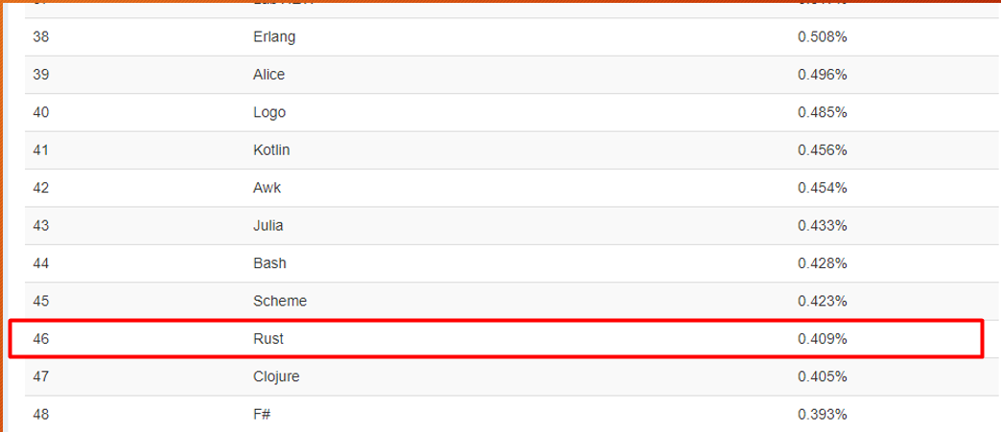
Rust - Popularity

Slide 5
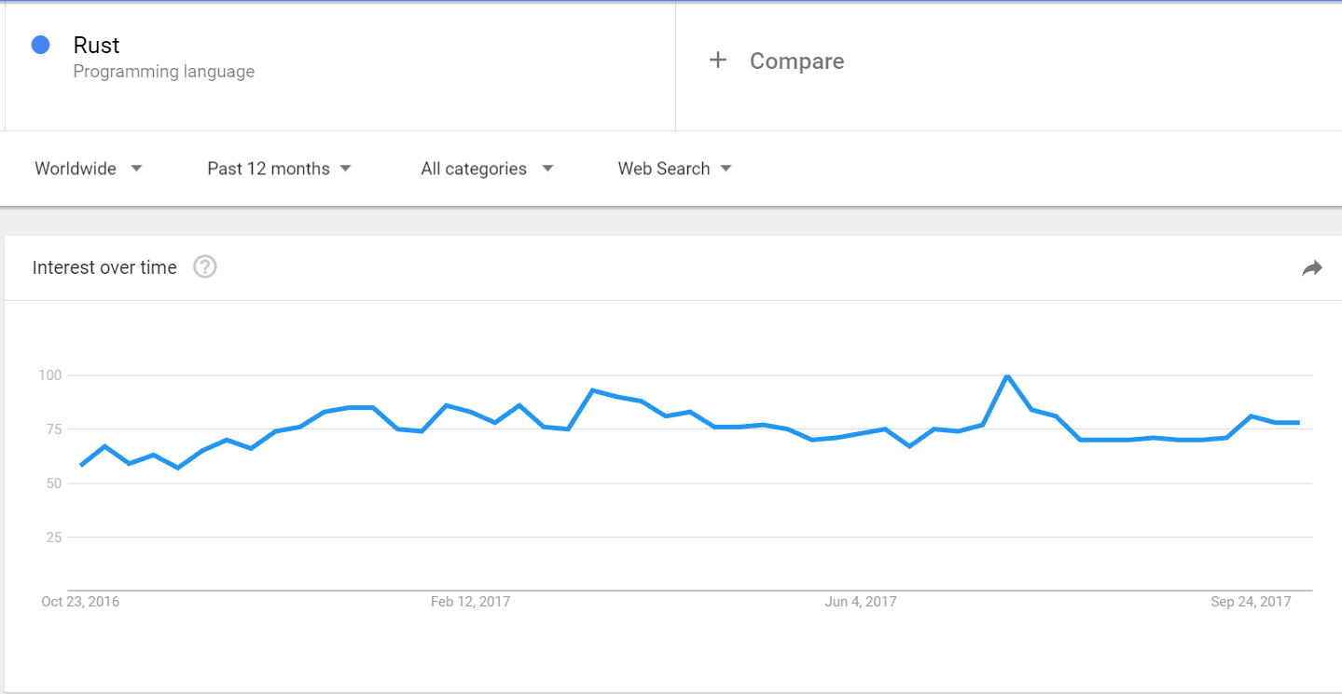
Rust – Google Trends

Slide 6
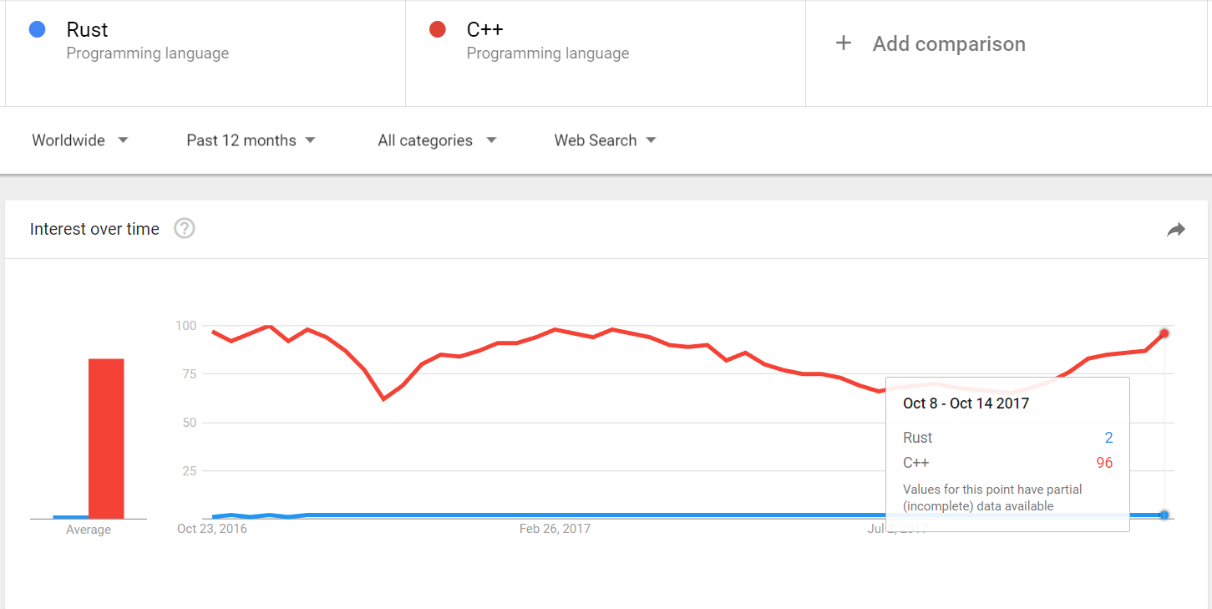
Rust vs C++ - Google Trends

Slide 7
How is Rust used? - Examples
Friends of Rust: https://www.rust-lang.org/en-US/friends.html
Mozilla’s Servo Browser Engine: https://servo.org/
Tor: https://www.torproject.org/projects/torbrowser.html.en
Piston Game Engine: http://www.piston.rs/
Dropbox: Back-End Infrastructure written in Go, but has some components written in Rust

Slide 8
Rust- Features
Ownership
Memory Safety
Memory Management
Option<T>

Slide 9
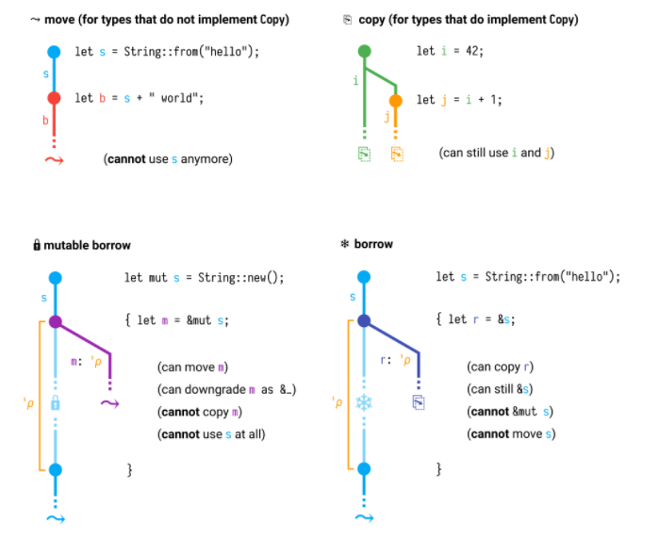
Rust- Ownership

Slide 10
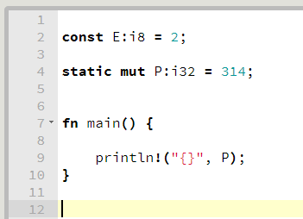
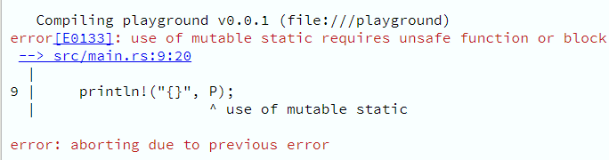
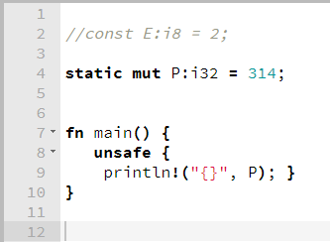

Rust – Memory Safety

Slide 11
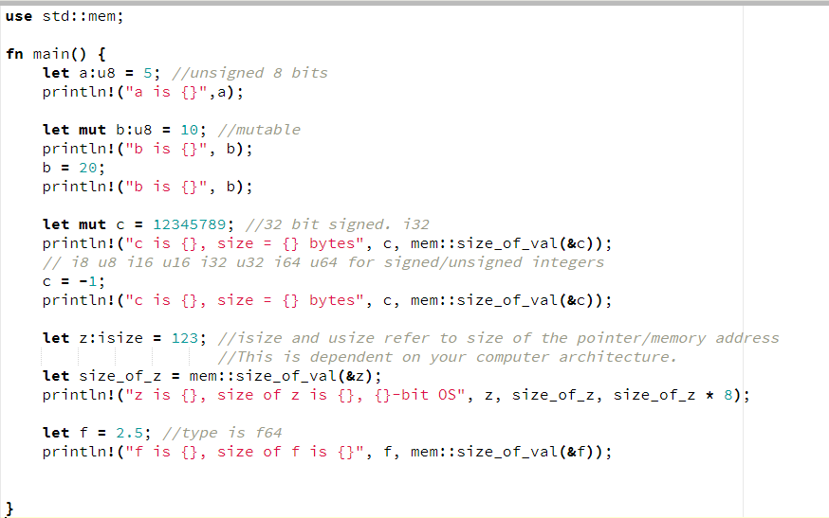
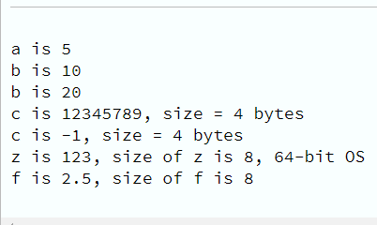
Rust – Data Types/Type Inference

Slide 12
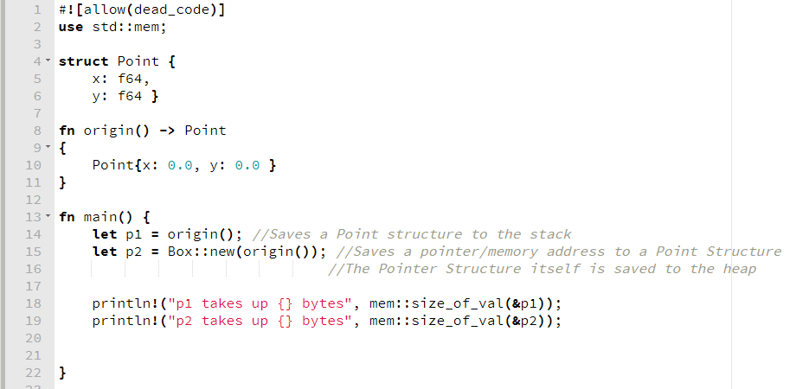

Rust – Memory Management

Slide 13
Rust
Live Coding Example
https://play.rust-lang.org/?version=stable&mode=debug

Slide 14
References
https://blog.rust-lang.org/2016/05/16/rust-at-one-year.html
https://dl.acm.org/citation.cfm?id=2960081
https://doc.rust-lang.org/
http://ieeexplore.ieee.org/document/7883291/
https://rufflewind.com/2017-02-15/rust-move-copy-borrow

Slide 15
Thank you

