Slide 1

A
Seminar
On
6G WIRELESS SYSTEM
Presented by
Mr./Ms.[Pulate Bhakti Subhash]
Roll No. [20CETA17]
Under the Guidance of,
Prof. [Deepak Gaikwad]
Department of Computer Engineering
SKN SITS Lonavala
Academic Year 2020-2021
T.E. SEM II

Slide 2
Outlines:
Introduction to the Domain
Identified Problem
Motivation
Purpose And Scope
Objectives and planned Outcomes
Literature Review (Existing Methods)
Proposed System Components & Working Process
System Features
Mathematical Model & Analysis
Survey of the selected Algorithm
Results
2

Slide 3
Outlines (Cont.):
Implementation technology
Implementation using data tables
Comparative outcome graphs
Merits & Demerits
Conclusion & Future Scope
References
Q&A
3

Slide 4
Introduction To The Domain:
Mobile Communication :-
Mobile Communication is the use of technology that allows us to communicate with others in different locations without the use of any physical connection (wires or cables). ... A mobile phone (also called mobile cellular network, cell phone or hand phone) is an example of mobile communication (wireless communication).
4

Slide 5
Identified Problem:
1.Lower Spectrum :-5G occupies broadband frequencies at sub-6 gigahertz (GHz) and above 24.25 GHz
2. Limitation in Internet Of Things
3.5G Networks Covers Limited Area Due To Lower Bandwidth
4. 5G takes 5 milliseconds for a packet of information to transmit over a frequency . Over 6G latency is estimated at 1 millisecond,
5

Slide 6
Motivation:
Motivation for every new mobile generation comes from the short comings of the previous generation. In case of 6G too,
it is going to be the major reason. 5G has been specified by ITU with several advanced features we show the main features of 5G. All these features are not available yet.
6G networks will be able to use higher frequencies than 5G networks and provide substantially higher capacity and much lower latency
6

Slide 7
Purpose And Scope:
Purpose :-
6G (sixth-generation wireless) is the successor to 5G cellular technology. 6G networks will be able to use higher frequencies than 5G networks and provide substantially higher capacity and much lower latency. One of the goals of 6G internet will be to support one microsecond-latency communication
Scope Of 6G
Next-generation 6G wireless networks will take this one step further. They will create a web of communications providers -- many of them self-providers -- much in the way that photovoltaic solar power has brought about co-generation within the smart grid
7

Slide 8
Objectives and planned Outcomes:
Objective Of 6G Systems:-
(i) extremely high data rates per device,
(ii) a very large number of connected devices,
(iii) global connectivity,
(iv) very low latency,
(v) lowering the energy consumption with battery-free IoT devices,
8

Slide 9
Literature Review (Existing Methods) :
9

Slide 10
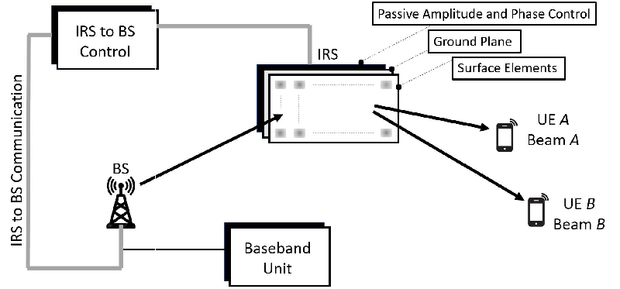
Proposed System Components & Working Process:
10

Slide 11
System Features:
1.high bit rate,
2.high reliability,
3.low latency,
4.high energy efficiency,
5.high spectral efficiency,
6.new spectrums,
7.green communication,
8.intelligent networks,
9.network availability, and convergence of communications,
11

Slide 12
Mathematical Model & Analysis:
Enter your Points here…
12

Slide 13
Results:
What to write refer following points here…
selected Algorithm and results obtained by the other researchers to solve same problem
Objectives
To develop ability of thinking and motivation for seminar
To develop ability to perform literature survey
To develop ability to generate proof-of-concept
per objective No 1, 2 and 3 results of implementation using data tables and comparative outcome graphs with other researchers for same data.
Prepare your own contents
13

Slide 14
Implementation technology:
Enter your Points here…
14

Slide 15
Implementation using data tables:
Enter your Points here…
15

Slide 16
Merits :-
➨It is designed to support higher number of mobile connections greater than the 5G capacity which is about 10 x 10⁵ per Km².
➨6G will revolutionize the health-care sector which eliminates time and space barriers through remote surgery and guaranteed health-care workflow optimizations.
➨As most of the mobile traffic is generated indoors. Moreover cellular networks have never really been designed to target indoor coverage efficiently. 6G overcomes these challenges using femtocells or Distributed Antenna Systems (DASs).
16

Slide 17
Demerits :-
➨6G uses cell-less architecture and multi-connectivity. Hence seamless mobility and integration of different kinds of links (THz, VLC, mmwave, sub-6GHz) need perfect scheduling. In cell-less architecture, UE connects to the RAN and not to a single cell. The challenge here is to design new network architecture.
➨6G uses visible light frequencies for part of its communications, hence drawbacks of VLC can be considered as drawbacks of 6G wireless technology. Visible light uses wavelength from 390-700 nm.
➨In order to manage large number of terminals and networking equipments more efficient and less energy consuming 6G system is a must. In order to fulfill this, network and terminal equipments circuitry and the communication protocol stack design is a challenge. The energy harvesting strategies are adopted to handle this requiremen
17

Slide 18
Conclusion
In order to understand advantages of 6G wireless and disadvantages of 6G wireless one has to understand 6G wireless technology basics and its difference with previous technologies such as 5G vs 6G >> and 4G vs 5G >>.
18

Slide 19
Future Scope
Beyond 5G (B5G) is seen as a path to 6G technologies that will replace fifth-generation capabilities and 5G applications.
5G's many private wireless implementations involving LTE, 5G and edge computing for enterprise and industrial customers have helped lay the groundwork for 6G.
Next-generation 6G wireless networks will take this one step further. They will create a web of communications providers -- many of them self-providers -- much in the way that photovoltaic solar power has brought about co-generation within the smart grid.
19

Slide 20
REFERENCES
[1], DeployM. Shafi Et Al., “5g: A Tutorial Overview Of Standards, Trials, Challengesment, And Practice,” Ieee J. Sel. Areas Commun., Vol. 35, No. 6, Pp. 1201–1221, Jun. 2017.
[2] M. Simsek, A. Aijaz,m. Dohler, J. Sachs, And G. Fettweis, “5g-enabled Tactile Internet,” Ieee J. Sel. Areas Commun., Vol. 34, No. 3, Pp. 460–473,Mar. 2016.
[3] 6G WHITE PAPER ON BROADBAND CONNECTIVITY NO. 10, 6G FLAGSHIP CENTER UNIV. OULU, OULU, FINLAND, JUN. 2020
20

Slide 21
Thank You!
21

Slide 22
Q&A….

