Slide 1

Staff Management A Full-Stack Project Using Java Spring MVC, Angular, and JPA with Hibernate
Presented By-Bhakti Tarkase batch:2023-9653

Slide 2

Staff Management
This presentation will discuss a full-stack project using Java Spring MVC, Angular, and JPA with Hibernate to achieve efﬁcient staff management. We will cover the beneﬁts of this technology stack and how it can improve your business operations.

Slide 3
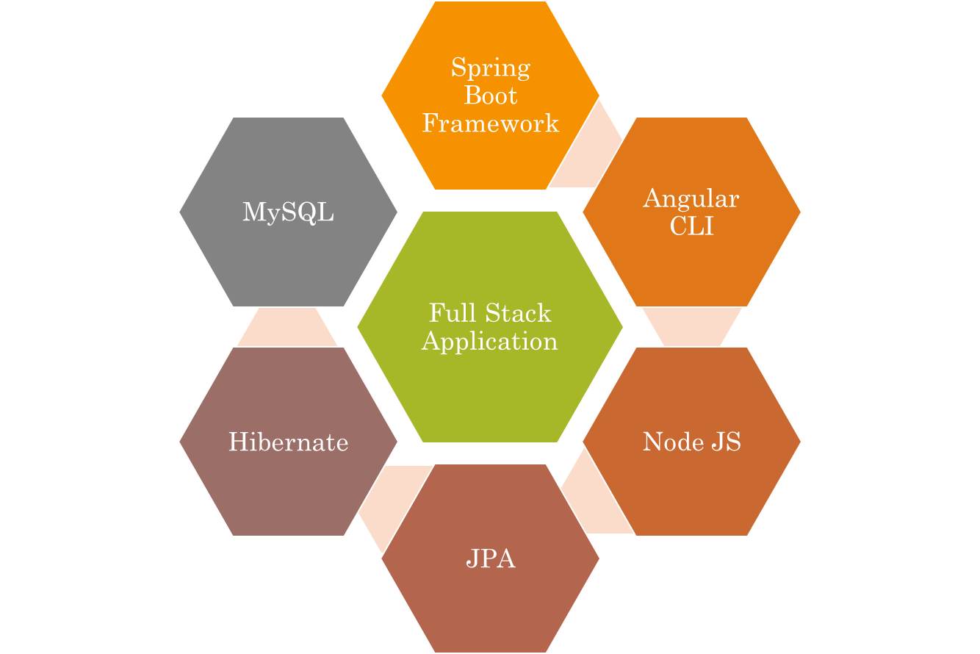
Technologies

Slide 4

Java Spring MVC
Java Spring MVC is a powerful framework for building web
applications. It provides a robust set of tools for handling requests, managing data, and integrating with other technologies. With Java Spring MVC, you can build scalable and maintainable applications that can
handle large amounts of trafﬁc.

Slide 5

Angular
Angular is a popular front-end framework for building dynamic web applications. It provides a set of tools for building user interfaces, handling user input, and managing data. With Angular, you can create responsive and interactive applications that provide a great user experience.

Slide 6

JPA with Hibernate
JPA with Hibernate is a powerful combination for managing data in Java applications. It provides a set of tools for mapping Java objects to database tables, handling transactions, and managing relationships between objects. With JPA and Hibernate, you can build scalable and efﬁcient data-driven applications.

Slide 7
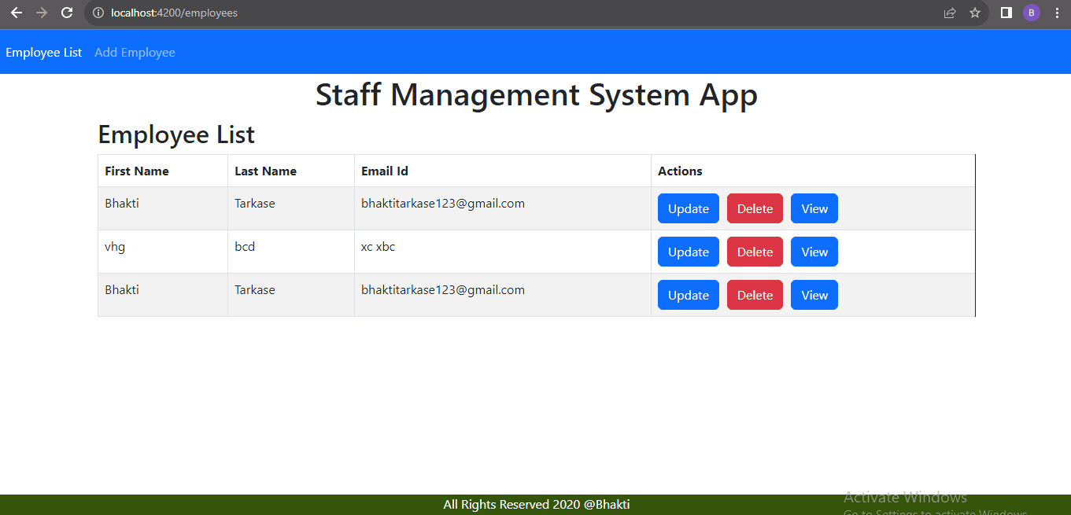
Home-Page

Slide 8
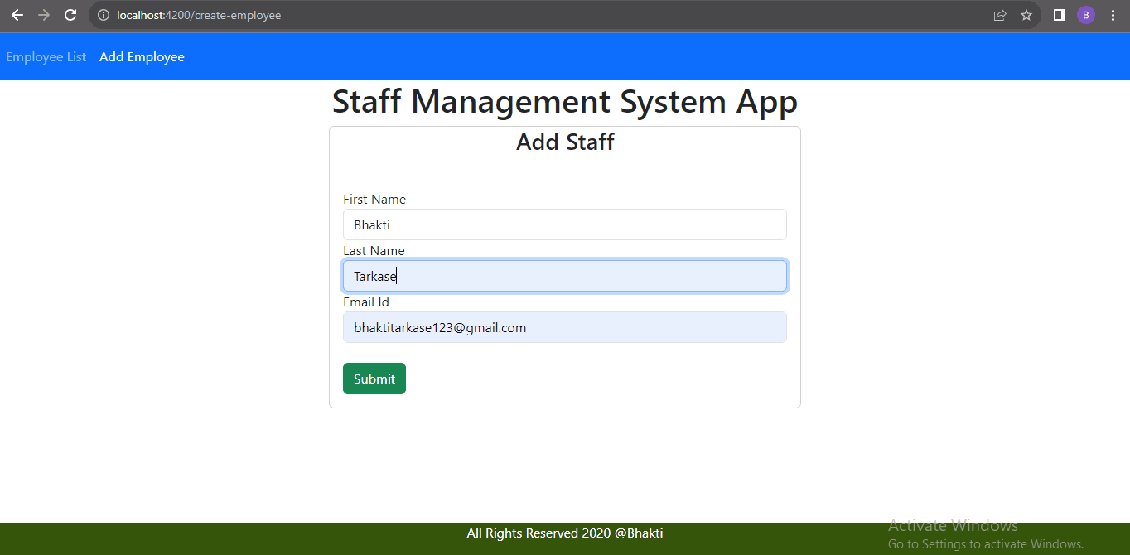
Insert Page

Slide 9
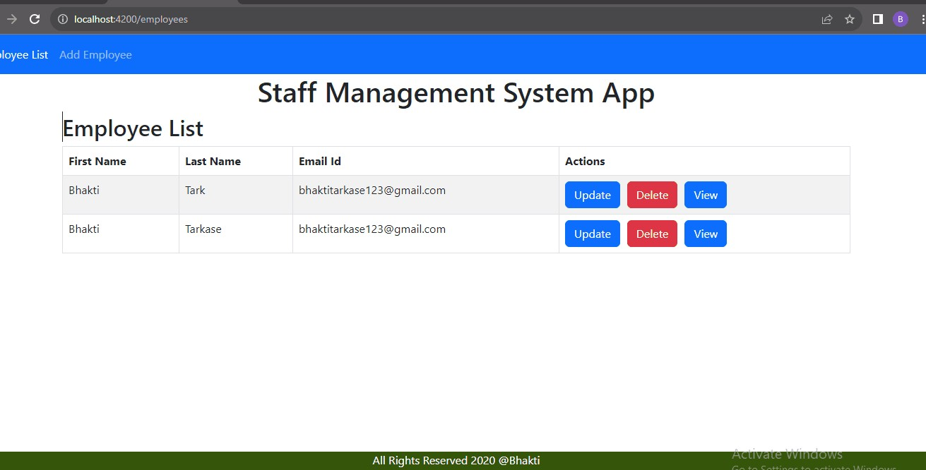
Delete-page

Slide 10
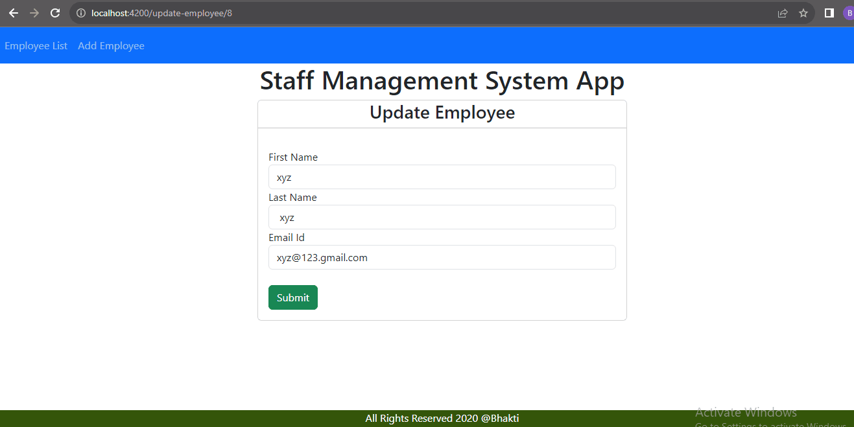
Update-page

Slide 11
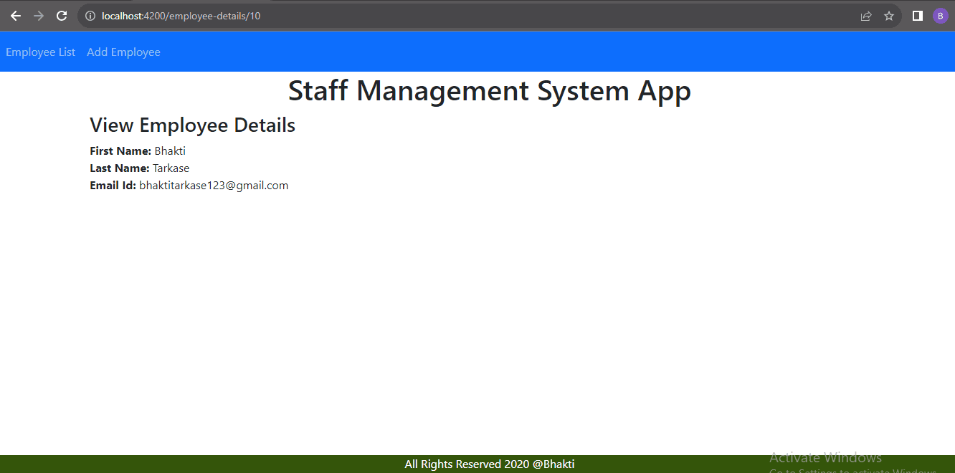
View-Page

Slide 12
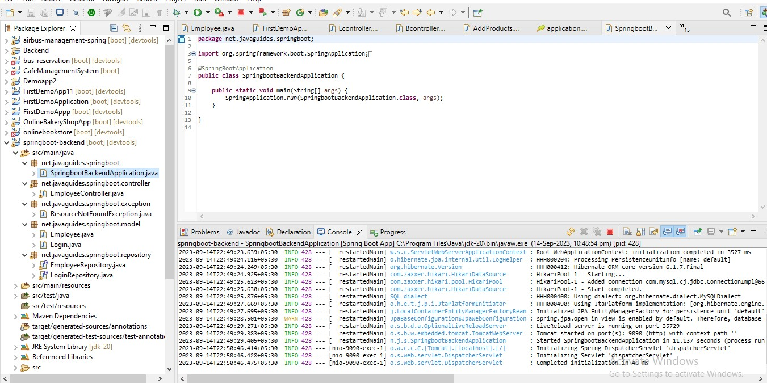
Spring-Boot-Application

Slide 13
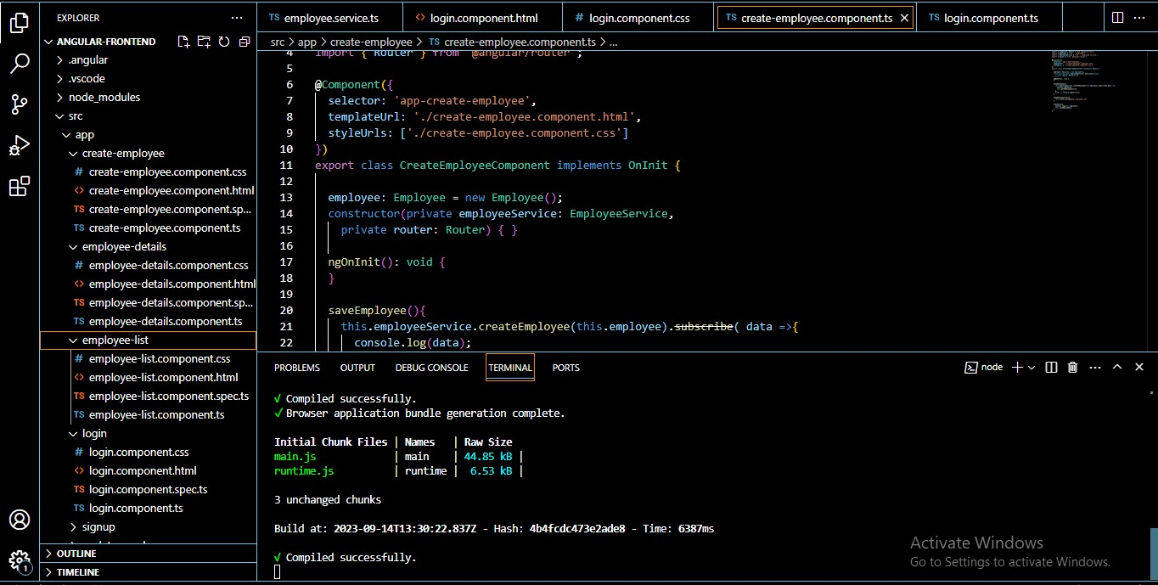
Angular-Application

Slide 14
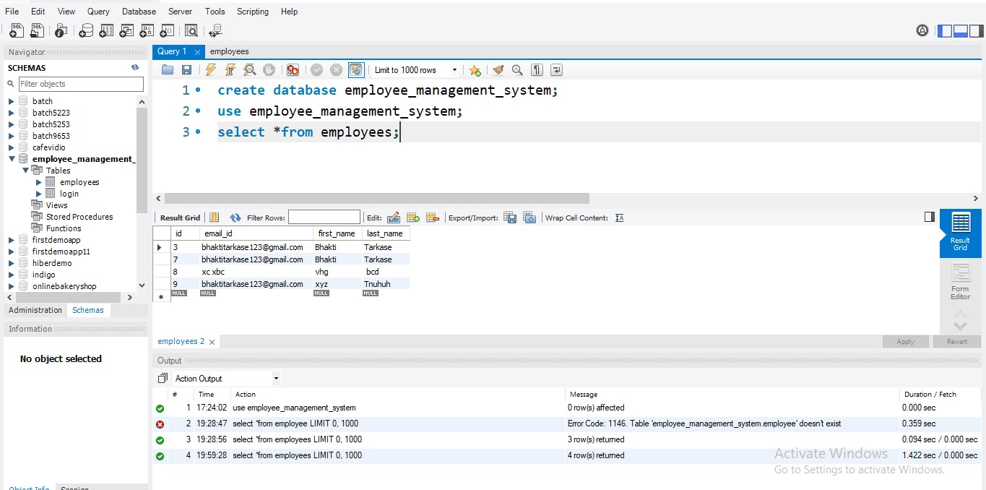
Mysql Database

Slide 15
Conclusion
In conclusion, our full-stack project using Java Spring MVC, Angular, and JPA with Hibernate can help you achieve efﬁcient staff management. With our system, you can streamline your operations, improve productivity, and reduce costs. Contact us today to learn more!

Slide 16

Thank You
ffiffiffiaaannnkkk yyyooouuu

