Slide 1
Application to get On-Street Parking
Group members:
Namrata Prajapati-36
Krina Mandavia-20
Bhakti Palkar-23

Slide 2
Index
Abstract of Project
Introduction to On-Street Parking
Aims and Objectives
Literature Survey
Problem Statement
Scope
Block Diagram
Software Used
References

Slide 3
Abstract
Parking search is a challenging task in most urban areas. The traffic resulting from drivers cruising for parking has a great effect on the environment , increasing energy consumption and emission of CO2.
As our country is progressing from developing to developed country status, traffic in city is one of the hectic problems all cities are facing. There is double digit growth of car owning customers e.g. in Mumbai there are 25 lakh cars .At any given point of time especially during peak hours there will be need for any car to find a parking space along road or in the enclosed premises.
Over that finding an exact location of parking slot is also important to avoid back traffic and wasted rounds to search parking place.

Slide 4
Introduction to street parking
The answer to most parking problems is not glamorous and is not costly. The answer is better on street parking management.
Good on street parking management can end on-street parking chaos. It enables streets to function more efficiently and to be better places. It makes them safer.
Parking management helps local commerce, residence, bus service, bicycle users, people on foot, and vehicle users of all kinds. It enables efficient and fair use of street space. It can ease local traffic problems at low cost. Ofcourse, it eases parking conflict.
On-street parking management also helps the wider off-street parking system and encourages more sustainable urban mobility.
It does all this at low cost and sometimes even make a revenue surplus.
Good on-street parking management is essential for every busy area of every town.

Slide 5
Aims and Objectives:
To help user find roadside parking space by showing parking slots on google map.
To show exact range of no parking.
Generating revenue for municipality.
To avoid back traffic and reduce searching time.
Balancing parking against other competing uses of space, such as pedestrian space, transit priority lanes or bicycle paths.

Slide 6
Problem Definition
In metropolitan cities like Mumbai where the population is at its peak and the roads are all messed with vehicle’s and long traffics. In such over increasing population it becomes a difficult job to find a parking spot for our vehicle. Due to this the people are forced to haphazardly park their vehicle wherever they find space, which result in traffic offence like illegal, haphazard double or angular parking.

Slide 7
Literature Review/ Background Work
The performance of the parking availability app improves significantly by using a prediction algorithm which is able to predict the parking availability in real-time based on a probability model of the historical parking data and real-time information.
The prediction algorithm is based on the development of a probabilistic model that is based on data that include the time of the day and day of the week, the location and parking capacity, the rates of vehicles occupying and leaving parking spots, time restrictions and parking rules, price, type of parking, events that disrupt parking availability etc.
All these elements which are used in the proposed system were found in the paper mentioned below.
Intelligent parking assist

Slide 8
Scope
Functional Requirements
Parking slot location
Real-Time parking availability details
Book parking slot online
The booking period will be decided based on travel time from user’s destination based on current traffic analysis

Slide 9
Scope
Non-Functional Requirements
Performance
Reliability
Availability
Maintainability
Portability

Slide 10
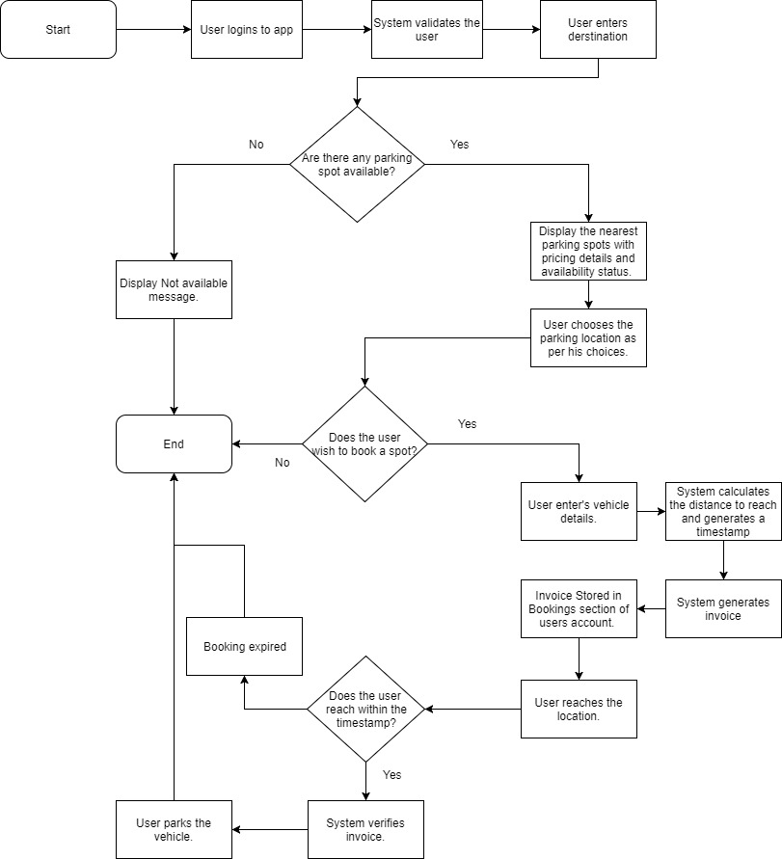
Block diagram:-

Slide 11
Software to be used
Software Technologies
Android SDK
Android Studio
MySQL

Slide 12
References
Tooraj Rajabioun, Brandon Foster, Petros Ioannou“Intelligent Parking Assist”21st Mediterranean Conference on Control and Automation,Greece,June 2013
Ali Ziat, Bertrand Leroy Nicolas Baskiotis and Ludovic Denoyer “Joint Prediction of Road-Traffic and Parking Occupancy Over a City With Representation Learning” 2016 IEEE 19th International Conference on Intelligent Transportation Systems (ITSC) Windsor Oceanico Hotel, Rio de Janeiro, Brazil, November 1-4, 2016

