Slide 1

Credit Scoring for Lending Institutions
Group members:
DIPALI AVHAD
BHAKTI PALKAR
AASHLESHA SHIROLE

Slide 2
Introduction
In the ever-evolving landscape of lending, accurate credit scoring is paramount for informed decision-making.
The primary goal is to enhance decision-making accuracy, reduce risks, and optimize lending portfolios.
Our project is dedicated to advancing the credit scoring process through the application of cutting-edge algorithms and comprehensive data analysis.
Leveraging diverse data sources, including financial history and socio-economic factors, our objective is to create a predictive model that assesses an applicant's creditworthiness. This not only streamlines the lending process but also enhances risk management, providing lending institutes with a robust tool for optimized portfolio performance in a dynamic financial environment.

Slide 3
Data Collection
Data Attributes: The dataset comprises essential attributes that play a crucial role in understanding credit scoring model.
These attributes include:
Demographic Details, Financial Information, Loan and Credit Details, Credit Profile, Payment and EMI Details, Monthly Balance and Credit Score
Data Dimensions:
1. This dataset contains a total of 100000 rows and 28 columns.
2. These dimensions reflect the size of the dataset and the number of data points and attributes available for our analysis.

Slide 4
Dataset Overview
ID: Unique identifier for each record.
Customer_ID: Identification for individual customers.
Month: Timeframe of data collection.
Demographic Details:
Name, Age, SSN, Occupation: Personal and professional information.
Financial Information:
Annual_Income, Monthly_Inhand_Salary: Key indicators of financial health.
Num_Bank_Accounts, Num_Credit_Card: Count of banking and credit accounts.
Loan and Credit Details:
Interest_Rate, Num_of_Loan, Type_of_Loan: Parameters related to loans.
Delay_from_due_date, Num_of_Delayed_Payment: Instances of payment delays.
Changed_Credit_Limit, Num_Credit_Inquiries: Credit limit changes and inquiries.

Slide 5
7. Credit Profile:
Credit_Mix, Outstanding_Debt: Variety of credit and current outstanding debt.
Credit_Utilization_Ratio, Credit_History_Age: Utilization ratio and credit history age.
8. Payment and EMI Details:
Payment_of_Min_Amount, Total_EMI_per_month: Adherence to minimum payments and total monthly EMI.
Amount_invested_monthly, Payment_Behaviour: Monthly investments and payment behavior.
9. Monthly Balance and Credit Score:
Monthly_Balance, Credit_Score: Monthly financial balance and credit score.

Slide 6
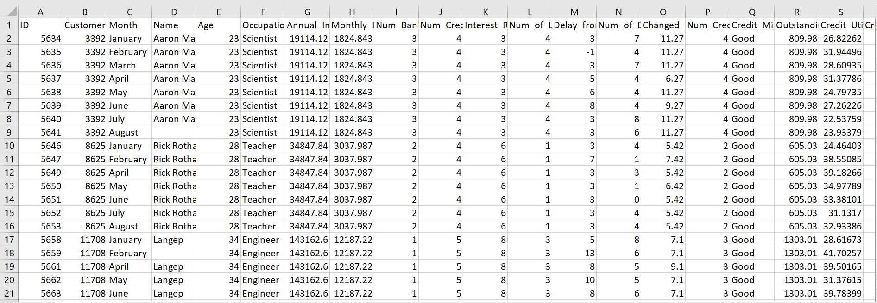
Data preprocessing
Prior to analysis, the dataset underwent thorough cleaning and preprocessing to handle missing values, outliers, and ensure consistency. This ensures the integrity and reliability of our credit scoring model.
Subsequently, we filled the missing values in the column with the calculated mode using data[‘ColumnName’].fillna(data[' ColumnName'].mode()[0])
This step ensured that our dataset was complete and ready for analysis.

Slide 7
Exploratory Data Analysis (EDA) Libraries
Data Exploration with Pandas
Visual Insights with Matplotlib
Enhanced Visualizations with Seaborn
Interactive Exploration using Plotly Express
Uncovering Key Insights through Visualization
Together, these libraries enable our exploratory data analysis, giving us important insights into the factors affecting credit score.

Slide 8
Data Visualization
Displaying Important Variables:
We've made use of data visualization to help us understand our dataset better. Ten important factors have been carefully chosen by us such as Annual Income, Num_Credit_Card, Interest Rate and so on.
Distribution Insights:
We have revealed the distribution of these variables using a grid of twenty visualizations. Bar charts provide information on the frequency of categorical variables, and histograms have been used to display the distributions of numerical qualities.

Slide 9
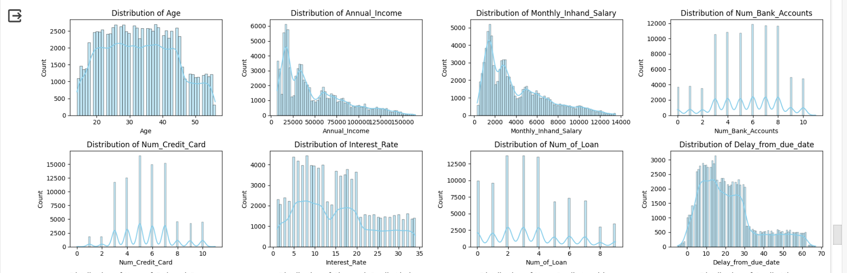
Visualization of Variable Distributions in Dataset

Slide 10
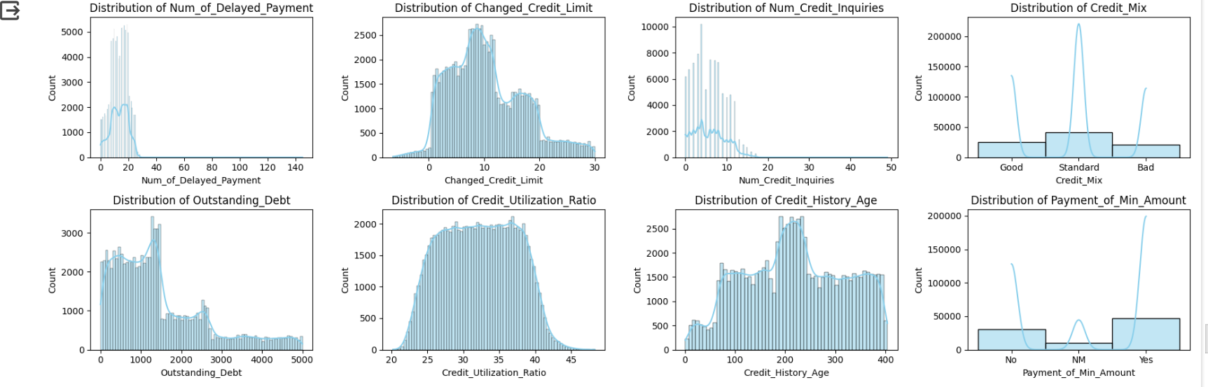

Slide 11
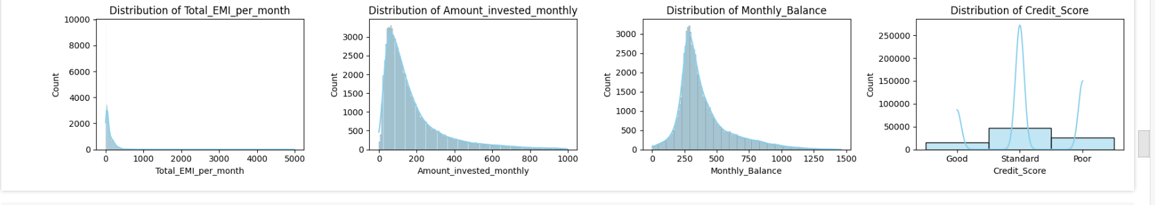

Slide 12
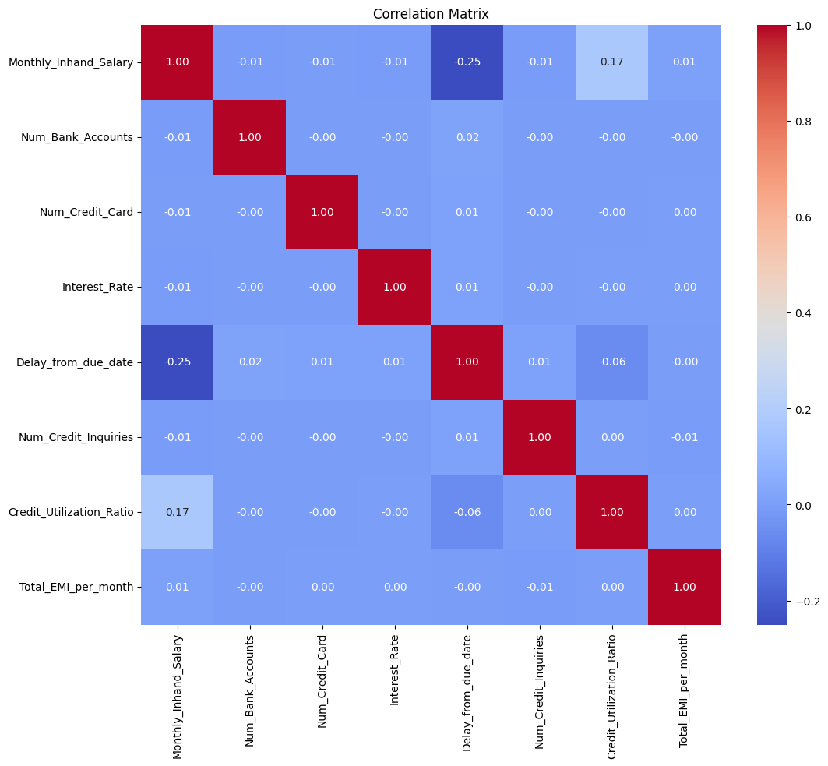
Correlation Analysis
Correlation Matrix: We've conducted a correlation analysis to understand the relationships between variables in our dataset. To make these relationships visually clear, we've employed Seaborn to create a heatmap. This analysis helps us uncover which variables are strongly related and which ones have little to no influence on each other. By understanding the correlations, we can better grasp the factors influencing credit scores and make data-driven decisions in our analysis.

Slide 13
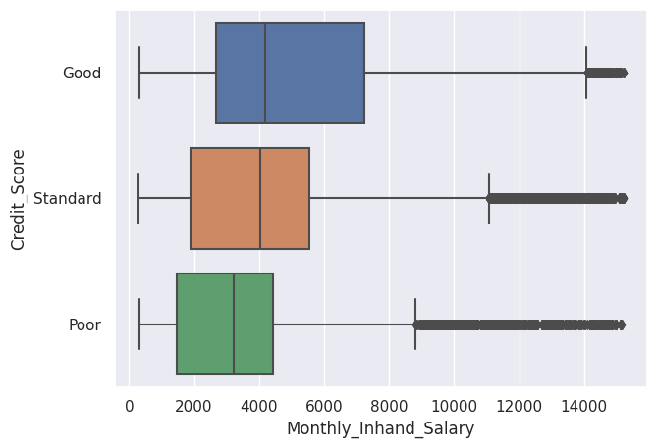
Average monthly salary for each type of credit score
This analysis helps us understand how the monthly in hand salary impacts the credit scores. By comparing credit scores across different monthly income, we gain valuable insights into one of the key factors influencing credit scores.

Slide 14
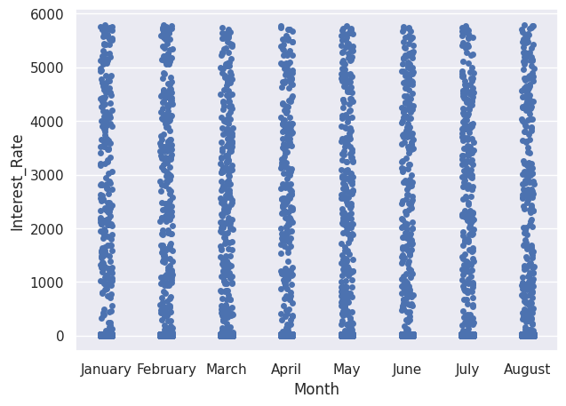
Interest Rate vs Month analysis
This interactive plot provides an engaging way to investigate how interest rates varies across months.

Slide 15
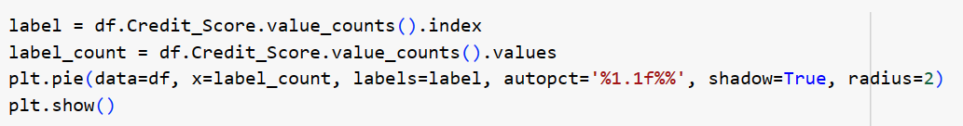
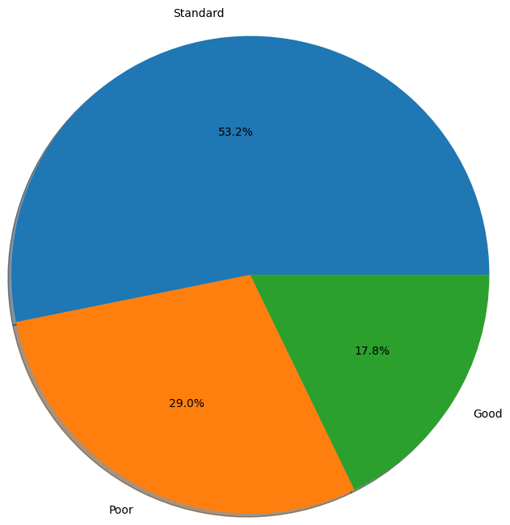
Percentage Distribution of Credit Score
We've created a pie chart representing distribution of values in the "Credit_Score" column with each slice representing the percentage of each unique value in the column.

Slide 16
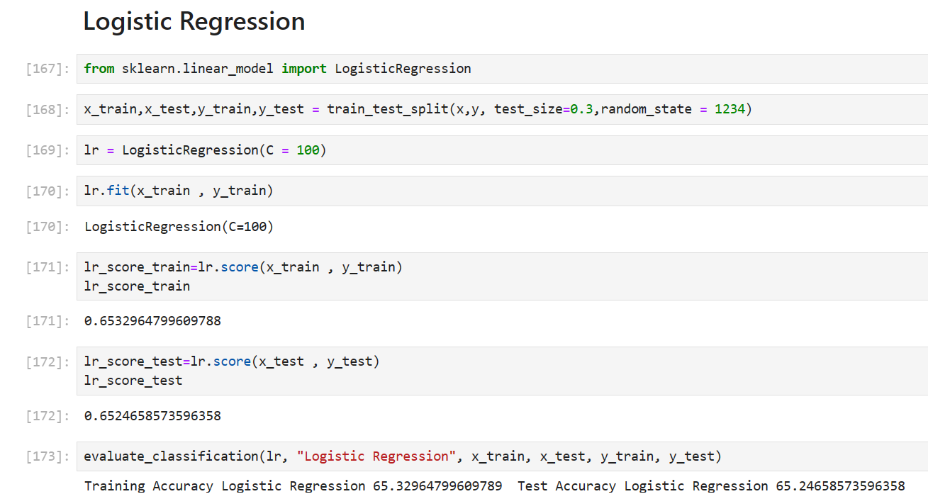
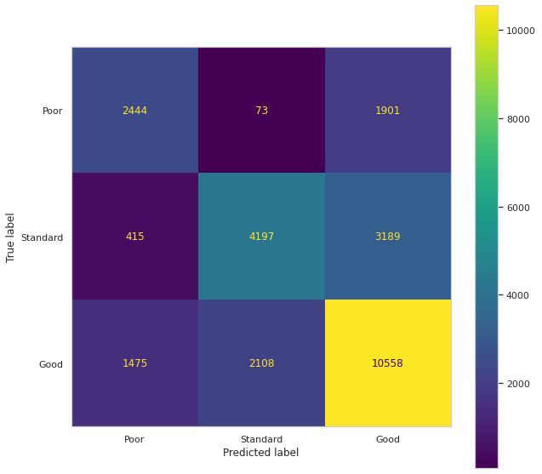
Logistic Regression
This model is utilized in the process of classification as well as predictive analytics.

Slide 17
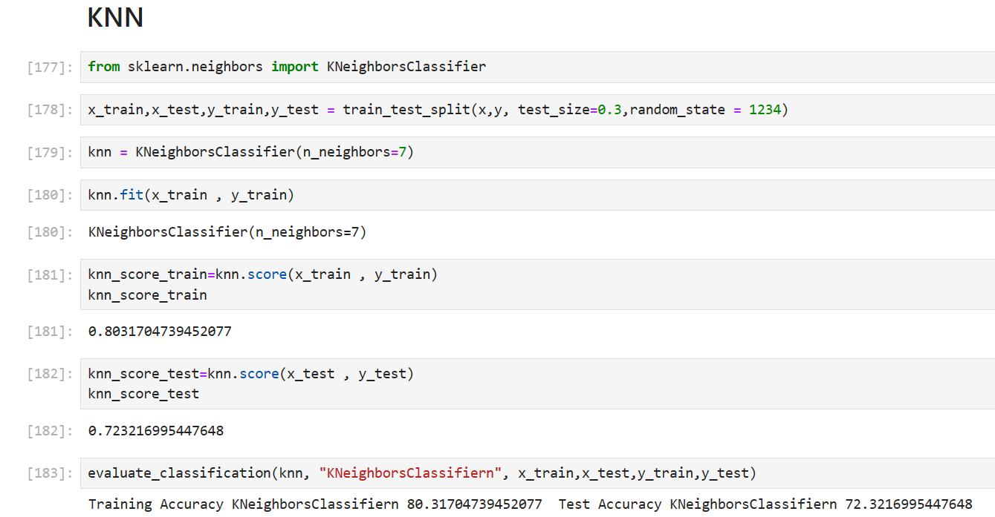
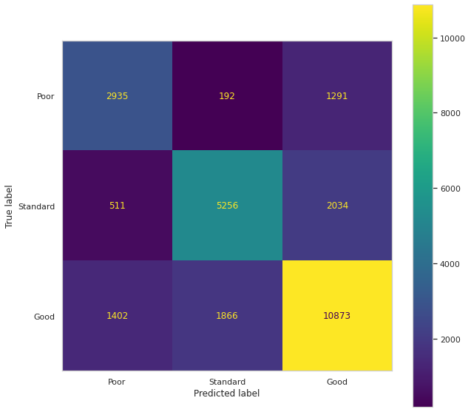
KNN
Both classification and regression issues can be resolved using the KNN technique. Here, the approach can be applied even when the variables are categorical, although it also is advisable to normalize any numerical variables to get rid of scale inconsistencies.

Slide 18
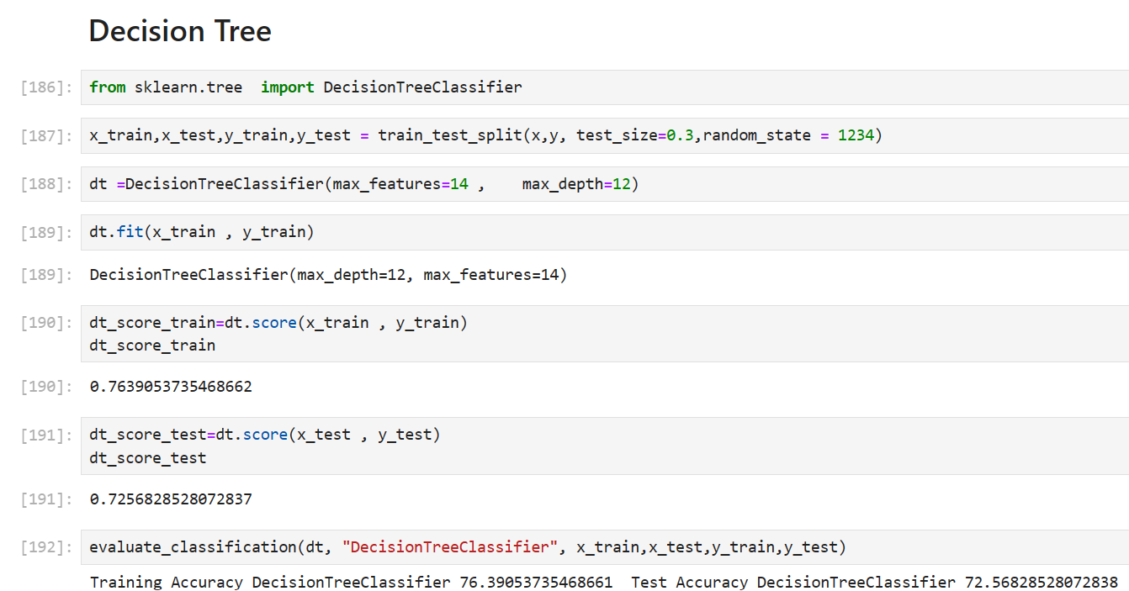
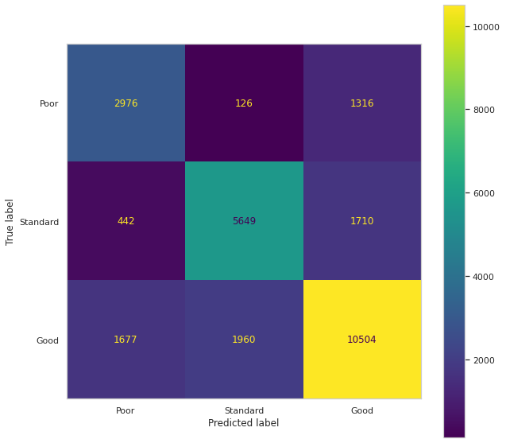
Decision Tree
This model is the most successful supervised learning strategies. A decision tree is a prediction model that links an observation of an item with branch representation to an assessment of a target value with leaf representation.

Slide 19
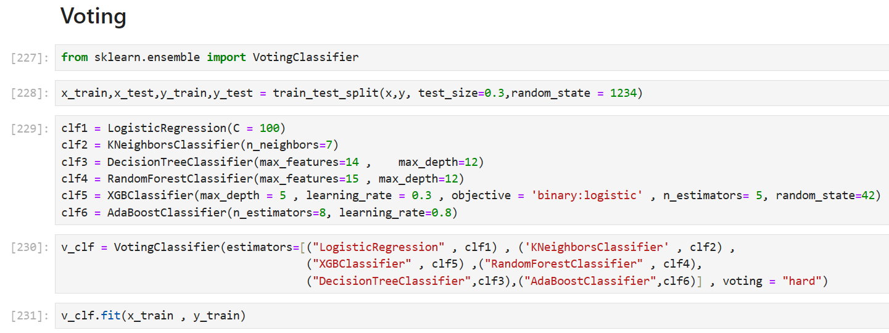
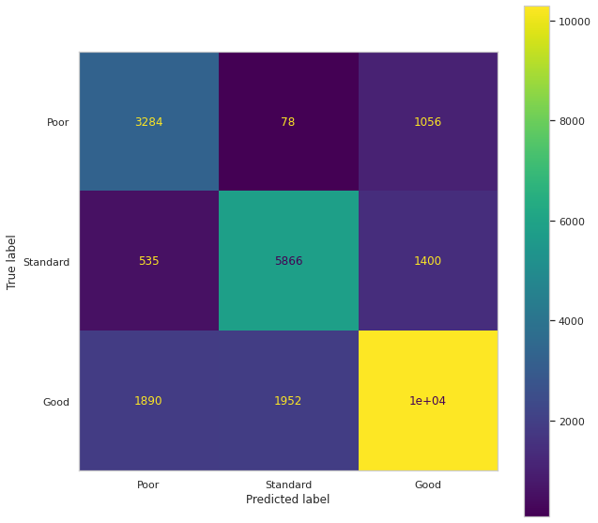
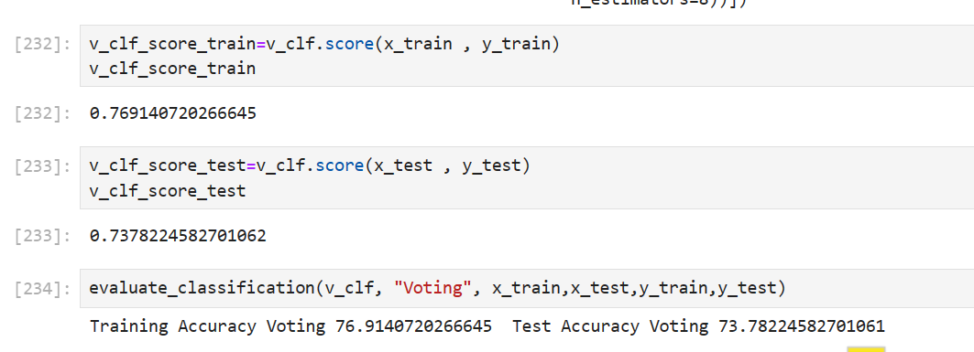
Voting
A voting method is an ensemble learning method that combines several base models to produce final optimum solution.

Slide 20
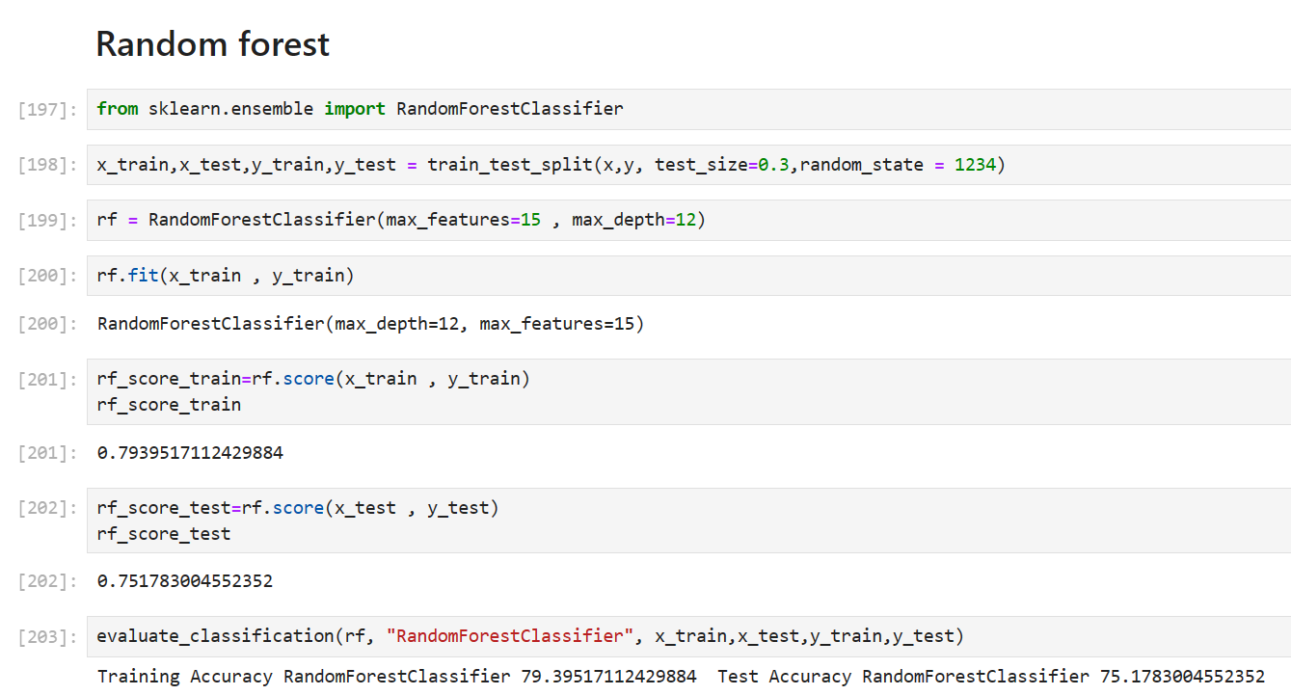
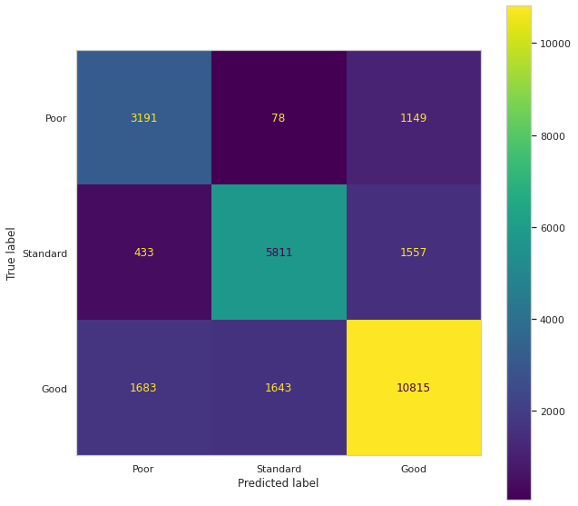
Random Forest
The Random Forest Classification algorithm gathers decision trees using random selections of data and selects the classification based on the classification with the most votes.

Slide 21
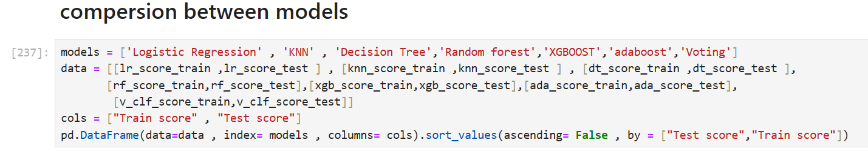
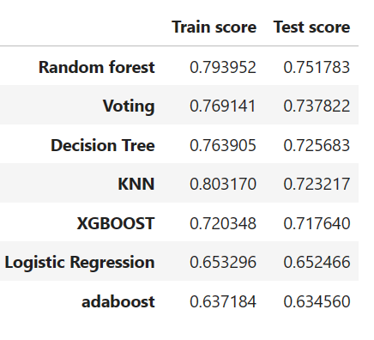
Comparision
Random Forest and KNN have the highest training scores (0.793952 and 0.803170 respectively), indicating good performance in learning from the training data.
Among the models listed, Random Forest and KNN performs relatively better than the others in terms of both training and test scores.

Slide 22
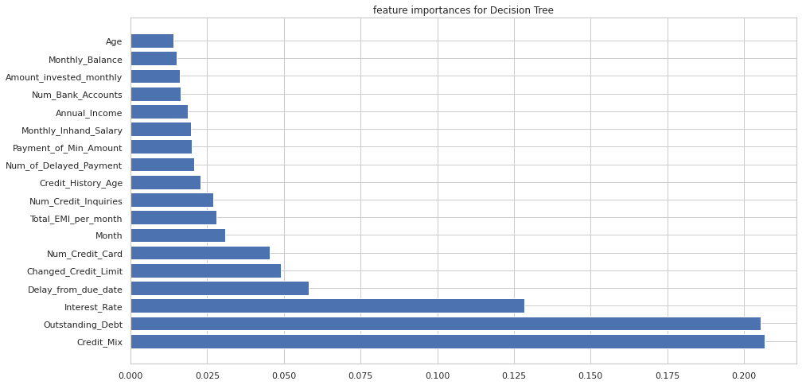
Important features determined by Random Forest

Slide 23
Conclusion
Key Findings
Higher annual income and monthly in-hand salary are generally associated with better credit scores.
A lower credit utilization ratio is typically associated with higher credit scores, as it indicates responsible use of credit.
A longer credit history with a record of timely payments is generally seen as positive by lenders.
Consistently making on-time payments and avoiding delayed payments can positively impact credit scores.
Having a moderate number of credit accounts in good standing can be seen as a positive indicator of creditworthiness.
A high number of delayed payments or frequent credit inquiries can be viewed negatively by lenders and may lower a person's credit score.
High levels of debt relative to income or large monthly payments can indicate financial strain and may lower a person's credit score.
Random Forest and KNN have the highest training scores (0.793952 and 0.803170 respectively), indicating good performance in learning from the training data.

Slide 24
Thank You

