Slide 1
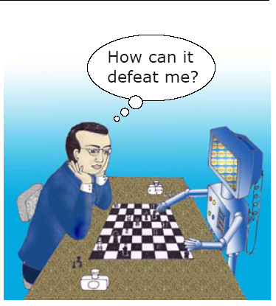
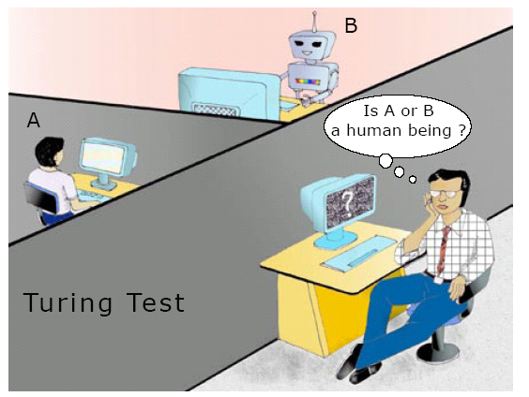
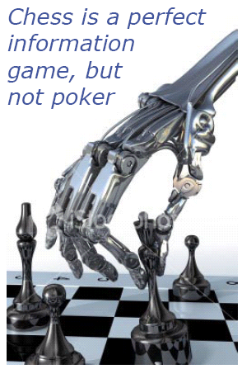
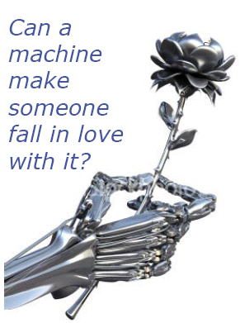
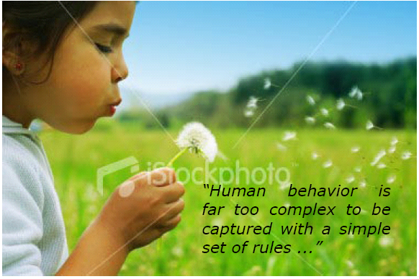
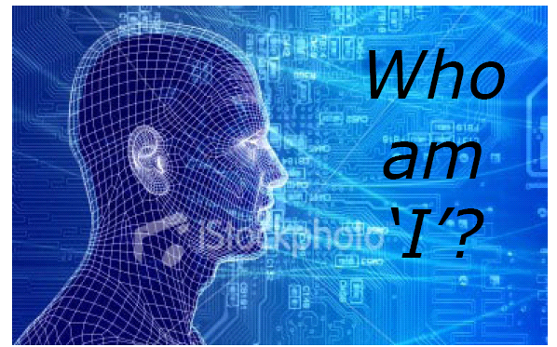
MAN AND MACHINE
Abhisek Tiwari¹, SUSHANTA SHARMA², Arun Uday³, Ajit K. Mall⁴ and K. Vaudeva Rao⁵
¹Bhaktivedanta Institute, USA
²Senior Software Engineer, TCS, Mumbai
³Senior Manager, HSBC Private Equity, Mumbai
⁴Senior Engineer, Analog Devices, Bangalore
⁵Bhaktivedanta Institute, Kolkata
SS-2022:001
This is a sample poster – for better visibility, use the same fonts sizes used in the poster and do not change the page set up: 35” x 43”. Please download the guidelines from the download menu on the conference website.
ABSTRACT
INTRODUCTION
MACHINES ACTING HUMANLY
Computers can beat world chess players, control satellites and spaceships thousands of miles from earth. Human beings on the other hand are gifted with creativity, that makes them remarkably distinct and superior to even super-fast computers.
The paper addresses logical scientific arguments that describe the behaviour of artificial intelligence (AI) to think, act, understand and behave as conscious entities. All these arguments subsequently indicate the lack of concrete decision making ability for machines.
The paper also provides insights from Vedanta to outline remarkable distinctions between conscious and mechanistic intelligence.
1996: Gary Kasparov defeated Deep Blue, IBM’s Chess Computer
1997: IBM’s Chess Computer defeats Gary Kasparov.
Kasparov suggested that humans may have helped the machine during the match.
The algorithm was modified in between games to understand Kasparov’s playing style and avoid a trap that the AI had fallen before.
Mechanistic processing through AI though fast, does not constitute thinking or intelligence.
AI machines would fail to generate correct emotional responses when interrogated by well-trained judge.
No computer so far has passed the Turing test.
SAMPLE
MACHINES THINKING HUMANLY
CAN MACHINES BE CONSCIOUS ?
WORD GAME: According to AI, using certain set of rules, the words “CARPET” and “MEAT” are regarded equal, and the words “LAP” and “LEAP” are regarded to be unequal. However, none of these pairs have any equality nor inequality relationship as understood by the machine.
AI performance is good with information game (such as Chess). However, a game such as Pocker, an imperfect information game that involves bluffing, cannot be well performed by AI when compared to humans.
Objections to possibility of intelligent machines:
Argument from Disability: Eg: Machines do have kindness, friendship etc.
Mathematical Objection (Goedel’s theorem): Machines cannot establish their truth of existence where as humans can.
Argument from Informality: Human behaviour cannot be captured into a simple set of rules.
Argument from Consciousness: Machines are unaware of their own mental states and actions.
Chinese Ball Room Argument: Just carrying out the steps of a computer program does not guarantee cognition.
CAN MACHINES BE CREATIVE ?
INSIGHTS FROM VEDANTA
Most AI models of creativity only explore spaces, not transform them, as they do not have self-reflexive maps enabling them to change their own rules.
Inducing creativity using heuristic strategies or through “creativity training” has very limited success.
AARON, is a 20 year long project by H. Cohen in machine creativity, producing original art work. Cohen conveys that AARON is not truly creative. He conveys that “Program can be written to act upon anything the programmer wants”, but that’s not the same as the individual human acting upon what he wants himself”
Consciousness uses brain as its computing instrument, just like we use paper or a calculator.
Human intelligence not produced from Mechanistic process. It is property of the conscious living force within the body, the spiritual particle, soul. Human beings have advanced intelligence than animals and all life forms are intelligent to various degrees.
CONCLUSIONS
A broad outline of AI is presented to defy the claim that one day machines will have characteristics like man.
There is a fundamental difference between man and machine and this gap can never be bridged.
Insights from Vedanta provide proper guidance and direction to humanity. Man can understand the purports of Vedanta where as Machines cannot.

