Slide 1
Implementation of Hines’ Neuronal Solver in MOOSE
Niraj Dudani
Rotation Presentation
Upi’s Lab
*best viewed in MS Windows

Slide 2
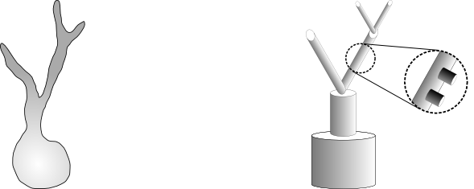
Compartmental Modeling Technique

Slide 3
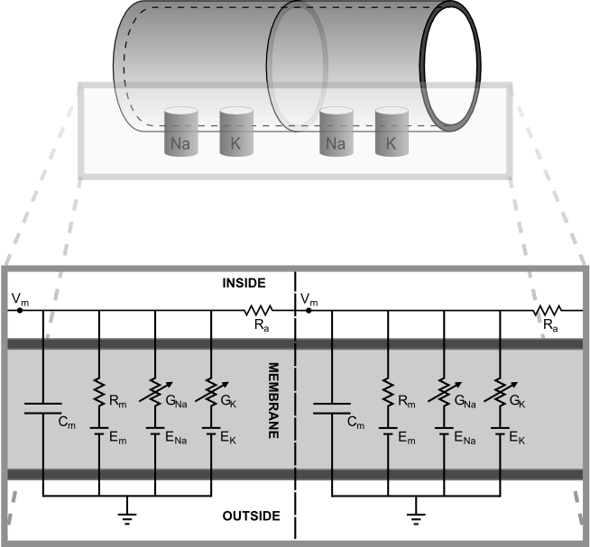
The Compartment: Equivalent Circuit

Slide 4
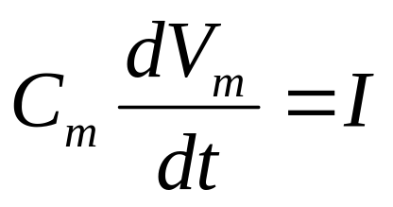
Evolution of Membrane Potential

Slide 5
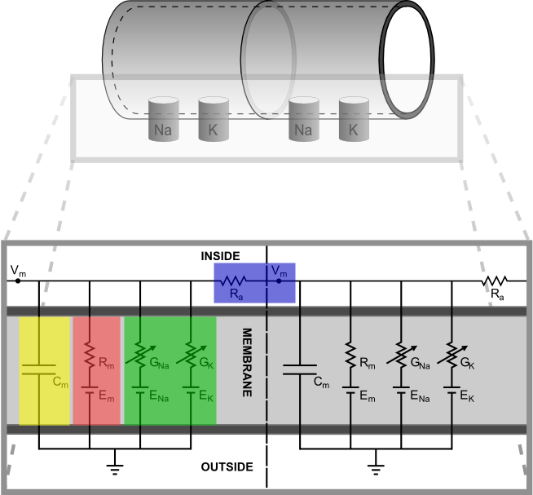
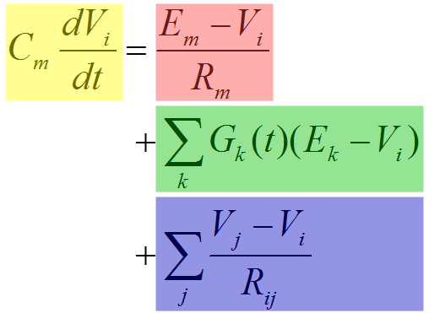
Current Sources and Sinks

Slide 6
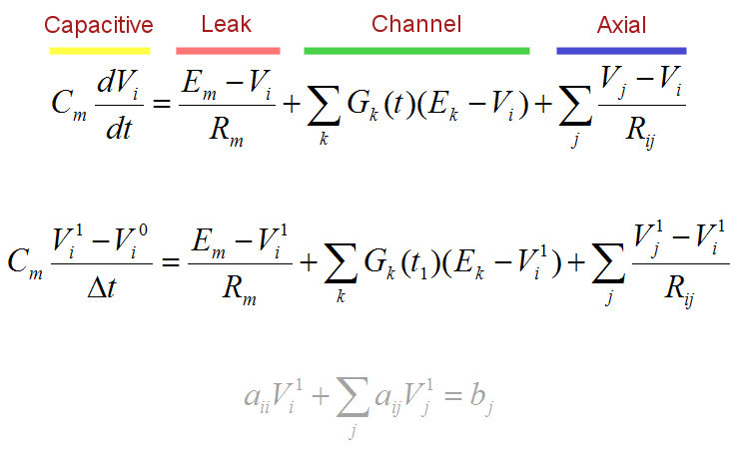
Compartmental Difference Equation

Slide 7
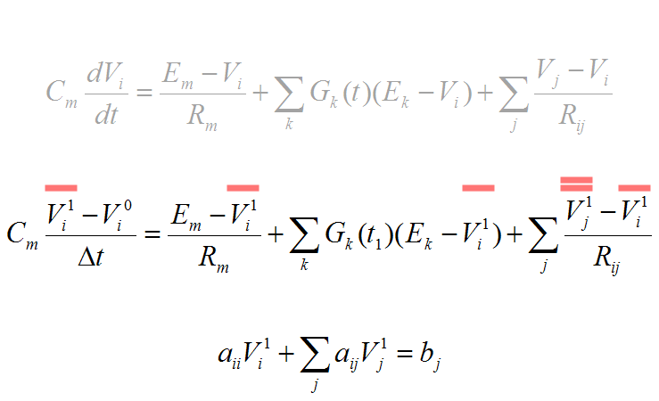
Compartmental Difference Equation

Slide 8
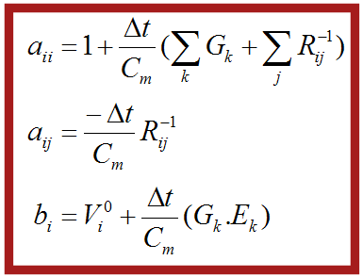
Compartmental Difference Equation

Slide 9

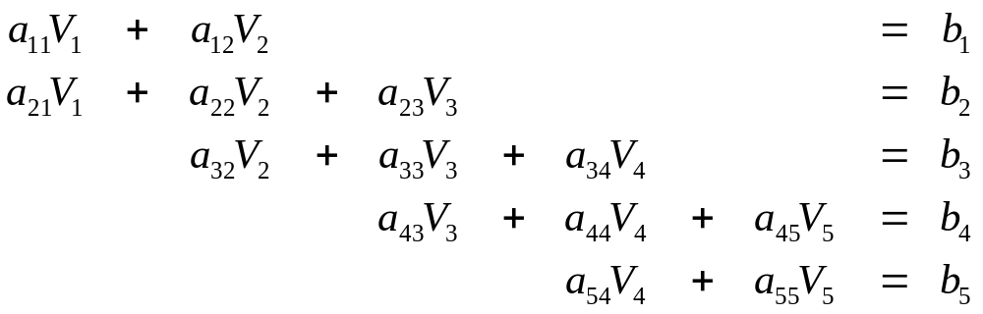
System of Linear Equations:
Unbranched Neurite

Slide 10
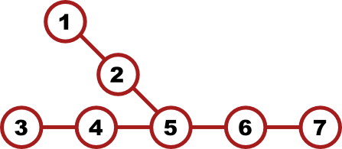
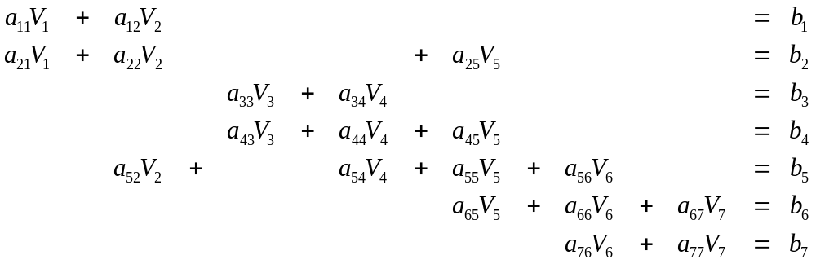
System of Linear Equations:
Branched Neurite

Slide 11
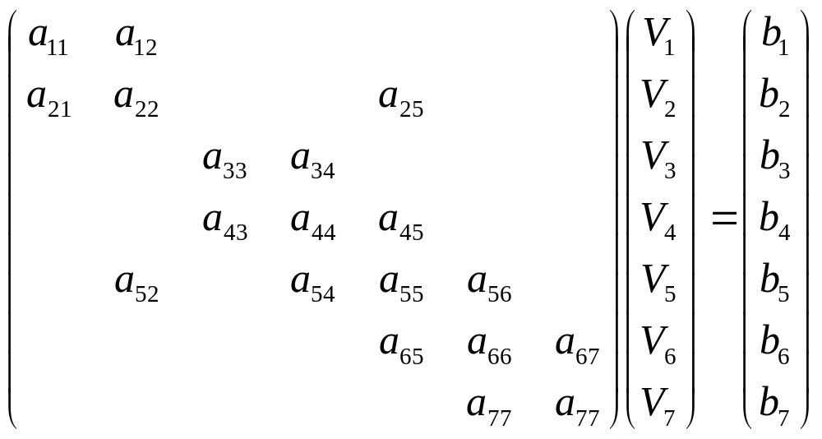
Linear System: Matrix Representation

Slide 12
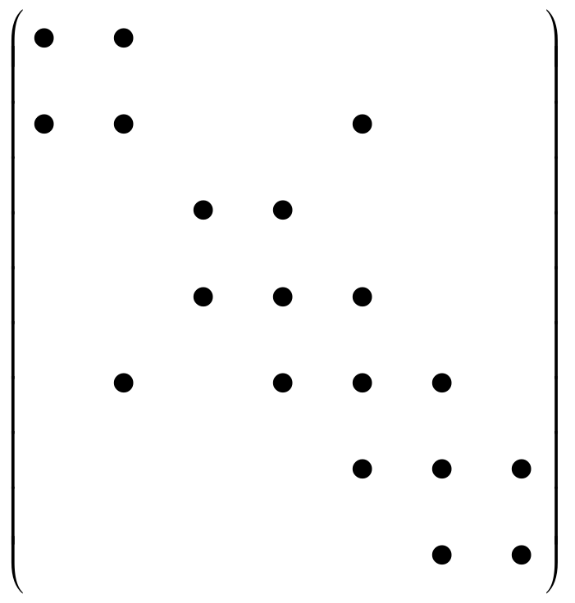

1D Representation: Saves Space
Matrix is 97% empty for a model with 100 compartments

Slide 13
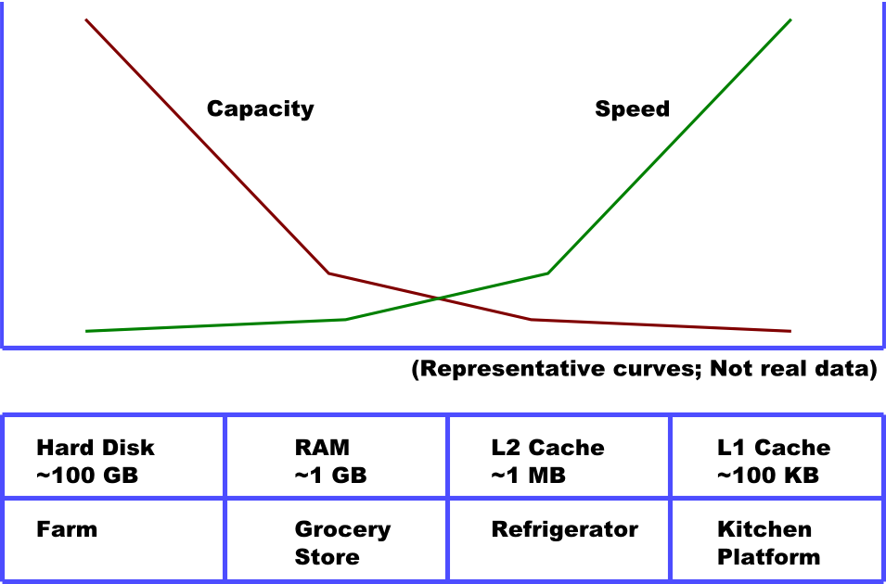
1D Representation: It’s Fast!
Cache Coherence

Slide 14
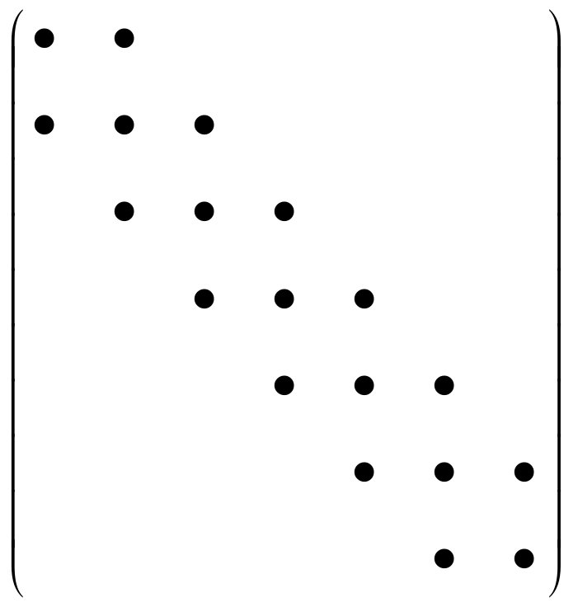
1D Representation: Storage Scheme
Convert to “Pseudo-tridiagonal” form.

Slide 15
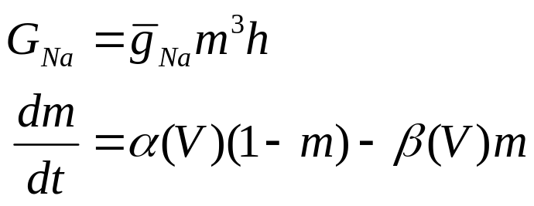
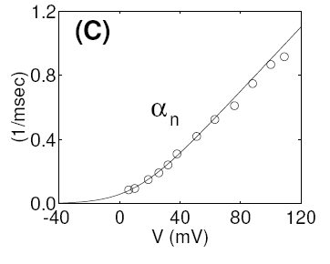
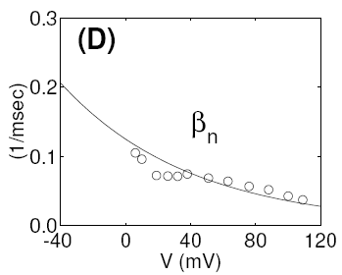
Channels: Hodgkin-Huxley Equations

Slide 16

Channels: Lookup Tables for Rate Constants
V_{m}(mV) | α_{m} | β_{m} | α_{h} | β_{h} | α_{n} | β_{n}
-100.00 | ● | ● | ● | ● | ● | ●
-60.00 | ● | ● | ● | ● | ● | ●
-59.95 | ● | ● | ● | ● | ● | ●
-59.90 | ● | ● | ● | ● | ● | ●
-59.85 | ● | ● | ● | ● | ● | ●
+50.00 | ● | ● | ● | ● | ● | ●

Slide 17
MOOSE – Multiscaling Object Oriented Simulation Environment
General purpose simulator for Neuroscience and Systems Biology
Successor to GENESIS
Supports plug-in solvers

Slide 18
Integration with MOOSE
moose #0 > create Compartment c1
moose #1 > create HHChannel c1/Na
moose #2 > addmsg c1/channel c1/Na/channel
moose #3 > copy c1 c2
moose #4 > addmsg c1/axial c2/raxial
moose #5 > setfield c1 inject 1e-9
moose #6 > reset
moose #7 > step 10 -t

Slide 19
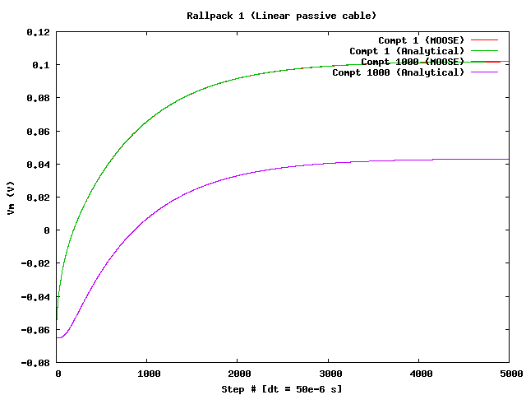
Results: Rallpack 1 Simulation

Slide 20
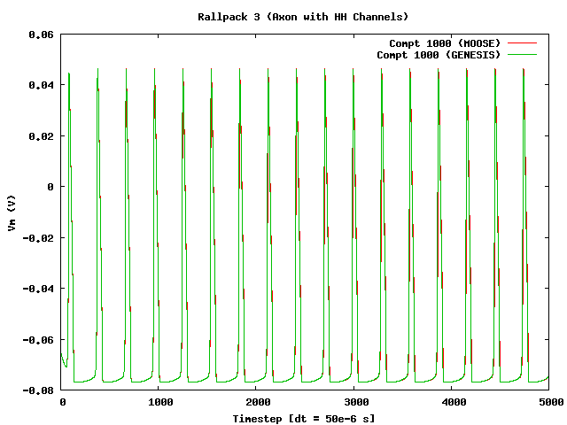
Results: Rallpack 3 Simulation

Slide 21
Results: Benchmarks
Preliminary benchmarks show speed comparable to GENESIS
Half as fast as GENESIS for active properties
Twice as fast as GENESIS for passive properties

Slide 22
Future Directions
Synaptic channels
Calcium dynamics
Speed-ups
Advanced solvers (with the help of CRL, Pune)

Slide 23
Thanks!
Upi
Subhasis
Raamesh
Ashesh, Dhanya, KP, Pragati, Harsha, Urvashi, Mehrab, Poorvi, Radhika, Rohini
Rinaldo
Sanjay Sane
Prof. P B Vidyasagar, Dr. Pratip Shil, Dr. Mihir Arjunwadkar

Slide 24
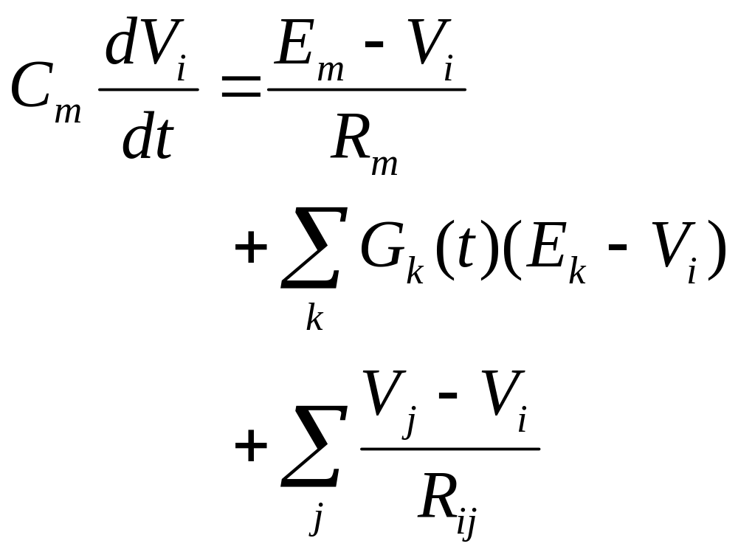
Editable Equations

Slide 25
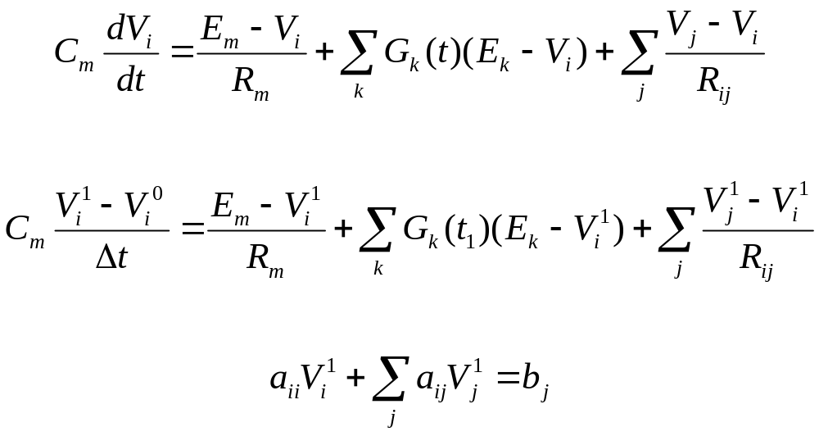
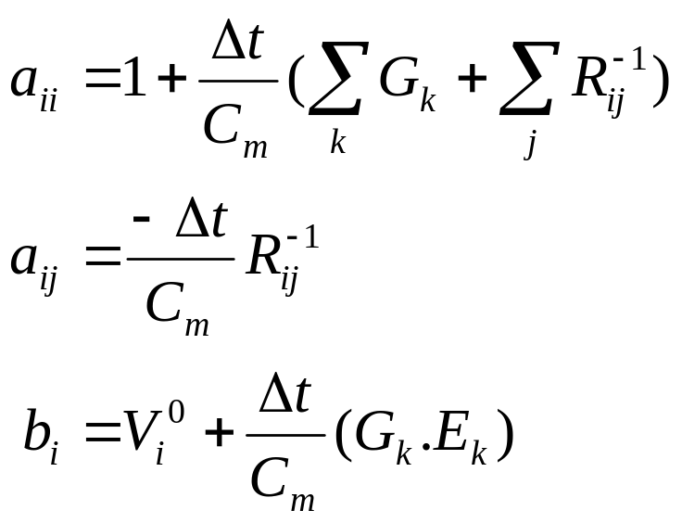
Editable Equations

