Slide 1
Applying Machine Learning to Reduce the Adaptation Space in Self-Adaptive Systems
- an exploratory work
Sarpreet Singh Buttar
Notes:
My thesis title is applying machine learning to reduce the adaptation space in self-adaptive systems. It is an exploratory work because machine learning has not been used before to reduce the adaptation space.

Slide 2
Background

Slide 3
What is self-adaptation?
Software system deal with various runtime uncertainties:
Dynamic conditions of the environment
Changing user goals
Self-adaptation enables the software system to autonomously deal with these uncertainties at runtime in order to achieve particular adaptation goals (list of requirements)
Various types of adaptation:
Architecture-based
Self-healing
Context-aware and mode-driven
Notes:
When a software system operates it has to deal with many runtime uncertainties which are often unpredictable and can lead to undesired behaviour in the software system. Self-Adaptation is a prominent approach that enables the software system to autonomously deal with the uncertainties at runtime in order to accomplish particular adaptation goals. There are various types of adaptations and we focused on architecture-based adaptation.

Slide 4
Architecture-based adaptation
Managed system contains the domain logic
Managing system contains the adaptation logic
Notes:
This adaptation decomposes the system in to a managed system that needs adaptation and contains the domain logic, and a managing system that holds the adaptation logic. These systems communicate with each other through sensors and actuators.

Slide 5
Architecture-based adaptation
Managing system uses MAPE-K (Monitor, Analyzer, Planner, Executor-Knowlege) feedback loop to achieve the adaptation goals of the managed system
Notes:
The managing system uses a MAPE-K feedback loop to achieve the adaptation goals of the managed system. The MAPE-K feedback loop consists of five components named as monitor, analyzer, planner, executor and knowledge.

Slide 6
Architecture-based adaptation
The monitor updates the managed system and environment models with collected data (current uncertain values of the managed system and its environment)
The analyzer creates adaptation options (a set of configurations), a.k.a. adaptation space
The planner makes an adaptation plan that consist of adaptation actions
Notes:
The monitor collects the runtime data from the managed system and its environment via sensors and updates the managed system and environment models with the collected data. Then the monitor triggers the analyzer that analyzes the updated models to determine whether an adaptation is needed. If needed, the analyzer creates the adaptation options and triggers the planner. The planner then reads the adaptation options and select the best adaptation option based on the adaptation goals. Then the planner makes an adaptation plan for the best adaptation option and triggers the executor. The executor then adapts the managed system by executing the adaptation plan via actuators. The knowledge is a repository shared by the monitor, analyzer, planner and executor to maintain their data.

Slide 7
Existing formal approaches (ActivFORMS, RQV)
The monitor, planner and executor works the same as before.
The model checker supports the analyzer by estimating the quality requirements (adaptation goals).
The model checker simulate each quality model with each adaptation option
A quality model represents the managed system and its environment for the quality requirement which is subject to adaptation.
Notes:
Existing formal approaches such as ActivFORMS and RQV provides guarantees to achieve the adaptation goals at runtime. In these approaches, the monitor, planner and executor works the same as before. However, these approaches connects the analyzer with a model checker that support the analyzer by estimating the quality requirements. It estimates the quality requirements by simulating each quality model with each adaptation option. A quality model represents the managed system and its environment for the quality requirement which is subject to adaptation.

Slide 8
Research Problem

Slide 9
Existing formal approaches use exhaustive verification
Model checking at runtime requires time and resources, e.g., CPU power and memory
Adaptation space may consist of hundred or even thousands of adaptation options
Overhead for some self-adaptive systems which needs fast adaptation
Not feasible with the large adaptation space
Notes:
Existing formal approaches use model checker to verify all the adaptation options that enable them to find the best adaptation option. However, model checking at runtime requires time and resources. The time and resources are directly dependent on the size of the adaptation space which may consist of hundred of even thousands of adaptation options. This can be overhead for some self-adaptive systems which need fast adaptation. Therefore, these approaches are not feasible with the large adaptation space. Hence, we aim to reduce the adaptation space to only the relevant adaptation options. This will enable the formal approaches to achieve the adaptation goals by only analyzing the relevant adaptation options.

Slide 10
Motivation
Notes:
Self-adaptive systems are successfully applied in the industry.

Slide 11
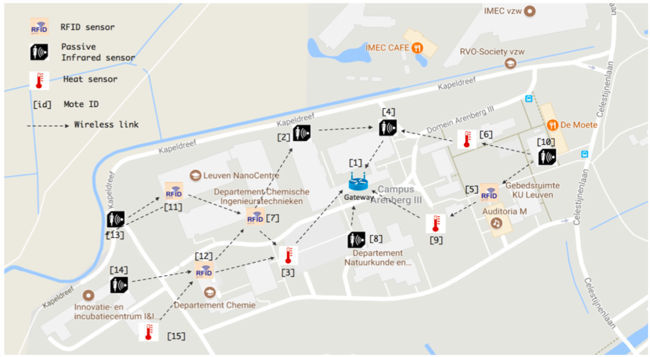
DeltaIoT: Internet Of Things (IoT) application
Various uncertain operating condition:
Dynamic traffic of the motes
Communication interference between the motes
Deployed at KU Leuven, Belgium
Two quality requirements (adaptation goals):
The average packet loss should be under 10%
The energy consumption of the IoT devices (motes) should be minimum
Notes:
DeltaIoT is an architecture-based self-adaptive IoT application that autonomously manages the settings of IoT motes under various uncertain operating conditions in order to maintain the quality requirements. It is constructed as a smart mesh network with 15 motes and deployed at computer science department of KU. These motes are connected via a wireless link and equipped with three different types of sensors: RFID provides access control to the labs, passive infrared monitors the occupancy status of the building, and heat sensors records the temperature. These sensors deliver their sensor data to the IoT gateway which is placed at the central monitoring facility DeltaIoT has two quality requirements:
1. The average packet loss should be under 10%. 2. The energy consumption of the motes should be minimum.
Achieving these quality requirements by hand tuning the settings is hard. On the other side, using formal approaches is time and resource consuming.

Slide 12
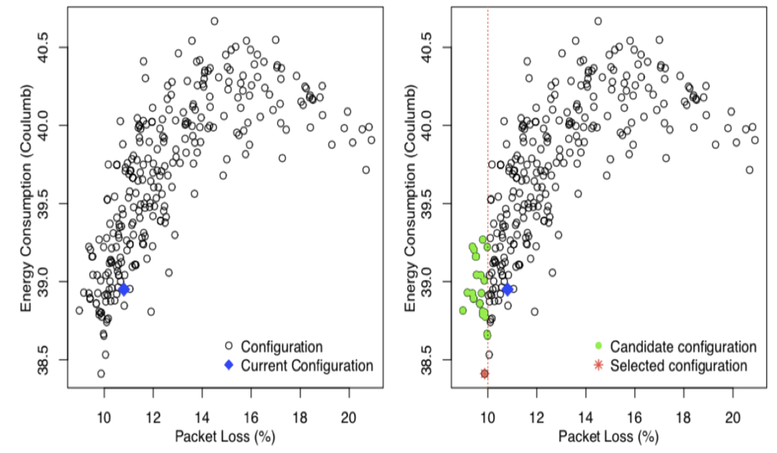
Selection of the best adaptation option with ActivFORMS
No need to analyze the complete adaptation space
Notes:
A recent research applied ActivFORMS on DeltaIoT to achieve its quality requirements. It shows that often there are few adaptation options which fulfill the quality requirements. The left hand side graph shows all the available adaptation options and their estimated quality requirements. The current adaptation option is represented with a blue dot. On the right hand side, the green dots represent those adaptation options which fulfil the packet loss quality requirement. The red dot represents the best adaptation option selected by the planner because it has minimum energy consumption compared to the others. It is clear from the figure that there is no need to verify the entire adaptation space. Rather, it is possible to achieve the quality requirements by only analyzing a subset of the relevant adaptation options. This will not only help to the achieve the quality requirements but also speed up the adaptation process.

Slide 13
Research Question

Slide 14
How to reduce the adaptation space in self-adaptive systems using machine learning?
Notes:
With this research question, we aim to reduce the adaptation space in a way that the quality requirements of self-adaptive systems are still achievable.

Slide 15
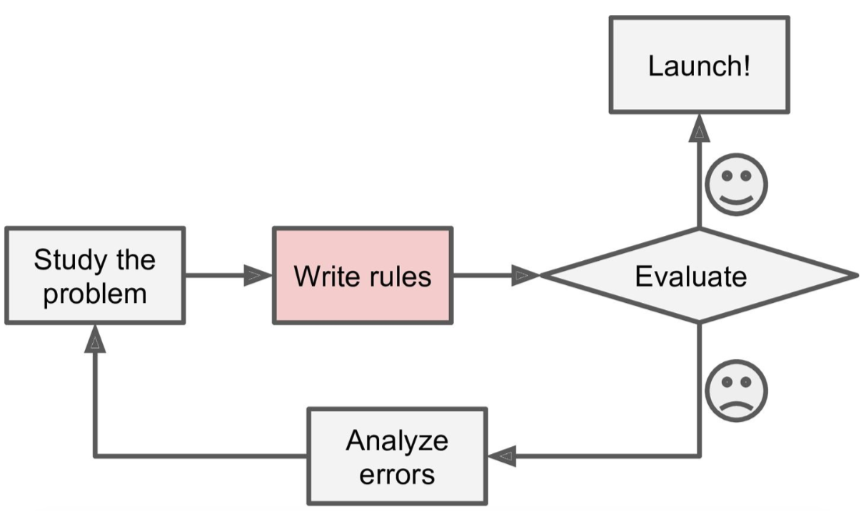
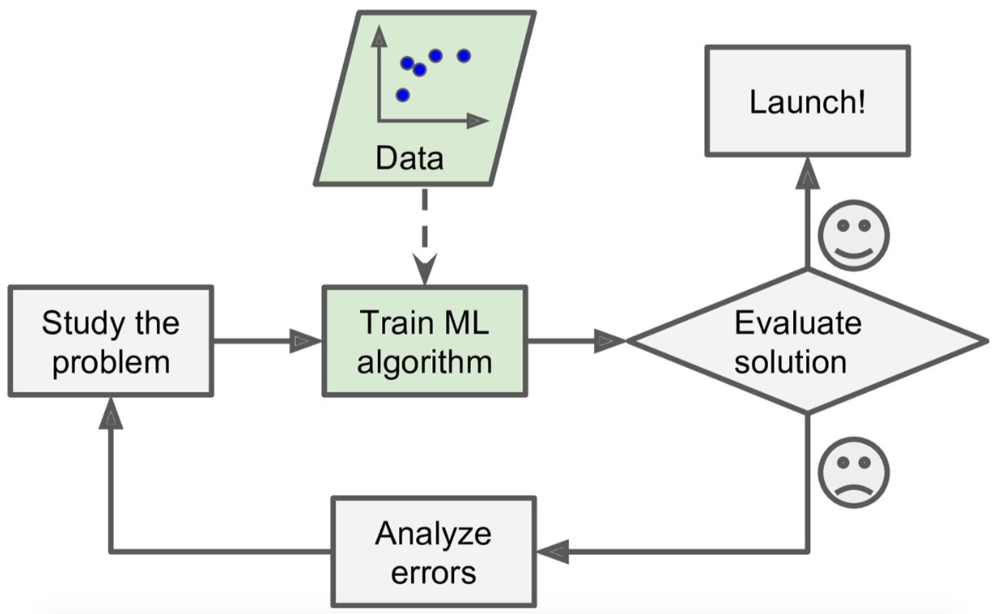
What is machine learning?
The traditional approach
Machine learning approach
Types of machine learning:
Supervised learning
Unsupervised learning
Semi-supervised learning
Reinforcement learning
Notes:
Machine learning is the science of programming computers so they can learn from data rather than hard coding rules. There are various types of machine learning and we focused on supervised learning in which the learning algorithm learns from the labelled examples under the human supervision.

Slide 16
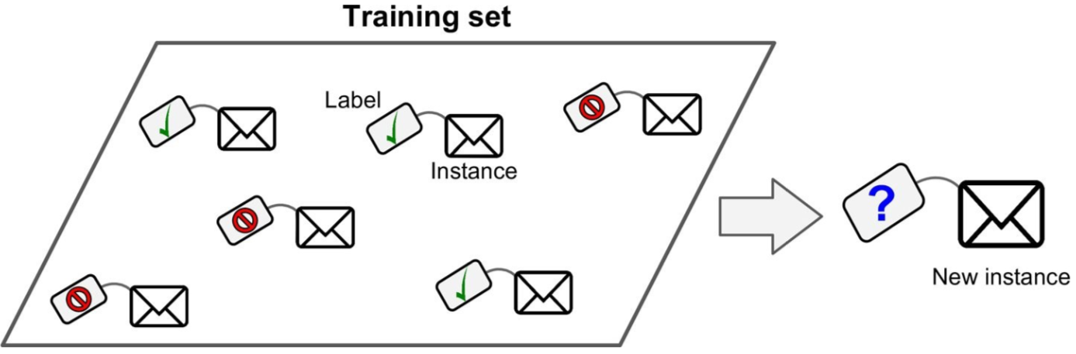
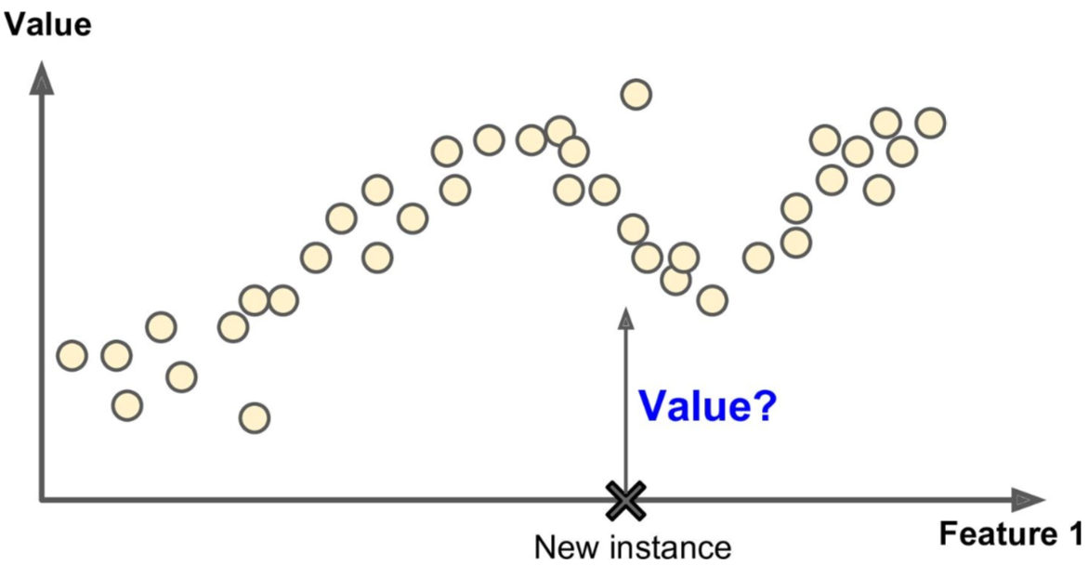
Classification & Regression approaches
Classification
Regression
Notes:
There are various approaches in supervised learning and we used classification and regression. In classification, the learning algorithm predicts the label of the new instance. In regression, the learning algorithm predicts the numeric value of the new instance.

Slide 17
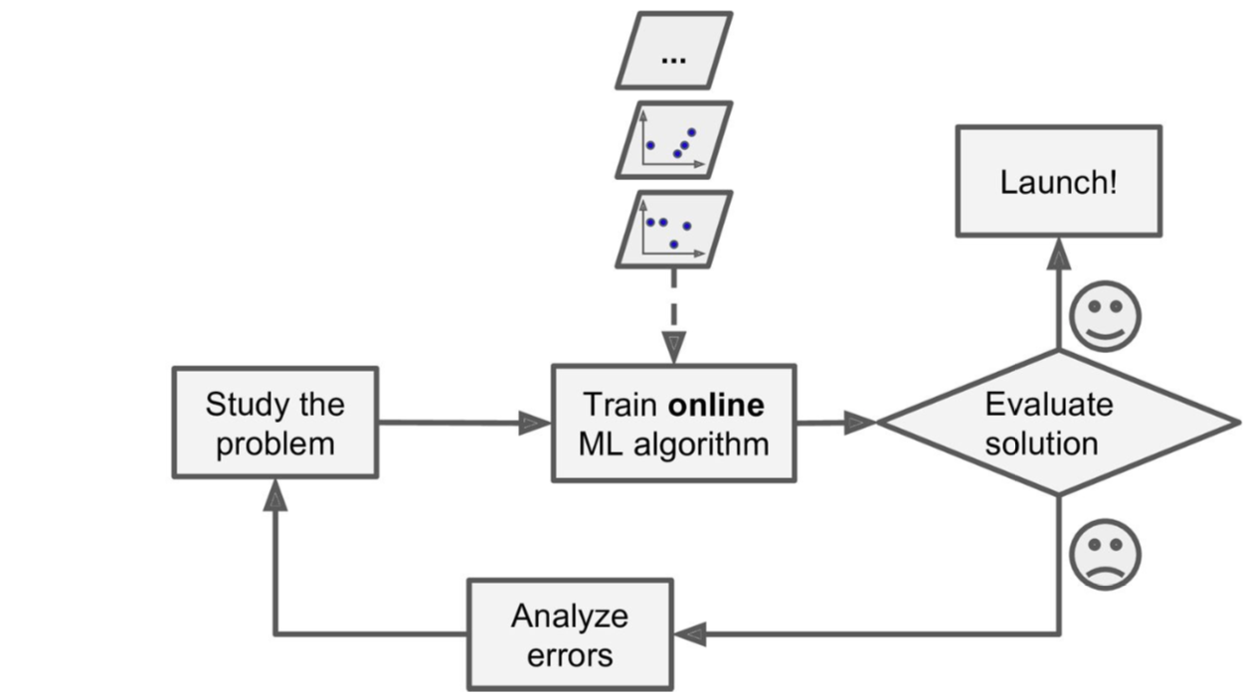
Online learning
New data (on the fly)
Notes:
Supervised learning can be done either offline or online and we focused on online learning because it enables the learning algorithm to continuously adapt itself according to the constant flow of data. The continuous adaptation helps the learning algorithm to learn in the uncertain environment.

Slide 18
Our Suggested Approach
Notes:
In this thesis, we present a general approach which uses machine learning to reduce the adaptation space in self-adaptive systems.

Slide 19
Architecture of our approach
The monitor, planner and executor works the same
The analyzer connect with the machine learner and model checker
The machine leaner selects the subset of the adaptation options which are valid in the current situation. It uses a learning algorithm which is placed in the knowledge
The model checker verifies the selected subset
Notes:
Our approach follows the principle of the architecture-based adaptation. We embed machine learning and model checker in the managing system so that they can integrate with the MAPE-K feedback loop. The monitor, planner and executor works the same as before. The analyzer connects with the machine learner and the model checker. The machine leaner supports the analyzer by selecting a subset of the adaptation options which are valid in the current situation. For selecting the subset, the machine learner uses a learning algorithm which is placed in the knowledge repository. The analyzer then uses the model checker to verify the selected subset. Our approach is not limited to any particular type of machine learning. Any type, e.g., supervised, unsupervised, reinforcement, etc., with online learning can be used. Similarly, our approach is not limited to a particular model checker. Any type of model checker, e.g., statistical or probabilistic, can be used. For evaluation, we applied our approach on DeltaIoT. We used online supervised learning with a statistical model checker that uses statistical techniques to estimate the quality requirements.

Slide 20
Method

Slide 21
Two controlled experiments on DeltaIoT
Independent variable:
Without machine learning:
ActivFORMS (existing formal approach)
With machine learning:
Classification
Regression
Dependent variables:
Adaptation space
Adaptation time
Packet loss
Energy consumption
Goal: Compare the values of the dependent variables
Independent variable:
Without machine learning:
ActivFORMS (existing formal approach)
With machine learning:
Classification
Regression
Dependent variables:
Adaptation space
Goal: Compare the selected adaptation options
Notes:
We performed two controlled experiments on DeltaIoT. In the first experiment, the independent variable is an approach (ActivFORMS, classification or regression). The dependent variables are the adaptation time, space, packet loss and energy consumption. The goal of this experiment is to compare the values of the dependent variables. In the second experiment, the independent variable is an approach. The dependent variable is the adaptation space. The goal of this experiment is to investigate whether the adaptation options selected by classification and regression are similar to ActivFORMS.

Slide 22
Results & Analysis

Slide 23
First experiment
On average
 | ActivFORMS | Classification | Regression
Packet Loss | 4.4 | 4.4 | 4.4
Energy Consumption | 12.6 | 12.6 | 12.6
Adaptation Space | 216 | 40 (81.2%) | 90 (58.3%)
Adaptation Time | 34.8 | 5.2 | 12.7
Notes:
All the approaches achieved the quality requirements, i.e., packet loss <10%, and minimum energy consumption. We can also see that ActivFORMS constantly explored all the available adaptation options, i.e., 216, to accomplish the quality requirements. However, classification only explored 40 adaptation options. Hence, reduced the adaptation space by 81.2% compared to ActivFORMS. Similarly, regression explored 90 adaptation options and reduced the adaptation space by 58.3%. The reduced adaptation space also helped classification and regression to decrease the adaptation time to 5.2 and 12.7 seconds respectively compared to ActivFORMS which took 34.8 seconds.

Slide 24
Second experiment
Notes:
It is clear from the above figure that classification mostly selected a lower number of adaptation options than ActivFORMS throughout all the adaptation cycles. In contrast, regression selected mostly a higher number of adaptation options. This can be seen in detail in below figure which shows that classification mostly selected a subset of the relevant adaptation options. Whereas, regression selected most of the relevant adaptation options as well as a number of irrelevant options. This shows that classification is more efficient than regression in terms of finding the most relevant adaptation option.

Slide 25
On average
 | Classification | Regression
Initial Training Time | 0.02 | 0.03
Prediction Time | 0.006 | 0.007
Training Time After Prediction | 0.008 | 0.010
Notes:
In our approach we use machine learning and this figures shows that it has almost no overhead on the adaptation time. We can see that the training time, prediction time and training time after the prediction is almost 0 seconds. This shows that the adaptation time is still dependent on the computational speed of the model checker.

Slide 26
Conclusion

Slide 27
An approach which integrates machine learning and model checker with MAPE-K feedback loop
Machine learning selects subset of the adaptation options
Model checker verifies the selected subset
Evaluated the approach on an IoT application
Our approach reduced the adaptation space and time and achieved the quality requirements
Our approach significantly reduced the adaptation time compared to a formal approach, i.e., ActivFORMS
Notes:
In this thesis, we present an approach which integrates machine learning and a model checker with the MAPE-K feedback loop. This integration enables machine learning to select a subset of the adaptation options which can be further verified by the model checker. We evaluate the approach on a self-adaptive IoT application, and compare the results with a formal approach called ActivFORMS. The results show that our approach successfully reduced the adaptation space as well as accomplished the quality requirements. In addition, the reduced adaptation space also significantly drops the adaptation time compared to ActivFORMS.

Slide 28
Thank You!

