Slide 1



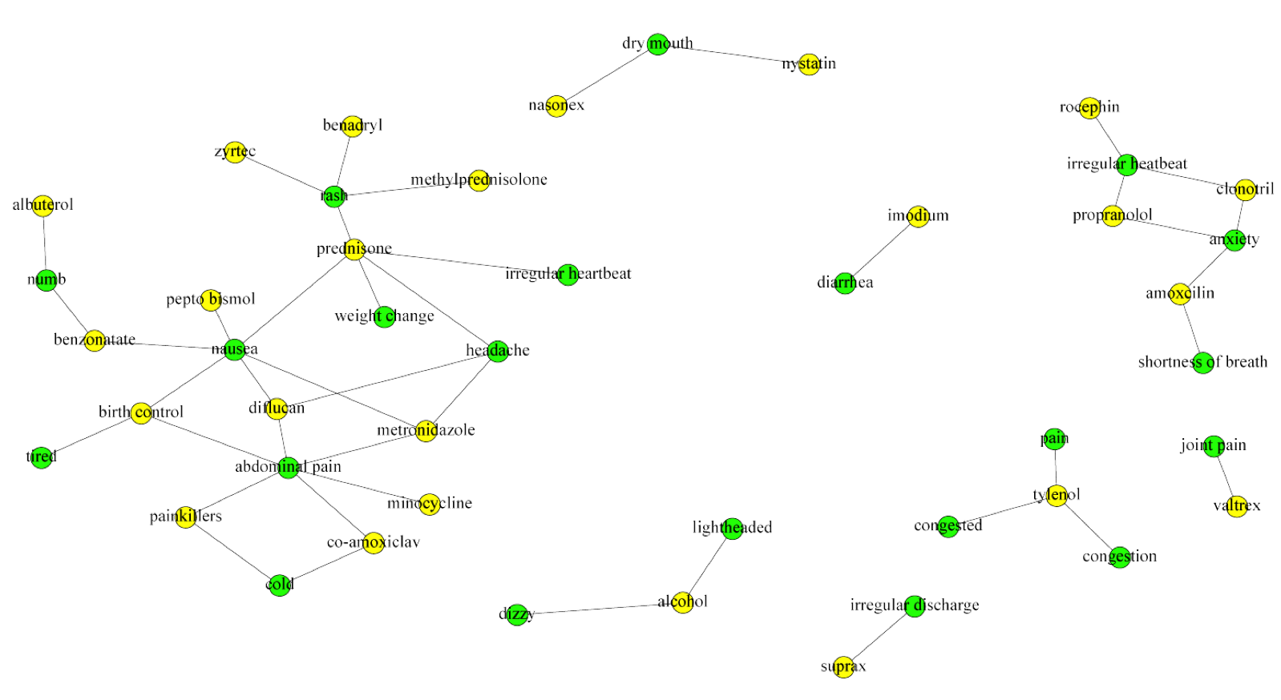

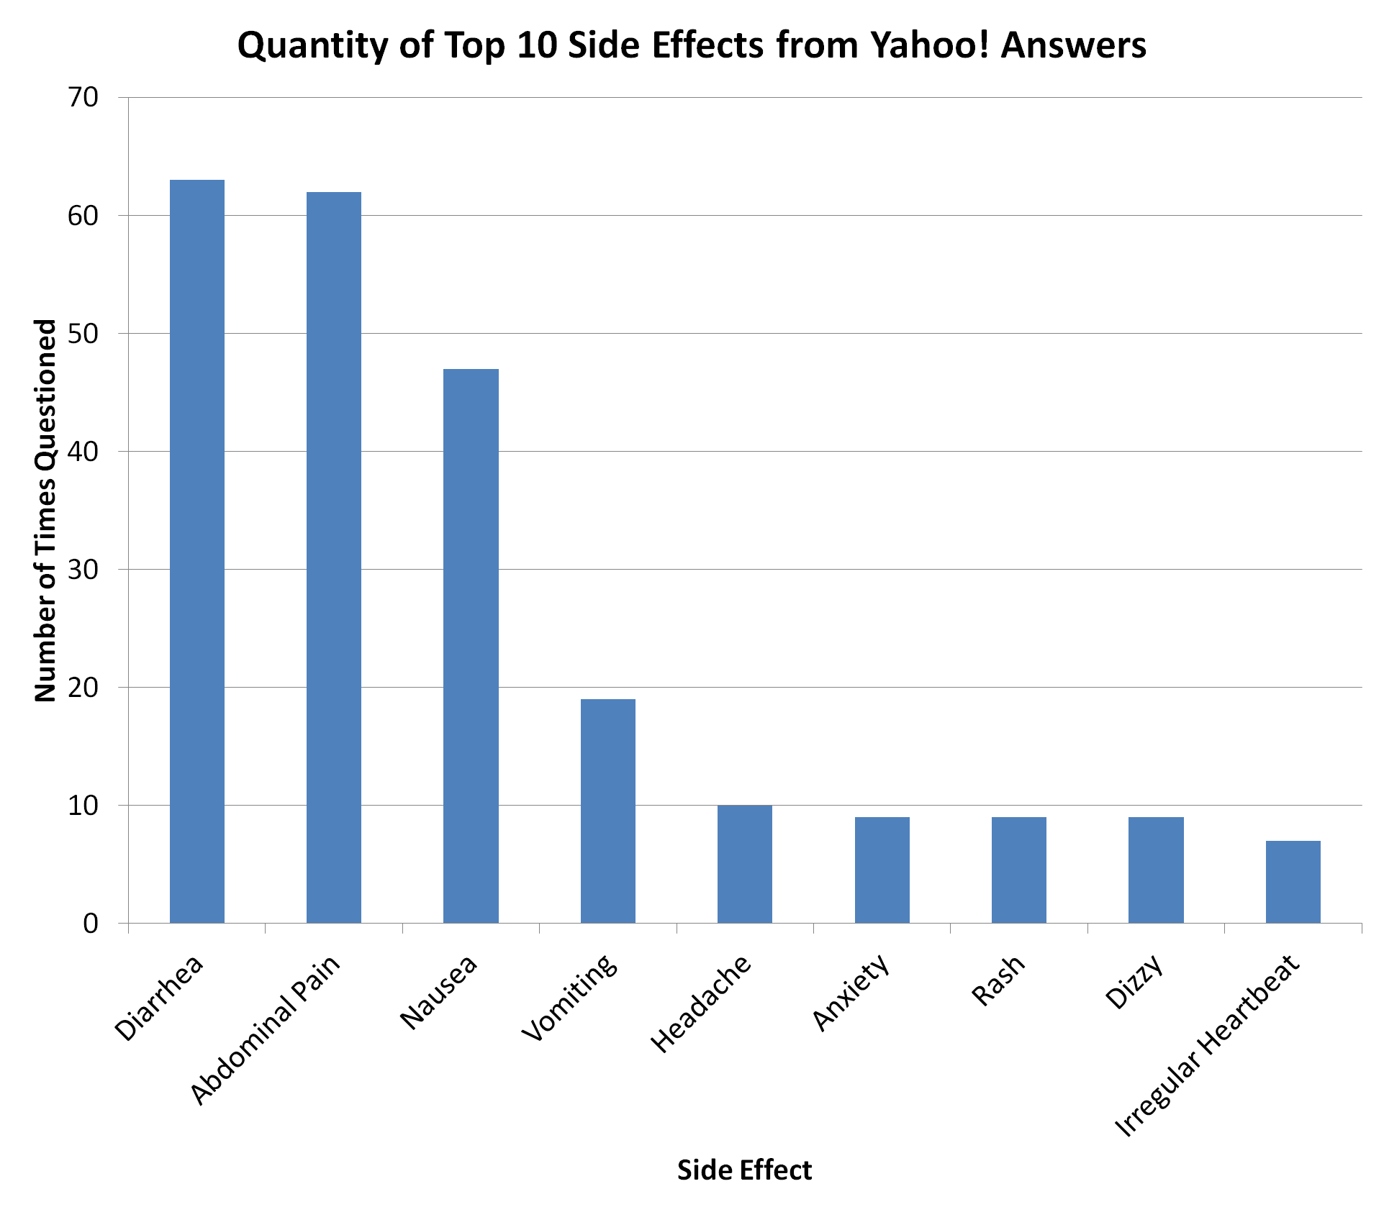
System Analysis of Yahoo! Answers Questions About Azithromycin’s Side Effects Gustavo Gryzinski¹, Yin Lu², Hong Huang³, Feng Cheng² ¹College of Art and Science, University of South Florida, Tampa, Florida, 33620 ²College of Pharmacy, University of South Florida, Tampa, Florida, 33612 ³School of Information, University of South Florida, Tampa, Florida, 33620
BACKGROUND
RESULTS
TABLES
Azithromycin is a common macrolide antibiotic drug that is used to treat a plethora of infections caused by bacteria. The main illnesses that it treats are ear infections, skin infections, respiratory infections, and sexually transmitted diseases – specifically chlamydia and gonorrhea. It has more recently been prescribed for acne as well. The mechanism by which this drug prevents bacteria from growing and spreading is by inhibiting the bacteria from synthesizing proteins, which are essential to its survival. What makes this drug particularly practical is the fact that it can individually target bacterial proteins, while leaving human proteins unaffected. One of the biggest concerns that surround any antibiotic is the potential side effects and different interactions that could occur. A popular forum that is used by people to ask about specific side effects and interactions, specifically drug-drug interactions (DDIs), of Azithromycin is Yahoo! Answers. The questions on this Questions&Answer forum can give an idea about the frequency of side effects and other specific interactions that are asked about. Further analysis of these questions can help in making connections between DDIs and side effects of Azithromycin.
Top 20 Side Effect Question Frequency | _{Top 20 DDI Question Frequency}
_{Diarrhea} | _{Alcohol}
_{Abdominal Pain} | _{Prednisone}
_{Nausea} | _{Birth Control}
_{Vomiting} | _{Tylenol}
_{Headache} | _{Amoxicillin}
_{Anxiety} | _{Imodium}
_{Rash} | _{Cannabis}
_{Dizzy} | _{Co-Amoxiclav}
_{Irregular Heartbeat} | _{Miralax}
_{Chest Pain} | _{Concerta}
_{Irregular Discharge} | _{Ritalin}
_{Swollen Glands} | _{Painkillers}
_{Itchy Skin} | _{Benzamycin}
_{Cold Symptoms} | _{Dramamine}
_{Sore Throat} | _{Sudafed}
_{Fatigue} | _{Zyrtec}
_{Lighheaded} | _{Benadryl}
_{Numb} | _{Ciproflaxcin}
_{Hearing Loss} | _{Suprax}
_{Shortness of Breath} | _{Benzonatate}
Figure 2: Bar Graph created from the amounts of questions asked about the top ten side effects of Azithromycin on Yahoo! Answers.
Table 1: Top 20 side effects and drug-drug interactions shown in the questions questions that were related to “Azithromycin side effect.” from Yahoo answers.
CONCLUSIONS
The most common side effects that were questioned about are diarrhea (63), abdominal pain (62), and nausea (47). There are many other side effects, but their frequencies are much lower – most of the other side effects were asked about between one to five times. There were many questions asked about DDIs, such as consuming alcohol or taking benadryl while also taking Azithromycin. The side effects that were linked to the most DDIs are abdominal pain, nausea, and rashes. Almost all of the side effects could be linked to DDIs. These findings could help people with decreasing the amount of side effects they experience due to DDIs.
Figure 1. The chemical structure of Azithromycin
OBJECTIVES AND METHODS
Objectives: Searching Yahoo! Answers for questions asked by people experiencing the undesirable side effects from taking Azithromycin yielded 471 results. Of these 471 questions, only 251 were actually related to Azithromycin’s side effects. The main purpose of this experiment was to analyze the frequency of different questions that are asked, as well as possibly draw connections between DDIs and certain side effects.
Methods: The Python Program was used to text mine through the Yahoo! Answers database for questions that were related to “Azithromycin side effect.” All of the side effects and interactions that were mentioned in those 251 selected queries were used as key terms to score each question with whichever side effect or other interaction that was asked about. For example, a person could ask a question about experiencing abdominal pains and mild anxiety, so that particular question would be labeled with “Abdominal pain, anxiety.” The top ten side effects were used to construct a bar graph of their respective quantities. Then all of the key terms were used to make a word cloud for the individual side effects due to Azithromycin. A web diagram was created in an attempt to connect the side effects of Azithromycin to some DDIs.
Figure 3: Word Cloud analysis of keywords of side effect symptoms shown in the questions that were related to “Azithromycin side effect” from Yahoo answers.
REFERENCES
Yahoo Answers! https://answers.yahoo.com/
Kucuktunc, Onur, et al. "A large-scale sentiment analysis for Yahoo! answers." Proceedings of the fifth ACM international conference on Web search and data mining. ACM, 2012.
Chen, Ye, et al. "Practical lessons of data mining at Yahoo!." Proceedings of the 18th ACM conference on Information and knowledge management. ACM, 2009.
Acknowledgements
Figure 4: Web diagram analysis of connections between side effects and DDIs from questions that were related to “Azithromycin side effect” from Yahoo answers.
This study were supported by the Startup Fund of the College of Pharmacy, University of South Florida, Tampa, Florida, USA.

