Slide 1

Towards a minimum information model for potential drug-drug interactions
Richard D. Boyce, PhD
University of Pittsburgh
12/12/2017

Slide 2
Disclosures
Neither myself or my spouse have any relevant financial relationships with commercial interests

Slide 3
Potential drug-drug interactions
Exposure two or more drugs that are known to interact
“potential” because exposure does not necessarily mean a clinically meaningful effect
Example: Fluconazole – simvastatin
Known pharmacokinetic interaction – inhibition of CYP3A4 metabolism
Might not be meaningful for the patient at low doses of fluconazole (≤ 200 mg/day)

Slide 4
Clues about the frequency of harm
Clinically important events attributable to drug-drug interactions [1]:
5.3% - 14.3% of inpatients
231,000 US emergency department visits
Hospital admissions associated with an adverse drug event attributable to drug-drug interactions [2]:
22.2% (interquartile range 16.6 - 36.0%)
Magro L, Moretti U, Leone R. Epidemiology and characteristics of adverse drug reactions caused by drug-drug interactions. Expert Opin Drug Saf. 2012;11(1):83-94. doi:10.1517/14740338.2012.631910
Dechanont S, Maphanta S, Butthum B, Kongkaew C. Hospital admissions/visits associated with drug-drug interactions: a systematic review and meta-analysis. Pharmacoepidemiol Drug Saf. 2014;23(5):489-497. doi:10.1002/pds.3592.

Slide 5
“When the Holes Line Up”
A + B
Prescriber’s Knowledge
Computer Screening
Pharmacist’s Knowledge
Patient Risk Factors
Drug Administration
Patient Education
Monitoring
Defenses
ADR
Latent Failures
Hansten PD, Horn JR. Modified from: James Reason, Human Error, 1990

Slide 6
PDDI knowledge and information sources
Prescriber knowledge is lacking^{1,2}
42.7% of drug pairs correctly identified¹
Information sources used by prescribers for PDDIs³
Pharmacists - 68.4%
Alerts - 10.8%
Other sources - 5.1%
Ko et al. Drug Saf. 2008;31(6):525-536.
Glassman. Med Care. 2002;40(12):1161-1171
Ko et al. Res Social Adm Pharm. 2008;4(4):355-366
Notes:
ePocrates Rx Formulary, Lexi-Drugs Platinum, mobileMICROMEDEX, and Tarascon ePharmacopoeia

Slide 7
Issues with using computers to screen for PDDIs
Drug interaction alerts have the potential to provide useful clinical decision support
Unfortunately, poor specificity overwhelms clinicians with information that is difficult to use for clinical decision making
Böttiger Y, Laine K, Andersson ML, et al. SFINX-a drug-drug interaction database designed for clinical decision support systems. Eur J Clin Pharmacol. 2009;65(6):627-633. doi:10.1007/s00228-008-0612-5.

Slide 8
We have to avoid over-alerting!
Systems that provide PDDI alerts at the point of care often alert to PDDIs that have little potential clinical significance
frustrating clinicians
“Drug safety alerts are overridden by clinicians in 49% to 96% of cases” [1]
can lead to inappropriate responses
“An increased number of non-critical alerts…was the only variable associated with an inappropriate provider response” [2]
Van der Sijs H, Aarts J, Vulto A, Berg M. Overriding of drug safety alerts in computerized physician order entry. J Am Med Inform Assoc. 2006;13(2):138–147.
Miller AM, Boro MS, Korman NE, Davoren JB. Provider and pharmacist responses to warfarin drug-drug interaction alerts: a study of healthcare downstream of CPOE alerts. J Am Med Inform Assoc. 2011;18 Suppl 1:i45–50. PMCID: PMC3241165.
Notes:
Be sure to review the references and give a specific example

Slide 9
Ongoing efforts to improve PDDI decision support
Dr. Daniel Malone (U of Arizona) has led two multi-stakeholder conference series focused on how to address PDDI alert specificity
Both funded by the United States Agency for Healthcare Research and Quality
Hines LE, Malone DC, Murphy JE. Recommendations for Generating, Evaluating, and Implementing Drug-Drug Interaction Evidence. Pharmacotherapy: The Journal of Human Pharmacology and Drug Therapy. 2012;32(4):304–313. doi:10.1002/j.1875-9114.2012.01024.x
Scheife RT, Hines LE, Boyce RD, et al. Consensus recommendations for systematic evaluation of drug-drug interaction evidence for clinical decision support. Drug Saf. 2015;38(2):197-206. doi:10.1007/s40264-014-0262-8.
Payne TH, Hines LE, Chan RC, et al. Recommendations to improve the usability of drug-drug interaction clinical decision support alerts. J Am Med Inform Assoc. 2015;22(6):1243-1250. doi:10.1093/jamia/ocv011.
Tilson H, Hines LE, McEvoy G, Weinstein DM, Hansten PD, Matuszewski K, le Comte M, Higby-Baker S, Hanlon JT, Pezzullo L, Vieson K, Helwig AL, Huang SM, Perre A, Bates DW, Poikonen J, Wittie MA, Grizzle AJ, Brown M, Malone DC. Recommendations for selecting drug-drug interactions for clinical decision support. Am J Health Syst Pharm. 2016 Apr 15;73(8):576-85. doi: 10.2146/ajhp150565. PubMed PMID: 27045070; PubMed Central PMCID: PMC5064943.

Slide 10
Three outcomes of the conference series
Develop guidelines for systematic appraisal of PDDI evidence
Scheife RT, Hines LE, Boyce RD, et al. Consensus recommendations for systematic evaluation of drug-drug interaction evidence for clinical decision support. Drug Saf. 2015;38(2):197-206. doi:10.1007/s40264-014-0262-8
Notes:
This conference series is supported in part by grant #1R13HS021826-01 from the US HHS Agency for Healthcare Research and Quality (AHRQ). AHRQ’s goals are to promote effective, appropriate, high quality health care; increase access to care; and improve the way health services are organized, delivered, and financed. We also wish to thank the following companies for their generous support and commitment to the aims of this project. Cerner Epocrates First Databank Truven Health Analytics Wolters Kluwer

Slide 11
Three outcomes of the conference series cont.
Identify a process for determining the most relevant PDDIs & approaches to reduce alert fatigue
Tilson H, Hines LE, McEvoy G, Weinstein DM, Hansten PD, Matuszewski K, le Comte M, Higby-Baker S, Hanlon JT, Pezzullo L, Vieson K, Helwig AL, Huang SM, Perre A, Bates DW, Poikonen J, Wittie MA, Grizzle AJ, Brown M, Malone DC. Recommendations for selecting drug-drug interactions for clinical decision support. Am J Health Syst Pharm. 2016 Apr 15;73(8):576-85. doi: 10.2146/ajhp150565. PubMed PMID: 27045070; PubMed Central PMCID: PMC5064943.
Notes:
This conference series is supported in part by grant #1R13HS021826-01 from the US HHS Agency for Healthcare Research and Quality (AHRQ). AHRQ’s goals are to promote effective, appropriate, high quality health care; increase access to care; and improve the way health services are organized, delivered, and financed. We also wish to thank the following companies for their generous support and commitment to the aims of this project. Cerner Epocrates First Databank Truven Health Analytics Wolters Kluwer

Slide 12
Three outcomes of the conference series cont.
Establish preferred strategies for presenting PDDI alerts
Payne TH, Hines LE, Chan RC, et al. Recommendations to improve the usability of drug-drug interaction clinical decision support alerts. J Am Med Inform Assoc. 2015;22(6):1243-1250. doi:10.1093/jamia/ocv011.
Notes:
This conference series is supported in part by grant #1R13HS021826-01 from the US HHS Agency for Healthcare Research and Quality (AHRQ). AHRQ’s goals are to promote effective, appropriate, high quality health care; increase access to care; and improve the way health services are organized, delivered, and financed. We also wish to thank the following companies for their generous support and commitment to the aims of this project. Cerner Epocrates First Databank Truven Health Analytics Wolters Kluwer

Slide 13
What information should be present in a PDDI alert?
drugs involved,
seriousness,
clinical consequences,
mechanism of the interaction,
contextual information/modifying factors,
recommended action(s), and
evidence
Payne TH, Hines LE, Chan RC, Hartman S, Kapusnik-Uner J, Russ AL, Chaffee BW, Hartman C, Tamis V, Galbreth B, Glassman PA, Phansalkar S, van der Sijs H, Gephart SM, Mann G, Strasberg HR, Grizzle AJ, Brown M, Kuperman GJ, Steiner C, Sullins A, Ryan H, Wittie MA, Malone DC. Recommendations to improve the usability of drug-drug interaction clinical decision support alerts. J Am Med Inform Assoc. 2015 Nov;22(6):1243-50. doi: 10.1093/jamia/ocv011. Epub 2015 Mar 30. Review. PubMed PMID: 25829460.

Slide 14
Example – warfarin (oral anticoagulant) – diclofenac (NSAID) (cont)
Well known interaction and very common alert in some settings
Contextual factors
Specific formulation of the NSAID
Age
Prior history of bleed
risk conferring or mitigating concomitant medications

Slide 15
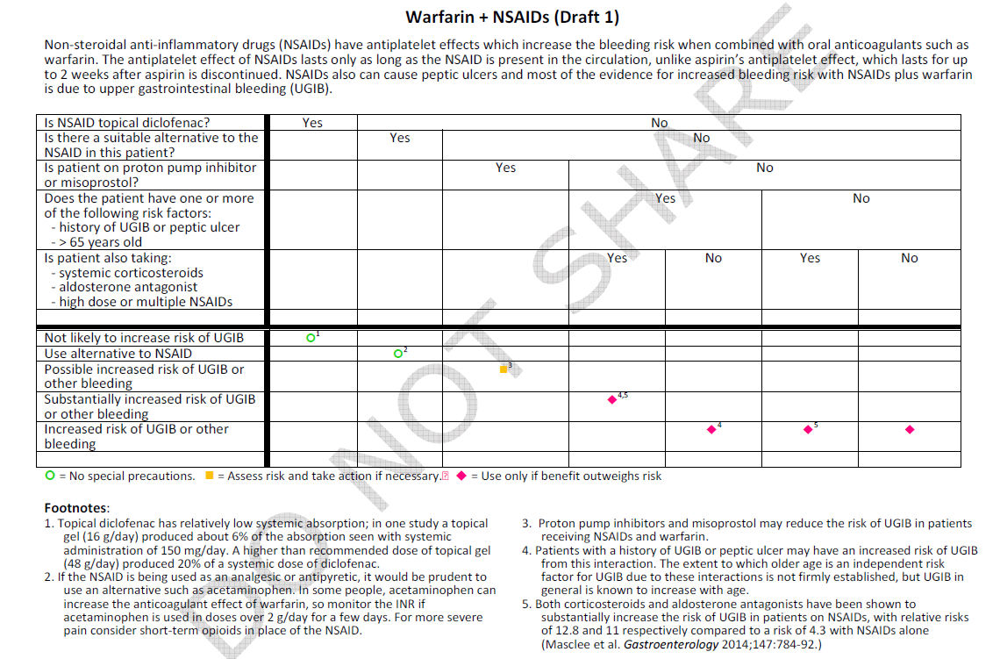

Slide 16
Where does the information come from?
Pre-market studies
Post-market studies
Clinical experience
Rarely reported in
Reported in
Rarely reported in
Reported in
Scientific literature
Rarely reported in
Product labeling
Source for
Source for
Drug Compendia synthesize PDDI evidence into knowledge but
May fail to include important PDDIs
Often disagree about PDDI evidence and seriousness ranking
May include numerous PDDIs with little evidence for liability reasons

Slide 17
PDDI Minimum Information Task Force
Formed to create a clinical decision support standard based on these recommendations
Home page: https://goo.gl/MDq2Ye

Slide 18
Objective and deliverables
Objective: Develop a minimal information model for drug interaction evidence and knowledge as part of an HIT standard like HL7
Deliverables: using an interesting and non-trivial set of potential drug-drug interactions:
Data Model: A data model (schema) for potential drug interaction knowledge and evidence
Vocabulary: A precise vocabulary describing/defining the data model
Serializations: one or more serialization formats of the abstract data model
Demonstration of how the minimum information model can support medication reconciliation

Slide 19
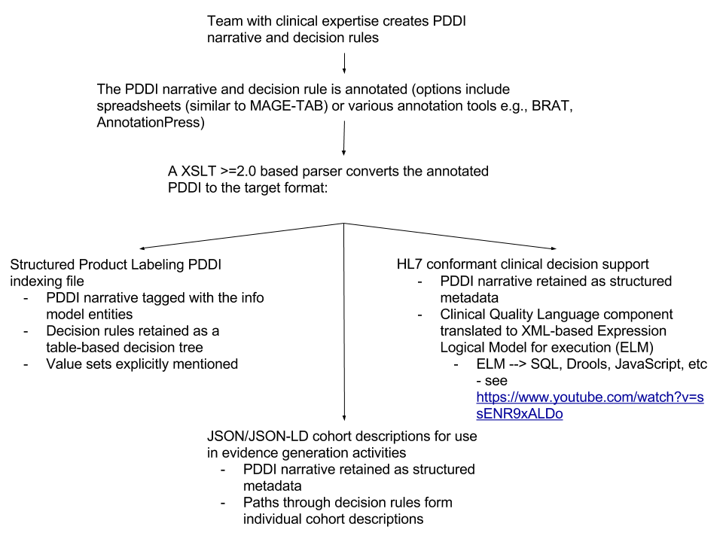
Envisioned potential PDDI CDS Minimum Information workflow

Slide 20
Meet the PDDI Minimum Information Task Force:
volunteer-based – ~40 folks have participated in calls and writing
WorldVista, W3C, AMIA Pharmacoinformatics, ISPE, and academics
broad stakeholder involvement
NLM, ASHP, industry, academic institutions
Open public participation
formed within the Health Care and Life Sciences Interest Group that operates publicly through the World Wide Web Consortium (W3C)

Slide 21
Progress of the task force so far…
Formal definitions for 10 minimum information items
https://github.com/MPIO-Developers/MPIO/raw/master/mpio.owl
Agreement on the scope of knowledge representation
i.e., relationship between core information items, value sets, and a CDS rule language
Draft W3C Interest Group Note with motivation, definitions, and specific use cases
https://goo.gl/nnMHyv

Slide 22
Progress so far…
Selected 11 PDDIs to focus on and developed rule-based decision trees for all of them
https://goo.gl/rYpmjt
Implemented as Drools rules running against a simulated patient population stored in the common data model used by the Observational Health Data and Informatics collaborative
https://github.com/dbmi-pitt/iDIA_Rules

Slide 23
Forthcoming
A simple parser to generate JSON and XML documents from PDDI information represented in the model
Initially using a spreadsheet as input for structured narrative
Translation of the clinical context for selected PDDIs to CQL using the NLM Value Set Authority and FHIR

Slide 24
Envisioned potential PDDI CDS Minimum Information workflow

Slide 25
Questions for this group
Overall suggestions and questions?
How can the PDDI Min Info task force harmonize its efforts with ongoing HL7 CDS activities?

Slide 26
Discussion

Slide 27
Learn more!
http://dikb.org
Contact me rdb20@pitt.edu

Slide 28
Acknowledgements - Funding
The American taxpayers via NLM R01LM011838

Slide 29
Discussion

