Slide 1
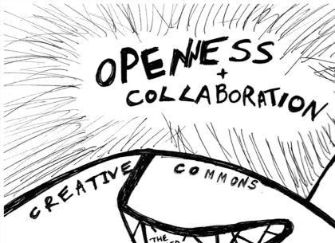
Wikimania
2009-08-28
OER Content Interoperability for WikiMedia platforms
Mike Linksvayer
Creative Commons
Detail of image by psd · Licensed under CC Attribution 2.0 · http://flickr.com/photos/psd/1805374441

Slide 2
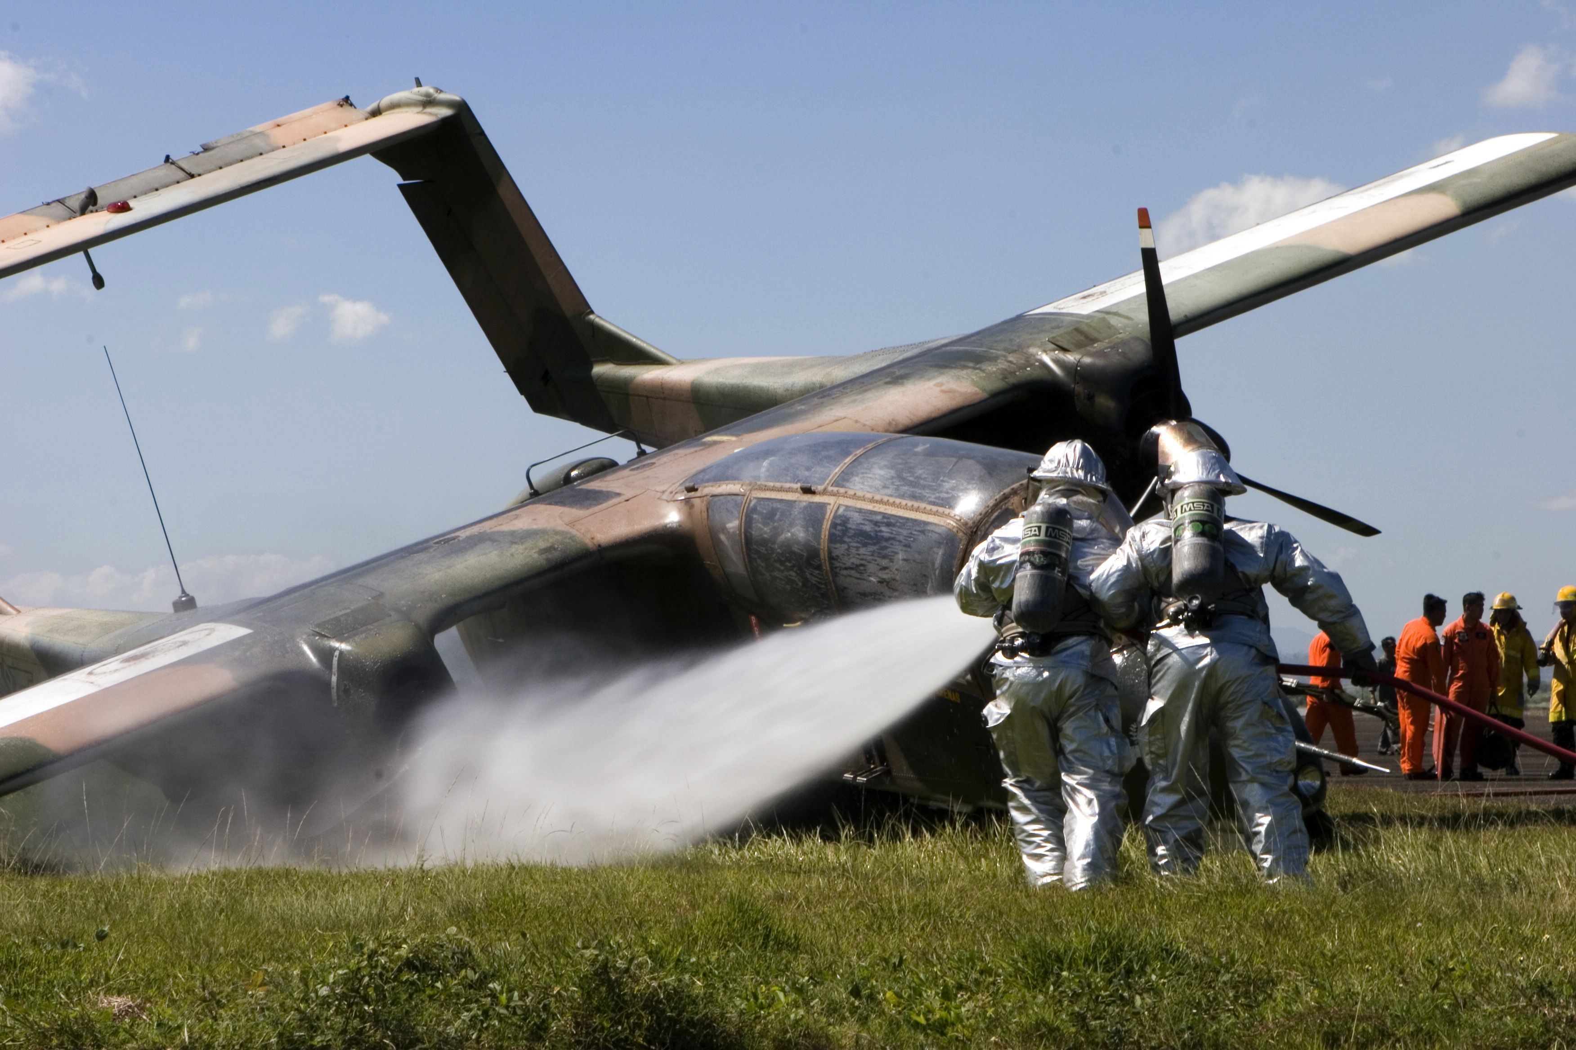
“Talon Vision '07 and Amphibious Landing Exercise '07, which were designed to enhance interoperability and professional relations between the U.S. and Philippine armed forces.”
File:OV-10A_PhilAF_crash_2006.jpeg

Slide 3
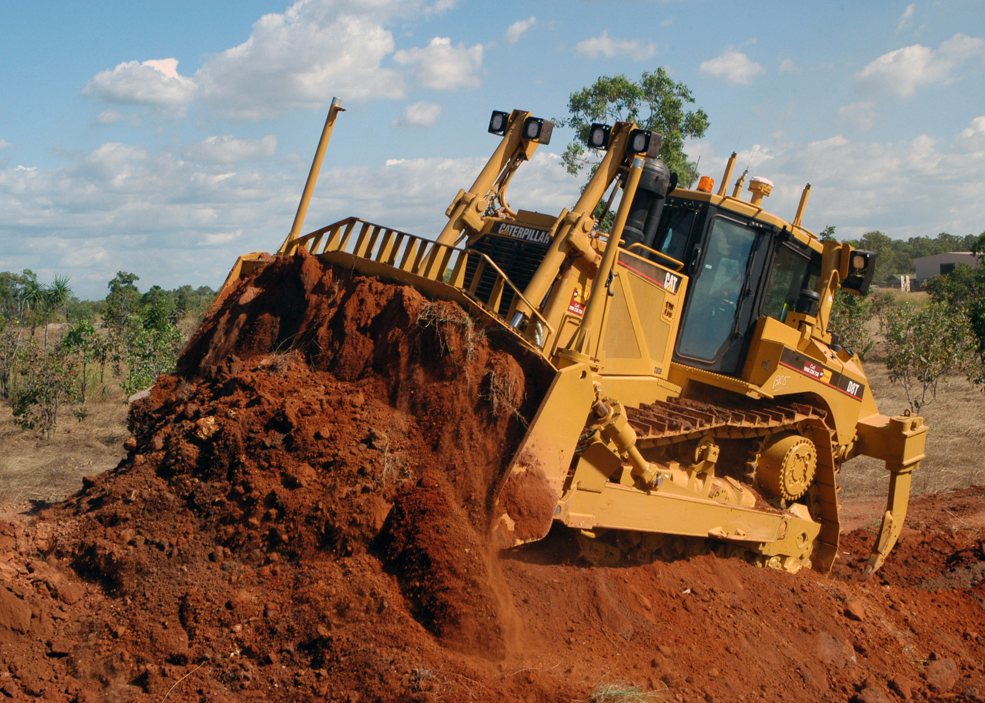
“Exercise Talisman Saber is designed to maintain a high level of interoperability between U.S. and Australian forces, demonstrating the U.S. and Australian commitment to our military alliance and regional security.”
File:Seabee_using_Cat_D8T.jpg

Slide 4
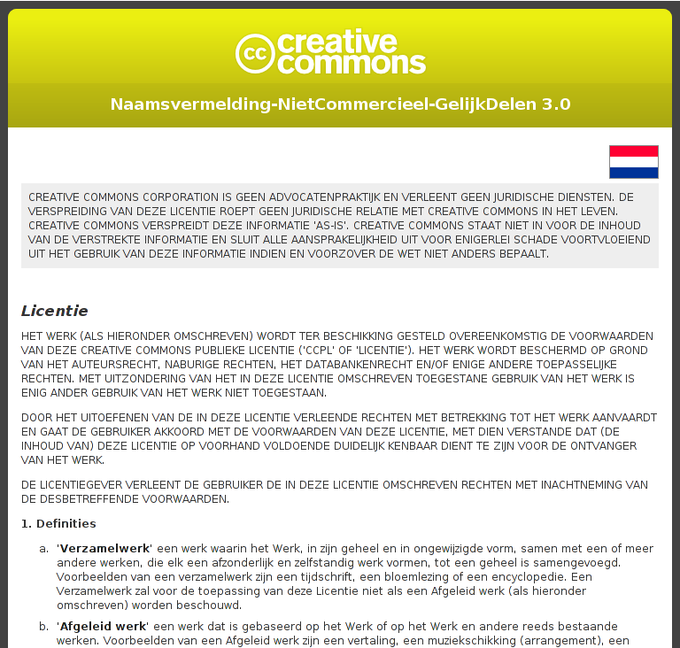
Lawyer Readable

Slide 5
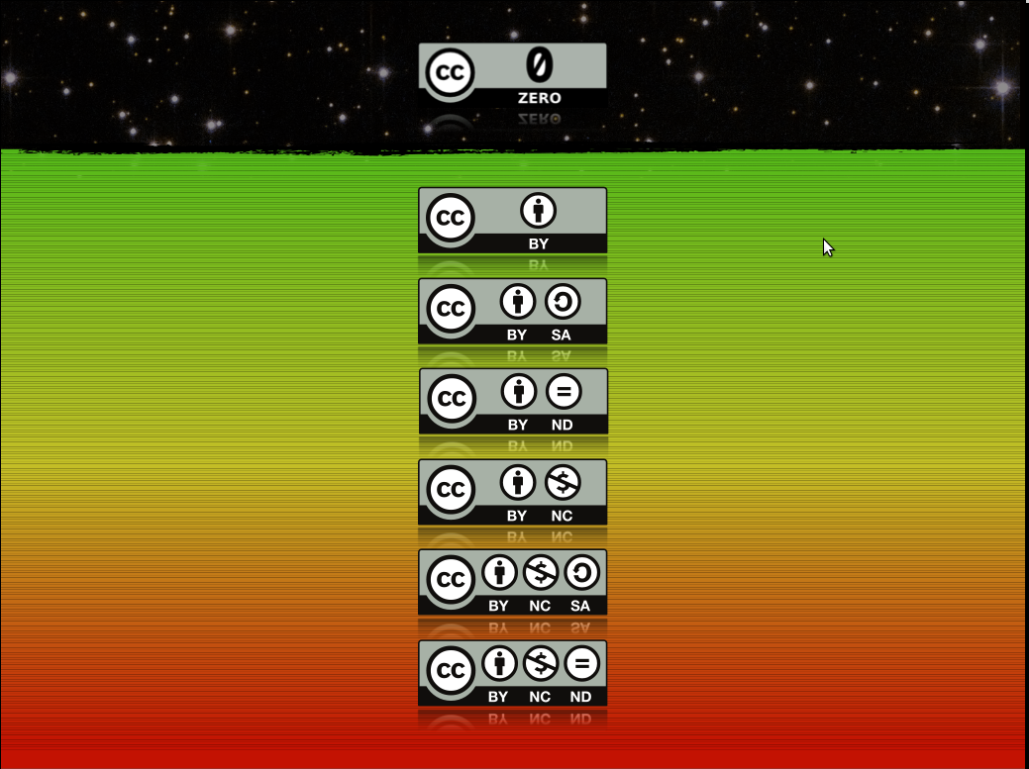






Six Mainstream Licenses

Slide 6
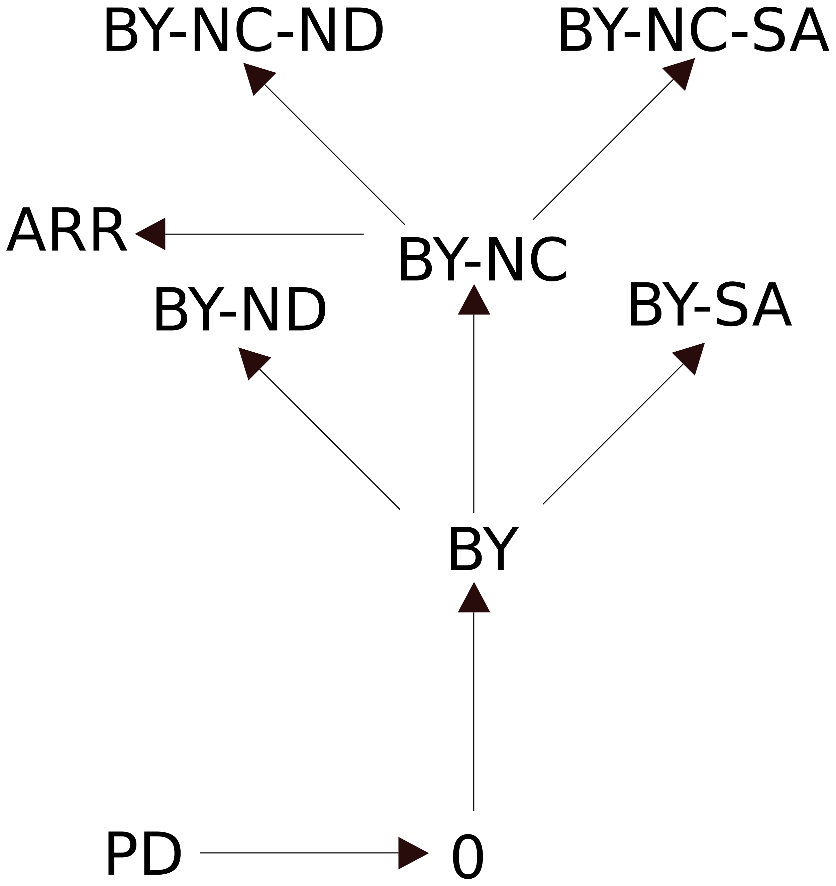

Slide 7

Stretch of image by Pfctdayelise · Licensed under CC Attribution 3.0
http://commons.wikimedia.org/wiki/File:Propaganda_poster_for_Wikimedia_licensing_vote_-_vote_yes_for_licensing_sanity.svg

Slide 8


Slide 9
kthxhi

Slide 10

Human Readable

Slide 11
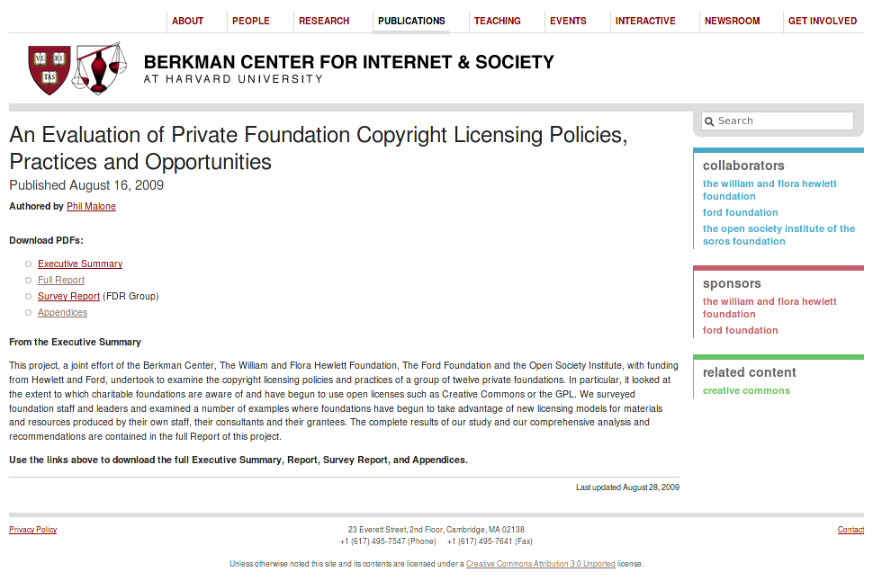

Slide 12


Slide 13
Machine Readable
<rdf:RDF xmlns="http://creativecommons.org/ns#"
xmlns:rdf="http://www.w3.org/1999/02/22-rdf-syntax-ns#">
<License
rdf:about="http://creativecommons.org/licenses/by-nc-sa/3.0/nl/">
<permits rdf:resource="http://creativecommons.org/ns#Reproduction"/>
<permits rdf:resource="http://creativecommons.org/ns#Distribution"/>
<requires rdf:resource="http://creativecommons.org/ns#Notice"/>
<requires rdf:resource="http://creativecommons.org/ns#Attribution"/>
<prohibits
rdf:resource="http://creativecommons.org/ns#CommercialUse"/>
<permits
rdf:resource="http://creativecommons.org/ns#DerivativeWorks"/>
<requires rdf:resource="http://creativecommons.org/ns#ShareAlike"/>
</License>
</rdf:RDF>

Slide 14
Machine Readable (Work)
<span xmlns:cc="http://creativecommons.org/ns#" xmlns:dc="http://purl.org/dc/terms/">
<span rel="dc:type" href="http://purl.org/dc/dcmitype/Text" property="dc:title">My Book</span> by
<a rel="cc:attributionURL" property="cc:attributionName" href="http://example.org/me">My Name</a>
is licensed under a
<a rel="license" href="http://creativecommons.org/licenses/by/3.0/">Creative Commons Attribution 3.0 License</a>.
<span rel="dc:source" href="http://example.net/her_book"/>
Permissions beyond the scope of this license may be available at <a rel="cc:morePermissions" href="http://example.com/revenue_sharing_agreement">example.com</a>.
</span>

Slide 15
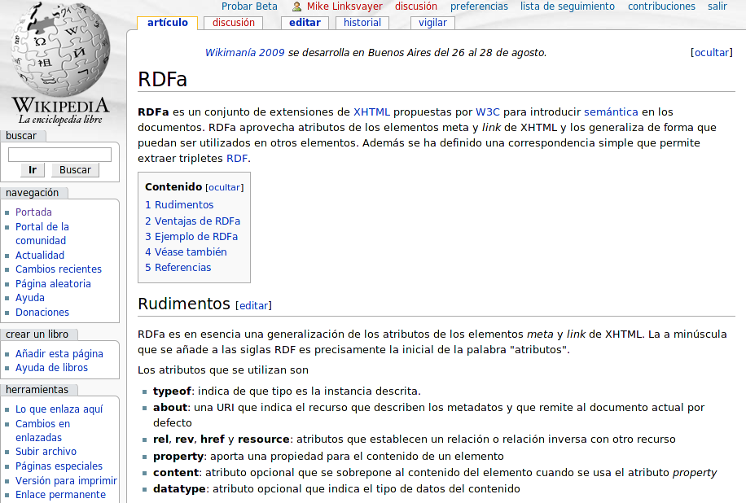

Slide 16
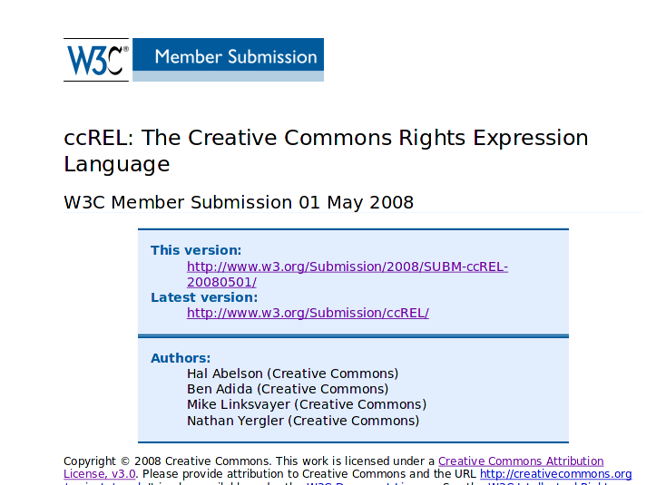

Slide 17
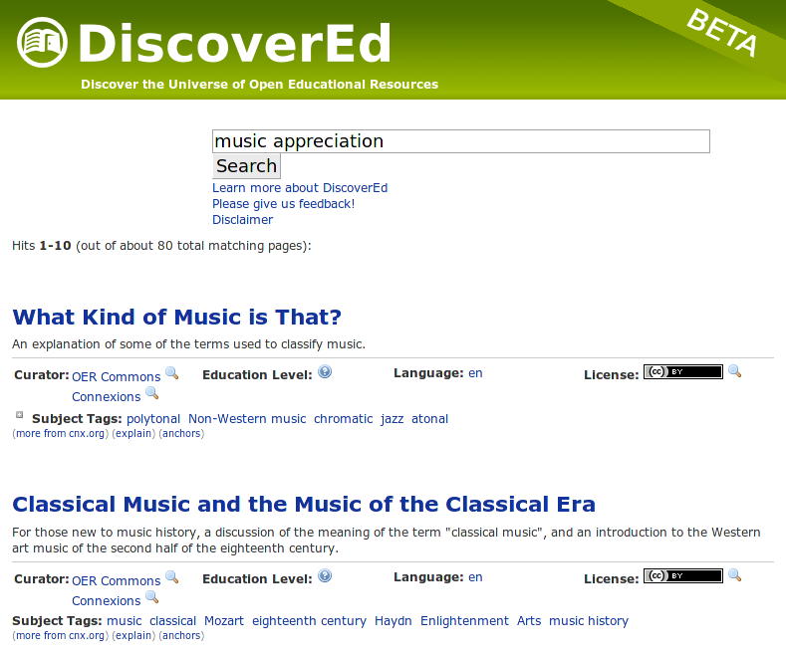

Slide 18
Free software, free formats, free standards help. Wikimedia projects are the vanguard. Yay!!!

Slide 19
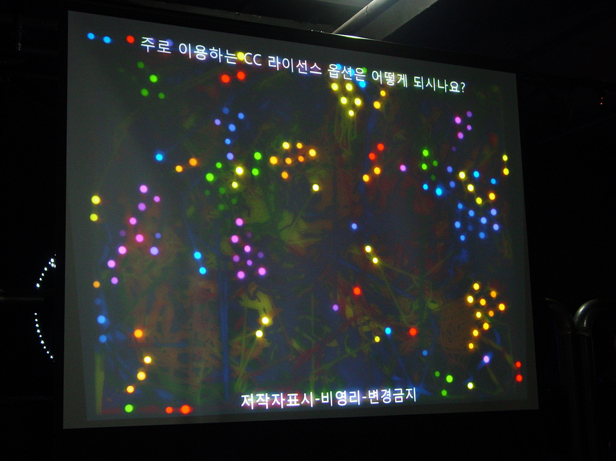
License
http://creativecommons.org/licenses/by-sa/3.0/
Attribution
Author: Mike Linksvayer
Link: http://creativecommons.org
Questions?
ml@creativecommons.org
Photo by asadal · Licensed under CC Attribution-ShareAlike 2.0 · http://flickr.com/photos/68242677@N00/2117153416/

