Slide 1
Compliance for DeFi on Algorand
Encode-x-ATX-DAO-Austin-Hackathon 2022
Samuel Tosin and Brian Haney

Slide 2
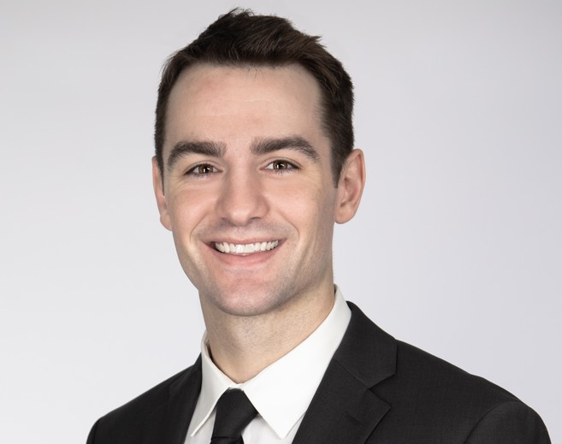
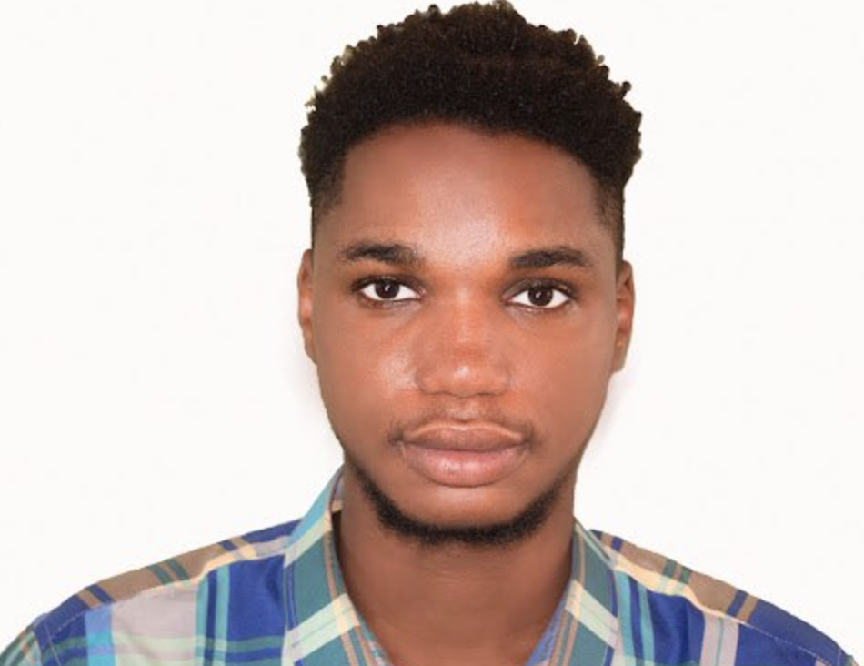
Team
Samuel Tosin
Software Engineer
University of Lagos
Computational Chemistry
OSS Developer on Algorand
Brian Haney
Compliance Automation Engineer
J.D. Notre Dame Law School
2020 Research Fellow Stanford Law School
OSS Developer on Algorand

Slide 3
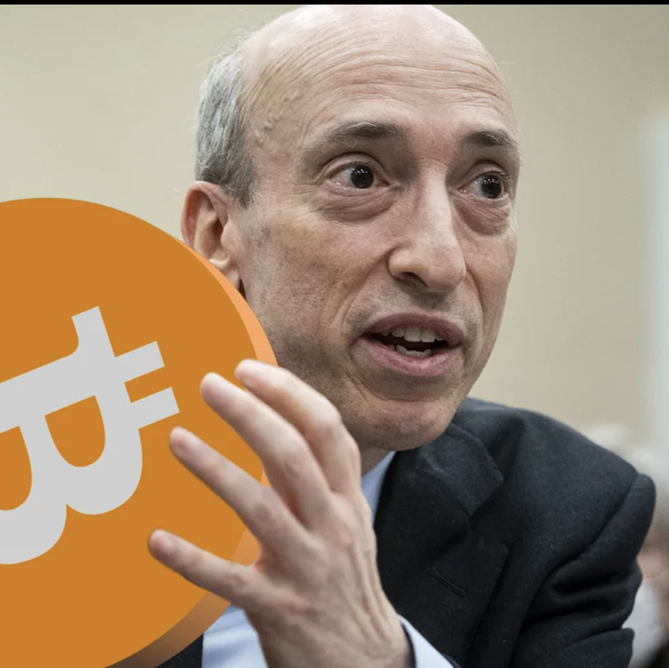
Problem
Fraud on Algorand
No clarity on Security
96 SEC Enforcement Actions
Why Ripple?

Slide 4
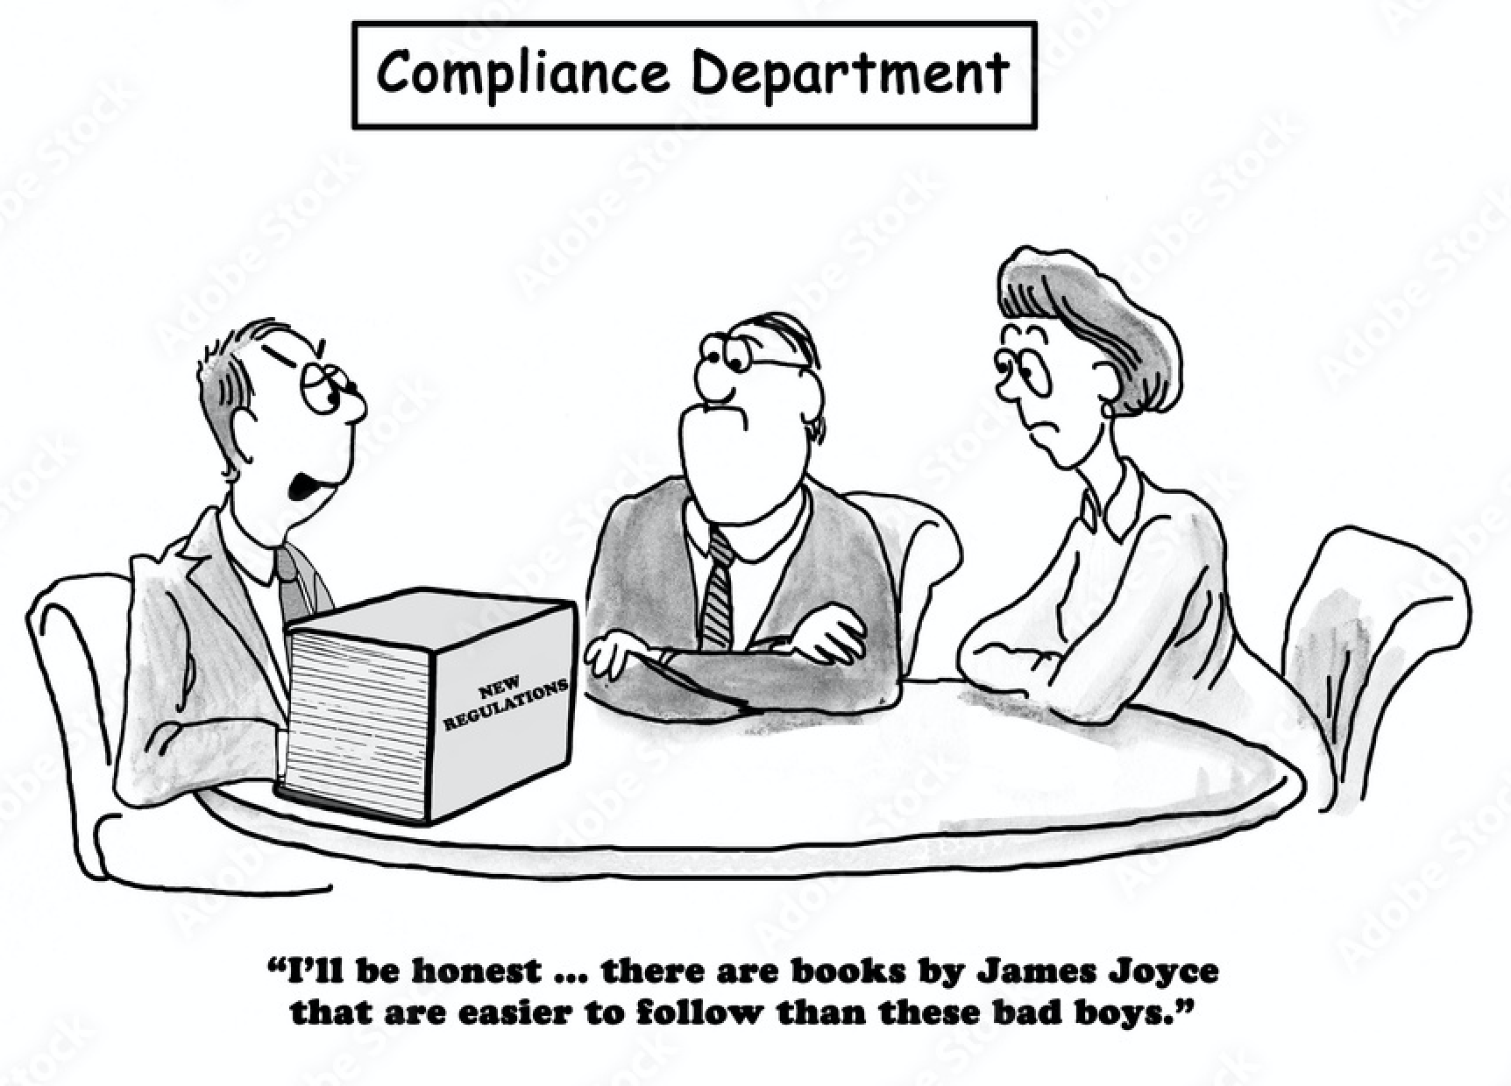
Solution
Register security token
Create a non-security token
Automate securities compliance
Reduce regulatory risk

Slide 5
Roadmap
2021
Research Paper
First Customer
2022
Q2: AlgoStake; Solana Foundation Grant
Q3: Launch on Solana and Algorand
Q4: Report Automation; Scale

