Slide 1

GLOBAL DEVELOPMENT MEASUREMENT

Slide 2
Cluster Analysis
Group 3
Mentor Name:
Tanmay Raosaheb Deshmukh
Chigurupati Chakri
Ms. Deepti Gupta
Mr. Vadde Venkatesh
Mr. Bhanu Prasad

Slide 3
Business Problem:
Creating clusters on global development measurement dataset.
Objective:
The objective of the analysis is to form clusters based on the given global development measurement data.

Slide 4
Project Architecture / Project Flow
Data Exploration
Dataset:
Rows: 2704
Features: 25
EDA and Visualization
Missing values are present in all the features except “Country” & “Population Total”. Created different Visualizations like (Boxplot, Distribution plots, bar plots, histograms, etc.,) to understand the patterns in the data.
Data Pre-processing
Ease of Business & Number of Records features are dropped from the dataset.
Removed special characters ($, %) before numbers.
Converted few features to numeric datatype from Object type. Used mean & KNN-based imputation techniques.
Model Performance
Using Elbow Curve to get optimal Clusters.
Performance is calculated through Silhouette's Score and distance between means of each cluster.
We performed random forest as a classification model
Deployment
We deployed the model using Streamlit.
Model Building
Planning to build models like
Hierarchical Clustering, K-Means Clustering, DB Scan.

Slide 5
Data set details
No. of Rows: 2704
No. of Features: 25
No. of Categorical Features: 1
No. of Continuous Features: 24
Some columns description:
Birth_Rate: The birthday column is crucial in understanding the demographic characteristics of the population, such as age distribution, generation, and life stage.
CO2 Emission: The CO2 emission column is vital in understanding the environmental impact of human activities, such as climate change, air pollution, and sustainable development.
Business Tax Rate: The business tax rate column represents the percentage of corporate income that is taxed by the government.
Country: The country column is essential in understanding the business environment, as different countries have unique regulatory frameworks, economic conditions, and cultural contexts.
Energy Usage: Energy usage is a key indicator of economic activity, as it affects the production, transportation, and consumption of goods and services.
GDP: GDP is a widely used indicator of a country's economic performance, as it reflects the size and growth rate of the economy.

Slide 6
Exploratory Data Analysis (EDA)

Slide 7
What we had done with our data:
Data set details
Describing data
Removing symbols & convert object into float
Missing values
Dropping column
Unique count and unique values of each column.
Duplicate values
Correlation
Renaming columns
Histogram
Outliers
EDA Analysis by Using Pandas Profiling

Slide 8
Exploratory Data Analysis (EDA)
Identified null values in the dataset, all the features are having null values except “Country” & “Population Total” features.
Feature wise Percentage of Null Values
Feature | % of Null Values
birth_rate | 4.400888
business_tax_rate | 47.37426
co2_emission | 21.412722
country | 0
days_to_start_business | 36.464497
energy_usage | 33.986686
GDP | 7.766272
health_exp%_GDP | 11.427515
health_exp_percapita | 11.427515
hours_to_do tax | 47.633136
infant_mortality_rate | 9.615385
internet_usage | 6.397929
lending_interest | 30.473373
life_expectancy_female | 5.029586
life_expectancy_male | 5.029586
moble_phone_usage | 6.176036
population_0_14 | 8.136095
population_15_64 | 8.136095
population_65+ | 8.136095
population_total | 0
population_urban | 0.961538
tourism_inbound | 13.609467
tourism_outbound | 17.418639

Slide 9
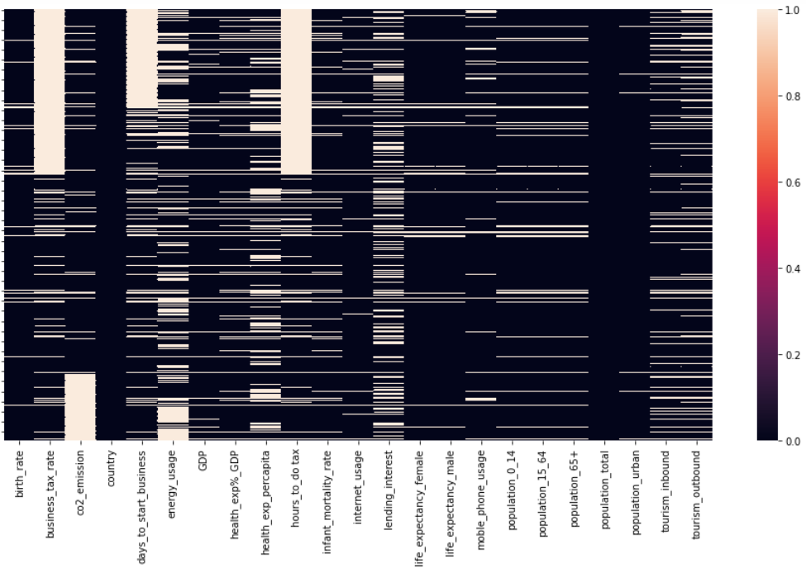
Heatmap to Visualize Null Values in the Dataset
Hours to do tax and Business tax rate are having high null values

Slide 10
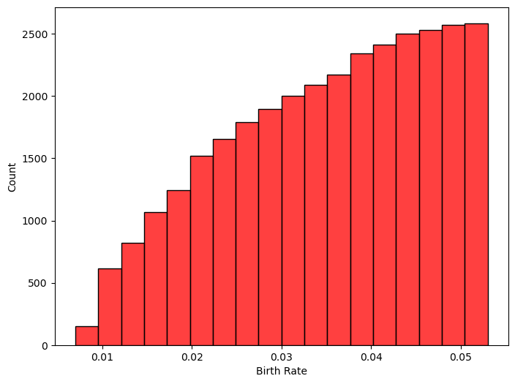
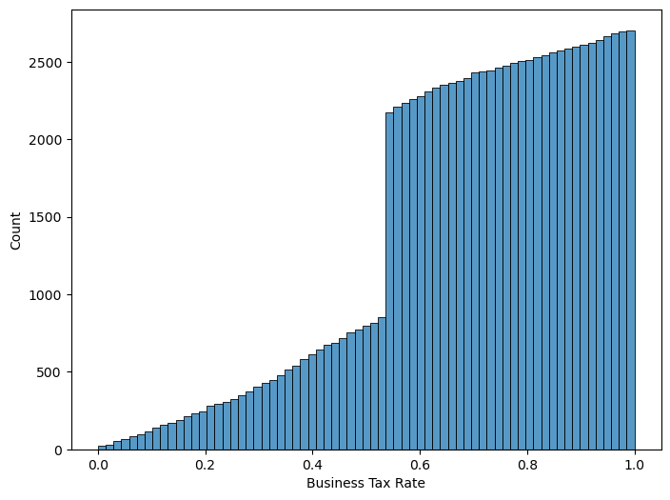
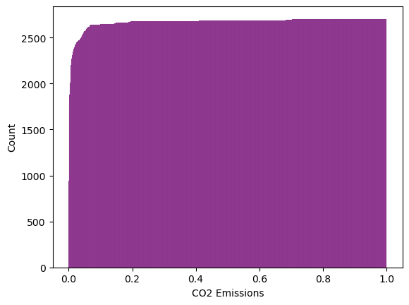
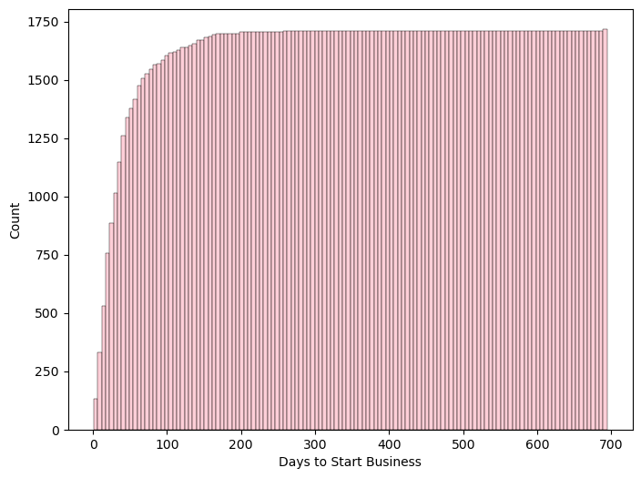
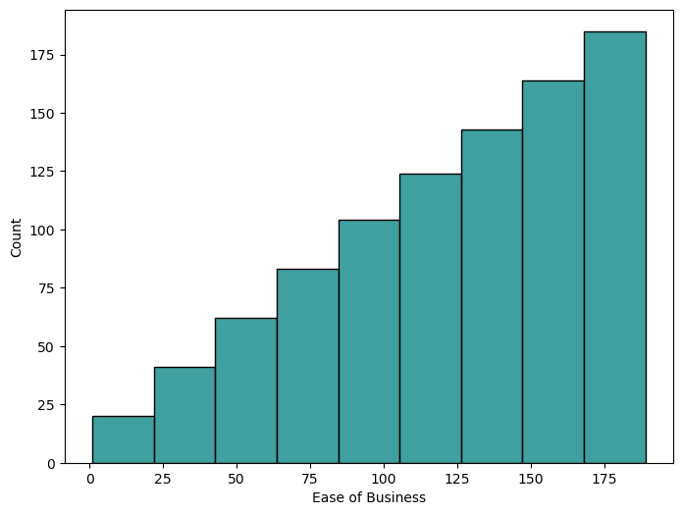
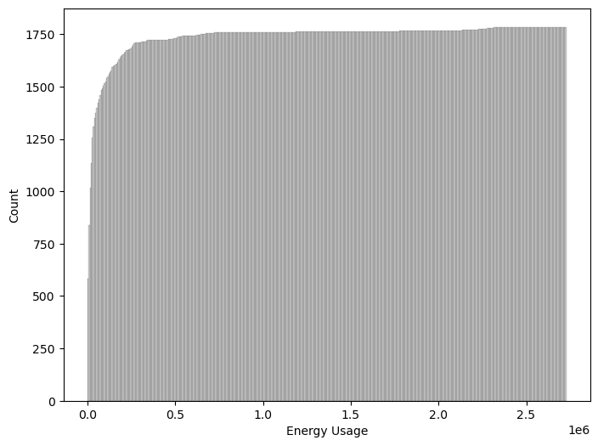
Histograms to visualize the distribution of the data

Slide 11
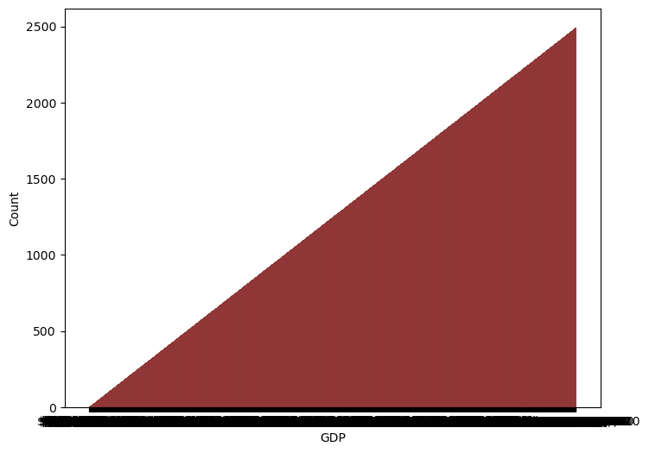
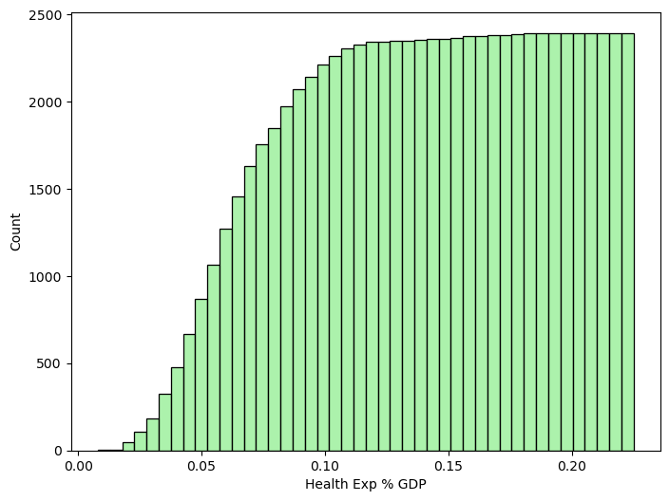
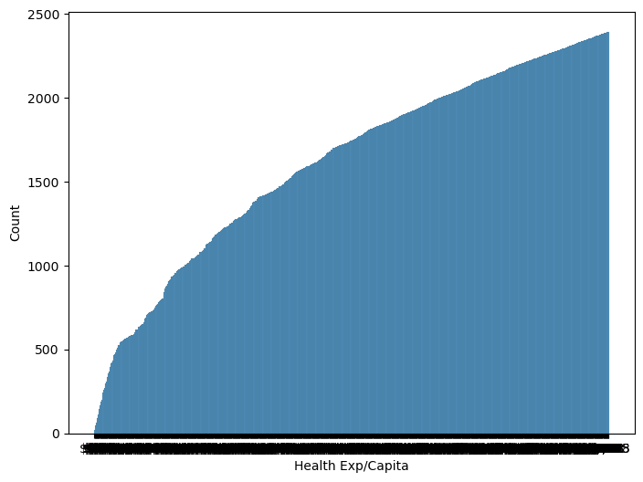
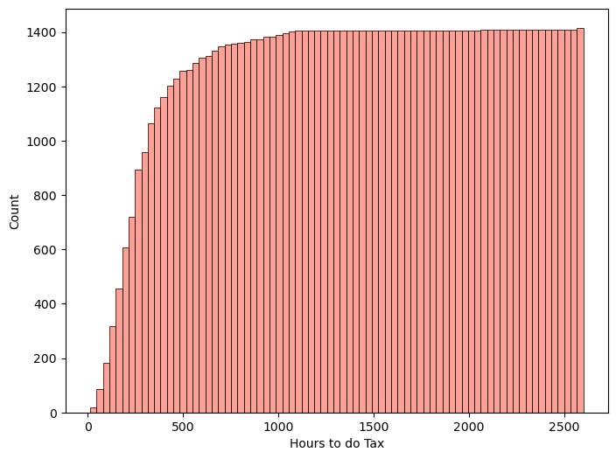
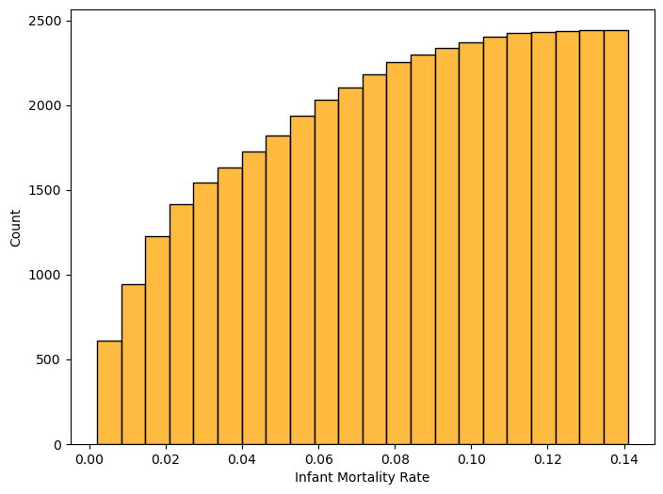
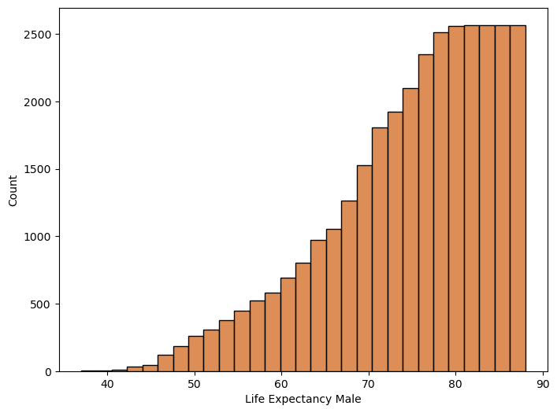
Histograms to visualize the distribution of the data

Slide 12
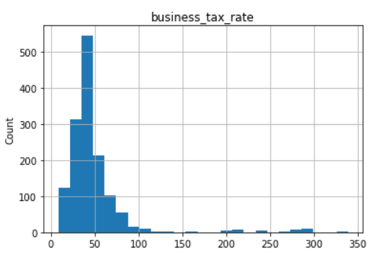
Histograms
Data Distribution: lending_interest, GDP, population_total, co2_emission, days_to_start_business, tourism_inbound, energy_usage, tourism_outbound features are highly skewed.
Range and Spread: By observing the width of the histogram, we can understand the range and spread of the data.
Outliers: Histograms can help identify outliers, which are data points that significantly deviate from the majority of the data. Business_tax_rate have high outliers.

Slide 13
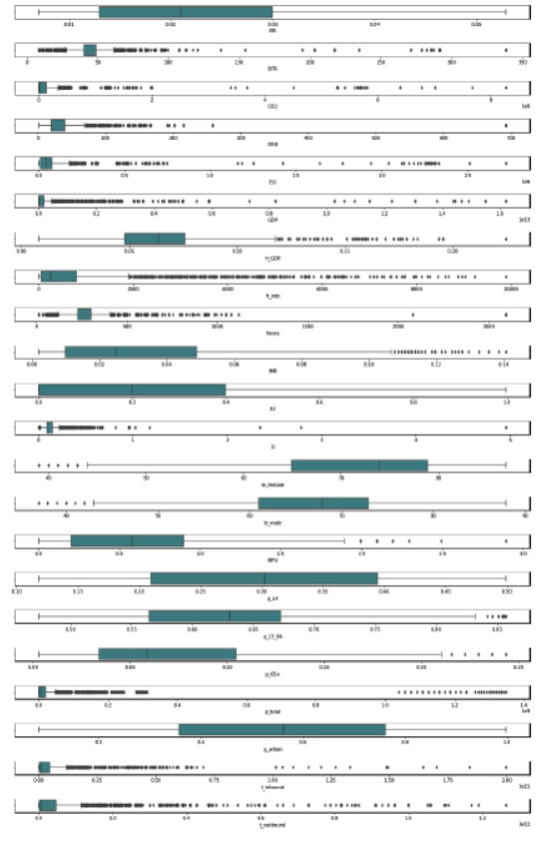
Exploratory Data Analysis (EDA)
.
Box plot representing that there are outliers in some of the columns of the data
Box Plot

Slide 14
Interpretations on Boxplots
High Outliers
business_tax_rate
co2_emission
days_to_start_business
energy_usage
GDP
health_exp%_GDP,
health_exp_percapita
hours_to_do tax
population_total
tourism_inbound
tourism_outbound
Few Outliers
infant_mortality_rate
life_expectancy_female
life_expectancy_male
moble_phone_usage
population_15_64
population_65+

Slide 15
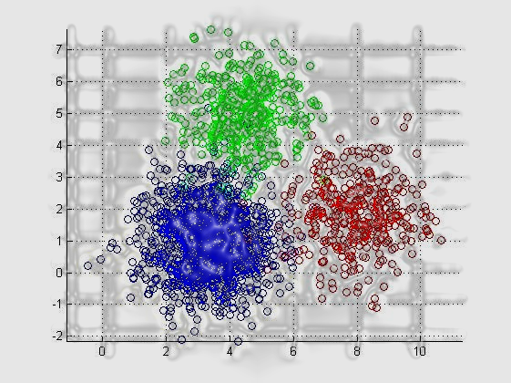

Features Engineering

Slide 16
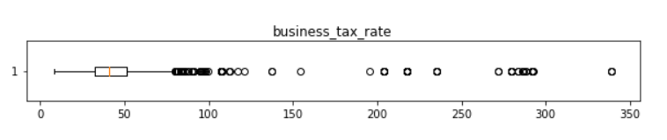
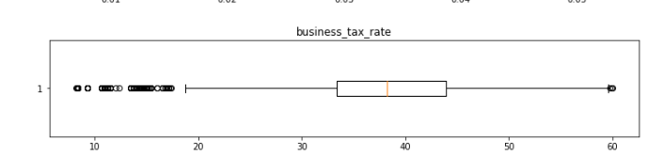
Interpretations on Boxplots
max(Business Tax Rate) is around 340% , which means paying 340 rupees as tax for every 100 rupees profit. The global highest Business Tax Rate is around 55% , so assuming the max value to be 60% and replacing all the ouliers (i.e., above 60%) with np.nan and will fill them later using imputation techniques.

Slide 17
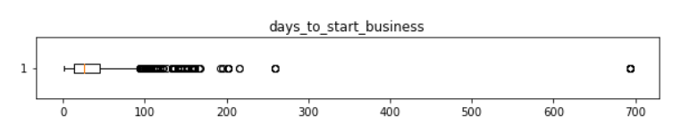
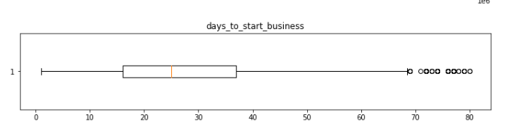
Interpretations on Boxplots
max(Days to Start Business) is 694 days. Accounting 18-20 business days a month it takes like around 3 years , comparing it to real time global values, the max time required to start a business is around 50 days. Based on the boxplot assuming the max days to start a business is 80 days and replacing all the outliers with np.nan and will figure a way to fill them up with sensible number later based on all other parameters

Slide 18
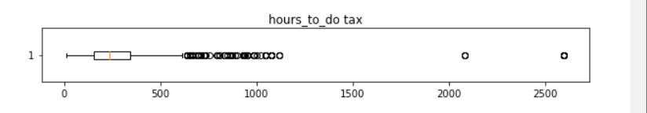
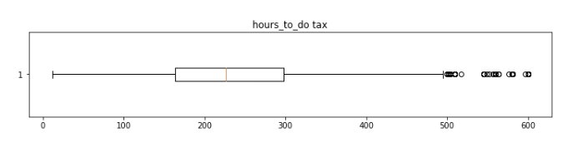
Interpretations on Boxplots
Based on the boxplot assuming 600 hours as max (hours to do tax ) and replacing all the outliers with np.nan and will figure a way to fill them up with sensible number later based on all other parameters.

Slide 19
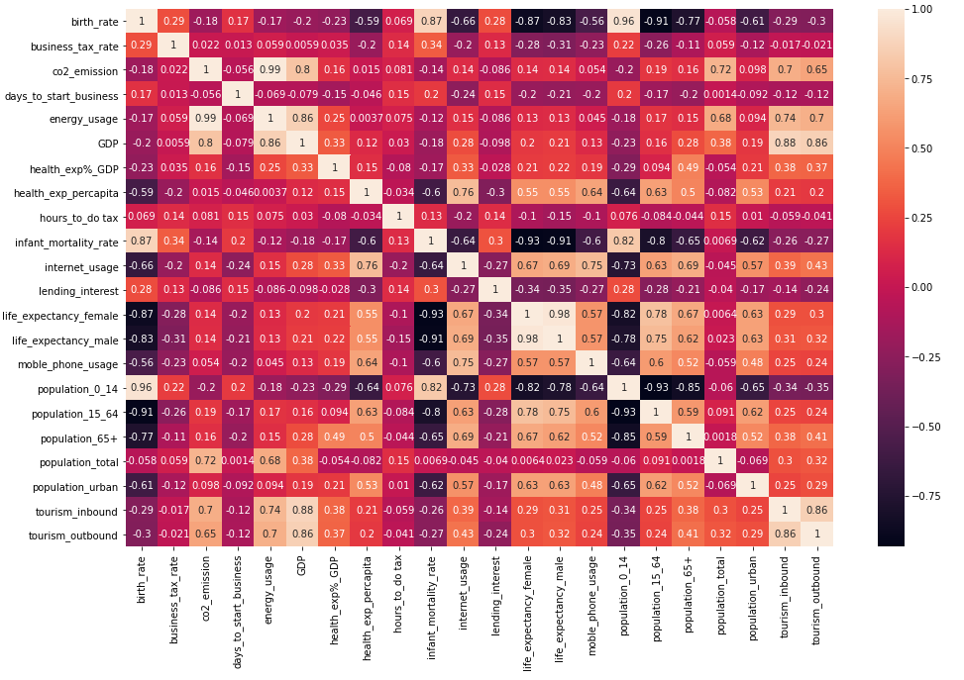
Correlation Heatmap
CO2 and energy usage are having more correlation of 0.99 with each other than any variables

Slide 20
MODEL BUILDING
We have tried to explore 3 Cluster Algorithms:
K-Means Clustering
Agglomerative Cluster.
DBSCAN Cluster.
Out of these 3 models, we will consider those with high silhouette scores.

Slide 21
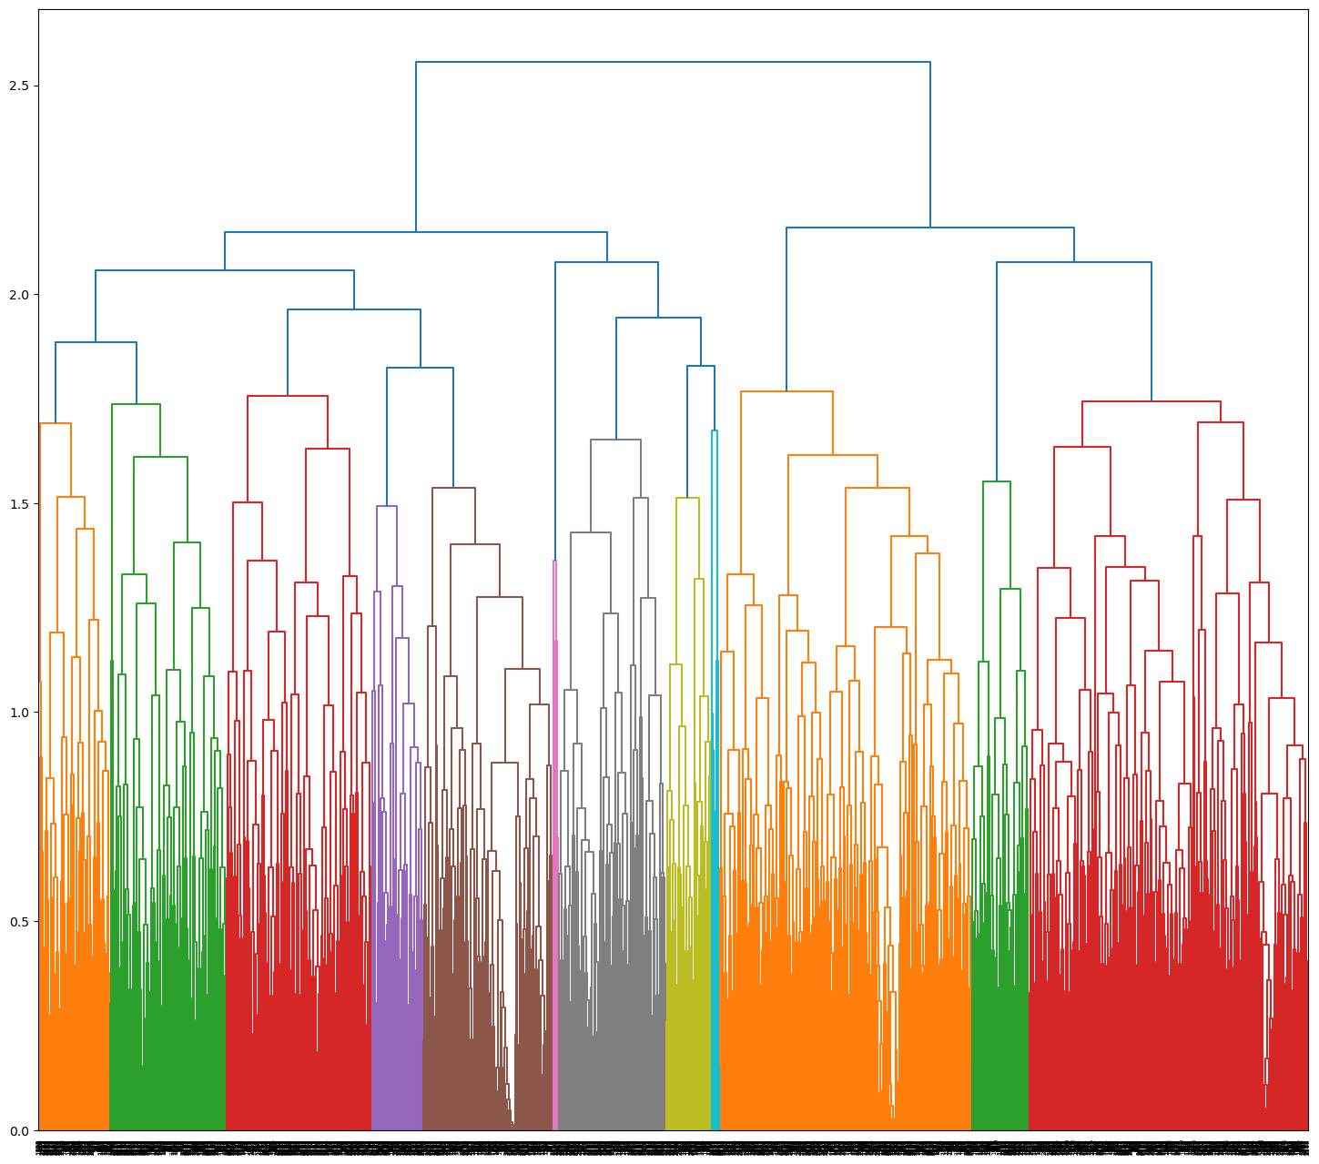
hierarchical clustering
In this algorithm we can obtain the optimal number of clusters from the model itself, human intervention is not required.
Dendrograms help us in clear visualization, which is practical and easy to understand.
Number of clusters considered =5

Slide 22
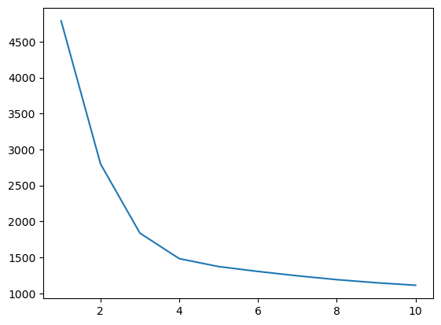
K-Means clustering
K-means assigns every data point in the dataset to the nearest centroid, meaning that a data point is considered to be in a particular cluster if it is closer to that cluster's centroid than any other centroid.
The goal of K-means clustering is to partition a set of objects into K clusters in such a way that the sum of the squared distances between the objects and their assigned cluster mean is minimized

Slide 23
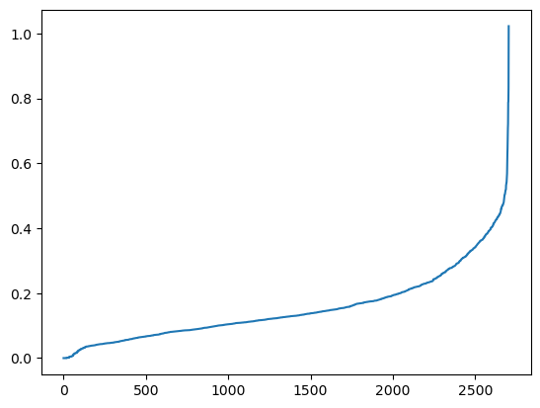
Dbscan clustering
Handling noise and outliers: DBSCAN is robust to noise and outliers in the data, which is common in global development datasets. It can identify and exclude noise points, ensuring that the clustering results are more accurate and reliable.
Flexibility in cluster shapes: Unlike traditional clustering algorithms like k-means, DBSCAN can identify clusters of varying shapes and densities, making it suitable for datasets with complex structures.

Slide 24
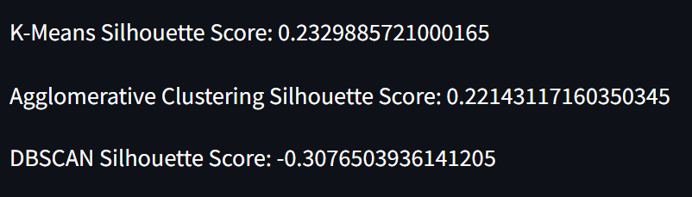
Silhouette score comparison
On comparing the silhouette score of all 3 models, KMEANS gives us the highest score.
Therefore we will be considering KMEANS as our best fit model.

Slide 25
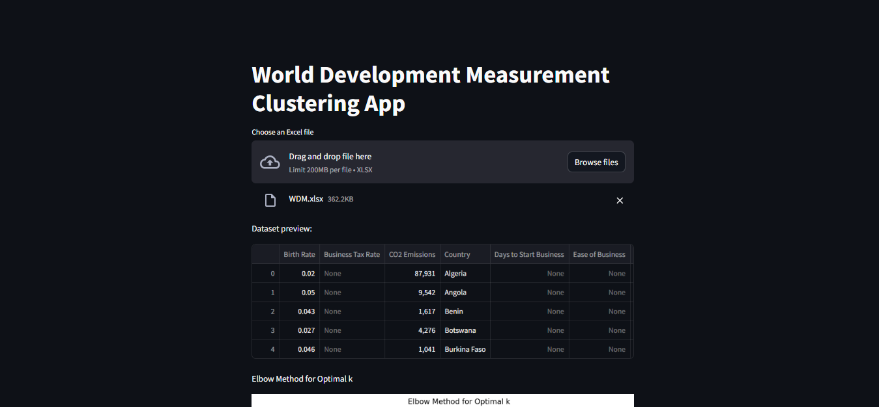
Deployment
We have deployed the model using streamlit.

Slide 26
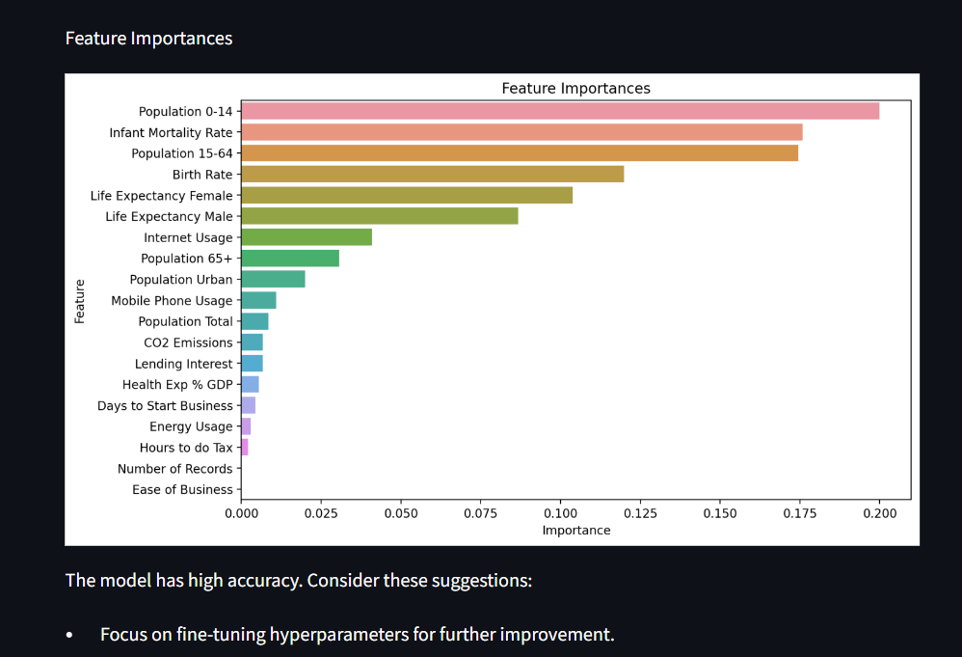
The model is accurate. To improve it further, tune the hyperparameters. The most important features are population 0-14, infant mortality rate, and population 15-64.

Slide 27
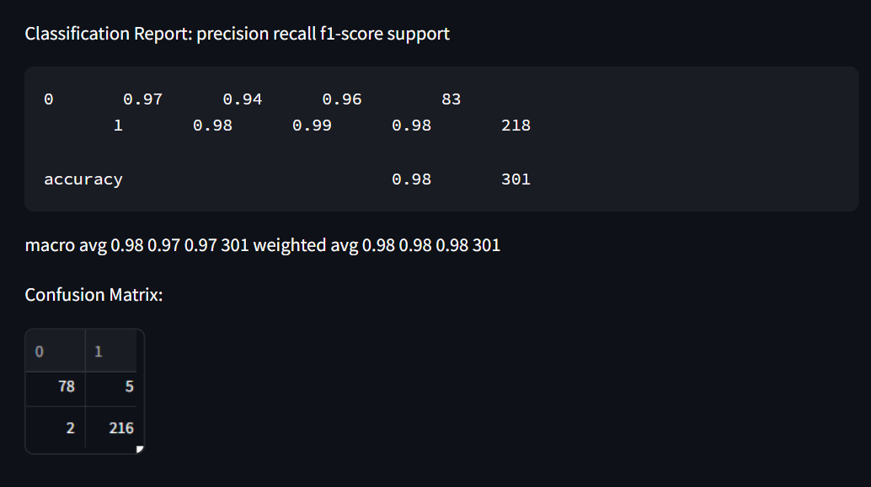
The chart shows the importance of the features of a machine-learning model. The model has high accuracy, but we can still improve it by fine-tuning the hyperparameters. Hyperparameters are settings that control the learning process of the model. By adjusting these settings, we can find the optimal configuration that gives us the best results.

Slide 28
Challenges we faced
Selecting the most suitable clustering algorithm for the project was a challenge, as each algorithm has its strengths and weaknesses.
During model building, we encountered difficulties in feature engineering, as it was crucial to extract relevant insights from the data without overfitting.
Lastly, evaluating the model's performance was a challenge, as it required careful consideration of various metrics to ensure the model was accurately capturing the complexities of global development.

Slide 29

Thank you

