Slide 1
Animal Image Detection Statistical Machine Learning
Bhanu Pratap Rohan Jadaun

Slide 2
Introduction
Libraries:
OpenCV
Panda
Numpy
TensorFlow
OS
Dataset:
Taken from Kaggle
Includes various animal categories (e.g., lion, zebra, monkey,cat etc.)
Approx 2500 images.

Slide 3
Data Preprocessing
Steps:
Image Loading
Resizing to 128x128 pixel
Label Encoding
Outlier classes removed

Slide 4
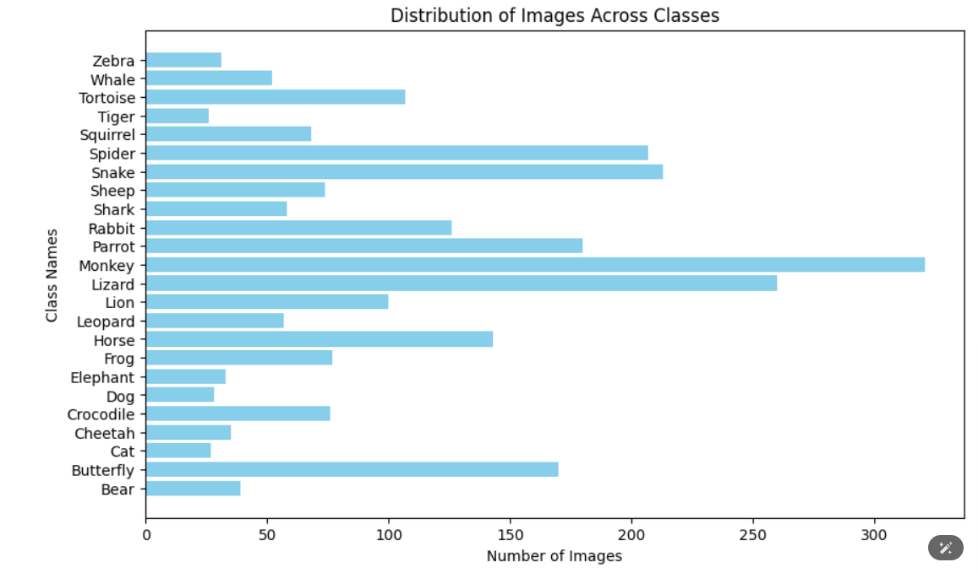
Bar graph shows the number of images per class.

Slide 5
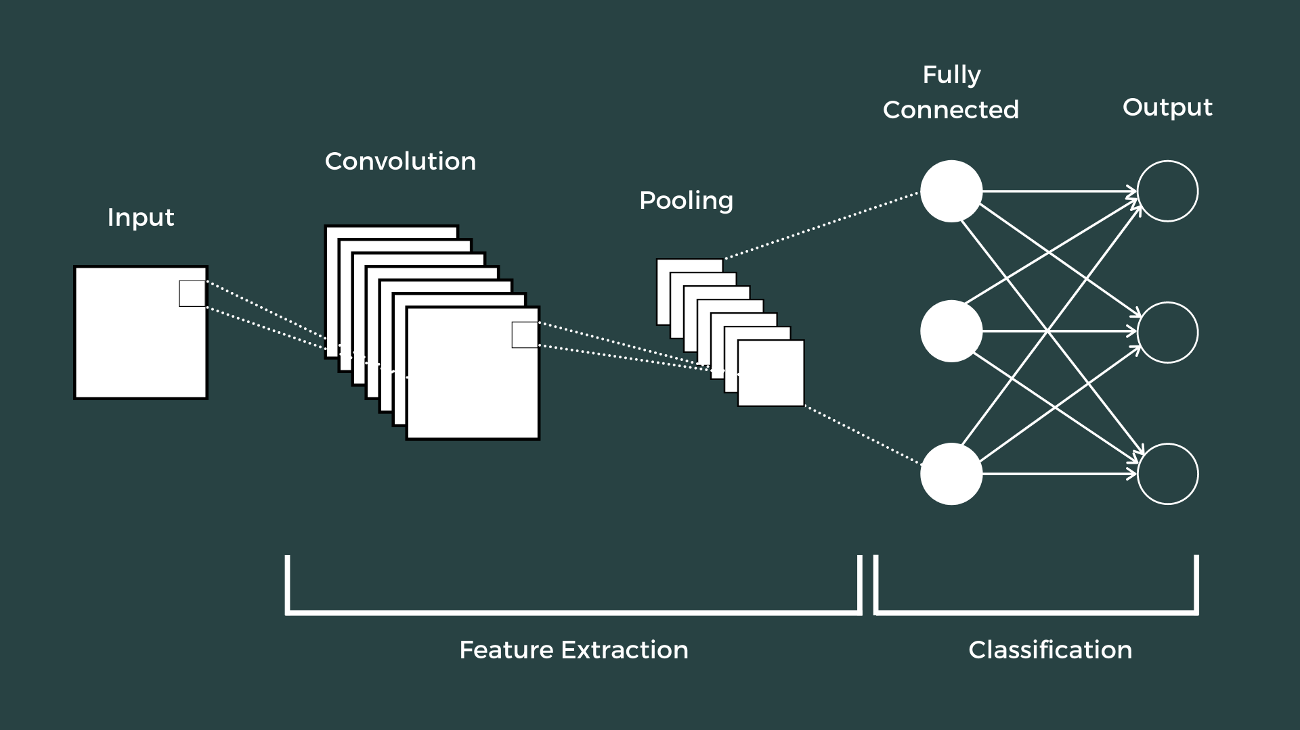
CNN Models
Example Workflow of a CNN:-
Input: An RGB image (128, 128, 3)
Convolutional Layer: Applies 32 filters -> (128, 128, 32)
Max Pooling: Reduces spatial dimensions -> (64, 64, 32)
Dense Layer: Maps features to 128 neurons -> (128,)
Output Layer: Predicts probabilities for 10 classes -> (10,).

Slide 6
Model Architecture - MobileNetV2
1. MobileNetV2 pre-trained on ImageNet
2. Added layers for fine-tuning:
Global Average Pooling
Dense (128 units, ReLU, L2 regularization)
Dropout (50%)
3. Output Layer: Softmax activation for classification.

Slide 7
Model Architecture - VGG19
1. VGG19 pre-trained on ImageNet
2. Custom Layers Added:
Global Average Pooling
Dense (1024 & 512 units, ReLU)
Dropout (50%)
3. Output Layer: Softmax activati.n for classification.

Slide 8
Training and Validation
Training details:
Optimizer: Adam
Learning Rate : 0.0001
Final Results:
Training Accuracy: 91.84%
Testing Accuracy: 82.85%

Slide 9
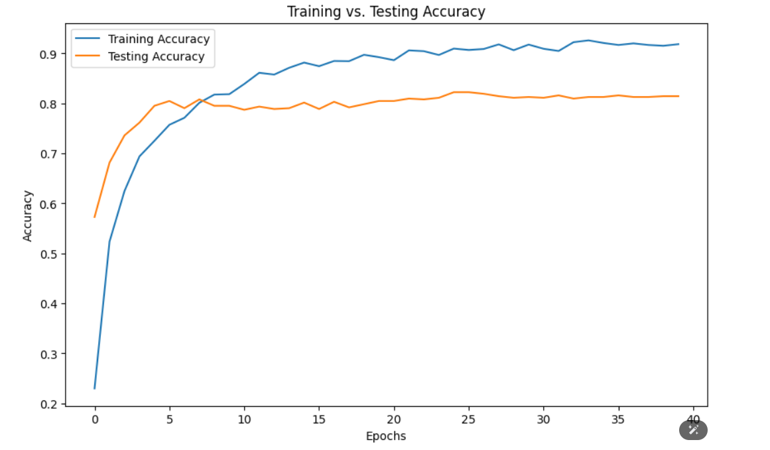
Plot of Training Acc. vs Testing Acc.

Slide 10
Flask Web Application
Features:
Upload animal images
Predict the class with probability
Deployment:
Frontend : HTML ,CSS
Backend : Flask

Slide 11
Conclusion
Achievements:
Successfully developed an animal image classification system.
Achieved high training and validation accuracy.
Deployed a functional web application for real-time predictions.
Future Work:
Deploy to a cloud platform for broader accessibility.
Improve accuracy with larger datasets and advanced models.

