Slide 1
Hackathon
Vehicle Insurance Prediction

Slide 2
Problem Overview
Problem Statement
To predict whether the customer would be interested in Vehicle insurance or not.
Data set provided
train.csv – 381109 records with 12 columns
test.csv - 127037 records with 11 columns

Slide 3
Observations
In Train data set, there are 3 categorical columns such as Gender, Vehicle_age, Vehicle_damage and 8 numerical columns id, Age, Driving_License, Region_Code, Previously_Insured, Annual_Premium, Policy_Sales_Channel, Vintage
There is no missing data in Train data set
Target variable i.e Response variable data is imbalance

Slide 4
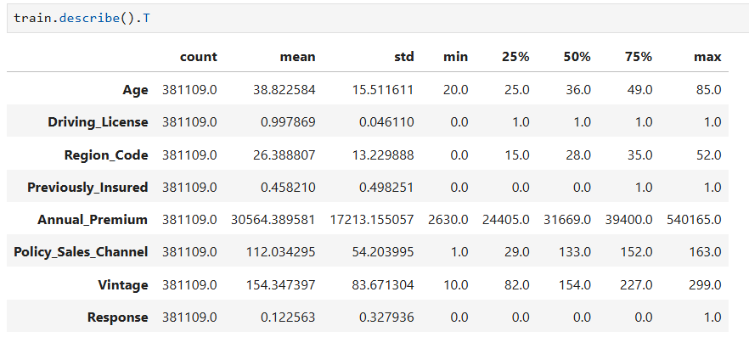
Observations
Statistical Inference, difference between mean and 50% tells about presence of outliers in

Slide 5
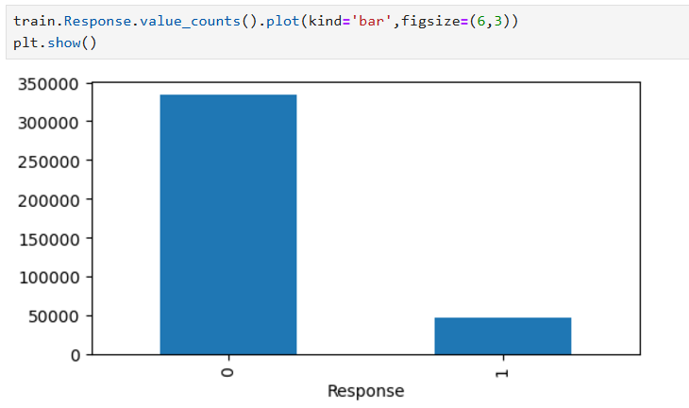
Data Analysis
Intrested and Not Intrested Response Distribution

Slide 6
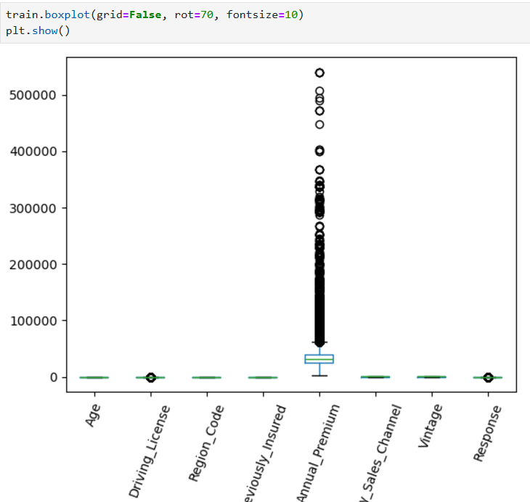
Data Analysis
Presence of outliers

Slide 7
Data Preparation
For categorical columns, we applied one hot encoder
To mitigate the imbalance we over sampled the data
To minimize the impact of outliers we applied scaling

Slide 8
Classification Analysis
Applied the following models and scores obtained
Model | roc_auc score
LogisticRegression | 0.836459
DecisionTreeClassifier | 0.837536
RandomForestClassifier | 0.854321

Slide 9
Prediction Success rate
Results of predicted output compared with Target column in Test data
Model | Success Rate
AdaBoostClassifier | 74.84%
VotingClassifier | 74.05%
StackingClassifier | 74.48%

Slide 10
Conclusion
Out of the 3 models considered we are recommending the Random Forest model for predicting whether customer is Intrested in Vehicle Insurance or not.

