Slide 1
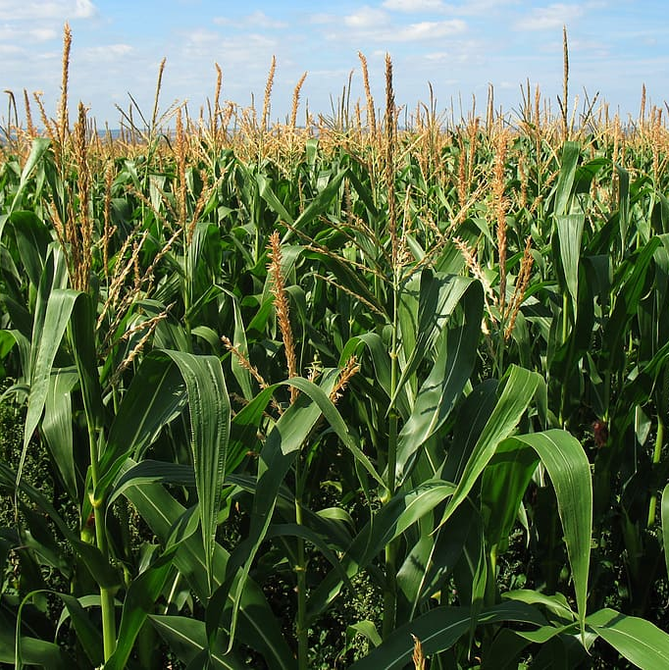


CROP PRODUCTION
DATA ANALYSIS PROJECT

Slide 2
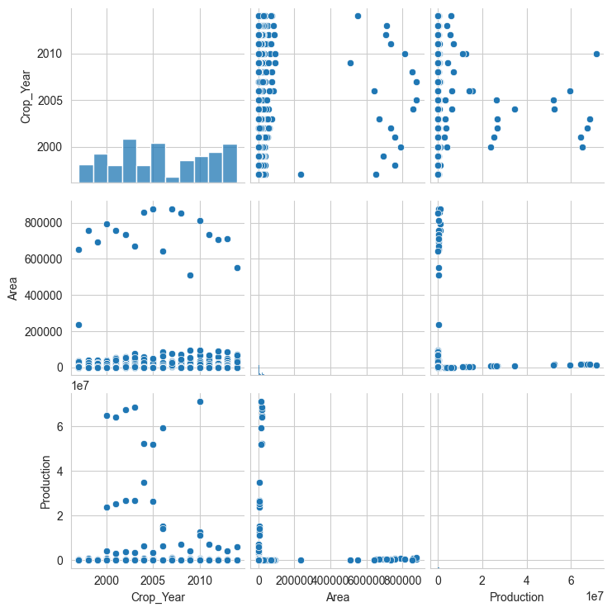
This is the pair plot that is plotted by using the seaborn library.
SEABORN LIBRARY PAIR PLOT
In this plot we can observe the type of relation between the different columns and variables of the dataset.

Slide 3
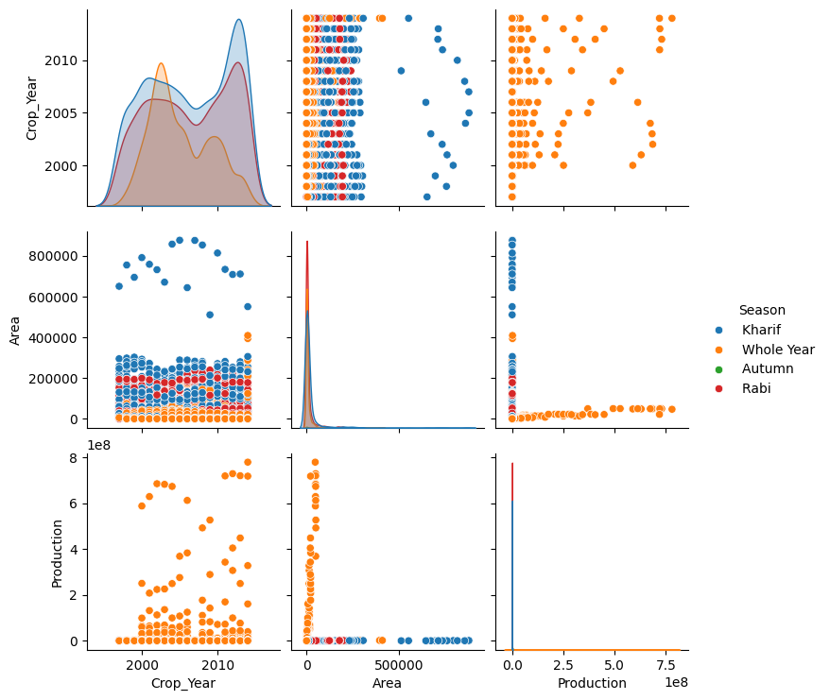
This plot is also a seaborn pair plot but it mainly specifies the seasons . There are mainly 6 seasons like kharif , rabi, summer, winter , autumn and whole year.
SEABORN PAIR PLOT WITH hue = ‘ Seasons’

Slide 4
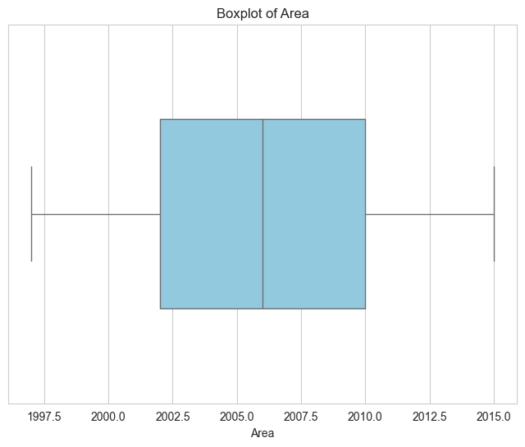
BOXPLOT FOR CROP YEARS
There are mainly 19 different crop years in which the production of different crops done. It is starting from 1997 to 2015. So, we have to plot a Boxplot in order to check whether there are any outliers in this column.

Slide 5
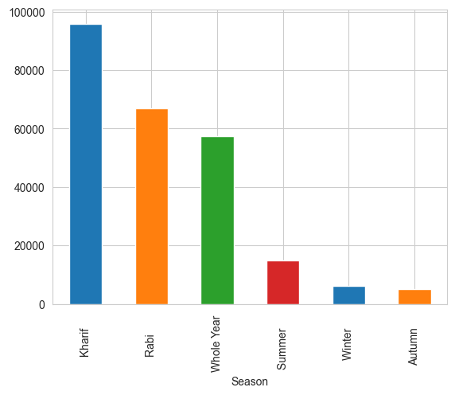
Seasons with their crop production
As we all know there are six seasons in the given dataset. They are Kharif , Rabi , Whole Year , Summer, Winter and Autumn.
When we compare all the six seasons of different years based on their crop production values, then we will get the output as shown in the bar graph.
In the bar graph we can see that the Kharif season has the highest production when compared to all other seasons.
Autumn season has the lowest crop production value and Whole year has the moderate level Production.

Slide 6
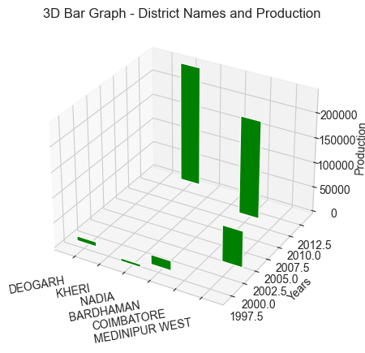
BAR GRAPH IN 3D
In this graph which id 3 dimensional data, where x-axis contains the District names and y-axis contains the Crop production in each year that is only the highest years and z-axis contains the years data.

Slide 7
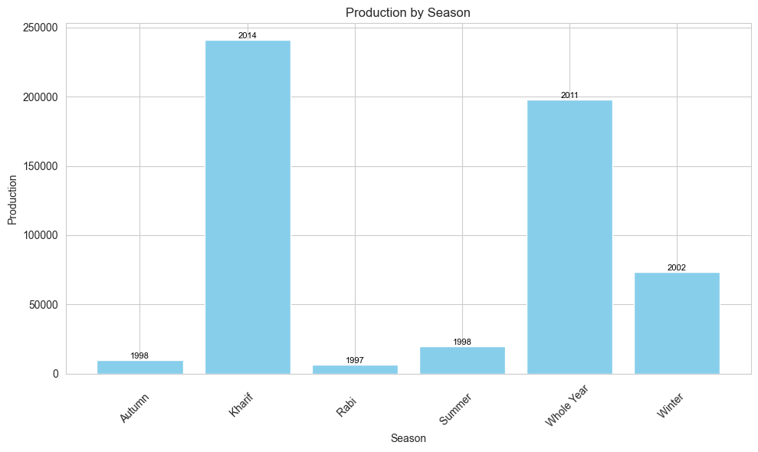
Graphs and Views

Slide 8
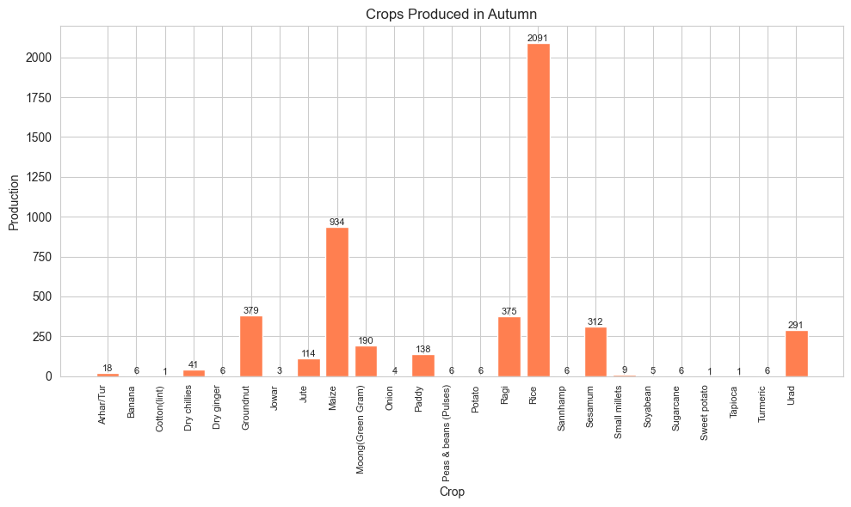
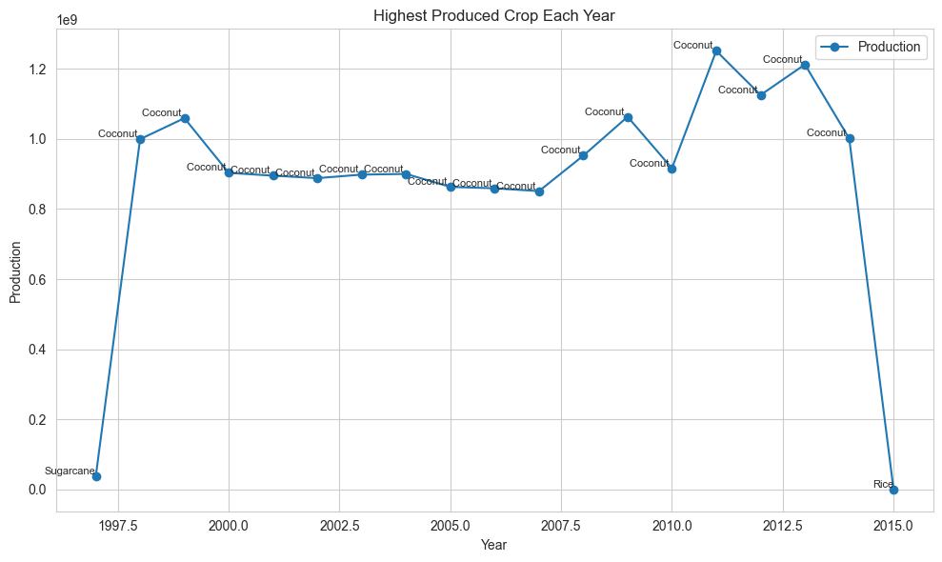
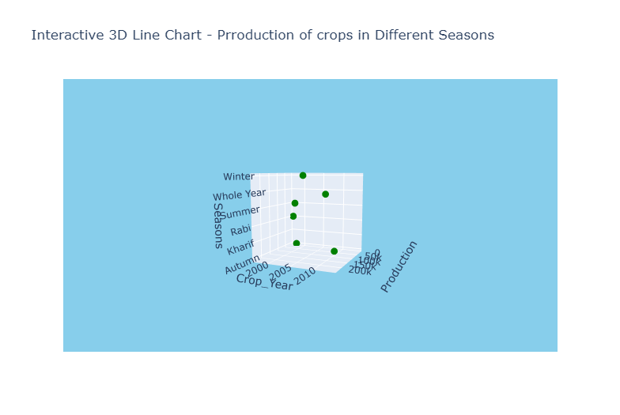
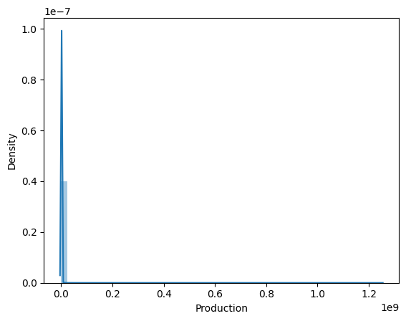
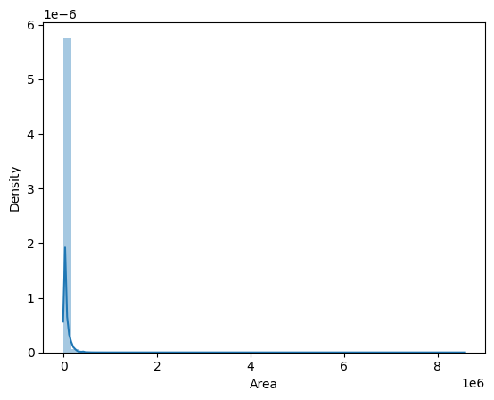
Dashboard:

Slide 9
Thank you
bhanudevaguptapu4@gmail.com

