Slide 1
ONLINE BANKING SYSTEM SIMULATION
Full-stack banking with BCNF schema, ACID transactions and indexing
Database Systems Engineering and Distributed Backend Development (25CS1302E) | KLH Bachupally Campus, CSE
Team 9 | Section 8
Jakka Bhanu (2520030006) Anand Akshita (2520030043)
Guide: Dr. D. Ramya Krishna
Notes:
Introduce the project, team, guide and course.

Slide 2
Abstract & Problem Statement
Abstract
Problem
A full-stack banking simulation for accounts, deposits, withdrawals, transfers and transaction history.
It uses a BCNF schema, ACID transactions and indexing to keep balances consistent.
Stack: React.js front end, Spring Boot REST back end, MySQL database.
Simple banking systems suffer from three connected problems:
1. Inconsistent data from redundant storage
2. Concurrency errors such as lost updates and half-finished transfers
3. Slow queries as data grows
A single database also limits scale and availability.
Online Banking System Simulation | KLH PBL 2026-27
2
Notes:
Explain that banking data is a promise about money, so correctness matters more than appearance.

Slide 3
Objectives & Scope
Objective 1
Objective 2
Objective 3
Design a BCNF-normalised schema so no fact is stored twice.
Ensure safe transactions with ACID properties and isolation levels.
Improve speed with indexing and study replication and sharding.
Scope
Customers, accounts, transfers and transaction history. This is a simulation: no real payment network, loans or interest. Replication and sharding are studied as concepts.
Online Banking System Simulation | KLH PBL 2026-27
3

Slide 4
Existing vs Proposed System
Feature | Existing System | Proposed System
Code structure | Mixed logic | Layered architecture
Data consistency | Redundant data | BCNF schema
Transactions | No concurrency control | ACID + isolation levels
Performance | Slow as data grows | Indexing + EXPLAIN
Limitation / Gap | Single database | Replication and sharding concepts
Online Banking System Simulation | KLH PBL 2026-27
4

Slide 5
Tools & Technologies
Front-End
Back-End
React.js: component-based single-page UI
Spring Boot + REST APIs: layered services
Database
Tools
MySQL (InnoDB): ACID, indexes, EXPLAIN
MySQL Workbench, Postman, Git & GitHub
Online Banking System Simulation | KLH PBL 2026-27
5

Slide 6
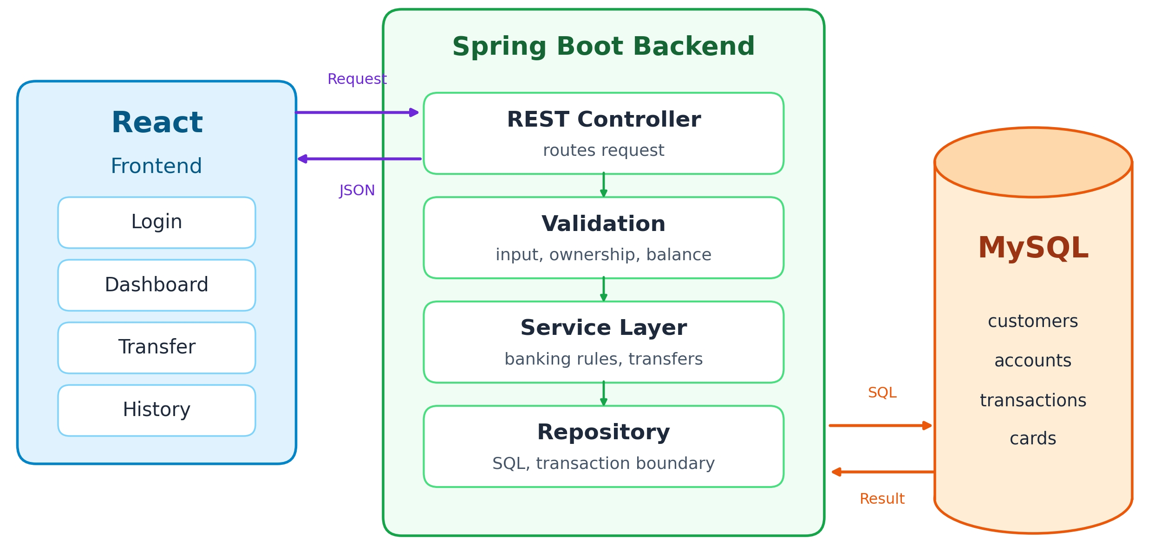
System Architecture
React sends a request to the REST Controller
Validation checks input, ownership and balance
Service Layer applies banking rules and sets the transaction boundary
Repository runs SQL against MySQL
Result flows back to the screen as JSON
Online Banking System Simulation | KLH PBL 2026-27
6

Slide 7
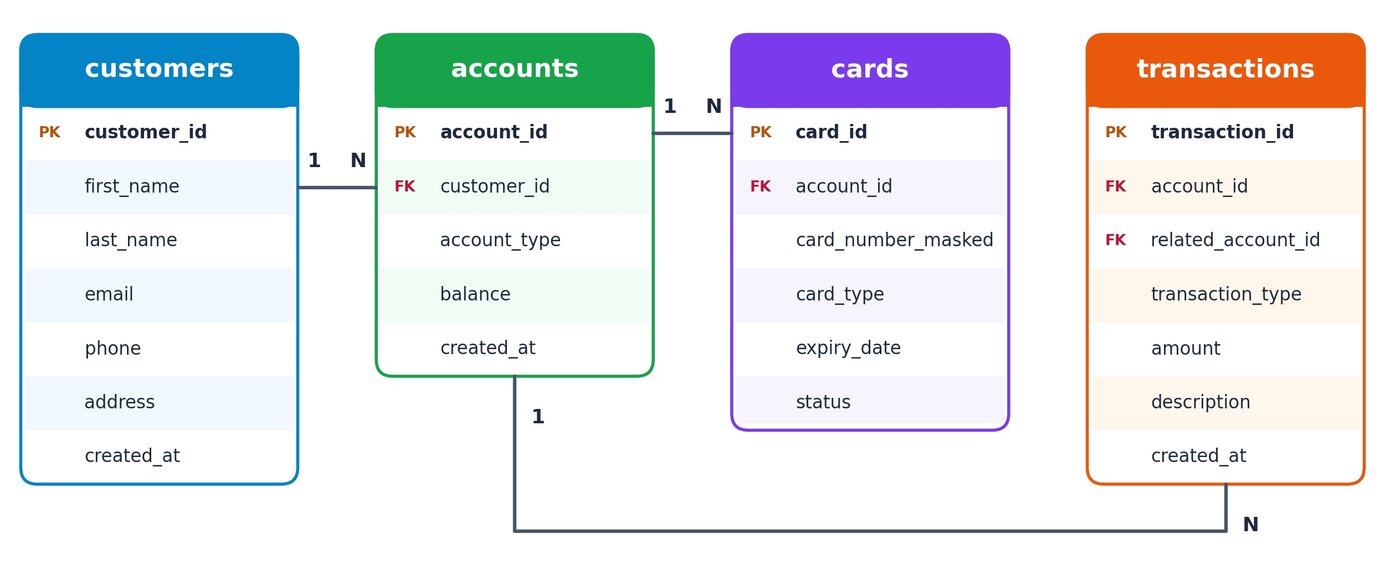
ER Diagram & Database Design
customers 1:N accounts. accounts 1:N cards and accounts 1:N transactions. transactions also reference related_account_id for the other side of a transfer. Every table is in BCNF: each determinant is a candidate key, and card data lives in its own table with only a masked number stored.
Online Banking System Simulation | KLH PBL 2026-27
7

Slide 8
ACID Transactions
BEGIN;
SELECT balance FROM accounts
WHERE account_id IN (:from,:to)
ORDER BY account_id FOR UPDATE;
UPDATE accounts SET balance=balance-:amt WHERE account_id=:from;
UPDATE accounts SET balance=balance+:amt WHERE account_id=:to;
INSERT INTO transactions (...) VALUES (...);
COMMIT; -- any error => ROLLBACK
Atomicity: debit, credit and record succeed or fail together
Consistency: constraints and balance check keep data valid
Isolation: row locks stop lost updates
Durability: committed transfers survive a restart
Rows locked in fixed order to avoid deadlocks
Online Banking System Simulation | KLH PBL 2026-27
8

Slide 9
Performance, Replication & Sharding
Indexing
Replication
Sharding
Index on transactions(account_id, created_at) for history, accounts(customer_id) and customers(email). EXPLAIN confirms the index is used instead of a full table scan.
A primary accepts writes and replicas copy its data. Reads such as history go to replicas, and a replica can take over if the primary fails.
Data is split across servers by a shard key such as customer or account ID. Transfers across shards need distributed-transaction handling.
Online Banking System Simulation | KLH PBL 2026-27
9

Slide 10
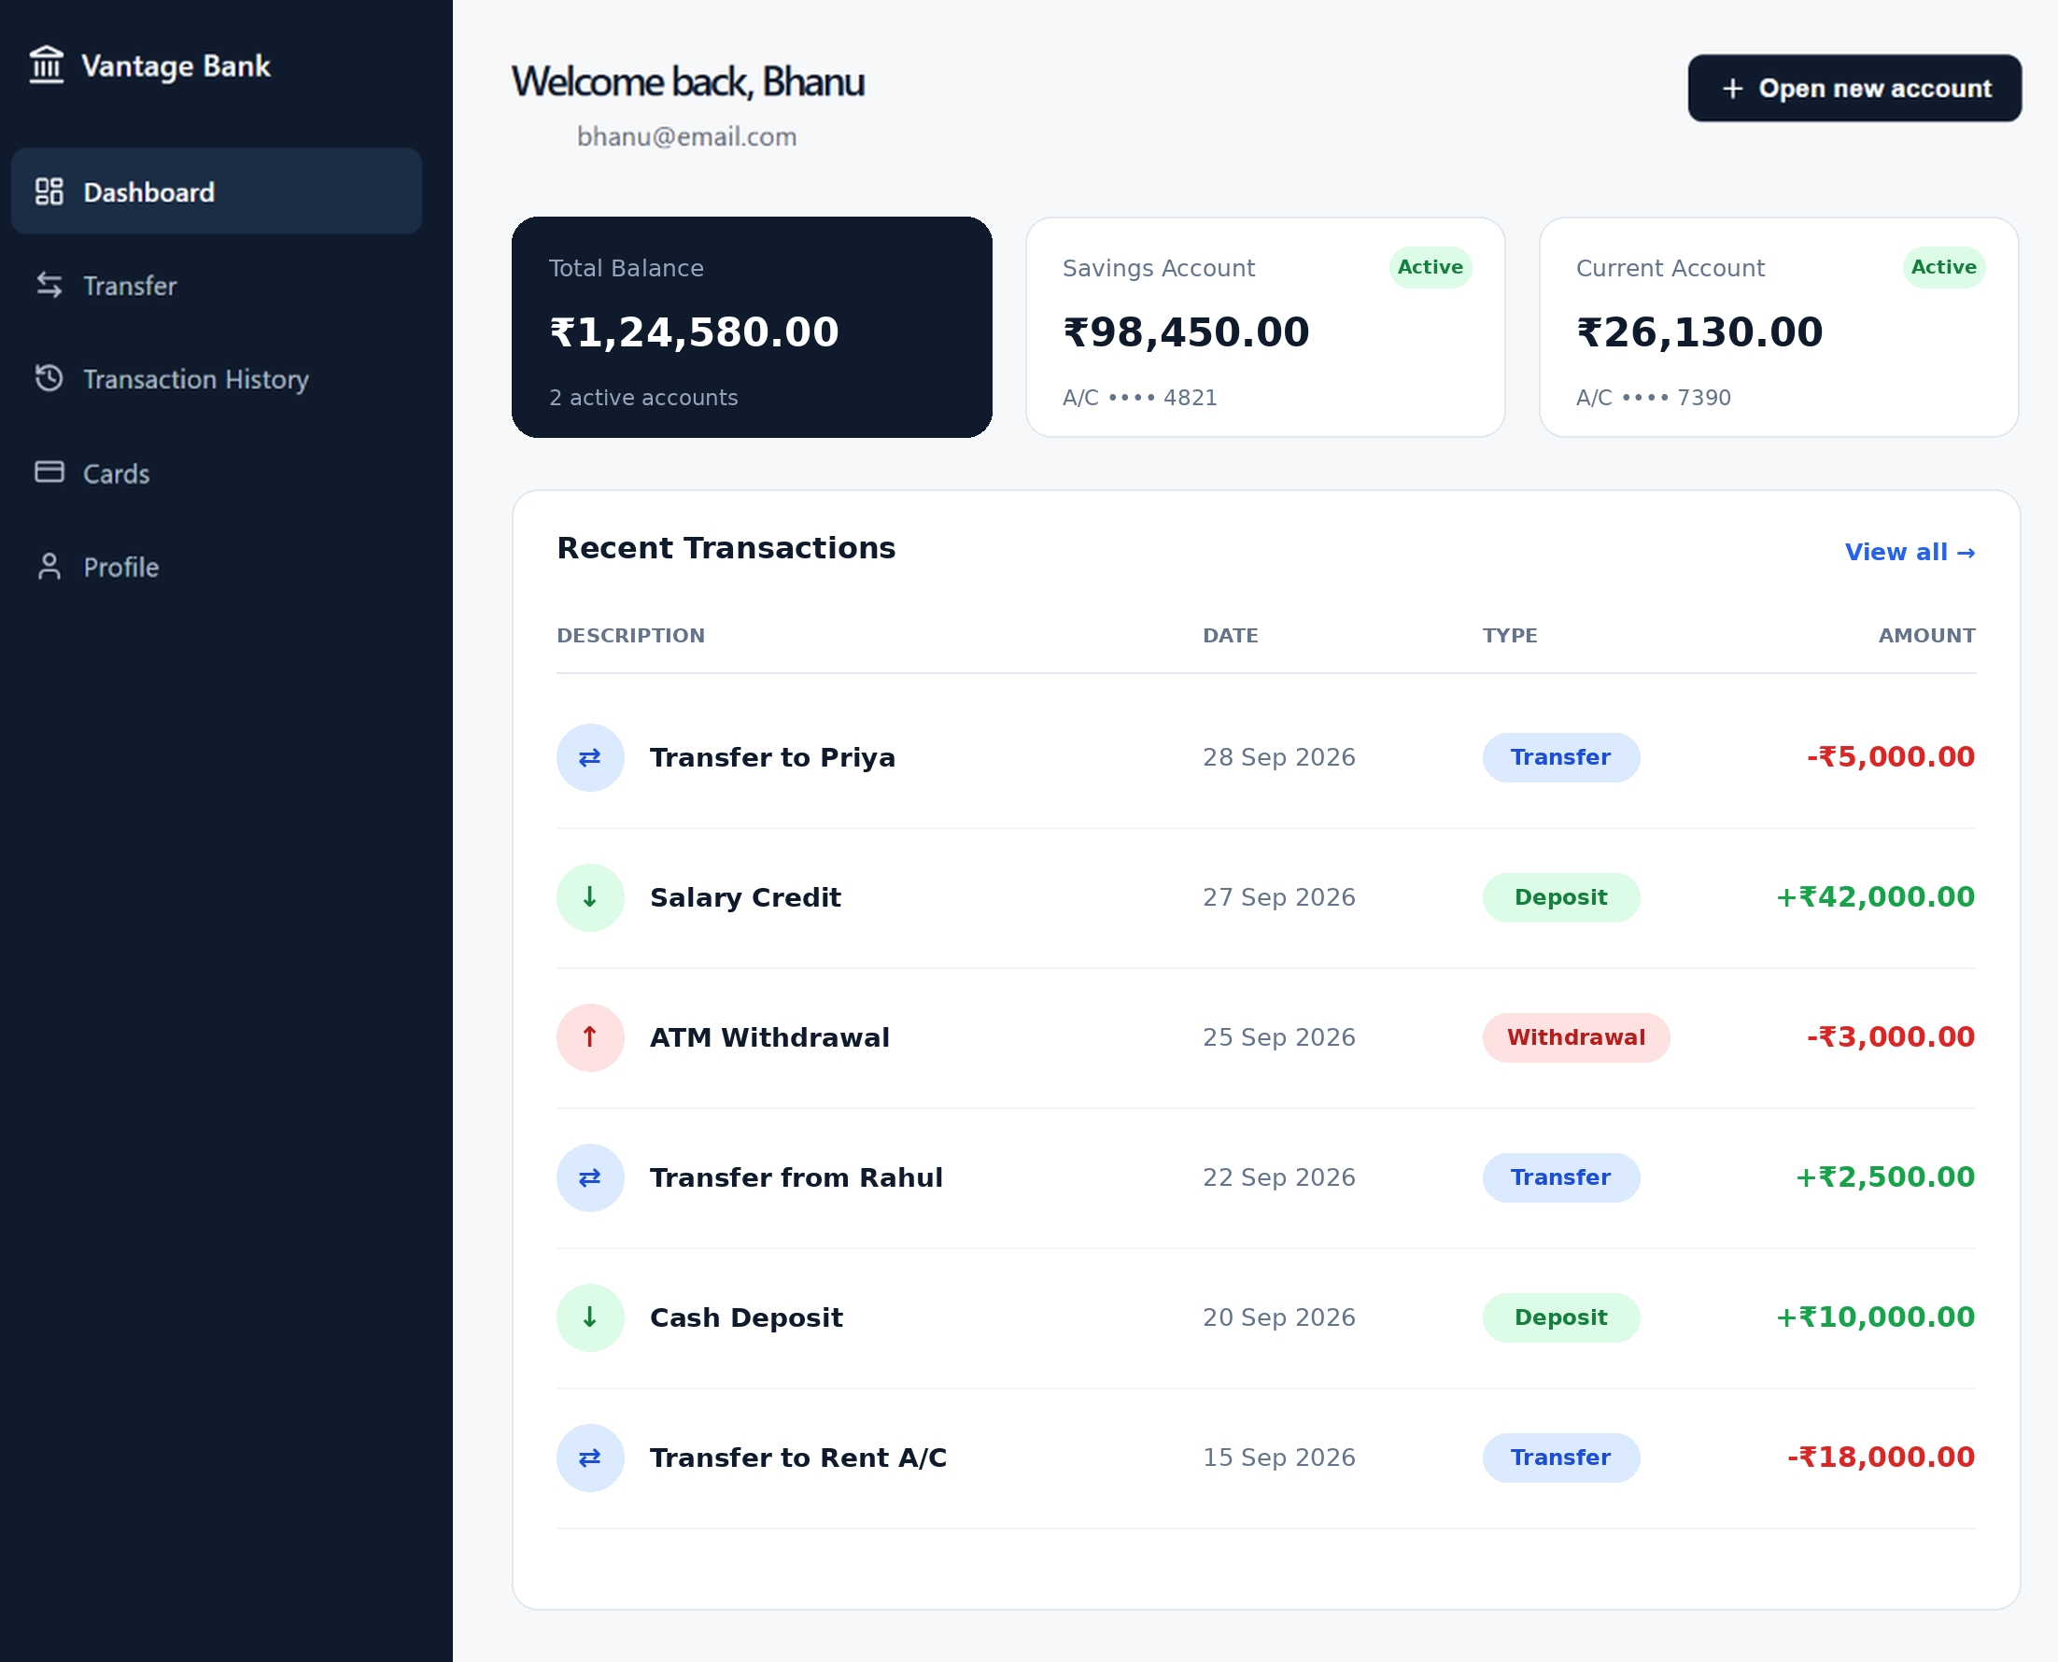
Implementation & Screens
Dashboard: total balance, accounts, recent transactions
Transfer: move money between accounts
Transaction History: type, date, amount
Cards: masked numbers and status
Profile and Open new account
Ownership and balance validation on every request
Online Banking System Simulation | KLH PBL 2026-27
10

Slide 11
Feasibility Study
Technical
Economic
Standard, well-documented tools
Open-source, no cost
Operational
Schedule
Simple screens, easy to maintain
Completed within the trimester
Online Banking System Simulation | KLH PBL 2026-27
11

Slide 12
Results & Testing
All REST APIs tested in Postman: status codes, JSON bodies and database effects
Balances stay consistent after transfers: the debit equals the credit and history matches balances
Invalid input (negative amount, unknown account, insufficient balance) rejected with no data change
Integration flow checked: dashboard, deposit, withdrawal, transfer, history
Concurrency and rollback cases are designed for and queued for final verification
Online Banking System Simulation | KLH PBL 2026-27
12

Slide 13
Conclusion & Future Scope
Conclusion
Future Scope
A working banking simulation with reliable transactions.
BCNF schema, ACID transactions and indexing were applied and all three objectives were met.
Layered architecture keeps rules in one place and the code easy to maintain.
JWT login security
Real replication and sharding
Role-based access, scheduled transfers, notifications, statements and cloud hosting
Online Banking System Simulation | KLH PBL 2026-27
13

Slide 14

Thank you
Questions?
Source code and documentation: scan the QR code for the GitHub repository

