Slide 1
Database Systems Engineering and Distributed Backend Development (25CS1302E)
ONLINE BANKING SYSTEM SIMULATION
Team Members
JAKKA BHANU : 2520030006
ANAND AKSHITA : 2520030043
Under the Esteemed Guidance of
DR. D. RAMYA KRISHNA

Slide 2
Abstract
The Online Banking System Simulation is a full-stack web application that replicates the core functionality of a modern digital banking platform. It is built using a three-tier architecture — React.js for the frontend, Spring Boot (Java) for the backend REST API, and MySQL for the relational database.
The system supports customer registration and OTP-verified secure login, multiple account types (Savings and Checking), real-time fund transfers with atomic transaction guarantees, transaction history with downloadable statements, debit/credit card issuance and management (limits, freeze/unblock, replacement), loan applications with automatic EMI calculation, fixed and recurring deposits, a real-time notification system, and comprehensive profile and security management including login activity tracking and two-factor authentication control.
The database schema is normalized up to Boyce-Codd Normal Form (BCNF) across 10 interconnected tables, with referential integrity enforced through foreign keys and business rules enforced through CHECK constraints. All financial operations (transfers, deposits) are implemented as atomic database transactions, ensuring balances remain consistent even under failure conditions.

Slide 3
Introduction
Digital banking has become the primary way individuals manage their finances, replacing traditional in-branch visits with instant, anytime access to accounts. Building such a system requires careful engineering across three layers: a relational database that correctly models financial relationships, a backend that enforces security and transactional correctness, and a frontend that presents this data reliably to the user.
Database Engineering: ER modeling, BCNF normalization, constraint enforcement, and indexing for query performance.
Backend Engineering: RESTful API design using Spring Boot, JWT-based stateless authentication, bcrypt password hashing, and OTP-based two-factor verification.
Transactional Integrity: all money-moving operations use database transactions (@Transactional) so that a transfer either fully completes or fully rolls back — never leaving accounts in a partially updated state.
Frontend Engineering: a responsive single-page application using React.js and React Router, with real-time UI updates reflecting backend data.

Slide 4
Problem Statement and Objectives
Problem Statement:
Many simplified or academic banking system implementations fail to reflect how real banking software is engineered — they often store data without proper normalization, allow transactions that can leave account balances inconsistent under failure or concurrent access, and lack meaningful authentication or security mechanisms. This creates a gap between theoretical database/backend coursework and practical, production-relevant implementation.
Objectives:
Design a relational database schema normalized to BCNF, correctly modeling customers, accounts, cards, transactions, beneficiaries, loans, deposits, notifications, and login activity.
Implement a secure backend REST API enforcing JWT-based authentication, bcrypt password hashing, and OTP-based two-factor verification.
Guarantee transactional integrity for all fund-moving operations (transfers, deposit debits) using atomic database transactions.
Build a complete, functional frontend covering the full customer journey: registration, login, account management, transfers, loans, deposits, card management, and profile/security settings.
Demonstrate real-world banking security and usability patterns (OTP verification, login activity tracking, card freeze/replace) within an academic project scope.

Slide 5
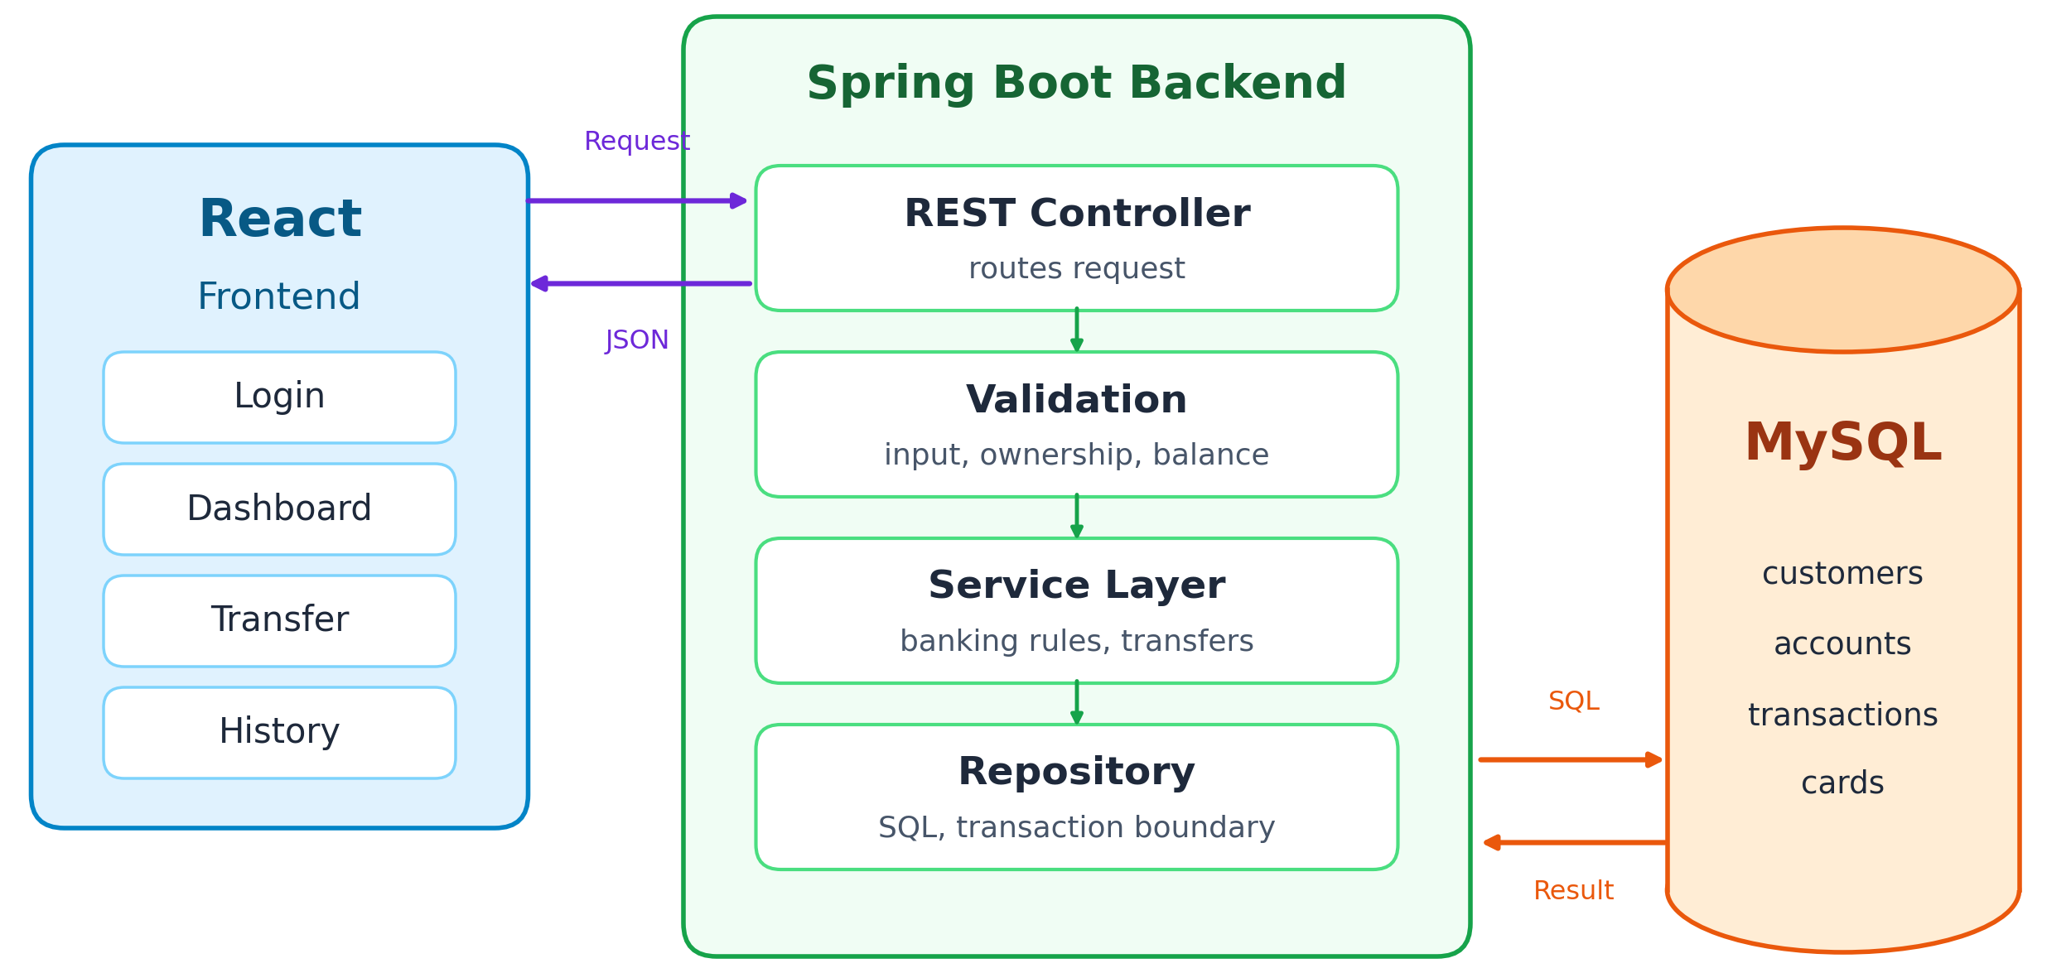
SYSTEM ARCHITECTURE

Slide 6
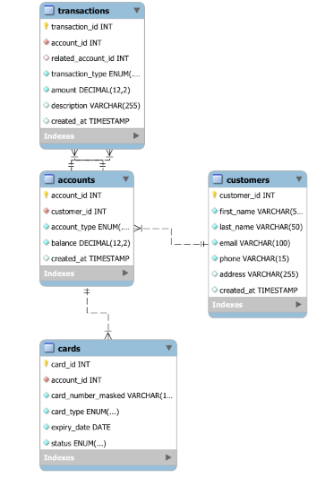
ER DIAGRAM

Slide 7
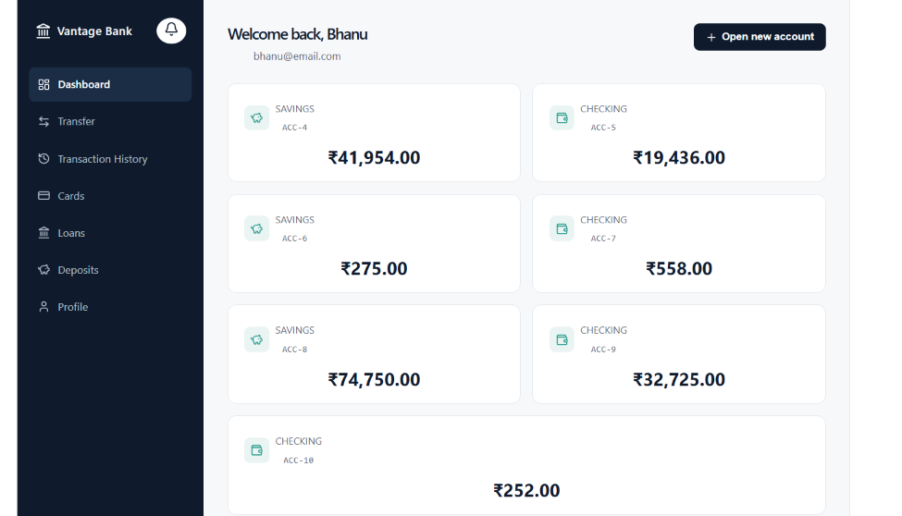
OUTPUTS

Slide 8
Results
All REST API endpoints (authentication, accounts, transfers, cards, loans, deposits, notifications, profile) were independently tested and verified using Postman before frontend integration.
Fund transfers were verified to maintain atomicity: account balances update correctly and consistently, with two corresponding transaction records (debit and credit) created in a single atomic operation.
Password security was verified: passwords are never stored or transmitted in plain text; bcrypt hashing was confirmed via direct database inspection.
OTP-based two-factor login was tested end-to-end: login requires both a correct password and a valid, time-limited OTP before a session token is issued.
Card management features (issue, block/unblock, limit changes, online/contactless toggles, replacement) were tested and confirmed to correctly update database state.
Loan EMI calculations were verified against the standard amortization formula.
The complete system was tested end-to-end across all modules in a real browser environment (not just API-level testing), confirming correct integration across all three tiers (React → Spring Boot → MySQL).

Slide 9
Hardware and Software requirements
Hardware:
Development machine: Intel i5 (8th gen) or equivalent, 8GB+ RAM, 10GB free storage
Client (end user): any device with a modern web browser, 2GB+ RAM
Software:
Operating System: Windows/macOS/Linux
Frontend: React.js (via Vite), React Router DOM, Lucide React icons
Backend: Java 17/21, Spring Boot 3.x, Spring Data JPA, Hibernate
Database: MySQL Server 8.0, managed via MySQL Workbench
Security libraries: jjwt (JWT), jBCrypt (password hashing)
Development tools: Spring Tool Suite 4 (STS4) / Eclipse, VS Code
API testing: Postman
Version control: Git, GitHub

Slide 10
Conclusion
This project successfully demonstrates the design and implementation of a full-stack banking simulation that goes beyond basic CRUD operations to reflect genuine banking software engineering concerns: normalized relational design, atomic transaction handling, secure authentication, and a complete, usable customer-facing application.
All stated objectives were met: a BCNF-normalized schema was designed and implemented; secure, two-factor authentication was built and verified; transactional integrity was enforced and tested; and a complete frontend was delivered covering account management, transfers, loans, deposits, cards, notifications, and profile/security features. The project demonstrates practical, working knowledge of relational database engineering and modern full-stack web development.

Slide 11
Future Scope
Integration with a real SMS/email gateway (e.g., Twilio, SendGrid) for genuine OTP delivery, replacing the current on-screen simulated delivery used for demonstration purposes.
PDF-formatted, bank-style downloadable statements, replacing the current CSV export.
Database replication (primary-replica) for read scaling, and horizontal sharding by customer ID, as originally scoped in the project abstract.
Voice-assisted navigation for accessibility (balance checks, transfers via voice commands).
Expanded KYC verification workflow with document upload and manual/automated verification status.
Production deployment with CI/CD pipeline, containerization (Docker), and cloud hosting.

Slide 12
Thank you

