Slide 1
Data Structures and Algorithms -3 (25CS2103E)
A Dictionary-Based Fuzzy Search and Spell Correction Engine for Smart Shopping
Team Members
Jakka Bhanu : 2520030006
Anand Akshita: 2520030043
Harini P : 2520030177
Under the Esteemed Guidance of
Dr. S. Madhavi

Slide 2
Contents
Abstract
Introduction
Literature survey
Problem Statement and Objectives
Hardware and Software requirements
Results
Conclusion
Future Scope

Slide 3
Abstract
Online shopping platforms rely heavily on search boxes to help customers find products, but customers frequently misspell item names while typing, causing traditional exact-match search systems to return no results. This project implements "A Dictionary-Based Fuzzy Search and Spell Correction Engine for Smart Shopping" — a console-based system that retrieves and corrects misspelled product searches in real time. The catalog is indexed using a Trie, and the Levenshtein Edit Distance algorithm (Dynamic Programming) identifies the closest matching product, displaying a "Did you mean...?" correction. Beyond spell correction, the system supports autocomplete, keyword and multi-keyword search, category browsing, price-range filtering, a Top-N item finder, a shopping cart, and a warehouse-fulfillment checker — together demonstrating Tries, Dynamic Programming, hashing, Binary Search, Heaps, and Network Flow working as one cohesive system.

Slide 4
Introduction
E-commerce search is one of the most heavily used features on any shopping platform, directly influencing whether a customer finds a product or leaves empty-handed
Exact-match search — the simplest approach — fails the moment a query contains even one typing mistake
This problem grows as catalogs expand across more categories and brands, since customers rarely remember exact spellings
This project builds a search engine that tolerates and corrects such mistakes automatically, going beyond spell correction to support multiple realistic shopping search behaviors
The system is implemented entirely in Java as a menu-driven console application

Slide 5
Literature Survey
Exact string matching fails whenever a query doesn't match a stored string character-for-character, making it unsuitable for typo-prone input
Edit distance (Levenshtein, 1965) is the standard measure of similarity between strings, widely used in spell-checkers and sequence alignment
Real-world engines like Elasticsearch and Solr implement fuzzy search using Levenshtein-based matching at scale
Tries are the standard structure behind autocomplete in browsers, IDEs, and search bars
Rabin-Karp and Aho-Corasick are established algorithms for efficient substring and multi-keyword search
Network flow algorithms (Ford-Fulkerson, Edmonds-Karp) underpin resource-allocation problems like order fulfillment and logistics
This project combines these established techniques into a single, working shopping-search application

Slide 6
Problem Statement and Objectives
Problem Statement:
Traditional exact-match product search fails whenever a customer misspells a product name, resulting in "no results found" and a poor shopping experience, especially as catalogs grow larger and more diverse.
Objectives:
Develop a Trie-based dictionary/catalog search engine
Implement fuzzy search using Levenshtein Edit Distance to correct misspelled queries
Provide autocomplete suggestions as the customer types
Support keyword and multi-keyword search using Rabin-Karp and Aho-Corasick
Enable efficient price-range filtering using Binary Search
Provide a Top-N cheapest/most expensive finder using a Heap
Implement a shopping cart and a warehouse-fulfillment check using Max-Flow
Ensure the system scales efficiently to a large product catalog

Slide 7
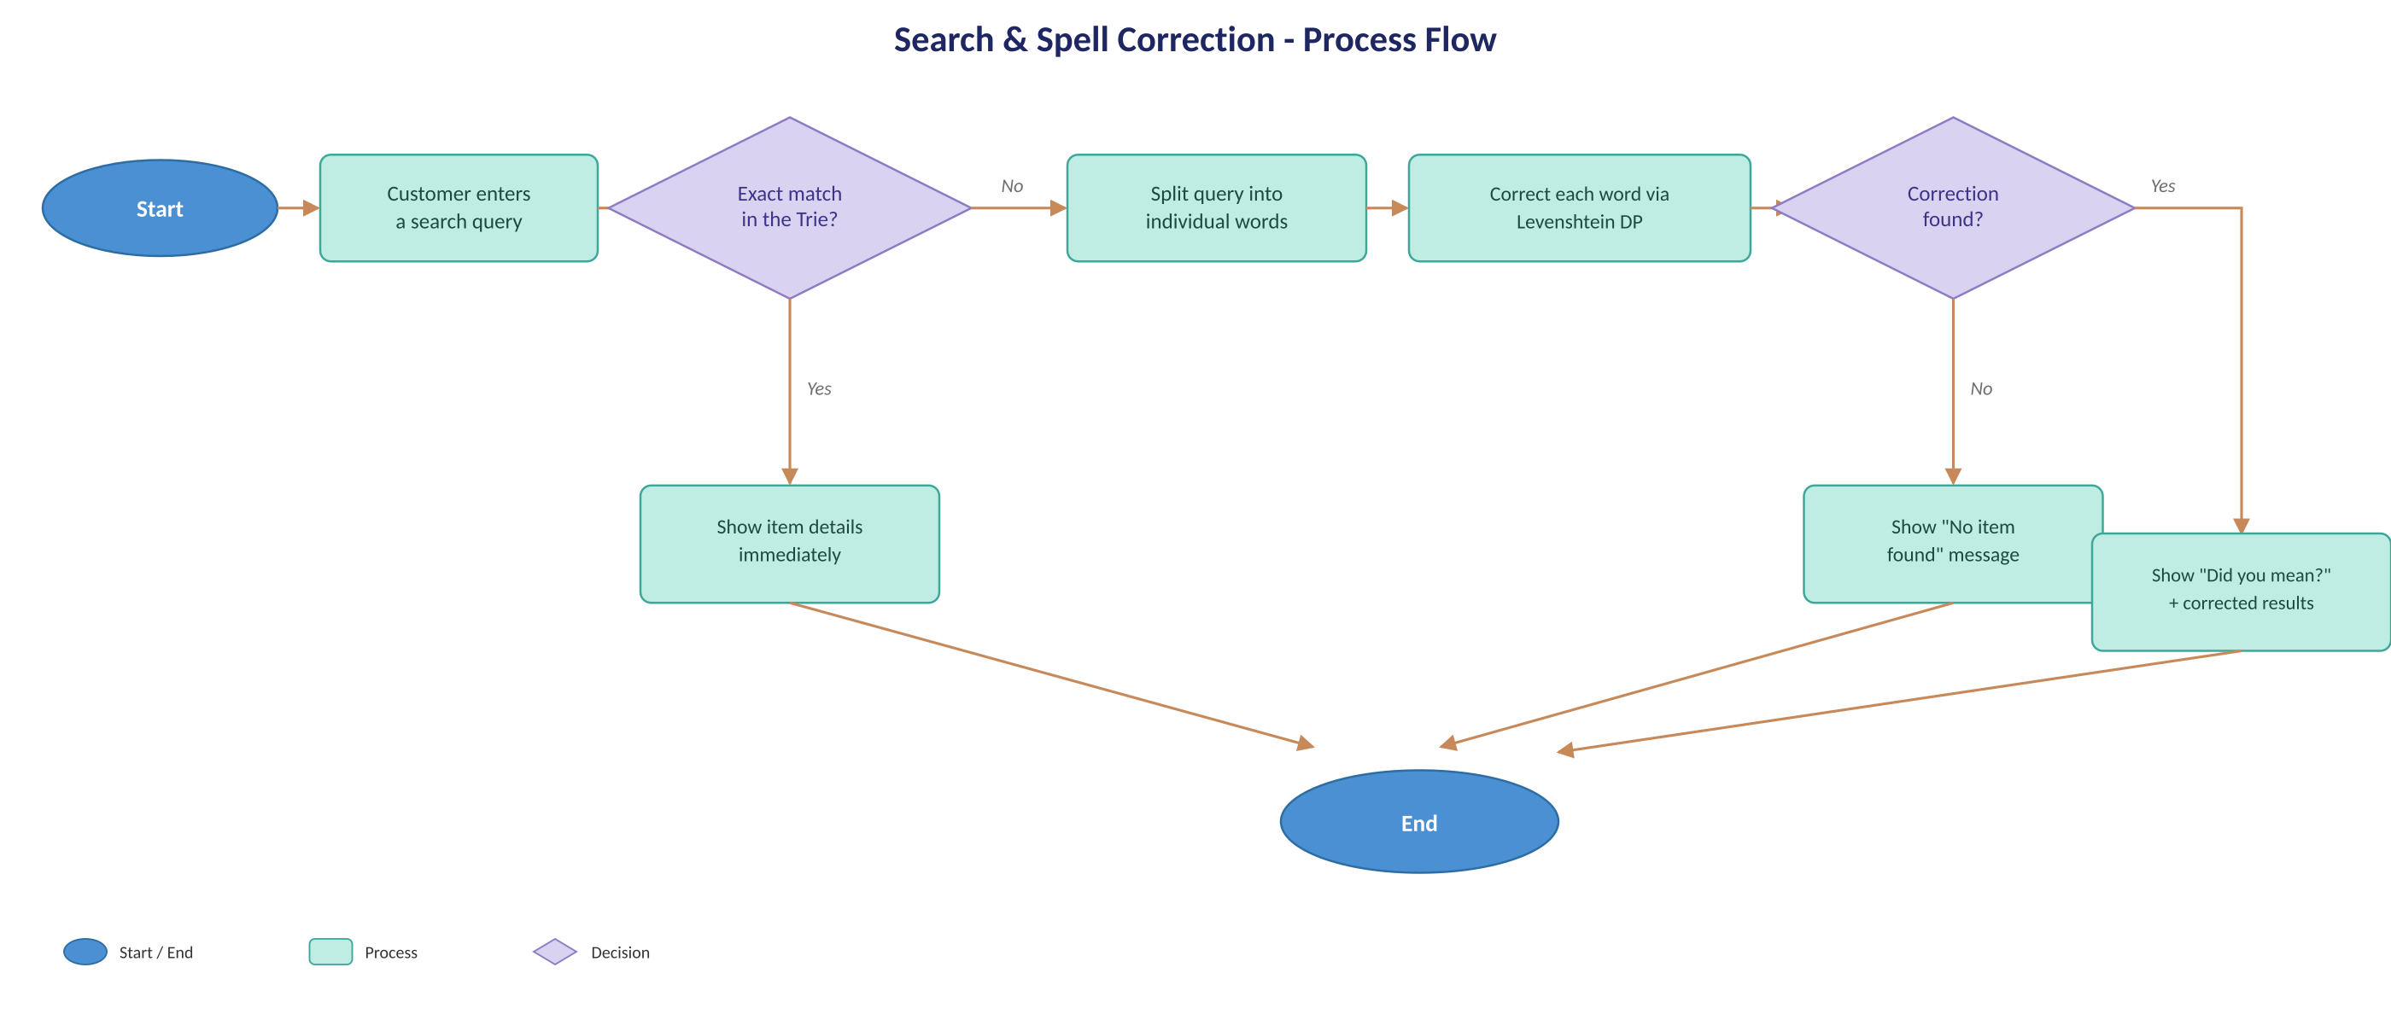
Flow Chart

Slide 8
Results
Fully working, menu-driven Java console application with 13 features
Spell correction verified on single-word ("shooz" → shoes) and multi-word ("opa chrger" → oppo charger) typos, plus misspelled category names
Rabin-Karp, Aho-Corasick, Binary Search, and Heap-based search all return correct, efficient results without scanning the full catalog
Max-Flow correctly computes warehouse fulfillment for cart orders, including bottleneck cases
All optimized results validated against brute-force comparisons for correctness
Tested end-to-end against 2,175 products across 15 categories

Slide 9
Hardware and Software requirements
Hardware Requirements:
Any standard PC or laptop (Intel i3 / equivalent or higher)
Minimum 4 GB RAM
100 MB free disk space
Software Requirements:
Operating System: Windows / Linux / macOS
Java Development Kit (JDK) 11 or later
Code editor / IDE: VS Code, IntelliJ IDEA, or Eclipse
No external libraries or database required — uses core Java only, plus a CSV data file

Slide 10
Conclusion
This project successfully demonstrates that classic data structures and algorithms — Tries, Dynamic Programming, hashing, Binary Search, Heaps, and Network Flow — can be combined into one practical system that solves a real e-commerce problem: helping customers find what they meant to search for, even when they misspell it. Beyond spell correction, the system supports a complete set of shopping-search features, making it a functional, demonstrable prototype rather than a single-purpose algorithm exercise.

Slide 11
Future Scope
Extend the console application into a web-based or GUI interface
Replace the CSV catalog with a real database (SQL/NoSQL) for persistent, larger-scale storage
Add phonetic matching (e.g., Soundex, Metaphone) to catch typos that sound similar but look very different
Support multilingual and regional-language product search
Incorporate ranking based on customer purchase history or popularity, not just edit distance
Extend the Max-Flow warehouse model to real-time inventory and multiple delivery hubs
Add user authentication and order history for a complete e-commerce experience

Slide 12
Thank you

