Slide 1

A Project Review Meeting on Passenger Name Record
By
Name: BHANU JAKKA Roll No:2520030006
Name: HAVISHAA REDDY Roll No: 2520030371
Team Number: 17
Under the guidance of
D. PAVITHRA
Assistant Professor
Department of Computer Science and Engineering
Koneru Lakshmaiah Education Foundation (Deemed to be University estd. u/s. 3 of the UGC Act, 1956) Off-Campus: Bachupally-Gandimaisamma Road, Bowrampet, Hyderabad, Telangana - 500 043. Phone No: 7815926816, www.klh.edu.in

Slide 2
Outline of the Presentation
Abstract
Introduction
Problem Statement
Project Flow Diagram
Objectives with Justification
Modules[Frontend web pages]
Expected Outcomes of the Proposed Work
Conclusion
References

Slide 3
Abstract
The Passenger Name Record (PNR) Manager is a web-based application developed to simplify and streamline the management of airline booking records. A PNR is a unique 6-digit alphanumeric code assigned to each passenger’s booking, which acts as a reference to access complete travel information.
It stores essential details such as passenger information, flight itinerary, seat allocation, and Special Service Requests (SSR) like meal preferences or special assistance. Efficient management of PNR data is crucial for airline operations, as it directly impacts service quality and operational accuracy.
This system provides a centralized platform where users can easily search, view, modify, and cancel PNR records. The search functionality enables quick retrieval of booking details using the PNR code or passenger-related information. The detailed view displays all relevant data in a structured format, allowing users to clearly understand and manage bookings.

Slide 4
Abstract
The modify and cancel features provide flexibility in handling changes, while SSR management ensures that specific passenger requirements are properly addressed.
A key feature of the system is the audit trail, which records every action performed on a PNR, including updates and cancellations. This enhances transparency, accountability, and system monitoring. Additional features such as notifications, history tracking, and data export further improve usability and functionality.
The PNR Manager is built using modern web technologies, offering a responsive and user-friendly interface. By automating and centralizing booking operations, the system minimizes manual errors, saves time, and increases efficiency. Overall, it provides a reliable and structured solution for managing airline reservation data effectively.

Slide 5
Introduction
PNR is the fundamental database ledger holding an airline passenger's complete itinerary data.
The Industry Problem: Legacy reservation networks suffer from communication lag, leading to data mismatches, audit trails errors.
Decoupled Multi-Portal Design: Independent, specialized interfaces tailored for Passengers (self-service) and Aviation Admins (manifest overrides).
Real-Time Data Flow: A centralized state architecture that synchronizes updates across both portals instantly with zero page-reloads.

Slide 6
Problem Statement
Passenger Name Records (PNRs): Core records storing passenger and flight details, but current systems lack transparency and efficient tracking of modifications or cancellations.
Audit Trails & Accountability: Airlines struggle to maintain accurate logs of booking actions, making accountability and record management difficult.
Special Service Requests (SSR): Services like meals or medical assistance are often mishandled, while manual processes increase errors and delays.
Need for Modern Solution: Traditional systems lack notifications, history tracking, and usability; a streamlined platform is required to integrate SSR handling, audit logging, and user‑friendly design for improved passenger experience.

Slide 7
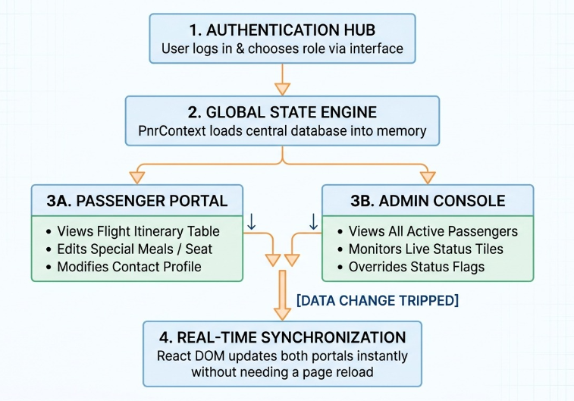
Project Flow Diagram

Slide 8
Objectives with Justification
Objectives with Justification:
Transparent PNR Management – To ensure clear tracking of modifications and cancellations, reducing disputes and confusion.
Efficient SSR Handling – To manage passenger needs like meals, wheelchair assistance, or medical support in a streamlined way.
Error Reduction – To minimize manual mistakes and inconsistencies by automating record updates.
User‑Friendly Interface – To simplify operations for both staff and passengers, making the system easy to use.
Booking History Tracking – To provide accountability and quick access to past records for better management.
Real‑Time Notifications – To keep passengers and staff updated instantly about booking changes.
Scalability and Security – To handle large volumes of data reliably while ensuring safe and secure record management.

Slide 9
Modules [Frontend web pages]
Frontend Web Pages (Modules):
Login Page – Secure access for users and admins with proper validation.
Signup Page – Registration for new users with form validation.
Dashboard – Central hub showing booking overview and quick actions.
PNR Search Page – Search by PNR number, passenger name, or flight details.
Detail View Page – Displays complete passenger and flight information.
Modify Form Page – Allows authorized users to update booking details.
Cancel Booking Page – Handles cancellations with confirmation prompts.
SSR Management Page – Add or update special service requests (meals, wheelchair, medical needs).
Audit Log Page – Tracks all modifications and actions for transparency.
Notifications Page – Displays system alerts and booking updates.
Admin Panel – Provides management tools for administrators.
History Page – Shows past bookings and modifications for reference.

Slide 10
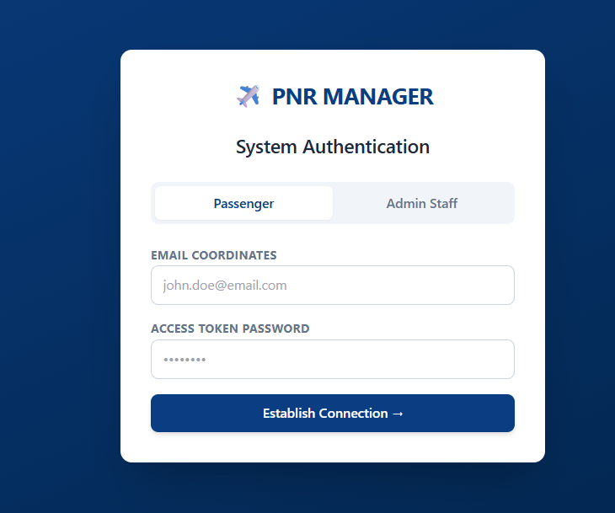
Modules [Frontend web pages]

Slide 11
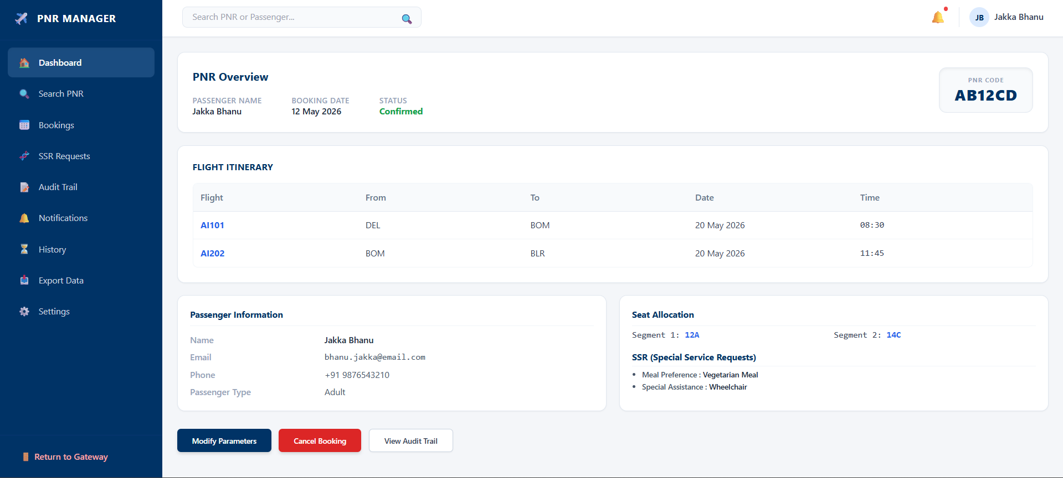
Modules [Frontend web pages]

Slide 12
CO MAPPING
CO1: Foundations of Front-End Engineering & Framework Design
Virtual DOM Reconciliation
Unidirectional Data Flow
Declarative UI States
CO2: JavaScript & TypeScript Engineering for Frameworks
JavaScript Closures
Asynchronous Core Async/Await Flow
ES6 Modules

Slide 13
CO MAPPING
CO3: React Component Model (Engineering View)
Props as Immutable Configuration Contracts
Deterministic UI Functions
Controlled Form Components
CO4: State Architecture, Async Data Engineering & API Integration
Global State vs. Localized Co-location
React Context Architecture Rationale

Slide 14
CO MAPPING
CO5: Routing, Forms, Accessibility & Performance Engineering
Inline CSS Media Query Injection
Print Virtualization Boundaries
Component Unmounting Guards
CO6: Build Systems, Testing, CI/CD & Deployment Engineering
Vite Compiler Build Systems
Single-Page App (SPA) Bundling Optimization

Slide 15
Expected Outcomes of the Proposed Work
Expected Outcomes of the Proposed Work:
Improved transparency in managing Passenger Name Records with clear audit trails.
Efficient handling of modifications, cancellations, and booking history.
Streamlined management of Special Service Requests (SSR) such as meals and medical assistance.
Reduction of manual errors and inconsistencies in passenger records.
Enhanced passenger satisfaction through notifications and easy access to booking details.
User‑friendly interface that simplifies operations for both staff and passengers.
Reliable system performance with secure data handling and accountability.
Foundation for future scalability and integration with advanced airline services.

Slide 16
Conclusion and Future Scope
Conclusion: The PNR Manager project improves airline booking systems by making passenger records transparent, efficient, and easy to manage. With features like SSR handling, audit logging, notifications, and history tracking, it reduces errors, ensures accountability, and enhances passenger experience.
Future Scope: The system can be expanded with AI‑based support, mobile app integration, multilingual access, and predictive analytics for passenger needs. Advanced security like blockchain and cloud scalability can further strengthen reliability, making it adaptable to future airline industry demands.

Slide 17
References
References:
International Air Transport Association (IATA) – Passenger Name Record (PNR) Guidelines.
International Civil Aviation Organization (ICAO) – Standards for PNR Data Exchange.
Amadeus Airline IT Solutions – PNR Management Systems.
Sabre Travel Network – Lifecycle of Passenger Name Records.
Academic resources on Database Management Systems and Airline Reservation Systems.

Slide 18
Thank you

