Slide 1
AI-Based Consumer Complaints Classification System
Using Machine Learning and Generative AI with N-Tier Architecture
Presented by: [Your Team Names]
Date: January 29, 2026

Slide 2
Agenda
Problem Statement
Proposed Solution
Key Features
Technology Stack
System Architecture
ML Pipeline & Workflow
Explainable AI Integration
Conclusion & Future Scope

Slide 3
Problem Statement
High Volume of textual complaints
Inconsistency in manual classification
Lack of explanation from black-box models
Architectural gaps for enterprise deployment

Slide 4
Proposed Solution
Hybrid AI approach
Deterministic ML (Scikit-learn)
Generative AI for explanations (Google Gemini)
N-Tier 5-layer architecture
Full ML lifecycle and DB persistence

Slide 5
How This Differs from Existing Solutions
Key Differentiators
Aspect | Existing Solutions | This Project
Architecture | Monolithic scripts or notebooks | N-Tier enterprise architecture (5 layers)
Explainability | Label prediction only | GenAI-powered natural language explanations
ML Approach | Complex transformers requiring GPUs | Lightweight Scikit-learn models (CPU-optimized)
Transparency | Black-box predictions | Full audit trail + confidence scoring
Deployment | Academic prototypes | Production-ready with database persistence
Unique Innovations:
Hybrid ML + GenAI Architecture: Combines traditional ML (Logistic Regression/SVM) for fast, accurate classification with Google Gemini for human-readable explanations of model decisions.
CPU-Optimized Inference: Uses TF-IDF + Scikit-learn models requiring no expensive GPU infrastructure, enabling deployment on standard servers.
Enterprise N-Tier Design: Professional 5-layer architecture with clear separation of concerns—Presentation, Application, AI/ML Processing, Data Access, and Data layers.
Explainable AI Integration: Consumers and support teams receive actionable context: "Classified as 'Billing Issue' due to mentions of unauthorized charges and payment disputes. Confidence: 92%."
Complete Audit Trail: Every complaint, prediction, confidence score, and explanation persisted in PostgreSQL for compliance and analytics.
Production-Ready Security: Environment-based configuration, parameterized SQL queries preventing injection attacks, and comprehensive error handling.

Slide 6
Key Features
Automated complaint triage
Confidence scoring
Explainable AI (XAI) via Gemini
Production-grade NLP pipeline
Persistent audit trail
Secure & modular design

Slide 7
Technology Stack
Backend/API: Python 3.12, Flask 3.x
ML: Scikit-learn, TF-IDF, Logistic Regression/SVM
Generative AI: Google Gemini API
Database: PostgreSQL/MySQL
Architecture: N-Tier (5 Layers)
DevOps: Docker/Podman, GitHub Actions

Slide 8
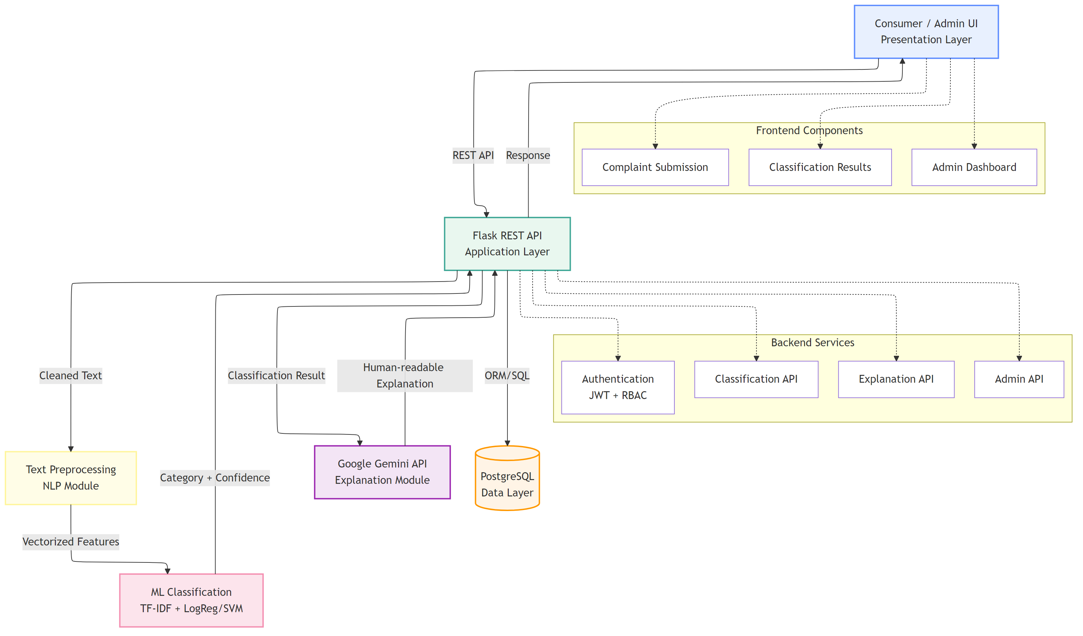
System Architecture
N-Tier Enterprise Architecture
1. Presentation Layer (REST API)
2. Application Layer (Flask)
3. AI/ML Processing Layer (Preprocessing, TF-IDF, Classification; GenAI explanations)
4. Data Access Layer (parameterized SQL)
5. Data Layer (PostgreSQL)

Slide 9
ML Pipeline & Workflow
Input via API
Preprocessing
Feature extraction (TF-IDF)
Classification (Logistic Regression/SVM)
Confidence scoring
GenAI explanation
Storage in DB

Slide 10
Explainable AI Integration
Importance of explainability
Input to Gemini (complaint + prediction + confidence)
Output example
Prompt engineering for concise factual explanations

Slide 11
Conclusion & Future Scope
Summary of hybrid ML + GenAI approach
Enterprise-ready N-Tier architecture
Future: real-time processing (Kafka/RabbitMQ)
Advanced models (BERT/GPT)
Multi-language support
Active learning feedback loop
Dashboard analytics

