Slide 1
Text to Image Generation
using BERT and GAN
Guide Project Coordinator By
Dr. S. Kavitha Mrs. G. Srisudha V. Bhanu(21AG1A6659)
Syed Sameer Sohail(21AG1A6656)
D. Harish(22AG5A6605)

Slide 2
Abstract :
Text-to-image generation is a challenging task that bridges computer vision and natural language processing. Existing models based on generative adversarial networks (GANs) typically use text encoders pre-trained on image-text pairs. However, these encoders often fail to capture the semantic depth of unseen text during pre-training, making it difficult to generate images that align well with provided textual descriptions.to overcome this issue, we introduce a new text-to-image generation model that incorporates BERT, a highly effective pre-trained language model in natural language processing. By fine-tuning BERT on a large text corpus, we enable it to encode rich textual information, enhancing its suitability for image generation tasks. Experiments conducted on a CUB_200_2011 dataset reveal that our method outperforms baseline models in both quantitative metrics and qualitative assessments.

Slide 3
Literature Survey Overview :
S.No | Author/Year/Title | Methodology | Pros/Cons
1. | Sutskever et al., 2014, "Sequence to Sequence Learning with Neural Networks" | Seq2Seq (RNN-based):The sequence-to-sequence(Seq2Seq) model used Recurrent Neural Networks (RNNs) to convert text descriptions into a sequence of image features. | Pros: Pioneered the concept of translating sequences. It was a major breakthrough in language tasks. Cons: Limited in image generation tasks, prone to losing information over long sequences, and incapable of handling large image datasets effectively.
2. | Reed et al., 2016, "Generative Adversarial Text-to-Image Synthesis" | GAN-based (text-to-image GAN): Used a GAN framework where the generator creates images based on text embeddings, and the discriminator ensures the generated image matches the text description. | Pros: Marked the first use of GANs for text-to-image synthesis. Produced more realistic images compared to previous methods. Cons: Generated images lacked fine details and high-resolution outputs.

Slide 4
Literature Survey Overview Cont….
S.No | Author/Year/Title | Methodology | Pros/Cons
3. | Reed et al., 2016, "Learning Deep Representations of Fine-Grained Visual Descriptions" | Conditional GAN with LSTM: Introduced a conditional GAN using LSTMs for text processing and CNNs for image generation, using fine-grained text descriptions. | Pros: Handled fine-grained visual descriptions well. Improved quality of the generated images. Cons: Images were often blurry and lacked clarity, especially for complex or abstract descriptions.
4. | Mansimov et al., 2016, “Generating Images from Captions with Attention" | Attentional Generative Models: Introduced a combination of RNNs with an attention mechanism that focuses on different parts of the input text while generating different parts of the image. | Pros: The attention mechanism improved the image generation process by focusing on specific text features. Cons: Generated images still lacked realism, and the method struggled with complex images.
5. | Nguyen et al., 2017, "Plug & Play Generative Networks: Conditional Iterative Generation of Images in Latent Space" | Plug-and-Play Generative Networks (PPGN): Used a GAN architecture in combination with a gradient ascent method to iteratively improve the generated images by backpropagating from a discriminator. | Pros: Introduced a flexible way of improving image quality by tuning latent space. Cons: Computationally intensive, and image quality was inconsistent across different samples.

Slide 5
Existing System :
In the existing text-to-image generation systems, most approaches rely on either standalone generative models like GANs (Generative Adversarial Networks) or simplified NLP embeddings to convert textual descriptions into images. While these systems have made significant progress, they often face limitations in effectively capturing the nuanced semantics of complex or lengthy textual descriptions. Traditional GAN-based architectures typically focus on generating images based on shallow text embeddings, which lack a deep understanding of the text's contextual meaning. This often leads to misaligned or oversimplified visual representations that fail to reflect the richness of the input text. Moreover, existing systems frequently struggle with scalability and generalization. For instance, models trained on specific datasets may perform poorly when exposed to new, unseen text descriptions or when tasked with generating images based on large or abstract textual inputs.

Slide 6
Proposed system :
We have proposed the combination of the two models i.e the BERT is an NLP model and the StackGAN is an Deep-learning model offers several significant advantages for image generation system. BERT's exceptional ability to understand and represent the semantic meaning of text provides a strong foundation for image generation. By incorporating BERT-generated sentence embeddings, the StackGAN architecture can leverage deep semantic understanding of the text description. In StackGAN basically the Architecture of this model is a Hierarchical manner so we can able to generate the image for the Larger text Description. so we combined this BERT and StackGAN to generate the images aligned with the give Text description Perfectly and to generate the High-quality realistic images.

Slide 7
Advantages :
Improved Image Quality: StackGAN's hierarchical approach allows it to generate more detailed and realistic images.
Better Text-Image Alignment: StackGAN's two-stage process can help ensure a stronger alignment between the generated image and the input text, resulting in more accurate and relevant image-text pairs.
Handling Ambiguity – BERT's contextual learning helps resolve ambiguities in textual descriptions, ensuring more accurate image generation compared to traditional text encoders.

Slide 8
Requirements :
Hardware Requirements :
GPU (NVIDIA RTX 3070 or RTX 3090)
Core (i5 Above)
RAM (8GB or 16GB)
Storage (512 or 1TB)
Software Requirements :
Deep Learning Frameworks : Tensorflow, Keras, Pytorch
Cloud Platform : Google Colab
Natural Language Processing Library : Nltk, Bert
serialization module in Python : Pickle
GAN Specific Libraries : Tensorflow_GPU, Keras-GAN

Slide 9
Algorithms:
NLP Based :
Bert Embedding
Deep Learning Based :
StackGan(Stage 1 & Stage 2)
Generator
Discriminator

Slide 10
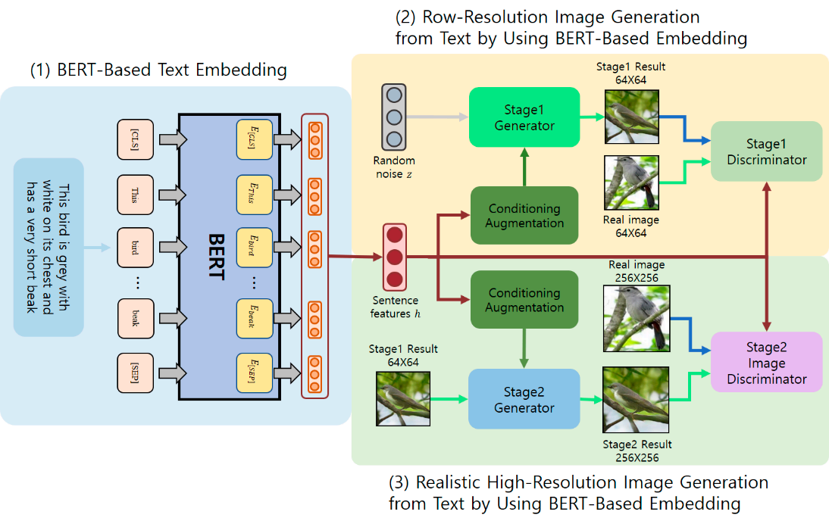
Architecture :

Slide 11
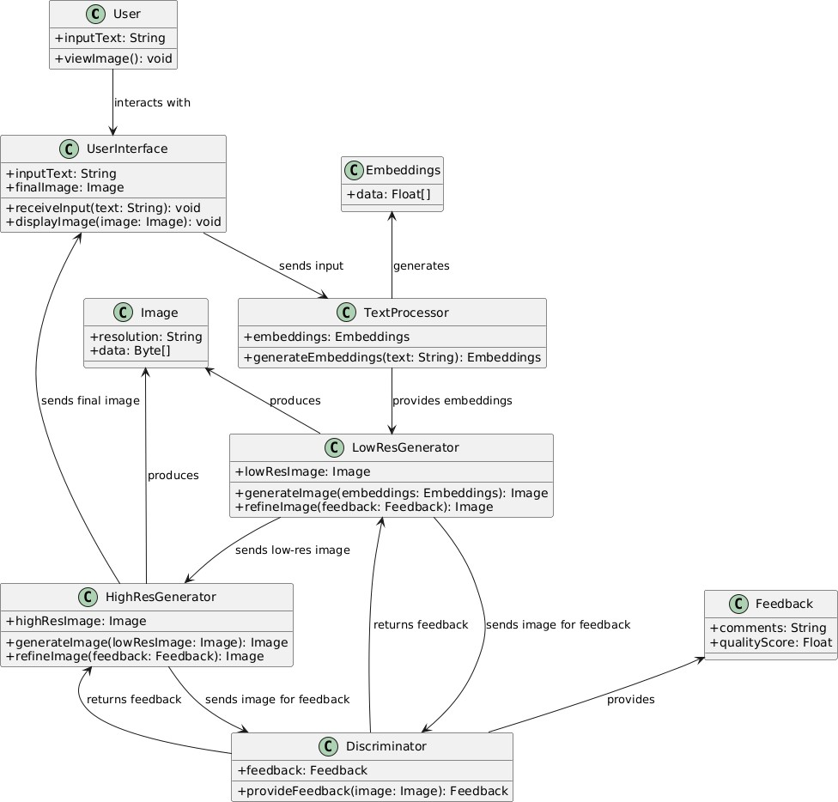
CLASS DIAGRAM

Slide 12
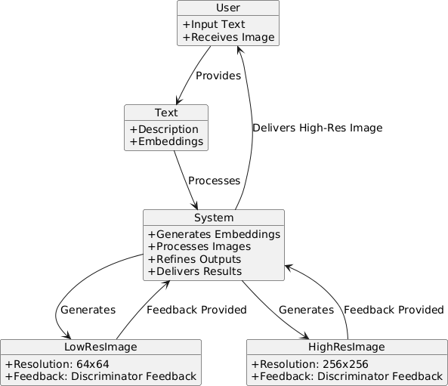
OBJECT DIAGRAM

Slide 13
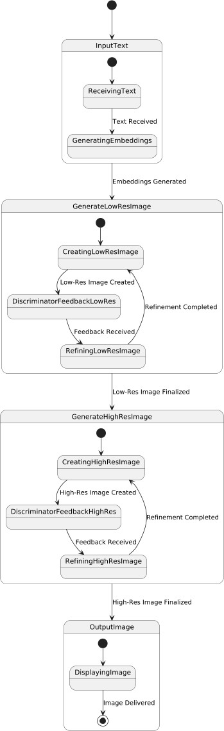
STATE CHART DIGRAM

Slide 14
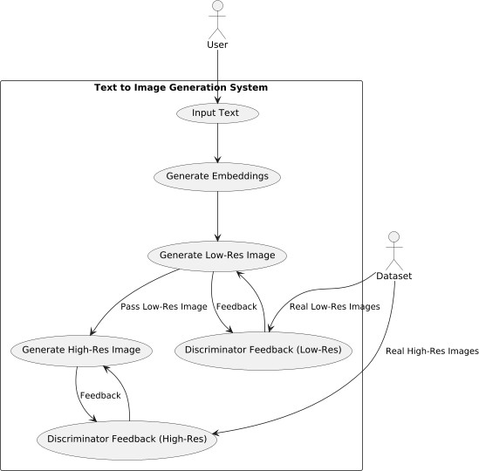
USE CASE DIAGRAM

Slide 15
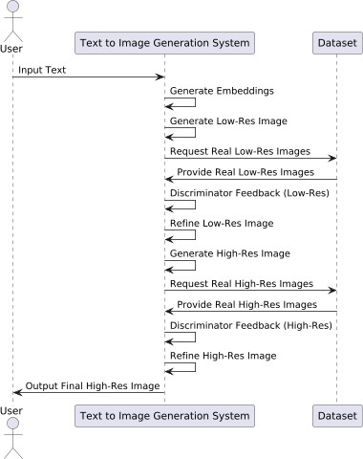
SEQUENCE DIAGRAM

Slide 16
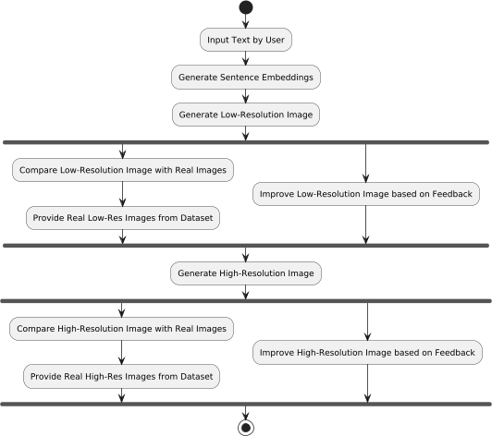
ACTIVITY DIAGRAM

Slide 17
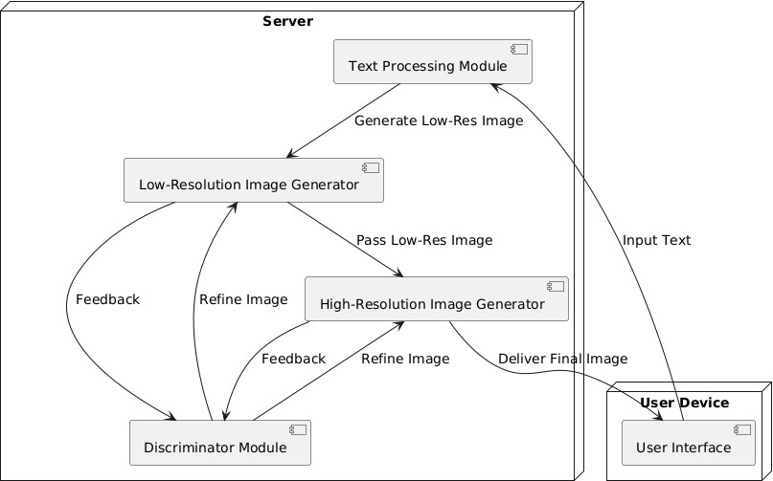
DEPLOYMENT DIAGRAM

Slide 18
Conclusion :
The proposed methodology is used to create StackGAN model which is a deep learning model that generates photo-realistic images from text descriptions using a two-stage process. First, it creates a low-resolution sketch based on the text. Then, it refines the sketch with intricate details and colors to produce a high-resolution image. By incorporating "BERT Text Embeddings ," StackGAN ensures the generated images accurately reflect the input text, leading to significant improvements in image quality, realism, and diversity.

Slide 19
Any Queries

Slide 20
Thank you

