Slide 1
Courier management system
DBUU Courier Company

Slide 2
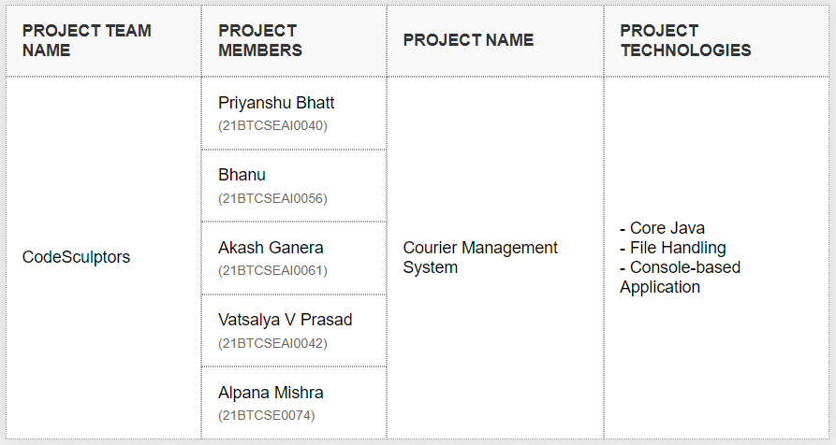
Team members

Slide 3
Introduction
This project simulates the operations of a courier company system named DBUU Courier Company. It includes the processes of customer registration, courier order booking, dispatch responsibility generation, courier delivery, and invoice generation.

Slide 4
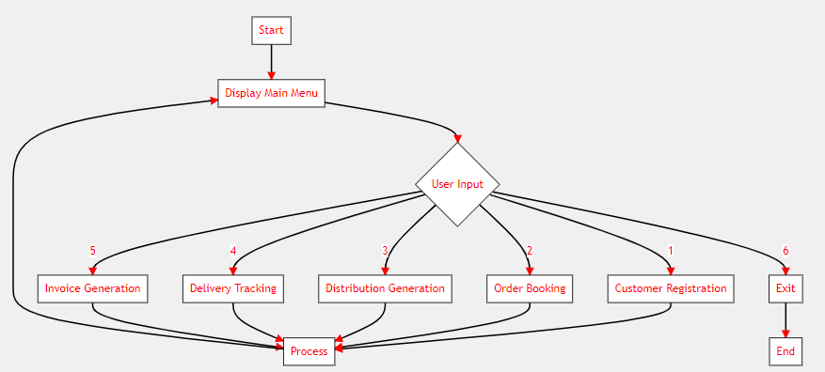
Main APPLICATION FLOW

Slide 5
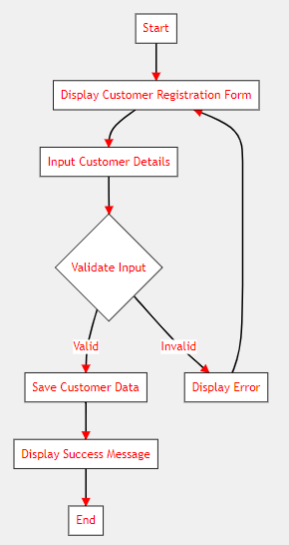
CUSTOMER REGISTRATION PROCESS

Slide 6
Customer Registration
Input:
Customer Name: John Doe
Date Of Registration: 05-Jul-2024
Address: 123 Main St, Apt 4B
City: New York
Pin: 10001
Telephone Number: 212-555-1234
E-mail Id: john.doe@email.com
Output:
Customer is saved.

Slide 7
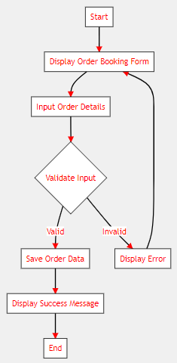
ORDER BOOKING PROCESS

Slide 8
Courier Order Booking
Input:
Customer Id: 1001
Date Of Order: 06-Jul-2024
Recipient Name: Jane Smith
Recipient Address: 456 Oak Ave
Recipient City: D
Courier Weight: 2.5
Description: Important Documents
Output:
Order is saved.

Slide 9
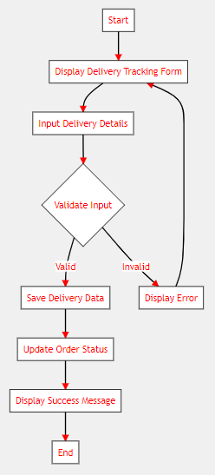
DELIVERY TRACKING PROCESS

Slide 10
Courier Dispatch Responsibility Generation
Input:
Date Of Distribution: 07-Jul-2024
Output:
Distribution list is generated.

Slide 11
Courier Delivery
Input:
Employee Id: 2001
Assigned Courier's: 2001, 2002, 2003
Order Id: 2001
Date Of Delivery: 08-Jul-2024
Status: D
Remarks: Delivered successfully to recipient
Output:
Delivery information is saved.

Slide 12
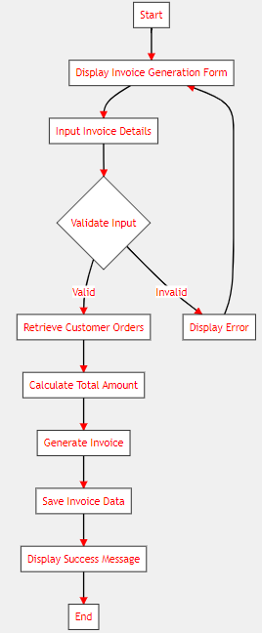
INVOICE GENERATION PROCESS

Slide 13
Invoice Generation
Input:
Customer Id: 1001
Invoice Month: 7
Invoice Year: 2024
Description: July 2024 Courier Services
Output:
Invoice is generated.

Slide 14
Conclusion
Thank you for using DBUU Courier Company. Goodbye!

Slide 15
Bibliography
1. Java Official Documentation
- Java SE Documentation:
https://docs.oracle.com/en/java/javase/index.html
2. File Handling in Java (Oracle Tutorials):
Basic I/O: https://docs.oracle.com/javase/tutorial/essential/io/
Reading, Writing, and Creating Files: https://docs.oracle.com/javase/tutorial/essential/io/file.html

Slide 16
bibliography
3. Console-based Application Tutorials (Oracle):
- The Java Tutorials - Basic I/O - Command-Line Arguments:
https://docs.oracle.com/javase/tutorial/essential/io/cl.html
Scanning and Formatting: https://docs.oracle.com/javase/tutorial/essential/io/scanning.html
4. Flowchart Creation Tools:
- Lucidchart (Online flowchart tool): https://www.lucidchart.com/pages/
- Draw.io (Free online diagram software): https://app.diagrams.net/

Slide 17
bibliography
5. Java Best Practices:
- Oracle's Java Coding Conventions:
https://www.oracle.com/java/technologies/javase/codeconventions-contents.html
6. Additional Java Resources:
- Oracle's Java Tutorials:
https://docs.oracle.com/javase/tutorial/
- Java API Documentation:
https://docs.oracle.com/en/java/javase/11/docs/api/index.html

