Slide 1

Bidarahalli, Virgo Nagar Post,, Bangalore-560049, Karnataka, India. Department of Electronics and Communication Engineering,
PROBLEM STATEMENT:
Develop a 2D occupancy grid map of a room using overhead cameras
PRESENTER:
Bhanu Prakash M C
USN:1EP21EC013
COLLEGE MENTOR:
Malini V L

Slide 2
Unique Idea Brief (Solution)
To develop a 2D occupancy grid map of a room using overhead cameras, you would typically follow these steps:
Camera Setup: Install overhead cameras in the room at appropriate positions to capture the entire area effectively. Ensure that the cameras have a suitable resolution and field of view to capture details necessary for mapping.
Image Processing: Use computer vision techniques to process the camera feed. This involves tasks such as image segmentation to identify objects, edge detection for object boundaries, and feature extraction for object recognition.
Object Detection and Tracking: Implement algorithms for object detection and tracking within the camera feed. This helps in identifying objects such as furniture, walls, doors, and other elements in the room.
Mapping Algorithm: Utilize a mapping algorithm like occupancy grid mapping to create a representation of the room. In occupancy grid mapping, the environment is divided into grid cells, and each cell is assigned a probability representing the likelihood of it being occupied by an object.
Update and Refinement: Continuously update the occupancy grid map based on new camera input and object movements within the room. This ensures that the map remains accurate and up to date.
Visualization: Present the generated occupancy grid map in a visual format that can be easily interpreted. This visualization helps in understanding the layout of the room and the positions of different objects within it.
By following these steps, you can develop a 2D occupancy grid map of a room using overhead cameras.

Slide 3
Features Offered
Simulation Environment: Realistic room simulation with customizable worlds and robot models.
Image Processing: Capture and process images using background subtraction to detect occupancy.
Occupancy Grid: Maintain and update a 2D occupancy grid based on detected changes.
ROS Integration: Implement ROS nodes and messages for seamless communication and integration.
Visualization: Tools for visualizing images, masks, and the occupancy grid.
Extensibility: Easily extend and customize the project to suit various applications.
Educational and Research Utility: Ideal for learning and research purposes in robotics and related fields.

Slide 4
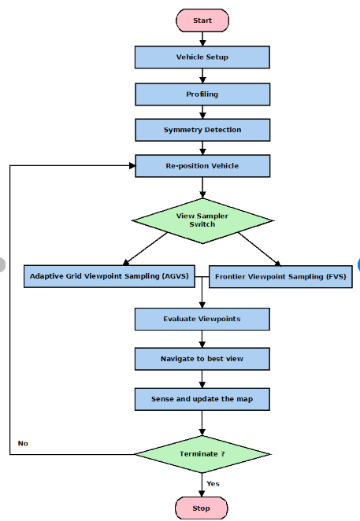
Process flow:

Slide 5
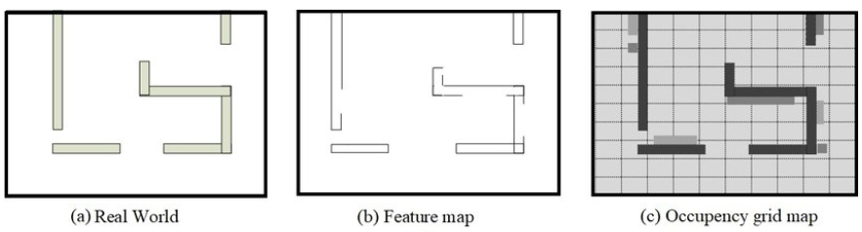
Architecture Diagram

Slide 6
Technologies used:
1. Robot Operating System (ROS)
ROS Master: Manages communication between nodes.
ROS Nodes: Modular processes that perform computation.
ROS Topics: Named buses over which nodes exchange messages.
ROS Messages: Data structures for communication between nodes.
ROS Launch Files: XML files that describe how to start up a collection of nodes and set parameters.
2. Gazebo Simulator
World Files: Define the simulated environment with objects and obstacles.
URDF (Unified Robot Description Format): XML format to describe the robot model and its components.
Plugins: Extend the functionality of Gazebo for custom behaviours and sensor data simulation.
3. Computer Vision
OpenCV (Open Source Computer Vision Library): Provides tools for image processing.
Image Capture and Processing: Convert images from ROS messages to OpenCV format, apply filters, and perform background subtraction.
Background Subtraction: Technique to detect moving objects from the static background.

Slide 7
Technologies used:
4. Programming Languages
Python: Used for writing ROS nodes and implementing image processing.
C++: (optional) Can be used for performance-critical parts of the application.
5. Visualization Tools
RViz (ROS Visualization): 3D visualization tool for ROS to display sensor data and state information.
Matplotlib/Other Plotting Libraries: (optional) For custom visualization of occupancy grid data.
6. Data Structures and Algorithms
Occupancy Grid Mapping: Technique to represent the environment in a 2D grid where each cell indicates free or occupied space.
Grid Update Algorithms: Methods to update the occupancy grid based on new sensor data.
7. Development Tools
Catkin: ROS build system to compile and manage packages.
RViz Configurations: Files to configure RViz for visualizing the occupancy grid and other sensor data.
Launch Scripts: Scripts to start the simulation, nodes, and other required components.
8. Operating System
Ubuntu Linux: Preferred OS for ROS and Gazebo due to better support and compatibility.

Slide 8
Conclusion
Developing a 2D occupancy grid map of a room using overhead cameras is a comprehensive project that integrates various technologies and methodologies from robotics, computer vision, and simulation. By leveraging the Robot Operating System (ROS), Gazebo simulator, and OpenCV for image processing, this project provides a robust framework for simulating and mapping indoor environments.
This project demonstrates the power of combining simulation, computer vision, and robotic frameworks to solve complex problems in mapping and navigation. By continuing to develop and enhance such systems, we move closer to creating more intelligent and autonomous robotic solutions capable of operating effectively in diverse environments.

Slide 9
THANK YOU

