Slide 1
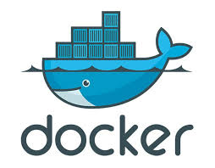
Docker
Title: Introduction to Docker
Subtitle: An Open Platform for Developing, Shipping, and Running Applications

Slide 2
What is Docker?
Definition: Docker is an open platform for developing, shipping, and running applications.
Key Concept: It separates applications from infrastructure and enables management in the same way.
Benefits:
Reduces delays between writing code and running it in production.
Allows developers to create, test, and deploy applications consistently across environments.

Slide 3
Docker in Action (Scenario)
Step 1: Developers write code locally and share it using Docker containers.
Step 2: The code is pushed to a test environment for automated and manual testing.
Step 3: Bugs are fixed in the development environment and redeployed for validation (CI/CD).
Step 4: Once testing is complete, the fix is pushed to production.

Slide 4
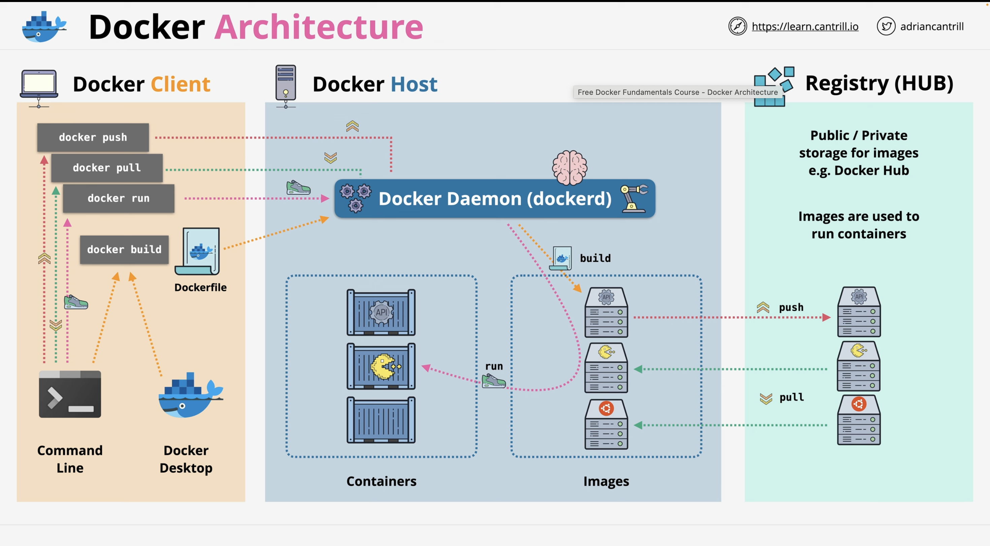
Docker Architecture
Overview: Docker is composed of several components that work together to manage applications in containers.
Components:
Images: Read-only templates used to create containers.
Containers: Running instances of images.
Dockerfile: A script that defines the environment and configuration.
Networks: Enable communication between containers.
Registries: Store Docker images (e.g., Docker Hub).
Volumes: Persist data used by containers.

Slide 5
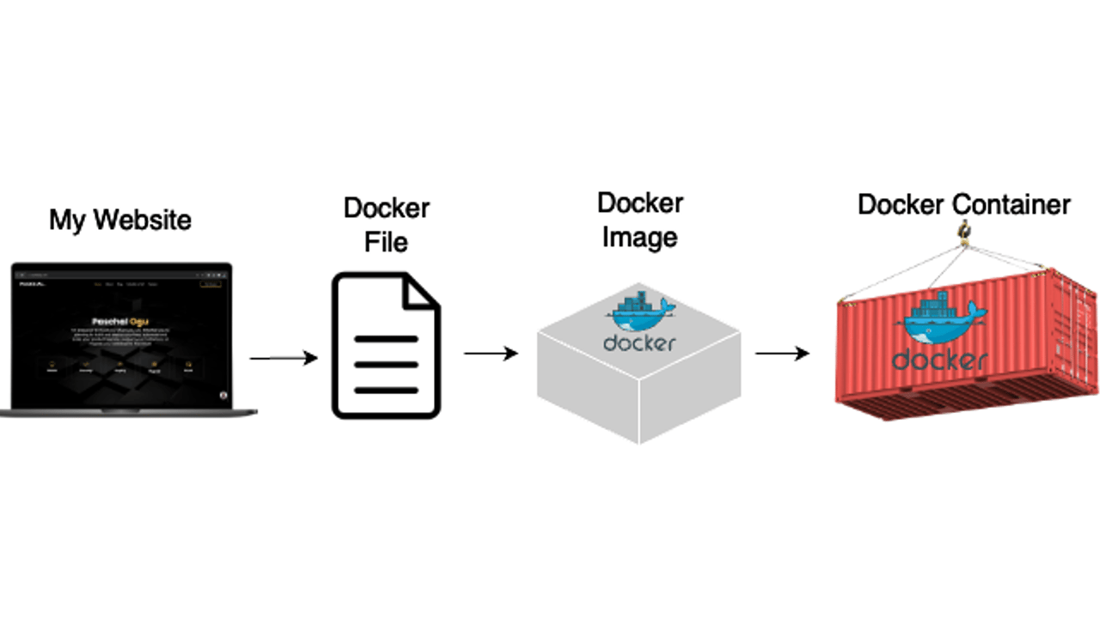
Docker Objects
Docker Images: Contains the application and environment dependencies.
Docker Containers: Instances of Docker images that can run applications.
Dockerfile: A file that defines the application and environment setup.
Networks and Volumes: Allow containers to communicate and persist data.
Tags: Used to label specific versions of images.
Docker Compose: A tool for defining and managing multi-container applications.

Slide 6
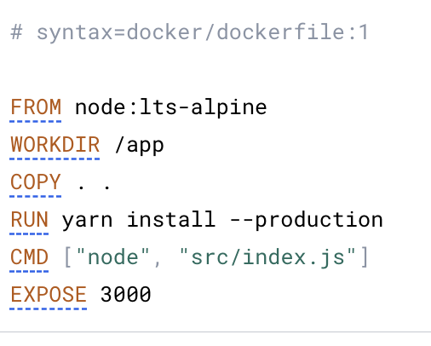
Dockerfile Example
Sample Dockerfile:
Layer Breakdown:
Layer 1: Ubuntu base image.
Layer 2: Updating package list.
Layer 3: Installing Python 3.
Layer 4: Copying application files into the container.
Efficiency: Docker only downloads missing or newer layers when pulling an image.

Slide 7
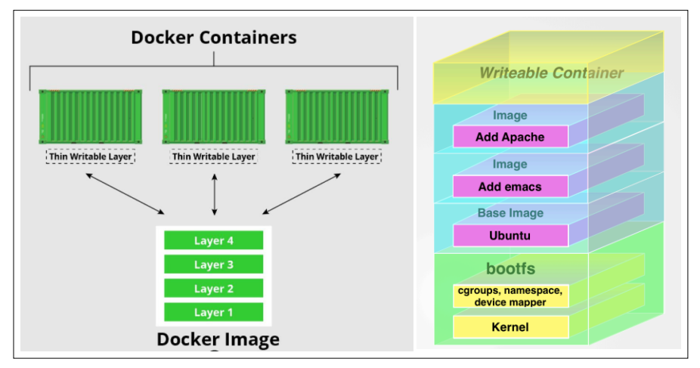
Images, Containers, and Layers
Read-Only Layers: All layers in an image are read-only.
Writable Layer: When a container is created, a writable layer is added on top of the read-only layers.
Container Lifecycle: Changes made during a container’s lifetime are stored in the writable layer. When deleted, the writable layer is discarded, leaving the original image layers intact.

Slide 8
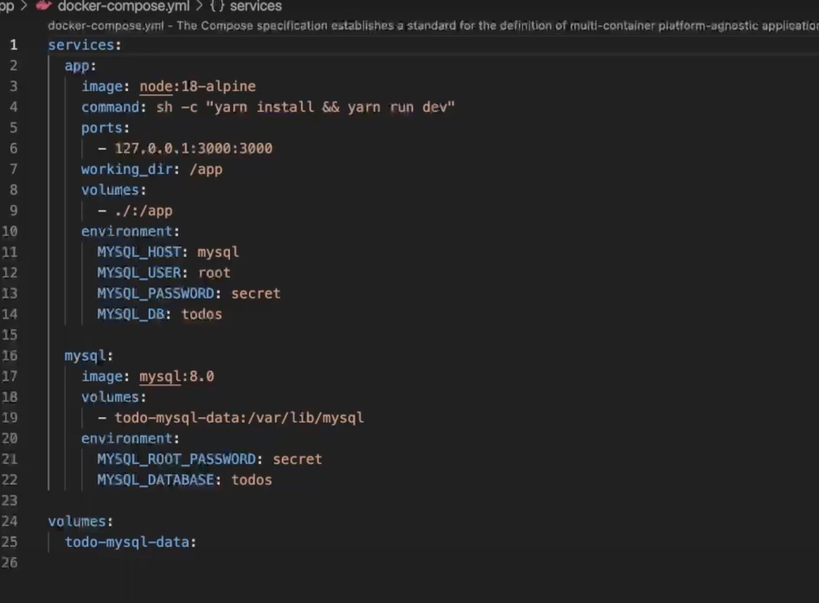
Docker Compose
What is Docker Compose? A tool for defining and running multi-container applications.
Usage:
Define services (e.g., web server, database) in a docker-compose.yml file.
Easily manage multiple containers in one configuration.
Example: Running a web app and database together in one file.

Slide 9
Docker Workflow Summary
Create Dockerfile: Define the environment and application requirements.
Build Image: Use docker build -t myapp:v1 . to build the image.
Test Locally: Run containers with docker run -d myapp:v1.
Push to Registry: Push your image to a registry with docker push myapp:v1.
Deploy: Deploy the containers in production.
Monitor and Maintain: Use commands to inspect, stop, and clean up containers.
Scale (Optional): Use Docker Compose, Swarm, or Kubernetes for multi-container apps.

Slide 10
Conclusion
Key Takeaways:
Docker simplifies the process of developing, testing, and deploying applications.
Containers provide consistency across different environments.
Docker enables developers to manage applications more efficiently, whether locally or in production.

