Slide 1
Image Steganography

Slide 2
Student Details:
Name : Bhanusri Dasari
Skills Build Email ID : dasaribhanu628@gmail.com
College Name : SRK Institute of Technology
College State : Andhra Pradesh
Internship Domain : Cyber Security with Kali Linux
Internship Start and End Date : From 3 June 2024 to 12 July 2024

Slide 3
Introduction to Image Steganography
Image steganography is the practice of hiding secret information within digital images.
This technique exploits the redundancy in image data, such as the least significant bits (LSBs) of pixel values, to embed hidden messages without noticeably altering the image's appearance.

Slide 4
Agenda:
Project Overview
Software and Tools Selection
Who are the End Users of this Project?
Your Solution and its Value Proposition
How did you customize the Project and make it your own
Modelling
Results
Links

Slide 5
Project Overview:
Steganography is the art and science of concealing information within other non-secret data (such as images, audio files, or text) to avoid detection. This project aims to explore various techniques and applications of steganography, emphasizing practical implementation and theoretical understanding.
Key objectives:
Understanding Steganography Fundamentals
Implementing Steganographic Techniques
Developing a Steganographic Tool
Security and Detection
Applications and Ethical Considerations
Deliverables:
A detailed report documenting the project's objectives, methodologies, and findings.
Source code of the steganographic tool developed during the project.
Demonstration videos or screenshots showcasing the tool's functionality.
Conclusion:
This project on steganography aims to provide a comprehensive exploration of both the
theoretical foundations and practical implementations of hiding data within digital media.

Slide 6
Software and Tools Selection:
Choose programming languages and libraries (Python, OpenCV, HashLib) suitable for implementation.
Install necessary software and tools for development and testing.

Slide 7
Who are the end users of this project?
General Users: Everyday individuals who use steganography tools to hide sensitive information within digital media (like images, audio files, or videos) for privacy or security reasons.
Law Enforcement and Intelligence Agencies: These entities may use steganography detection tools to uncover hidden messages or data during investigations.
Military Personnel: Military applications may involve embedding secret messages in images or other media for secure communication.
Security Experts: Cybersecurity professionals might utilize steganography tools to test network defenses or to secure data transmission.

Slide 8
Your solution and its value proposition
Steganography is the basic concept to hide the data inside other data.
In this project RGB Mechanism is used for pixel manipulation.
XOR operation is used for encryption and decryption of the test inside the image.
The project reads an image and hides the secret text within the pixel values using the least significant bits (LSB) method.
For security purpose that means to avoid unauthorized users taking the advantage of the message, a secret key used to hide and unhide the data.
Finally, By using this project we can hide the data inside an image using secret key and for unhide the message secret is used.

Slide 9
Implementing Image Steganography with Python
Image Manipulation:
Using Python's image processing libraries, such as Pillow, you
can read,manipulate, and save image files.
Data Embedding:
Algorithms are used to encode the secret data into the image's
pixels, ensuring it remains invisible.
Decoding and Extraction:
Complementary algorithms are employed to extract the hidden
data from the image, reverting the steganographic process.

Slide 10




Demonstrating the Project with Sample Images
Input Image
Hidden Data
Output Image
Data Extraction
An image used to hide the secret data.
The information that will be embedded within the image.
The image with the hidden data, indistinguishable from the original.
The process of retrieving the hidden data from the output image.

Slide 11
Libraries
Pillow: For image manipulation.
Pillow : For image manipulation.
Open CV : For advanced image processing.
INSTALL
NumPy : For numerical operations.

Slide 12
How did you Customize the Project and make it your Own
Algorithm selection and modification:
The choice of steganographic algorithm was carefully considered based on its suitability for embedding data within various media types.
User Interface Design :
The user interface (UI) was customized to ensure ease of use and intuitive interaction.
Integration of Additional Features :
Additional functionalities were integrated to extend the utility of the application beyond basic steganographic operations.
Testing and Validation Procedures :
Rigorous testing procedures were customized to validate the accuracy and reliability of the steganographic techniques employed.
Documentation and Reporting :
Detailed documentation was customized to provide comprehensive insights into the project’s development process.

Slide 13
Modelling:
Data Model
EmbeddingModel
Extraction Model
Encoding Process :
Load the image.
Convert the message into binary format.
Modify the image's pixel values to encode the message.
Decoding Process :
Load the encoded image.
Extract the binary data from pixel values.
Convert binary data back to the original message.

Slide 14
Modelling in Steganography
Data Model: This involves defining how data will be represented and manipulated within the steganography system. It includes decisions on data formats (text, binary, etc.), encoding schemes, and how data will be structured for embedding and extraction.
Embedding Model: This specifies the technique or algorithm used to embed hidden data into a cover media (such as an image or audio file). Modeling here involves determining how to modify the carrier file tembed the hidden information while minimizing perceptible changes and maintaining cover media integrity.
Extraction Model: This defines the method for extracting hidden data from the carrier media. Modeling the extraction process ensures that the embedded information can be accurately retrieved, even after potential alterations to the carrier file.

Slide 15
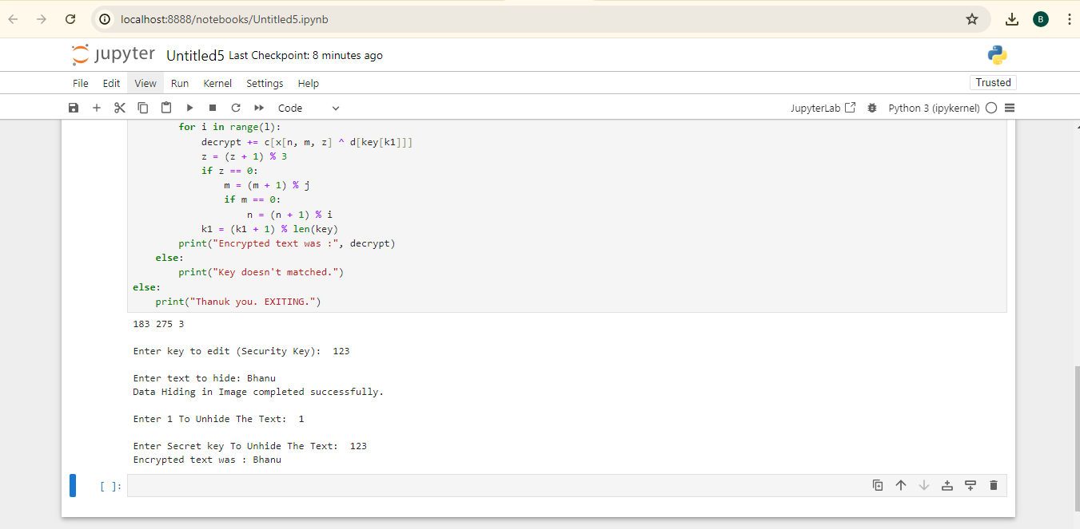
Output

Slide 16

Result
Original Image
Image
Download any sample image from google or any other websites.
Above image is normal image.
We can choose the image on which we want to do the encryption

Slide 17
Result
Encrypted Image
Image
After hiding the text in the image the image will be became as
We can see there is no difference in both the normal and encrypted images

Slide 18
Links :
https://github.com/Bhanu0922/Steganography_Project

Slide 19
Thank You

