Slide 1
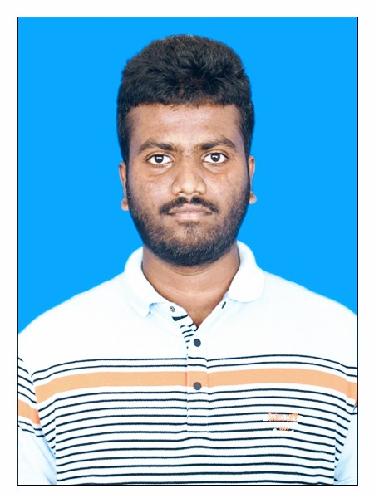


Konjeri Bhanu Prakash Reddy
Analyst/Software Engineer
ITransform L&D Left Shift Batch
Bachelor of Technology, Mechanical Engineering : 2018 – 2022
Certification
AZ-900: Microsoft Azure Fundamentals
Mumbai
konjeri-bhanu-prakash.reddy@capgemini.com
Skills
+91 6302682810
A4
C# | Basics, OOPS, Exception Handling
.NET Framework | ADO.NET, ASP.NET with MVC 5 and WEB API, Entity Framework
Database | SQL Server
Tools | GIT, POSTMAN, Swagger
UI Technology | HTML5, CSS & Angular
Add On Skills | Communication Skills, Team Management, UI Designing
Full Stack Developer
Understanding of RDMS concepts using SQL Server.
Practical understanding of C# and SQL concepts using Visual Studio and SQL Server.
Hands on experience in developing applications using .NET Framework, ADO.NET Core, ASP.NET and JWT based authentication.
Understanding of HTML5, CSS and Angular CLI
Online Flight Booking System Video link
Case study of Online Flight Booking System along with API Gateway, Swagger, payment, JWT Based Authentication, responsive UI with HTML5, CSS, Bootstrap and Angular used as User Interface. This application enables a customer to book a flight reservation in advance and can cancel the booking or Check in into the flight and also an admin user can perform various administrative operations like Airport management, Flight Management and Customer management.
Technologies used:
ANGULAR
ASP.NET CORE WEB API
Microsoft SQL Server
Check out my GitHub Repository

