Slide 1
PROPOSED SOLUTION AND INNOVATION
K
KLARO
SIH
SMART INDIA
HACKATHON
2026
Legal Metrology Intelligence
Proposed Solution
Uniqueness
Why Us
One-Scan Verdicts
Every photograph is a legal audit, not a complaint form.
Self-Binding Evidence
Dossiers seal themselves: OCR, values, citation, hash.
Officer-Grade Output
Console drafts notices, not more paperwork.
Clause-Exact Verdicts
Robust Architecture: one rule engine, one dossier, one ledger — no stitched tools.
Trust by Design: hashes and public statuses make every case independently auditable.
Statutory Engine: LMPC 2011 encoded as code; rules update in minutes, not gazette-years.
Impact-First: faster closures, cleaner markets, zero added infrastructure.
Hash-Sealed Dossiers
Manual filework
Klaro Enforcement Pipeline
Traceable outcomes
Innovation
Public Outcome Feed
1. Zero-Hardware Scanning
any smartphone becomes an inspector-grade tool.
2. Crowd-Powered Triage
high-signal cases rise before a file is ever opened.
3. Receipt-Style Orders
printed notices read like true statutory documents.
4. Free-Tier Native
open rule engine on serverless plans; funds go to scale, not licences.

Slide 2
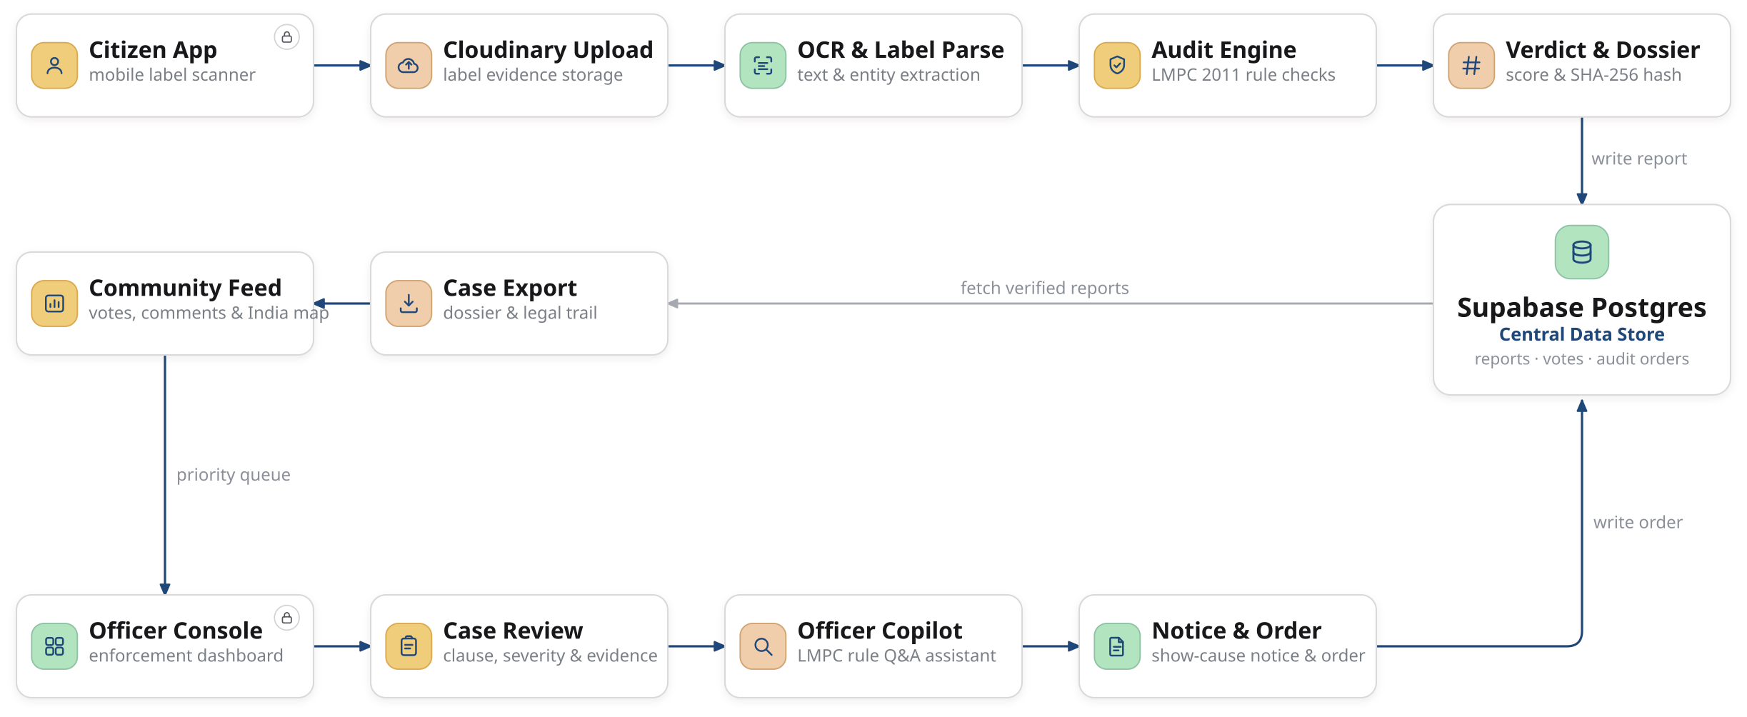
ARCHITECTURE
K
KLARO
SIH
SMART INDIA
HACKATHON
2026
Legal Metrology Intelligence
Characteristics
Technologies
Scan &
Intelligence
Klaro Audit Engine (LMPC 2011) · OCR & entity extraction · receipt-style verdicts · SHA-256 evidence hashing
App &
UI Layer
Next.js 16 App Router · Server Actions · React 19 · TypeScript · Tailwind CSS 3.4 · framer-motion · lucide-react
Identity &
Runtime
Clerk role-based auth · Bun runtime · Vercel deployment · @svg-maps/india · canvas-confetti
EVIDENCE CHAIN Label image → OCR snippet → measured vs required → citation → signature hash
Serving stack — Bun runtime · Vercel edge delivery · Clerk sessions · service-role server actions · free-tier everything
Data &
Integrity
Supabase PostgreSQL · Cloudinary evidence store · tamper-sealed signing · public audit trail

