Slide 1

Spam or Ham Detector
SMS Spam Classification using Machine Learning & NLP
EDA | Preprocessing | Model Development | NLP Architecture | Deployment

Slide 2
Agenda
1
Problem Statement & Objective
6
Model Development (Sprint 2)
Spam vs ham, binary classification
4 ML models compared on precision, recall, F1
2
Dataset Summary
7
NLP Architecture (Sprint 3)
5,572 messages, 2 columns
Embedding + BiLSTM neural network
3
Data Cleaning & Class Balance
8
Deployment (Sprint 4)
Duplicates, labels, class imbalance
Live Streamlit web app
4
EDA (Sprint 0)
9
Key Findings & Conclusion
Length, digits, capitals, common words
What we learned and next steps
5
Preprocessing (Sprint 1)
Text cleaning, split, TF-IDF, scaling

Slide 3
Problem Statement & Objective
Problem: Unwanted SMS (ads, scams) are mixed in with normal messages
Objective: Classify a message as spam or ham using only its text
Type: Binary classification (spam = 1, ham = 0)
Outcome: Compare models, pick the best one, deploy it as a web app
Questions this data can answer
Can we automatically detect unwanted or scam messages?
1
How do spam messages differ from normal ones (length, digits, symbols)?
2
Which words are strong signals of spam?
3
What the model has to tell apart
SPAM
HAM
WINNER!! You have been selected for a £900 prize. Call now to claim.
Hey, are we still meeting for lunch tomorrow?

Slide 4
Dataset Summary
5,572
2
0
13.4%
Total messages
Columns
Missing values
Spam in raw data
About the data
First rows of the dataset
Category: target label, categorical (spam / ham)
Message: the raw SMS text, unstructured
Imbalanced: ham 4,825 vs spam 747
No numeric columns, so we create them from the text
Category | Message
ham | Go until jurong point, crazy.. Available only ...
ham | Ok lar... Joking wif u oni...
spam | Free entry in 2 a wkly comp to win FA Cup fina...
ham | U dun say so early hor... U c already then say...
ham | Nah I don't think he goes to usf, he lives aro...

Slide 5
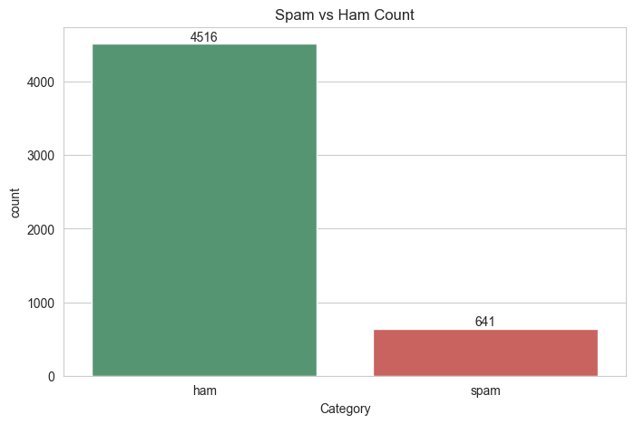
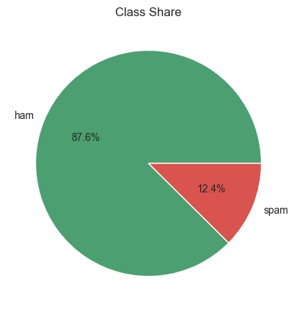
Data Cleaning & Class Balance
1
Missing values
None found in either column
2
Duplicates
415 duplicate rows removed: 5,572 → 5,157 messages
Label encoding
3
Observations
ham → 0, spam → 1 (ham 4,516 | spam 641)
Imbalanced: about 88% ham and 12% spam
Accuracy alone can mislead: always guessing ham already scores ~88%
So we judge models with precision, recall and F1, and use class weights
4
Data types
Message column converted to text (string)

Slide 6
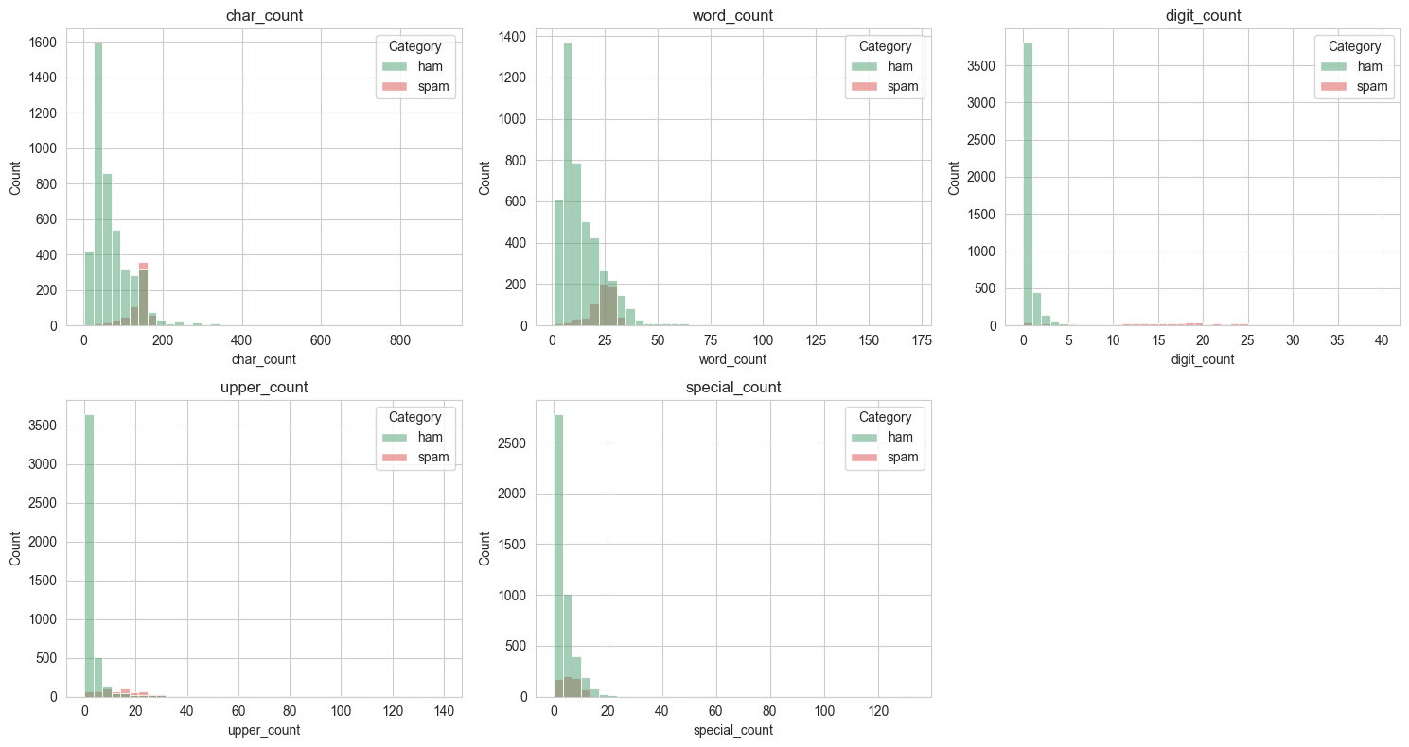
EDA: Feature Engineering & Distributions
Average per message
Feature | Ham | Spam
char_count | 70.95 | 137.54
word_count | 14.24 | 23.66
digit_count | 0.30 | 15.33
upper_count | 4.02 | 15.55
special_count | 3.87 | 6.04
Observations
Spam is about 2x longer than ham
Digits: ~15 in spam vs ~0.3 in ham
Spam uses more capitals and symbols
5 features created from each message: characters, words, digits, uppercase letters, special characters

Slide 7
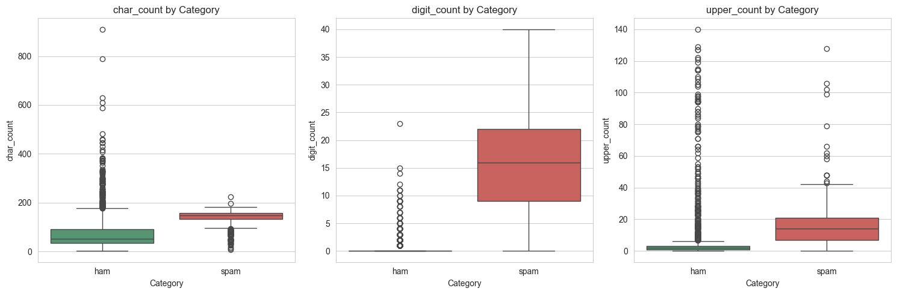
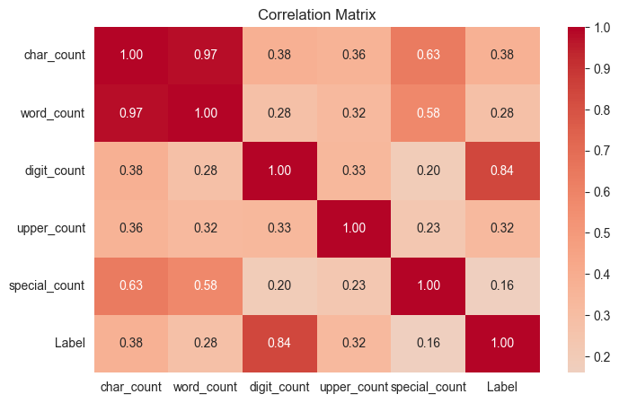
EDA: Outliers & Correlations
Boxplot observations
Correlation observations
Spam has higher medians for length, digits and capitals
Both classes have outliers (very long messages); we kept them as they are real texts
Digit count separates spam from ham the best
digit_count vs spam label: 0.84 (strongest)
char_count and word_count: 0.97, almost the same feature
special_count is the weakest (0.16)

Slide 8
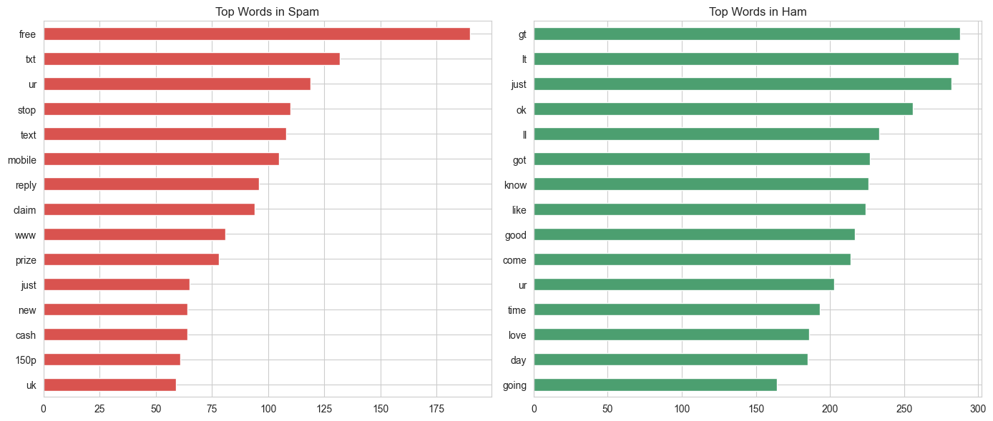
EDA: Most Common Words in Spam vs Ham
Observations
Spam: free, txt, stop, mobile, reply, claim, prize, cash
Ham: just, ok, got, know, like, good, love, day
Words like free, claim and prize will be strong features for the model
‘gt’ and ‘lt’ in ham are leftovers of &gt; and &lt; symbols in the raw text
Spam = promotional words that ask you to act
Ham = casual, everyday conversation

Slide 9
Sprint 1: Preprocessing
1
2
3
4
5
Clean Text
Train / Test Split
TF-IDF
Scale Numbers
Combine
Lowercase, keep letters only, remove stopwords, Porter stemming
80% / 20% stratified: 4,125 train, 1,032 test (12.4% spam in both)
Top 5,000 words and word pairs (1-2 grams), fitted on train only
MinMax scale the 5 count features to a 0-1 range
Stack TF-IDF + numeric features = 5,005 features
Example: text cleaning
Saved for deployment
Before
Ok lar... Joking wif u oni...
tfidf.pkl and scaler.pkl are saved with joblib, so the app applies the exact same steps.
After
ok lar joke wif u oni

Slide 10
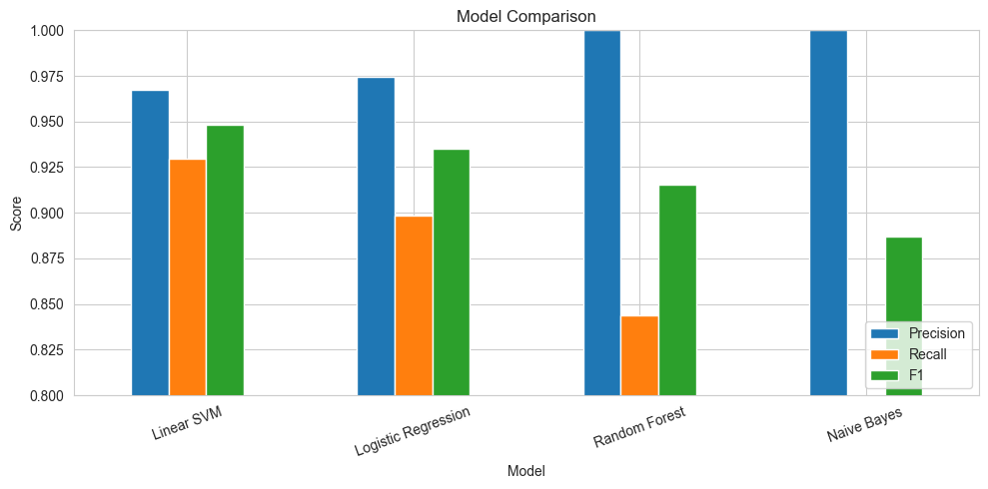
Sprint 2: Model Development
4 models trained on the same 5,005 features, tested on 1,032 unseen messages
Model | Accuracy | Precision | Recall | F1
Linear SVM | 0.9874 | 0.9675 | 0.9297 | 0.9482
Logistic Regression | 0.9845 | 0.9746 | 0.8984 | 0.9350
Random Forest | 0.9806 | 1.0000 | 0.8438 | 0.9153
Naive Bayes | 0.9748 | 1.0000 | 0.7969 | 0.8870
Accuracy is 97-99% for every model, so recall and F1 decide the winner
Naive Bayes and Random Forest: precision 1.00 but they miss too much spam (recall 0.80 and 0.84)
Linear SVM gives the best balance of catching spam and avoiding false alarms
Best model: Linear SVM
F1 0.948 | Recall 0.930 | Precision 0.968

Slide 11
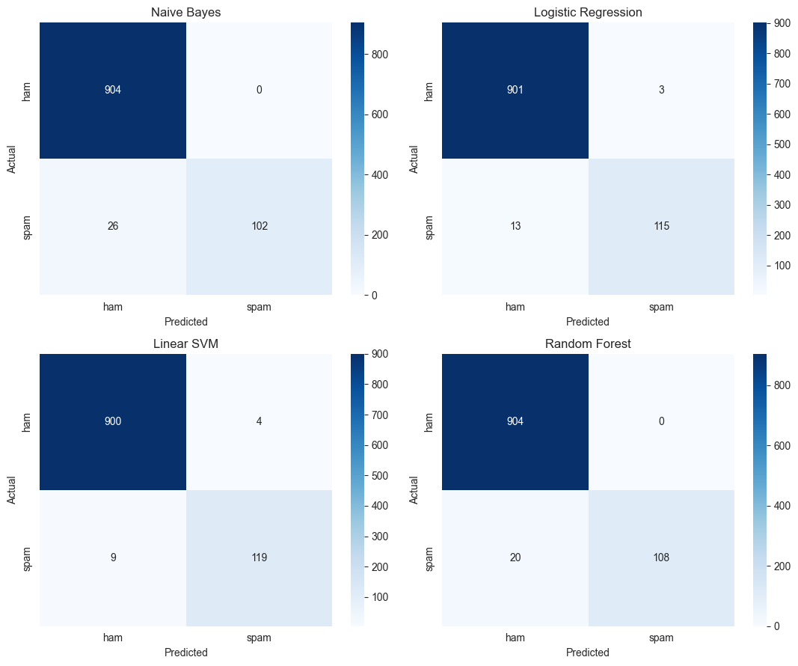
Sprint 2: Evaluating the Best Model
Linear SVM: classification report (test set)
Class | Precision | Recall | F1 | Support
ham | 0.99 | 1.00 | 0.99 | 904
spam | 0.97 | 0.93 | 0.95 | 128
Accuracy |  |  | 0.99 | 1,032
Linear SVM got 900 ham and 119 spam correct
Only 9 spam missed and 4 ham wrongly flagged as spam
Fewer missed spam than Naive Bayes (26), Random Forest (20) and Logistic Regression (13)
Saved as model.pkl for deployment

Slide 12
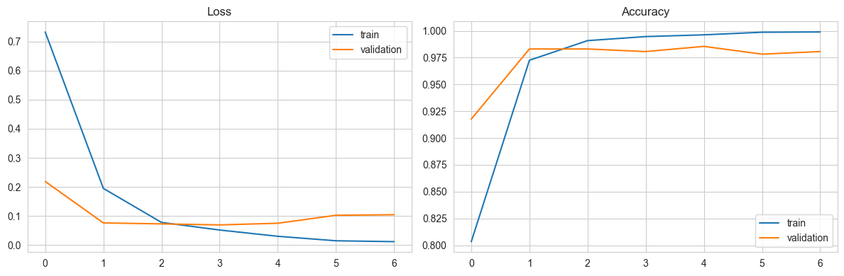
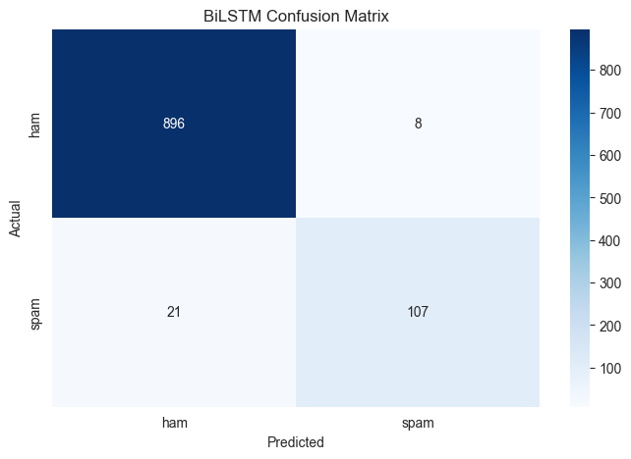
Sprint 3: NLP Architecture (BiLSTM)
Text Vectorization
›
Embedding
›
BiLSTM
›
Dropout
›
Dense
›
Output
5,000 words, 50 tokens
64 dimensions
32 units each way
0.3
16 units, ReLU
1 unit, sigmoid
F1 score
0.881
Recall
0.836
Trained with class weights (spam counted ~7x) and early stopping; best epoch (4 of 7) was restored
Test results: accuracy 0.972, precision 0.930, recall 0.836, F1 0.881
It did not beat Linear SVM: the dataset is small and it does not use the engineered numeric features

Slide 13
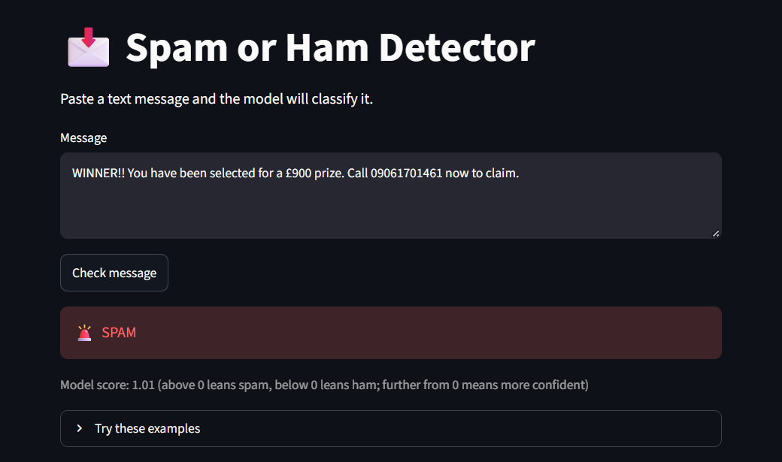
Sprint 4: Deployment with Streamlit
1 User Input
2 Preprocess
3 Vectorize
4 Predict
›
›
›
Paste an SMS into the text box
Same clean_text and 5 count features as the notebook
Saved TF-IDF and scaler, stacked together
Saved Linear SVM gives SPAM or HAM plus a score
Built with Streamlit in app.py
Loads once: model.pkl, tfidf.pkl and scaler.pkl (cached)
Output: red SPAM or green HAM result
Model score: above 0 leans spam, below 0 leans ham; further from 0 means more confident
Run with: streamlit run app.py
Running app: spam message detected, model score 1.01

Slide 14
Key Findings & Conclusion
1
What EDA showed
2
What the models showed
3
Future improvements
Data is imbalanced: 12% spam, 88% ham
Spam is longer, with more digits and capitals
Digit count is the strongest signal (0.84)
Spam words: free, claim, prize, cash
4 ML models and 1 BiLSTM compared
Linear SVM won: F1 0.948, accuracy 98.7%
BiLSTM (F1 0.881) did not beat it on small data
Deployed as a Streamlit web app
Tune the decision threshold to catch more spam
Try pretrained transformers such as BERT
Feed numeric features into the neural network
Add more recent spam examples
Result: a working spam detector that catches 93% of spam with 97% precision

Slide 15

THANK YOU

