Slide 1

MERGE SORT
Sri venkateswara college of engineering
Submitted by:
B Hema sree
22BFA04201

Slide 2
Abstract
Efficient Merging
The primary goal is to combine two pre-sorted arrays. This creates a new array. It contains all elements in sorted order.
Algorithm Overview
We'll use a two-pointer approach. It minimizes comparisons. This results in optimal performance and efficient use of memory.

Slide 3
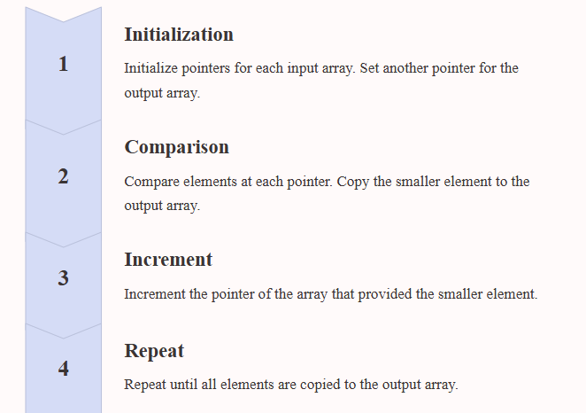
Algorithm: Two-Pointer Approach

Slide 4

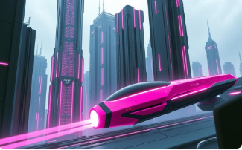

Pictorial Representation
Comparison
Visualization of comparing elements at current pointers.
Element Movement
Showing the smaller element being copied to the merged array.
Pointer Update
Illustrating the pointer increment after each copy operation.

Slide 5
Test Cases
Test Case 1:
arr1: {1, 3, 5}
arr2: {2, 4, 6}
Expected Output: {1, 2, 3, 4, 5, 6}
Test Case 2:
arr1: {1, 2, 3}
arr2: {4, 5, 6}
Expected Output: {1, 2, 3, 4, 5, 6}
Test Case 3:
arr1: {1, 5, 9}
arr2: {2, 3, 4, 6}
Expected Output: {1, 2, 3, 4, 5, 6, 9}

Slide 6
C Code Implementation
#include <stdio.h>
int main()
{
int n1,n2,n3;
int a[10000], b[10000], c[20000];
printf("Enter the size of first array: ");
scanf("%d",&n1);
printf("Enter the array elements: ");
for(int i = 0; i < n1; i++)
scanf("%d", &a[i]);
printf("Enter the size of second array: ");
scanf("%d",&n2);
printf("Enter the array elements: ");
for(int i = 0; i < n2; i++)
scanf("%d", &b[i]);

Slide 7
n3 = n1 + n2;
for(int i = 0; i < n1; i++)
c[i] = a[i];
for(int i = 0; i < n2; i++)
c[i + n1] = b[i];
printf("The merged array: ");
for(int i = 0; i < n3; i++)
printf("%d ", c[i]);
printf("\nFinal array after sorting: ");
for(int i = 0; i < n3; i++){
int temp;
for(int j = i + 1; j < n3; j++) {
if(c[i] > c[j]) {
temp = c[i];
c[i] = c[j];
c[j] = temp;
} } }
for(int i = 0; i < n3 ; i++)
printf(" %d ",c[i]);
return 0;
}

Slide 8
Output
Enter the size of first array: 5
Enter the array elements: 10 20 30 40 50
Enter the size of second array: 5
Enter the array elements: 96 73 52 48 17
The merged array:
10 20 30 40 50 96 73 52 48 17
Final array after sorting:
10 17 20 30 40 48 50 52 73 96

Slide 9


