Slide 1

Data-Driven Analysis of Spotify Hits
Song Insights from Spotify Streams Dataset
Bhanu Pratap Singh
09 Feb 2026

Slide 2
AGENDA
Business Context & Objective
Song Popularity & Key Drivers
Role of Discovery Platforms
Conclusion & Strategy Takeaways
Appendix: Methodology & Assumptions

Slide 3
Business Context & Objective
Spotify is a leading global music streaming platform that enables artists to distribute music to millions of listeners worldwide.
With millions of tracks released annually, only a small share achieve meaningful reach, making data-driven decision-making critical.
Thus, Spotify wants to know actionable recommendations to identify and promote trending songs

Slide 4
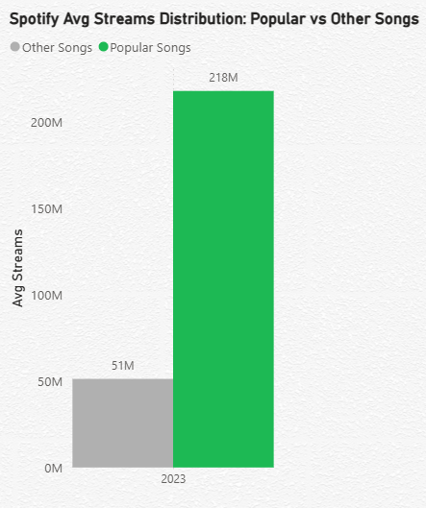
Song Popularity & Key Drivers
Defining Song Popularity:
Popularity measured using-
Average Streams per Year
Adjusts for release year bias
Songs in top 25% labeled as Popular Songs
Focuses on adjusted performance, not lifetime accumulation

Slide 5
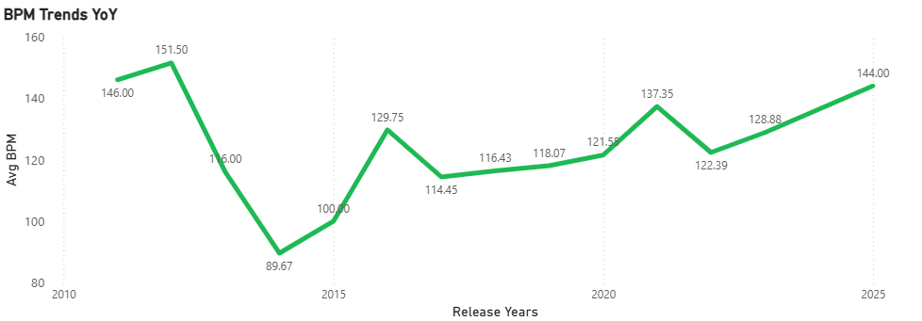
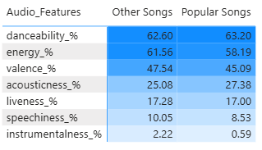
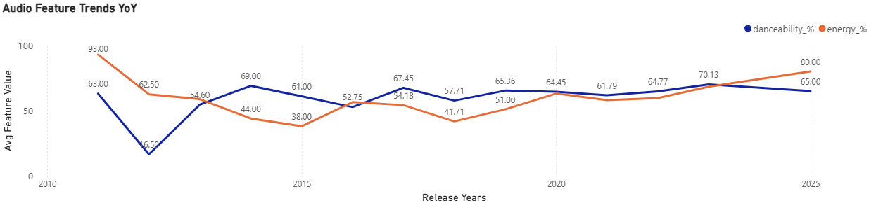
Song Popularity & Key Drivers
Rhythm and Intensity Trends
Audio Features for Hits:
BPM: 11% increase vs last year
Energy: 15% increase: strong YoY increase
Danceability: 7% decrease: slight decline but remains structurally high

Slide 6
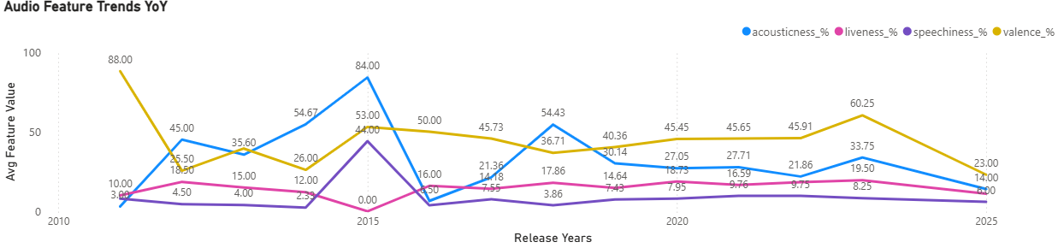
Song Popularity & Key Drivers
Audio Texture and Expressiveness Trends for Popular Songs:
Audio Features for Hits:
Valence: 162% decrease vs last year: Sharp decline after constant increase YoY
Acousticness: 141% decrease vs last year
Liveness: 77% decrease: slight decline but remains structurally moderate
Speechiness: 77% decrease but structurally low and constant.

Slide 7
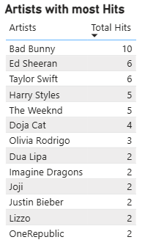
Song Popularity & Key Drivers
Artists Impact on Song Popularity:
Top artists consistently contribute multiple popular tracks
Popularity is not evenly distributed across artists
A small group of artists dominate hit creation

Slide 8
Role of Discovery Platforms
Songs don’t become popular instantly
Discovery platforms amplify momentum
We analyzed Spotify Charts, Shazam Charts, and Spotify Playlists
Song
↓
Charts
↓
Playlists
↓
Streams

Slide 9
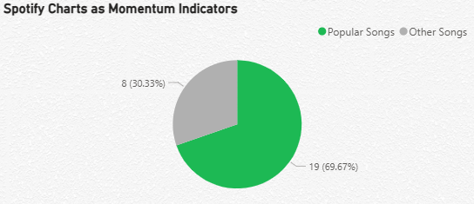
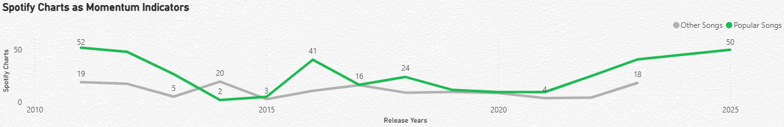
Role of Discovery Platforms
Spotify Charts
Popular songs show higher chart presence across most years
Chart exposure spikes align with higher average streams
Charts and Playlists amplify existing momentum rather than create it

Slide 10
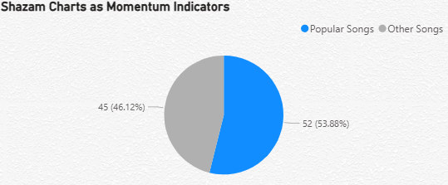
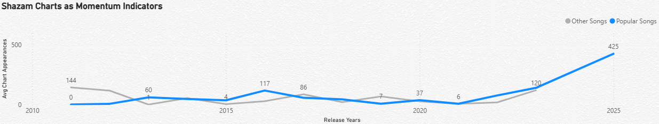
Role of Discovery Platforms
Shazam Charts
Popular songs show sharp growth in Shazam presence in recent years
Shazam acts earlier in the discovery funnel than Spotify charts
Indicates organic listener-driven discovery

Slide 11
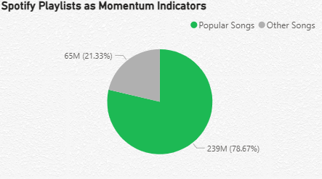
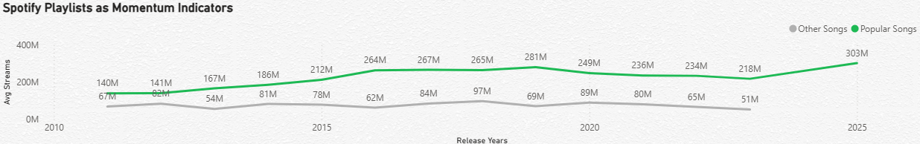
Role of Discovery Platforms
Spotify Playlists
Higher playlist exposure correlates with significantly higher streams
Popular songs benefit disproportionately from playlist inclusion
Playlists act as scaling mechanisms

Slide 12
Conclusion & Strategy Takeaways
How Popularity Is Built: A Funnel View
Audio Features & BPM → Create listener appeal
Artists → Enable repeat success
Shazam → Early discovery
Spotify Charts → Momentum
Playlists → Scale & sustain popularity
Key Takeaways:
Popular songs might grow faster and more energetic over time
A small number of artists dominate hit creation
Shazam enables early discovery
Spotify charts & playlists amplify momentum
Playlists scale successful songs to mass audiences

Slide 13
Appendix: Methodology & Assumptions
Assumptions & Limitations
Repeating song identifiers across source tables required removal of duplicated Song IDs to preserve one-to-one join integrity.
Song popularity is defined as the top 25% by average annual streams.
Analysis is limited to releases from 2011–2025 to ensure relevance to the modern streaming landscape.
Correlation-based findings indicate association and should not be interpreted as causal relationships.
Appendix:
(Refer Attached Files on mail)
Python
Data Cleaning & Feature engineering
EDA and Statistical Analysis
Predictive Model: Logistic Regression
Power BI
YoY analysis
Insights Visuals & Dashboarding

Slide 14
Thankyou
Bhanu Pratap Singh

