Slide 1
Customer Segmentation
A Data Science Project | Unsupervised Learning
Date:1 August 2025

Slide 2
Introduction & Business Problem
Objective: Segment customers based on their demographic and campaign data.
Why it matters: Targeted marketing boosts customer engagement and ROI.
Problem Type: Clustering — Unsupervised Learning Approach

Slide 3
Dataset Overview
Rows:2000+ customer records
Features:Age, Income, Marital Status, Spending on products, Campaign response
Key features:
Income
Kid Home
Teen Home
Spendings
Age

Slide 4
Exploratory Data Analysis (EDA)
Performed data visualization, checked missing values, analyzed distributions, and examined feature correlations to understand patterns.
Loaded the dataset and summarized it.
Checked for missing values, data distribution, and outliers.
Visualized distributions of key features like Age, Income, Spending.
Identified patterns between spending behavior

Slide 5
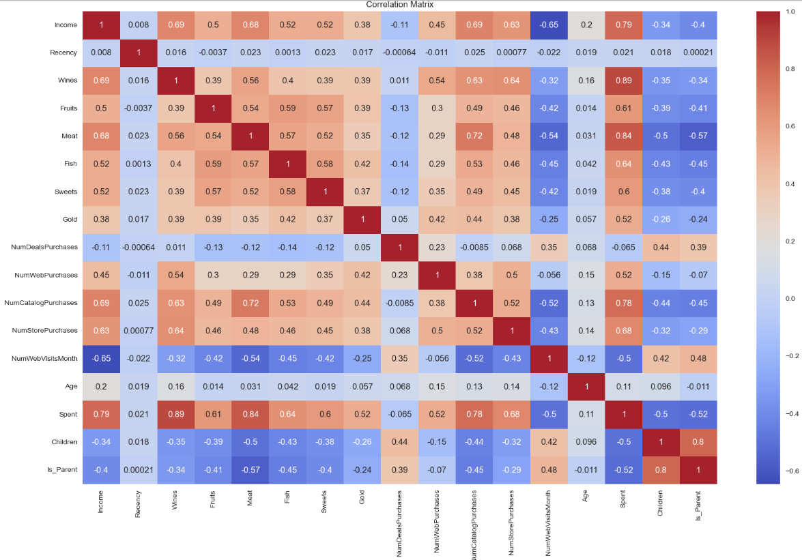
Visualization
Correlation Matrix(Heat map)

Slide 6
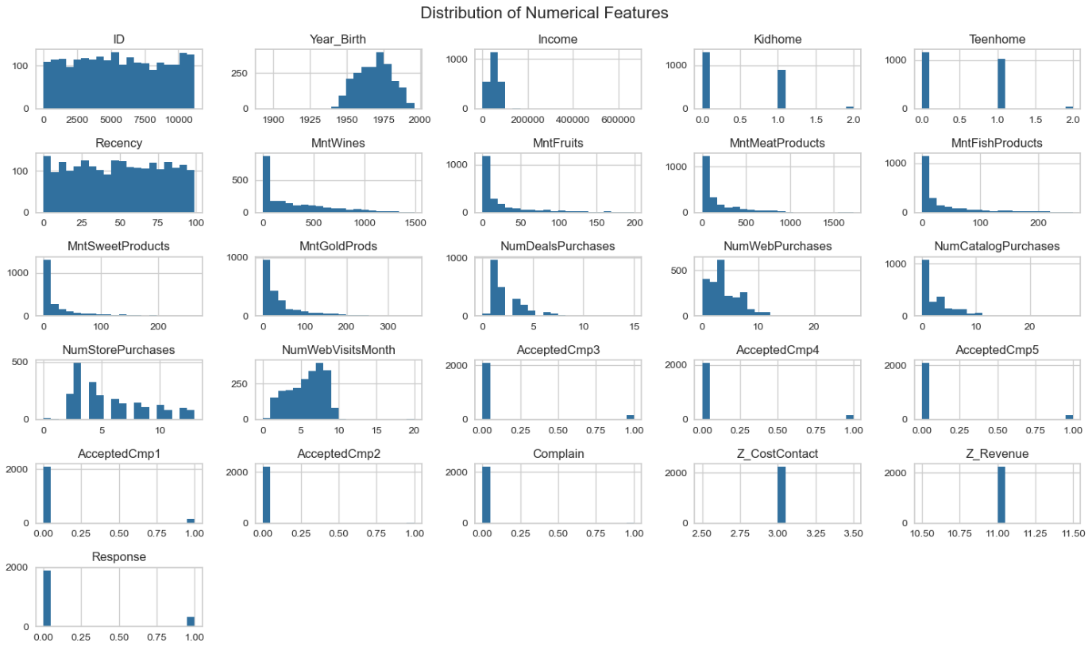

Slide 7
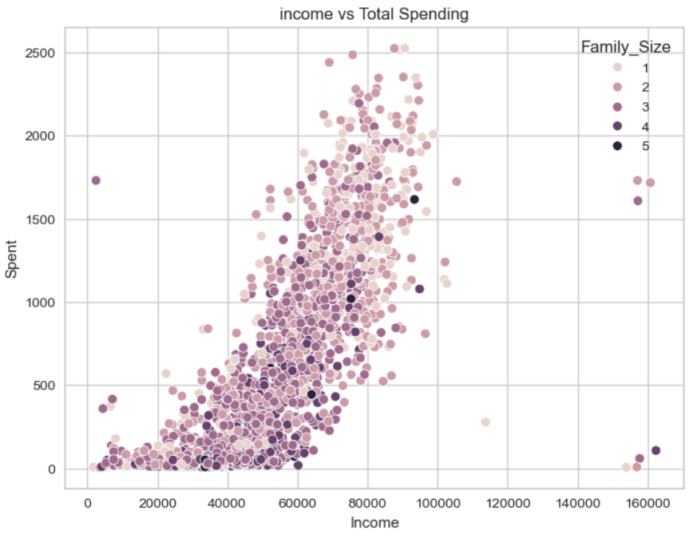

Slide 8
Feature Engineering
.
Combined different features into one
Label encoded categorical variables like Marital_Status, Education.
Scaled features using StandardScaler.
Created new features like total children and total spendings.

Slide 9
Dimensionality Reduction
Applied PCA to reduce dimensions and retain variance.
t-SNE used for 2D cluster visualization.
Helped in better visual representation of clusters.

Slide 10
Clustering Models Applied
KMeans with Elbow method for optimal K.
Gaussian Mixture Model (GMM) for probabilistic clustering.
Agglomerative Clustering for hierarchical segmentation.
DBSCAN for density-based cluster detection.

Slide 11
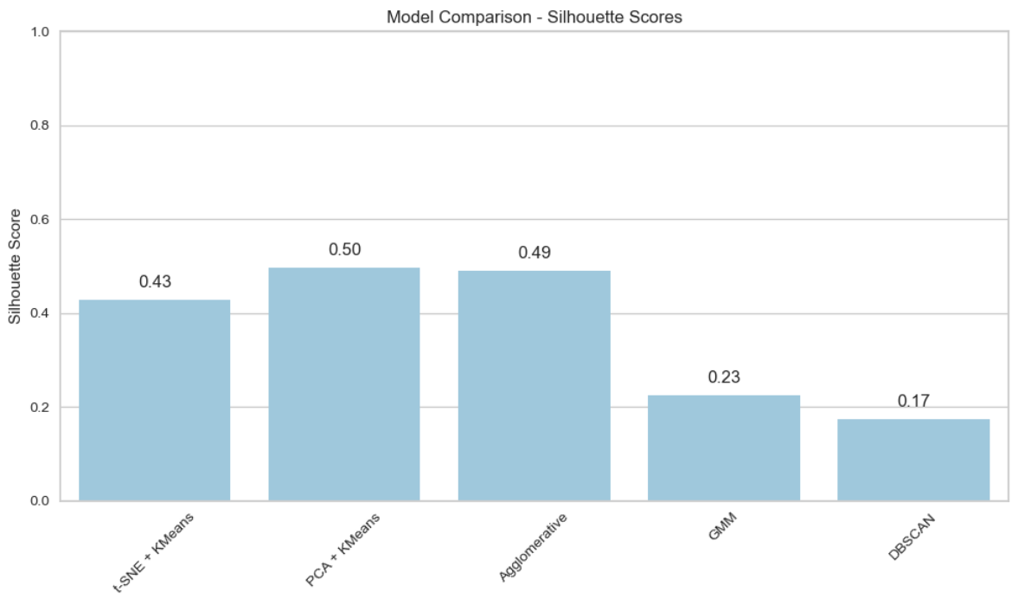
Model Evaluation
Silhouette Score used to evaluate cluster separation.
Plotted clusters using PCA and t-SNE.
Compared visual compactness and separation across models.

Slide 12
Cluster Insights
Cluster 0: low income and spending, Balanced family sizes, mostly paired and parented, customer for short time
Cluster 1: high income and spending, Balanced family sizes, not parent at most, customer for moderate time.
Cluster 2: moderate income and spending, high family sizes, mostly parent, customer for long time.
Helped identify potential marketing targets.

Slide 13
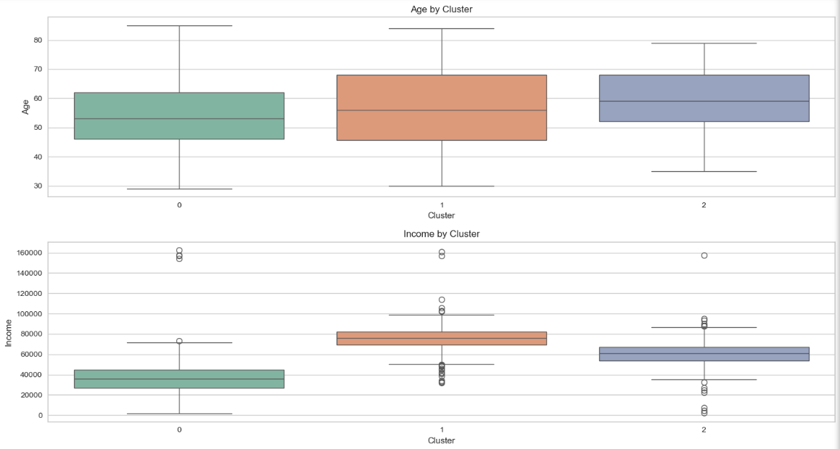
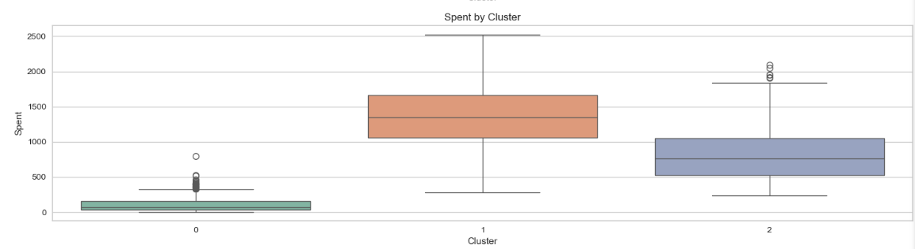

Slide 14
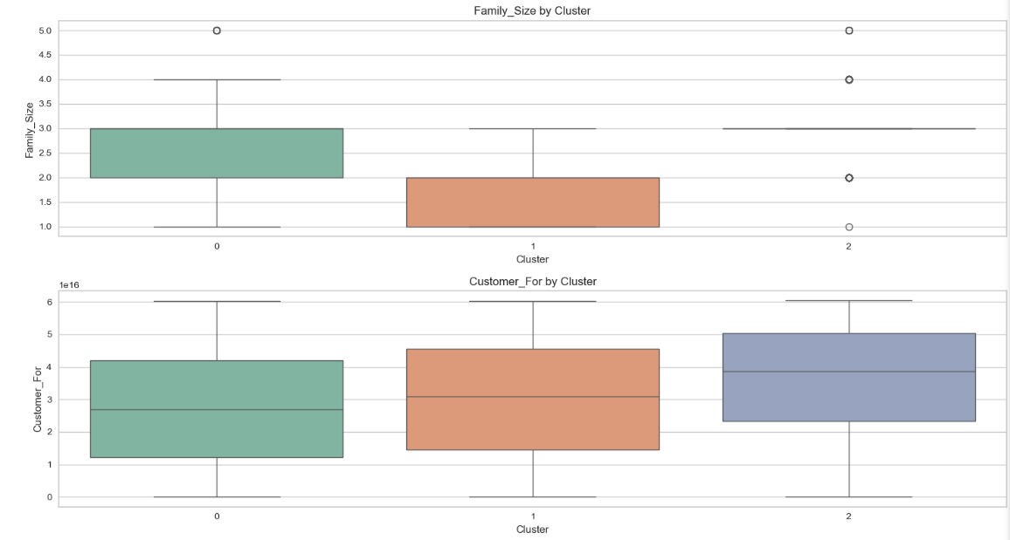

Slide 15
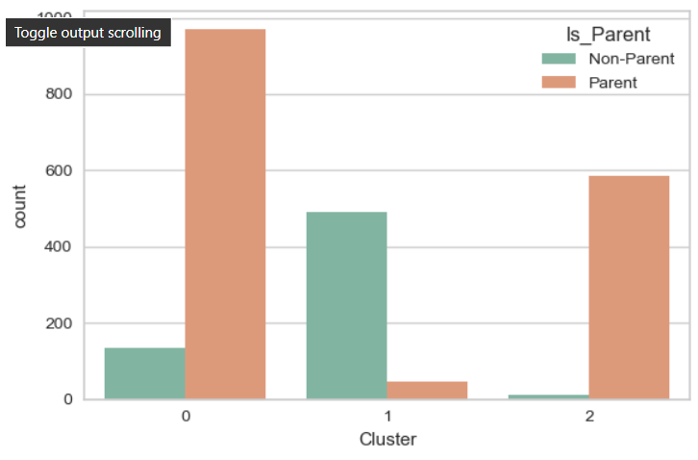
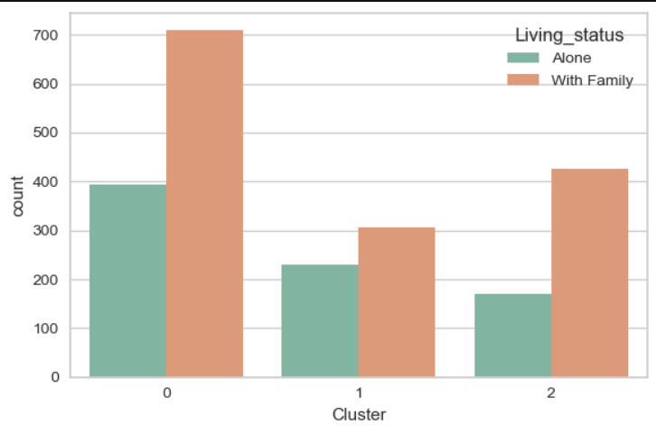

Slide 16
Cluster Insights base on Spending on different items
Cluster 0:
Moderate spenders.
Highest spend on Wines, followed by Meat and Gold.
Minimal spending on Fruits, Fish, and Sweets.
Cluster 1:
High spenders across most categories.
Wines and Meat are top spending categories.
Fish, Fruits, Sweets, and Gold show decent spending levels compared to other clusters.
Cluster 2:
Spend significantly on Wines, followed by Meat and Gold.
Overall, spend less than Cluster 1 but more than Cluster 0.
Fruits, Fish, and Sweets have lower values, similar to Cluster 0.

Slide 17
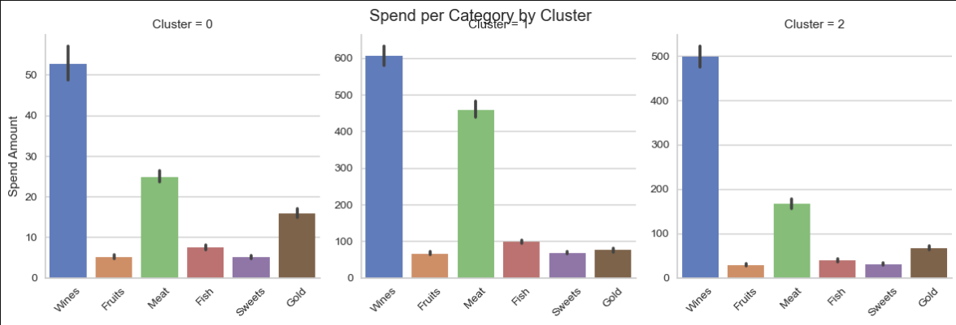
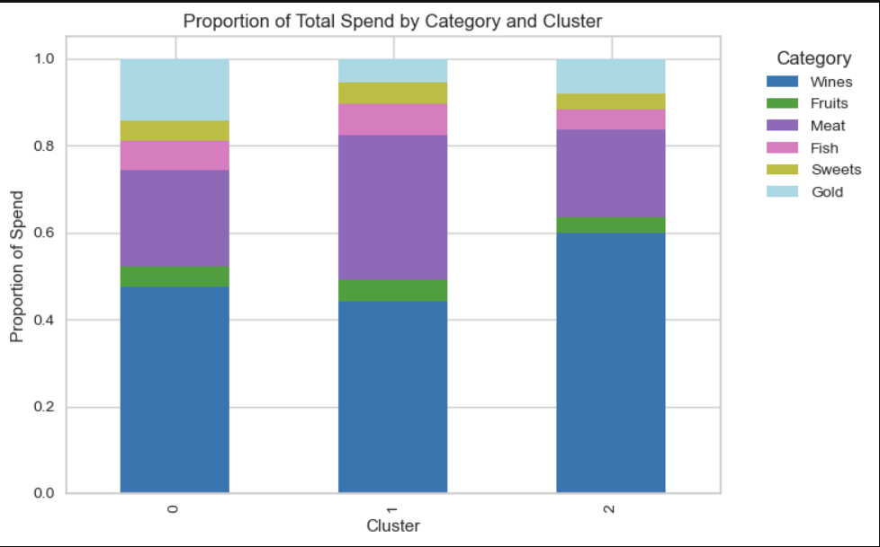

Slide 18
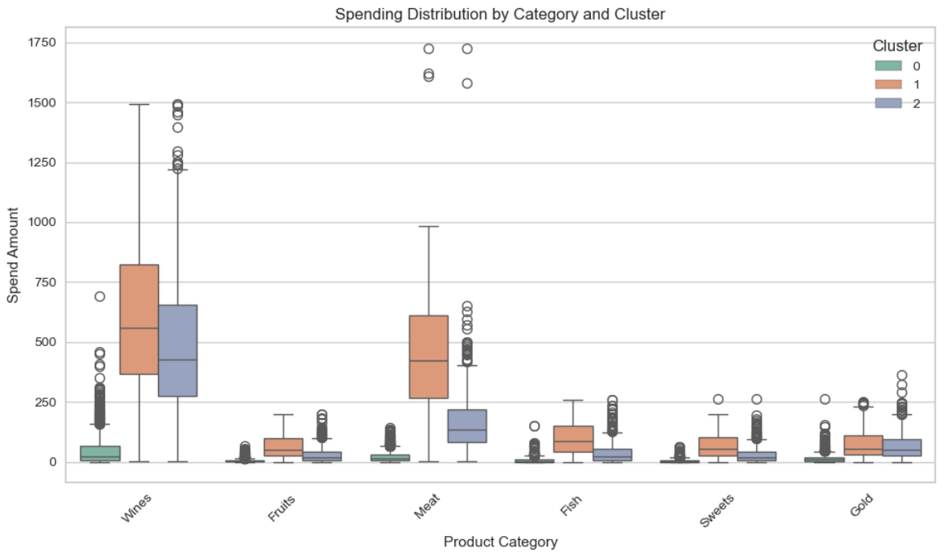

Slide 19
Model Deployment
Developed an interactive Streamlit app allowing users to input details and predict which category they belong to.
Built an interactive UI for customer segmentation.
Allowed users to input details and Deployed an app using streamlit

Slide 20
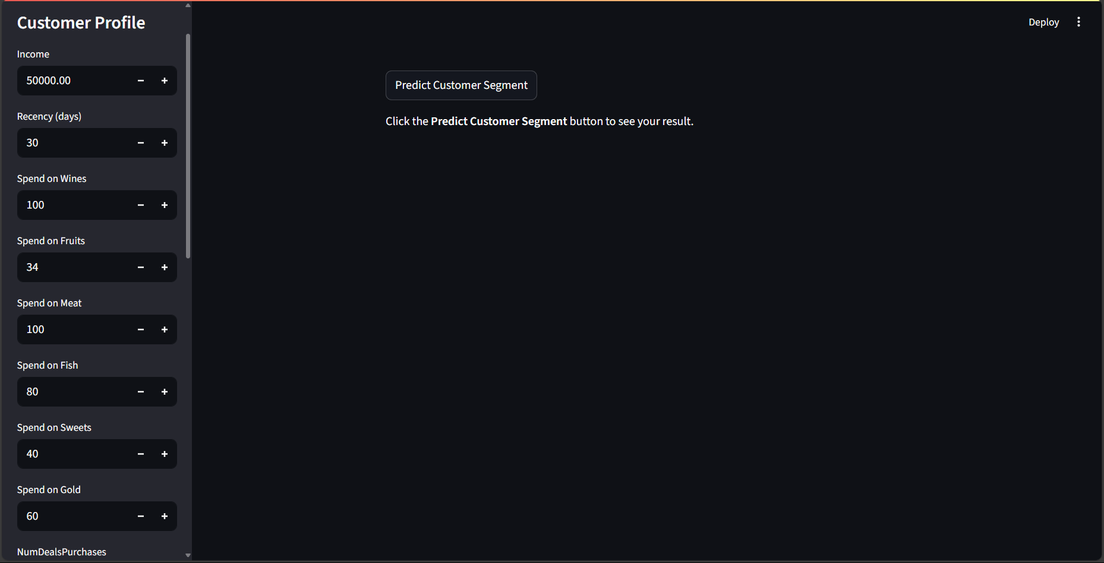
View Of Deployment Page

Slide 21
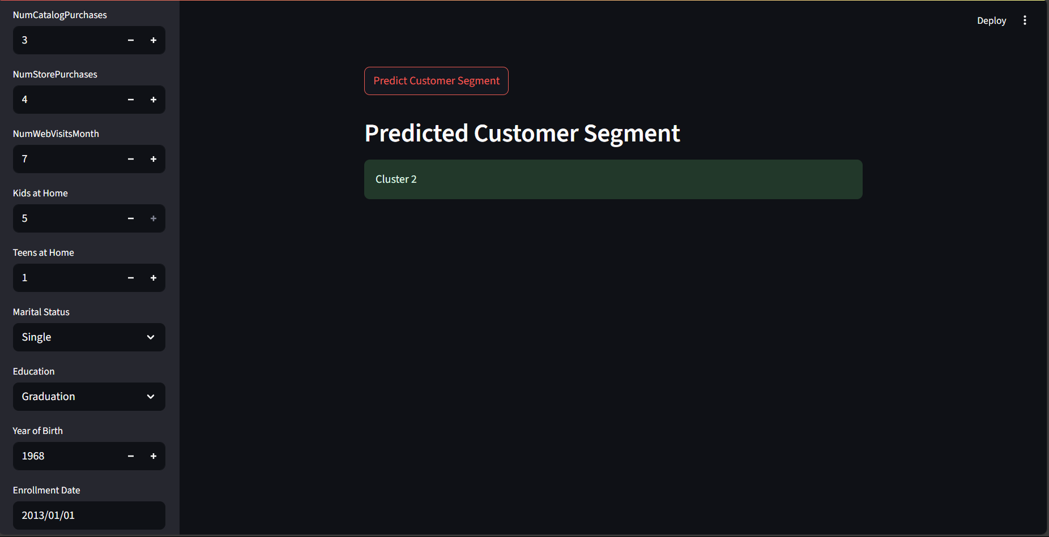

Slide 22
Challenges Faced During Project
Balancing dimensionality with interpretability.
Ensuring meaningful clusters (not just mathematical separation).
Dealing with overlapping clusters in GMM and DBSCAN.
Scaling and preprocessing decisions impacted clustering results.

Slide 23
Conclusion
Conclusion:
Successfully segmented customers using clustering techniques.
Identified meaningful behavioral patterns across groups.

Slide 24
THANK YOU

