Slide 1
Week 3
Advanced Cybersecurity
Practical Assessment
Network Discovery • Traffic Analysis • Vulnerability Assessment • Hardening
Role: Cybersecurity Intern Lab: 192.168.17.0/24 (Kali, Metasploitable2) Assessment window: 18 Aug 2026 Submission: 24 Aug 2026
CONFIDENTIAL — AUTHORIZED LAB USE ONLY

Slide 2
Project Objective
Simulate a real analyst workflow end to end, inside an isolated authorized lab.
1
Discover
2
Capture
3
Correlate
Identify live hosts and enumerate exposed services with Nmap.
Record live traffic with Wireshark across DNS, TCP, UDP, ICMP, ARP.
Match an active Nmap scan to its exact packet-level footprint.
4
Investigate
5
Assess
6
Harden & Verify
Profile top talkers, DNS behaviour, and flag suspicious patterns.
Turn findings into a risk-classified vulnerability assessment.
Apply real fixes and prove improvement with before/after evidence.
Week 3 – Advanced Cybersecurity Practical
2

Slide 3
Lab Architecture
2 authorized VMs on an isolated host-only / NAT segment
Gateway / Internet
192.168.17.1
192.168.17.0/24 — host-only / NAT lab segment
Kali Linux 2026
Metasploitable2
192.168.17.128
192.168.17.129
Attacker / Analyst
(Nmap + Wireshark)
Primary Target
(intentionally vulnerable)
Tools: Nmap 7.98 • Wireshark • UFW firewall • systemd • VMware Workstation
23
open ports found
on the target
2,238
packets captured
(0 dropped)
2
authorized VMs
in scope
Week 3 – Advanced Cybersecurity Practical
3

Slide 4
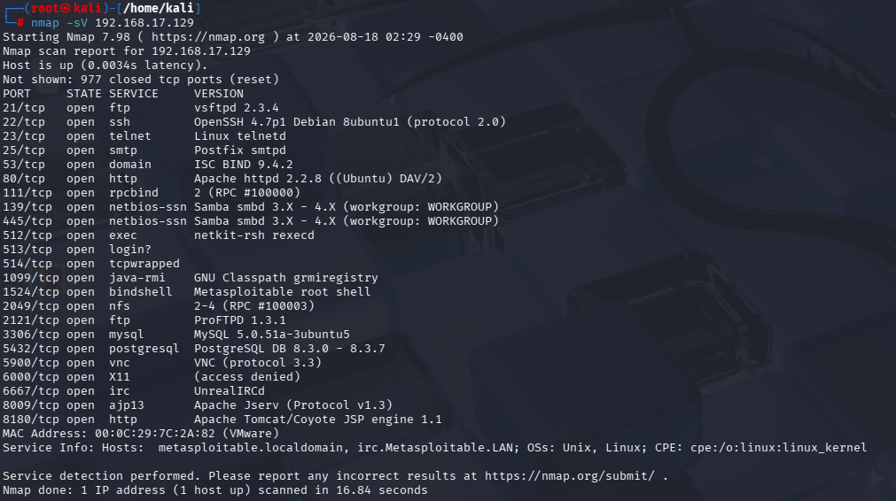
Nmap Assessment
nmap -sV 192.168.17.129 — service/version enumeration
23
open TCP ports
977
closed / reset ports
3
Critical services
(backdoors)
Standout finding: port 1524/tcp fingerprints as an already-listening, unauthenticated root shell ("Metasploitable root shell") — a built-in backdoor requiring no exploit at all.
Full 23-port table with per-port risk rating is provided in the written report, §7.
Week 3 – Advanced Cybersecurity Practical
4

Slide 5
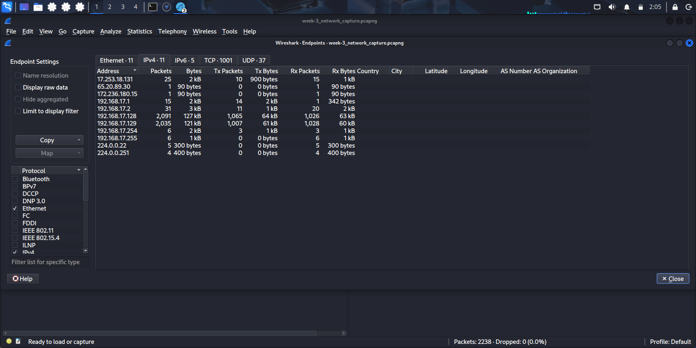
Wireshark Analysis
week-3_network_capture.pcapng — captured on Kali eth0
2,238
packets captured, 0 dropped
92%
of traffic is the .128 ↔ .129 pair
1,001
TCP conversations tracked
DNS · TCP · UDP · ICMP · ARP
protocols analyzed
Statistics → Endpoints (IPv4): 192.168.17.128 and .129 dominate the capture.
DNS anomaly: queries to the lab resolver (192.168.17.2) intermittently return ICMP Port-Unreachable instead of a response — flagged for review.
Week 3 – Advanced Cybersecurity Practical
5

Slide 6
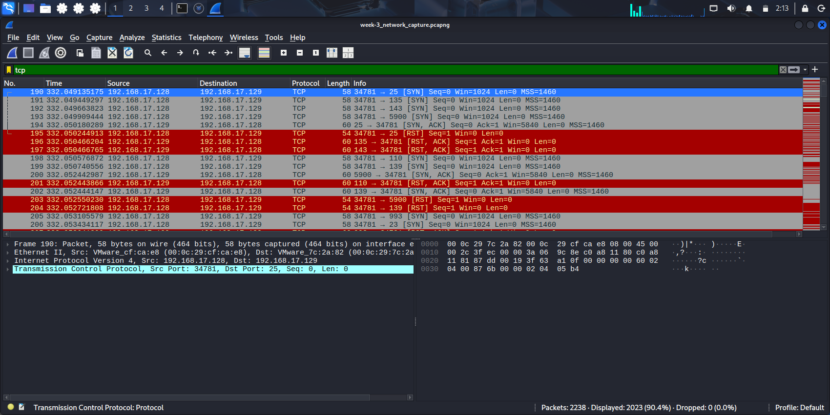
Nmap + Wireshark Correlation
A live nmap -sS scan, captured packet-by-packet in Wireshark
Nmap | Wireshark | Verdict
25/tcp open (smtp) | SYN → SYN,ACK → RST | Open — confirmed
139/tcp open (netbios) | SYN → SYN,ACK → RST | Open — confirmed
5900/tcp open (vnc) | SYN → SYN,ACK → RST | Open — confirmed
135 / 143 / 110 — not listed | SYN → RST,ACK | Closed — confirmed
SYN scan burst: .128 → .129 across dozens of ports within ~13 ms.
1,023 SYN packets (45.7%) and 1,000 RST packets (44.7%) isolated by filter — every Nmap-reported port state is backed by raw packet evidence.
Week 3 – Advanced Cybersecurity Practical
6

Slide 7
Traffic Investigation Highlights
At least 5 events investigated across the full 2,238-packet capture
SYN-scan burst
3 ports confirmed open
DNS ↔ ICMP anomaly
~1,023 SYN packets to sequential ports in <13 ms from .128 → .129
SYN,ACK returned for SMTP (25), NetBIOS (139), VNC (5900) in one burst
DNS query followed by "Port Unreachable" instead of a normal response
Classic Nmap fingerprint; authorized here, but is reconnaissance if unexpected
Directly feeds the vulnerability assessment findings
Resolver misconfiguration — not malicious, but worth correcting
ARP pre-resolution
External NTP egress
Traffic concentration
Target MAC resolved via ARP immediately before the scan burst
Outbound UDP/123 to a second public time server mid-capture
One host pair (.128 ↔ .129) makes up ~92% of all packets
Timestamp-confirms the scan originated on-segment from Kali
Legitimate, but confirm egress filtering allows only necessary destinations
A one-directional volume spike is itself worth investigating on any real network
Week 3 – Advanced Cybersecurity Practical
7

Slide 8
Security Findings
nmap --script vuln + service fingerprinting → 7 documented findings
1
vsFTPd 2.3.4 backdoor (21/tcp)
CVE-2011-2523 — exploit verified, returned uid=0(root)
Critical
2
Unauthenticated root bindshell (1524/tcp)
Direct root command execution, no auth required
Critical
3
Backdoored UnrealIRCd (6667/tcp)
Matches trojanized 3.2.8.1 distribution history
Critical
4
Telnet enabled (23/tcp)
Cleartext credentials, trivially sniffable
High
5
Outdated Samba (139/445 tcp)
Old branch, history of remote exploits
High
6
Weak-auth VNC (5900/tcp)
Protocol 3.3 — brute-forceable authentication
Medium
7
Excessive exposure — 23 open ports
Larger attack surface across one single host
Medium
Week 3 – Advanced Cybersecurity Practical
8

Slide 9
Risk Classification
Findings classified by exploitability and business impact
Critical
Unauthenticated, remote, leads to full/root compromise
High
Cleartext exposure or software with known remote-exploit history
Medium
Weak controls / unnecessary exposure needing a further step
Low
Minimal exploitability; access already restricted
Week 3 – Advanced Cybersecurity Practical
9

Slide 10
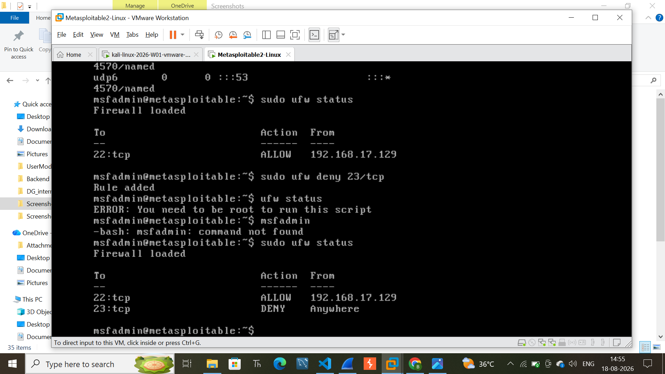
Hardening Performed
3 verified security improvements
1
2
3
Disabled unnecessary SSH on Kali
Enabled UFW + restricted SSH on target
Blocked Telnet at the firewall
systemctl disable --now ssh
ufw allow 22/tcp from trusted host; ufw enable
ufw deny 23/tcp
Removed an unneeded listener on the analyst's own host
Default-deny host firewall now active, replacing no protection at all
Cleartext credential exposure over Telnet is now blocked
Figure: firewall status after all 3 actions — 22/tcp ALLOW, 23/tcp DENY.
Week 3 – Advanced Cybersecurity Practical
10

Slide 11
Before vs After
Verified improvement for each hardening action
Issue | Before | After
SSH running on Kali analyst VM | Enabled, active at boot | Disabled & stopped — will not restart
No firewall on Metasploitable target | "Firewall not loaded"; SSH open to subnet | "Firewall loaded"; explicit SSH allow rule
Telnet reachable (23/tcp) | Open — confirmed via Nmap + Wireshark | 23:tcp DENY — blocked at the firewall
Attack surface: partially reduced. The two riskiest firewallable exposures (SSH, Telnet) are now under positive access control, and an unnecessary listener on the analyst host was removed. The 3 Critical, service-level backdoors (vsFTPd, bindshell, UnrealIRCd) remain and require software-level remediation — the clear top priority for the next pass.
Week 3 – Advanced Cybersecurity Practical
11

Slide 12
Recommendations & Conclusion
1
Remediate all 3 Critical findings immediately — upgrade/remove vsftpd, terminate the bindshell, replace UnrealIRCd.
2
Adopt a default-deny firewall posture on every host, with rules scoped to the real management workstation.
3
Retire cleartext / weak-auth protocols (Telnet, rexec, rlogin, rsh, VNC 3.3) in favour of SSH / TLS equivalents.
4
Patch outdated services — Samba, BIND, Apache/Tomcat, ProFTPD — to currently supported releases.
5
Reduce overall exposure and re-verify with a follow-up Nmap scan after each remediation step.
Conclusion
This assessment walked the full analyst workflow — discovery, capture, correlation, risk-classified findings, and verified hardening — inside an authorized lab. Three Critical, unauthenticated remote-compromise paths were confirmed on the target, and three real hardening actions measurably reduced exposure. The service-level backdoors remain the clear next priority.
Week 3 – Advanced Cybersecurity Practical | Submission Deadline: 24 August 2026

