Slide 1
Automobile Spare Parts E-Commerce Store
Prepared By
Name :M Bhanu
Roll No:23481A05E8

Slide 2
Introduction
Online platform to buy automobile spare parts easily.
Provides digital solution for spare parts shopping.
This system helps customers search and purchase automobile spare parts anytime without visiting physical stores.
The platform improves transparency by showing clear product details, prices, and availability in one place.

Slide 3
Problem Statement
Manual spare parts purchase is time-consuming.
Limited availability and lack of price comparison.
Customers face difficulty in identifying genuine spare parts and trusted sellers.
There is no centralized platform to track orders, manage returns, or get proper after-sales support.

Slide 4
Objective
To build an online spare parts store.
Easy browsing, cart, and purchase system.
To provide a secure and user-friendly platform for customers to search and select spare parts easily.
To improve accessibility by allowing users to compare prices and product details before purchasing.

Slide 5
Proposed Solution
Integrated shopping cart system to manage selected spare parts and quantities easily.
Secure user authentication and order management to ensure safe and reliable transactions.
Web-based e-commerce platform.
User-friendly interface with product images and prices.

Slide 6
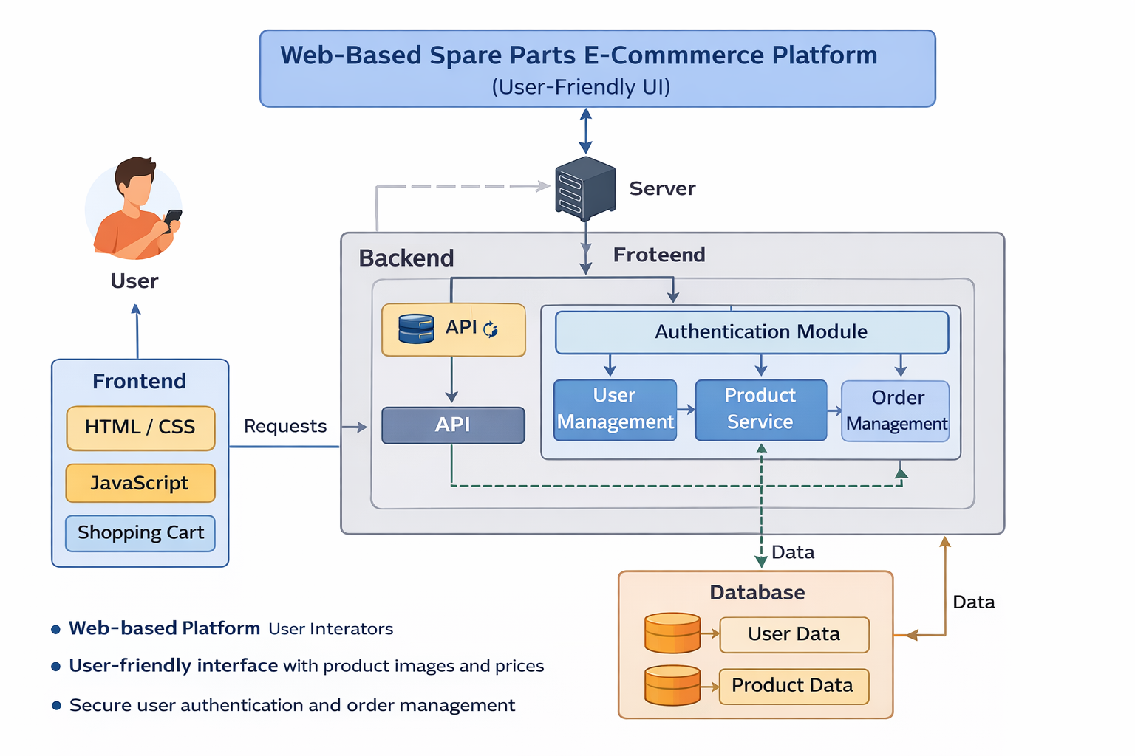
Architecture

Slide 7
Implementation
User authentication module allows users to register, login, and logout securely.
Admin can add, update, or remove spare parts from the product database.
Database integration ensures real-time update of product availability and stock details.
Flask routing is used to connect frontend pages with backend logic smoothly.

Slide 8
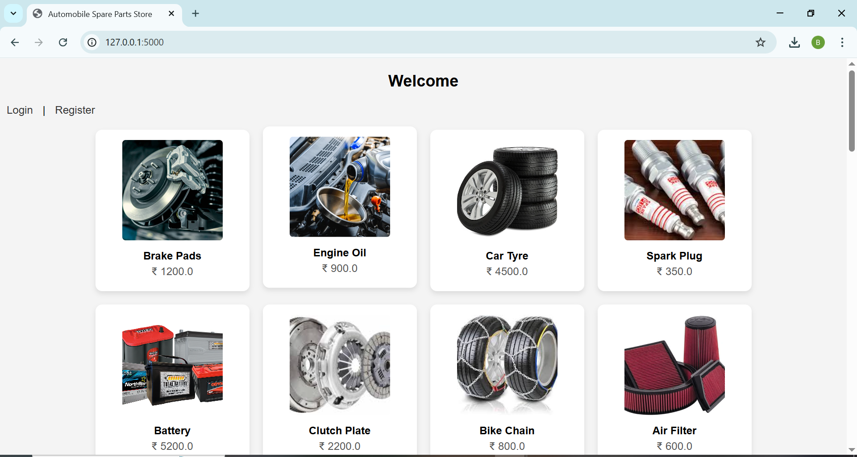
Output

Slide 9
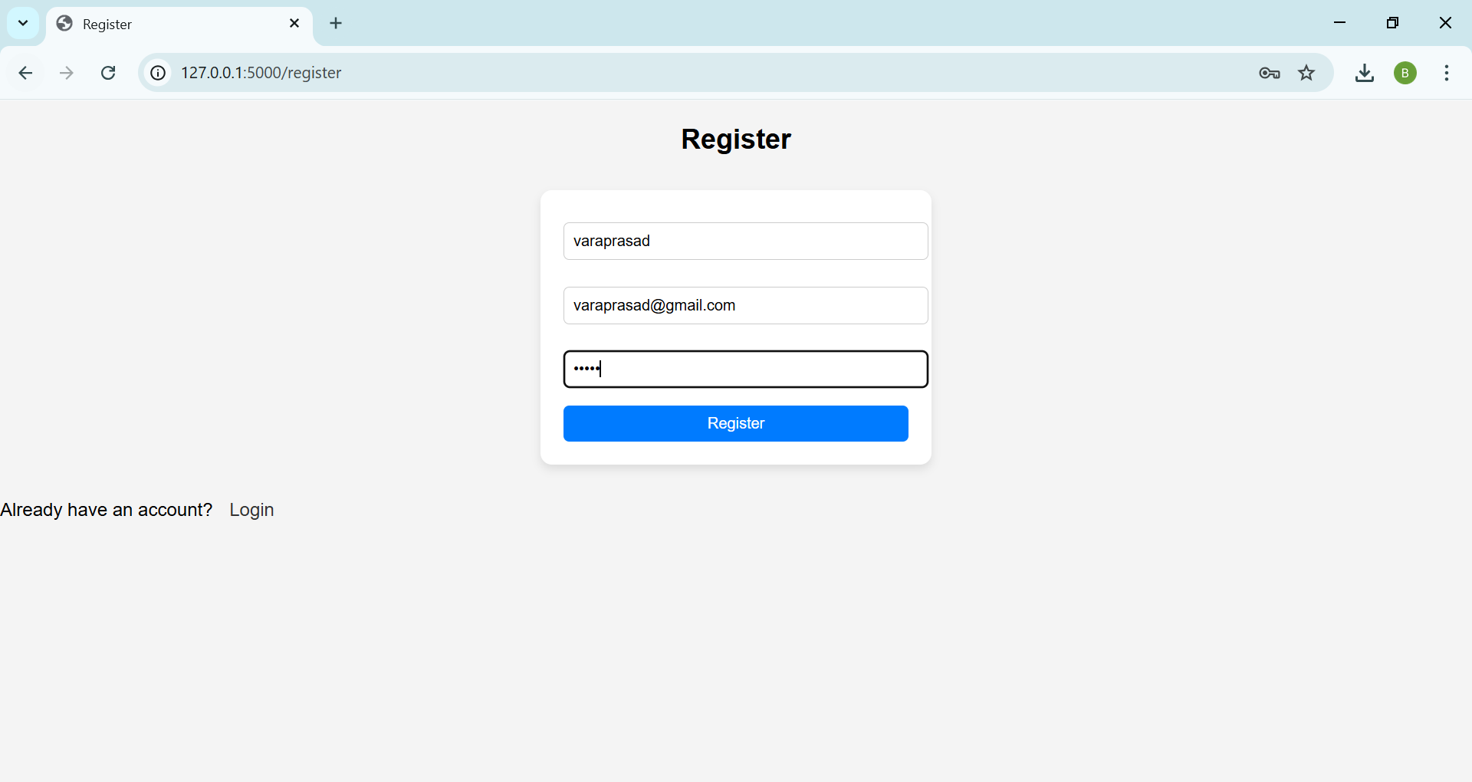
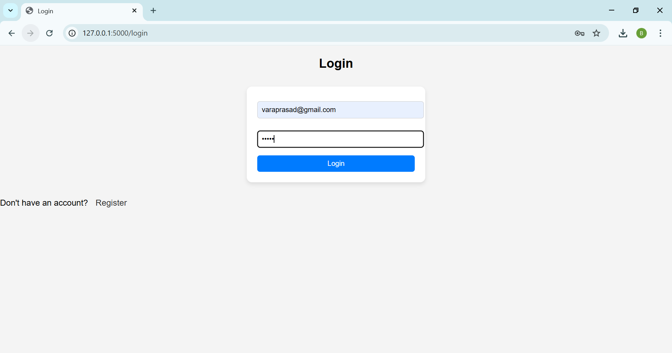
Output

Slide 10
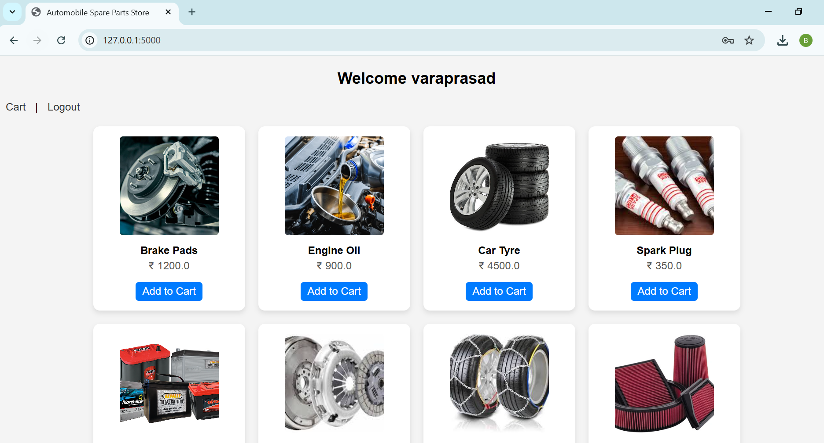
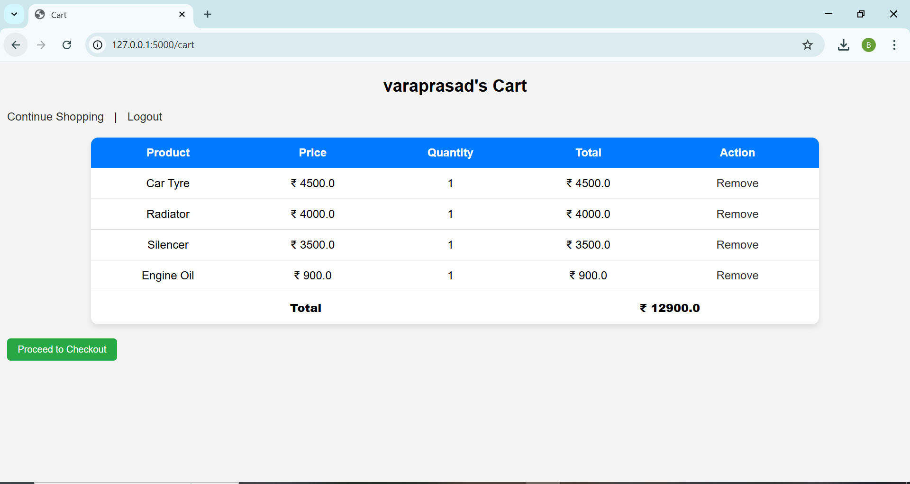
Output

Slide 11
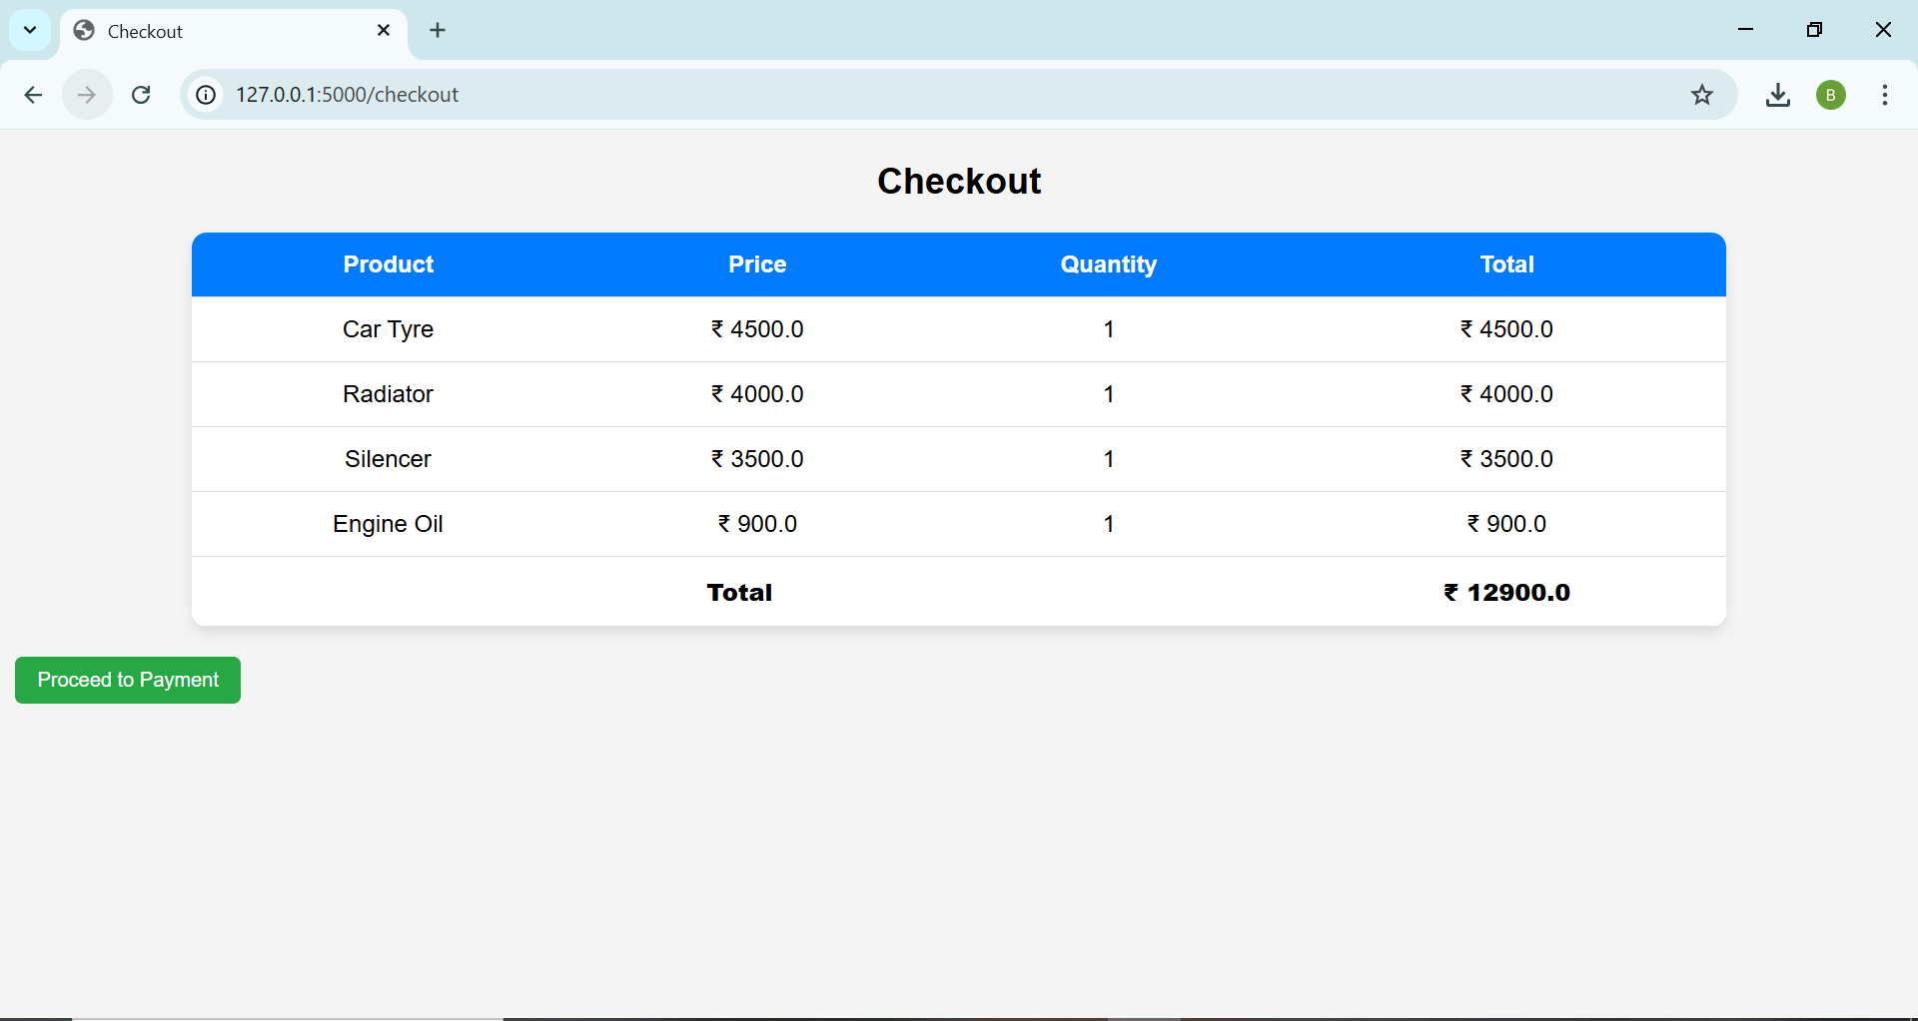
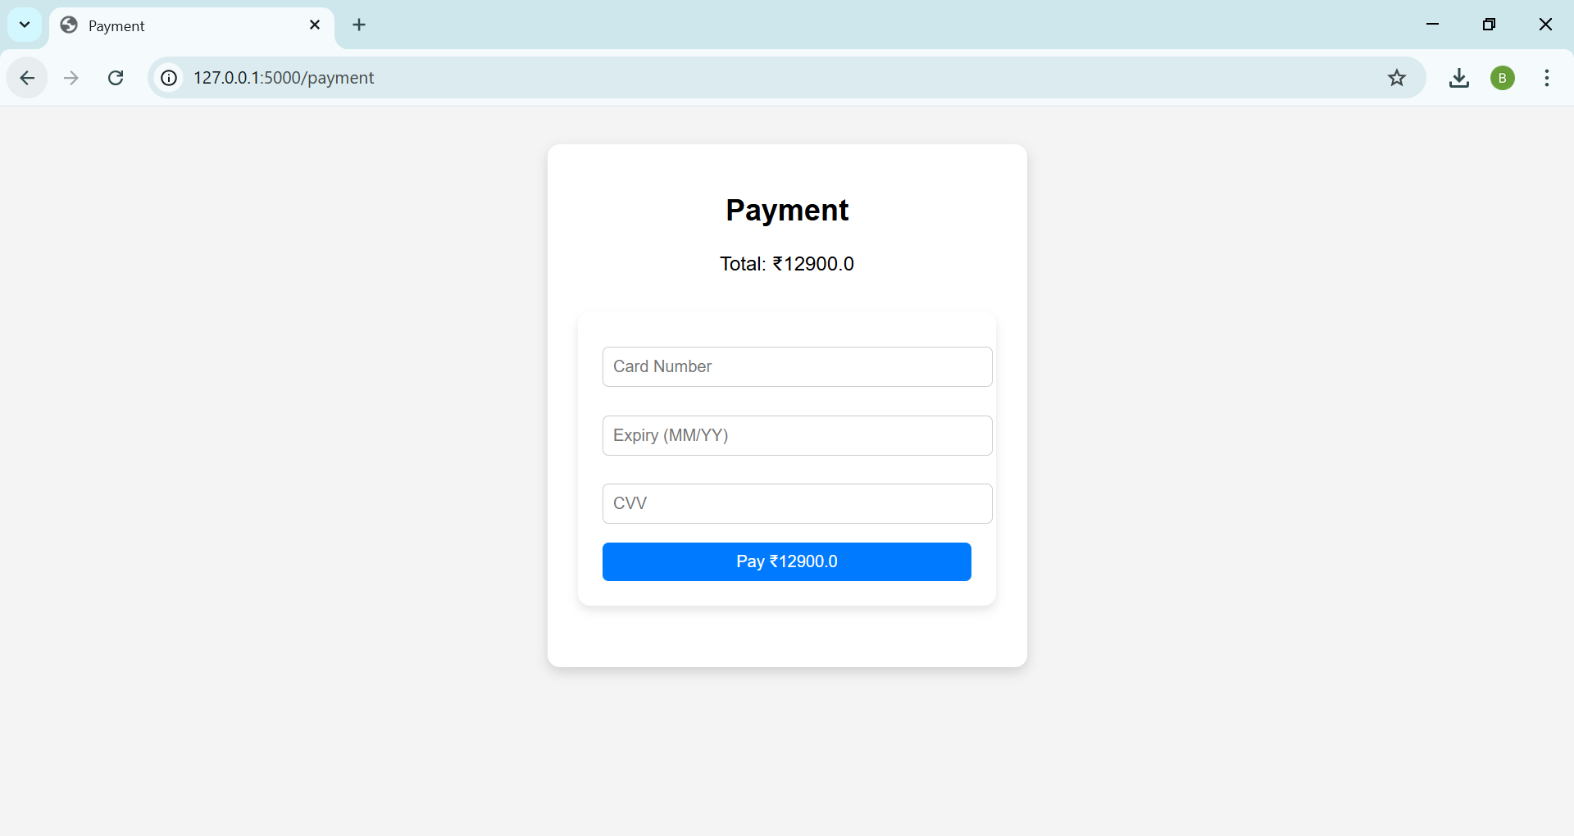
Output

Slide 12
Result
Automobile Spare Parts E-Commerce Store successfully developed.
Users can register, login, and view spare parts with images and prices.
Add to Cart feature works and shows item count in cart icon.
Cart displays selected items with total amount.

Slide 13
Future Enhancement
Online payment integration (UPI, Debit/Credit Cards).
Admin panel to manage products and orders.
Order tracking and delivery status updates.
Product search and category filtering.
User reviews and ratings for products

Slide 14
Conclusion
Project meets all basic e-commerce requirements.
Flask efficiently handles backend operations.
HTML and CSS provide a simple and user-friendly interface.
Session management is used for cart functionality.
Project can be extended with payments and order tracking.

