Slide 1
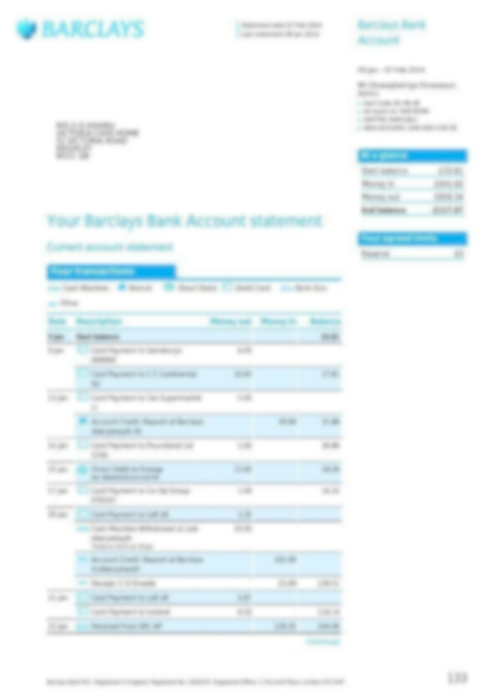
What is the account balance, please?
This is how it may look for people with Visual disability

Slide 2



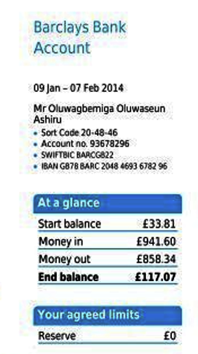
Visual assistance – New screen reader
What is the account balance?
The current account balance is £117.07

Slide 3
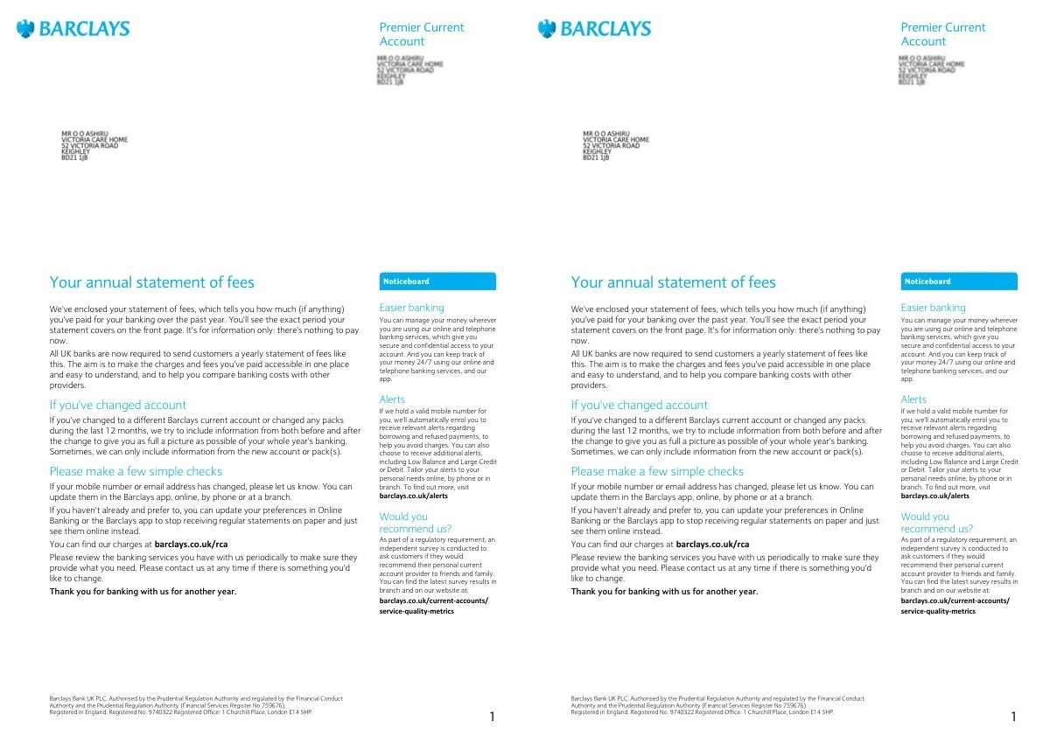
How long will it take to read this?
The document contains approximately 621 words. A screen reader would take about 207 seconds (or roughly 3 minutes and 27 seconds) to read it aloud at an average speed of 180 words per minute
How long will it take to understand ?
…

Slide 4
Cognitive assistance – Engaging and Fast!
What are the changes? Summarize
Responds in seconds >>
**Changes to Barclays Current Account**
Barclays has made several changes to its current account, including:
* **No Paper Statements**: Barclays will no longer provide paper statements for their customers. Instead, they will offer an online service where customers can view and download their statements.
* **Alerts**: Customers will be able to set up alerts to notify them of various transactions on their accounts.

