Slide 1
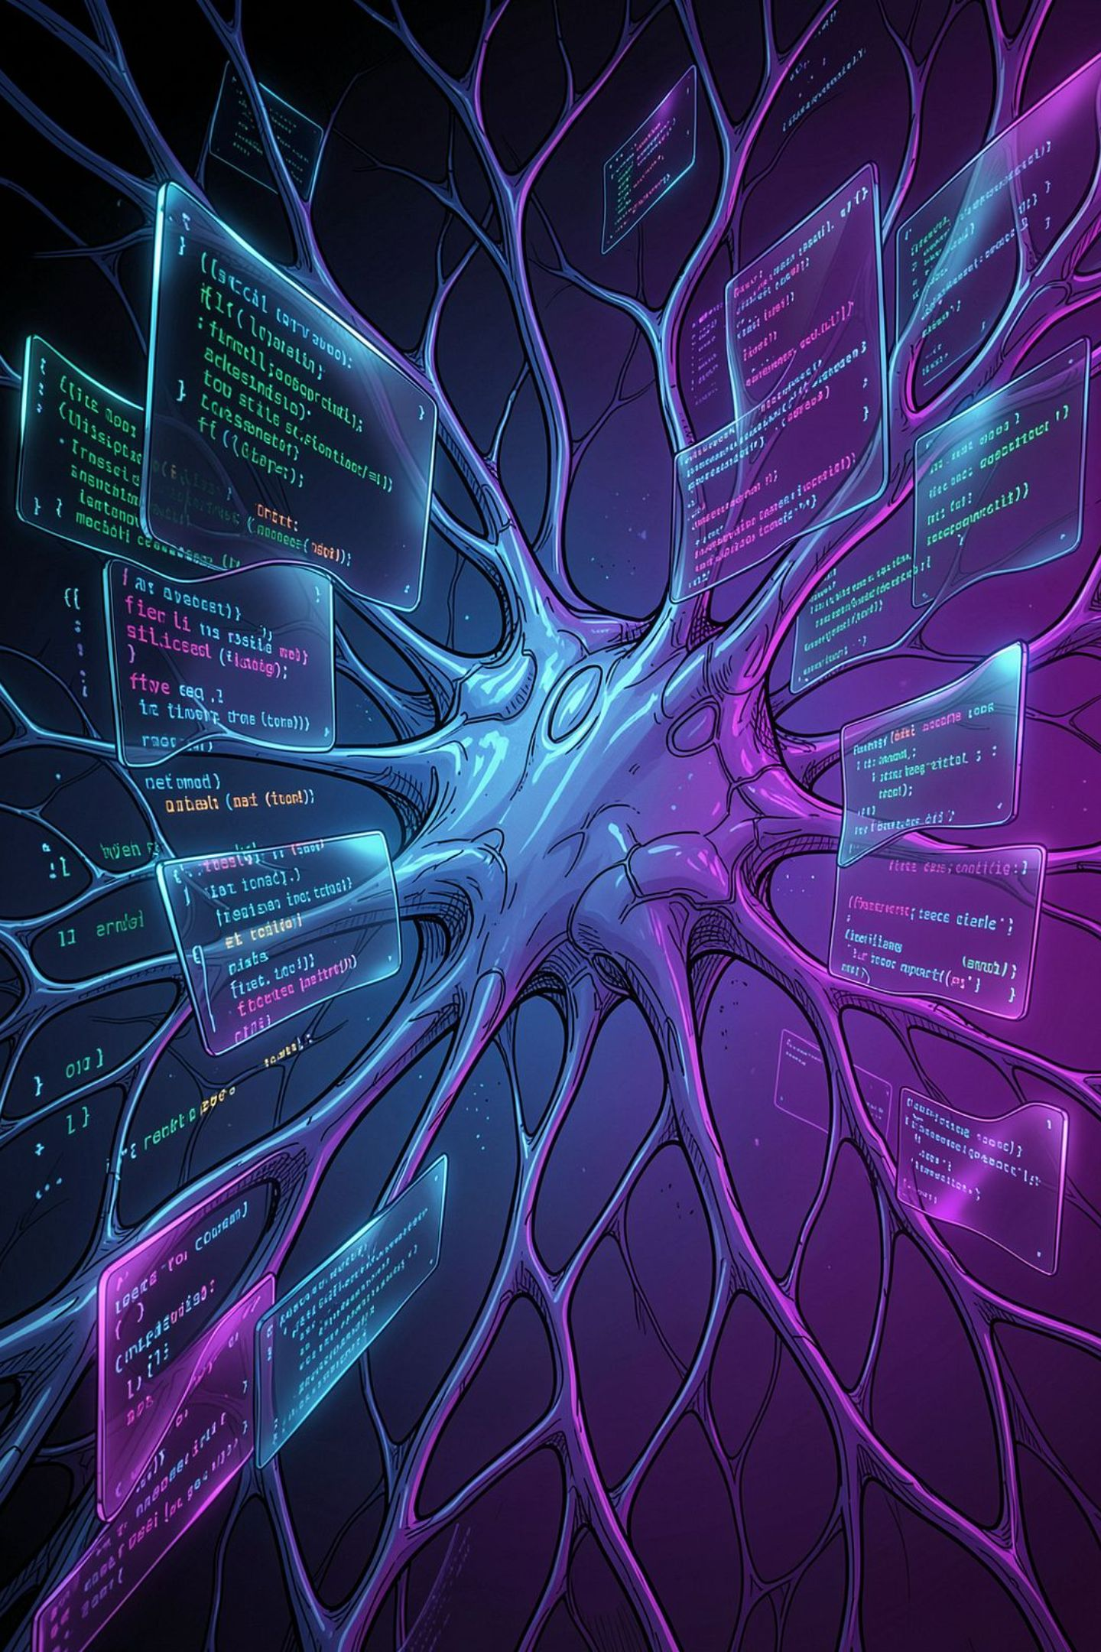
CODEX AI
Your Autonomous Multi‑Agent Software Engineer
K.LIKHITHA

Slide 2

The Problem
Debugging
Developers often spend hours trying to track down bugs in large codebases.
Code Reviews & Testing
Writing tests and thorough reviews are time‑consuming and inconsistent.
Security & Compliance
Vulnerabilities go undetected until late in the lifecycle.
Repository Understanding
Onboarding and repo comprehension slow feature delivery.
Hours saved
Missed bugs
Large numbers, cite in demo
High cost per incident
Manual reviews
Expensive & slow

Slide 3
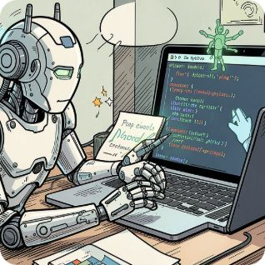

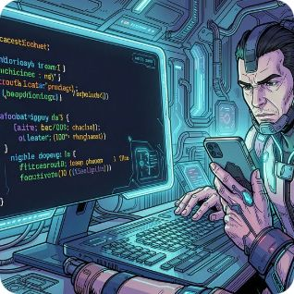
Solution — CodePilot AI
Autonomous multi‑agent software engineer that reads your repository, finds and explains bugs, generates fixes and tests, audits security, and produces final reports — all with one click.
Reads Repositories
Finds & Explains Bugs
Fixes & Tests
Contextual repository understanding across languages and monorepos.
Auto fixes, unit tests, and Git diffs ready for review.
Accurate detection with root‑cause narratives for engineers.

Slide 4
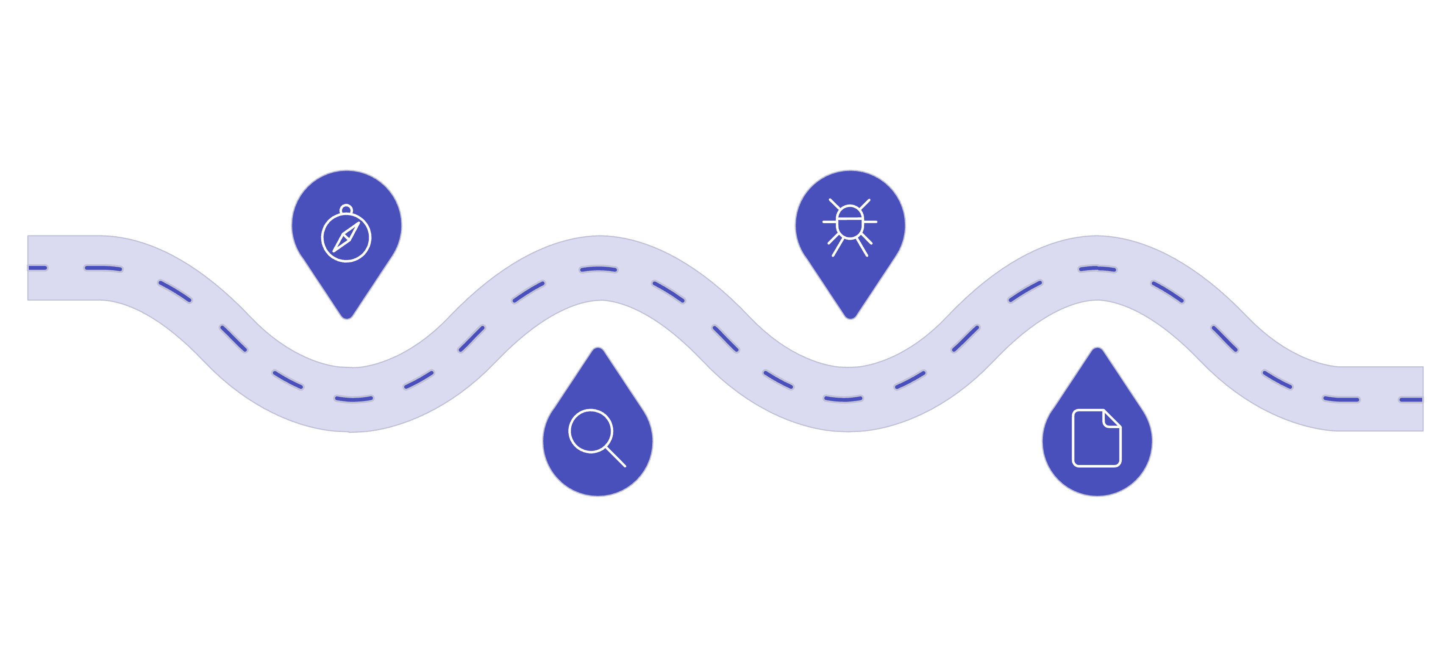
Architecture
Planner Agent
Bug Hunter
Coordinates the multi-agent pipeline
Detects defects and generates reports
Repository Analyzer
Final Report
Consolidates findings and recommendations
Scans codebase and surfaces issues
The multi‑agent pipeline coordinates specialized agents with a central planner. Each agent analyzes, proposes changes, and contributes to the final consolidated report.

Slide 5




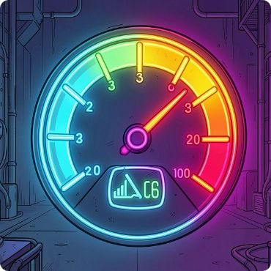
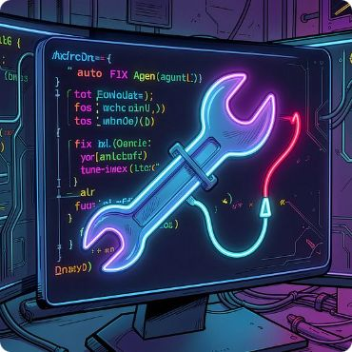
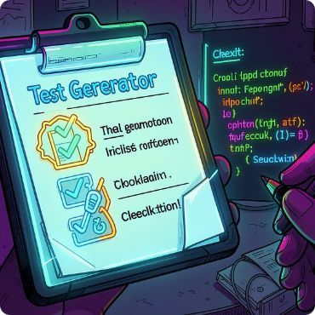


AI Agents
Repository Analyzer
Bug Hunter
Root Cause
Security
Build graph, dependency map, and code ownership insights.
Static & dynamic checks tuned by learned heuristics.
Explainable diagnostics linking failures to code paths.
SCA, dependency vulnerabilities, and secret detection.
Performance
Auto Fix
Test Generator
Documentation
Hotspots, regression risk, and optimization suggestions.
Patch generation, contextual tests, and safe rollouts.
Unit, integration, and fuzz tests tailored to repo patterns.
API docs, change logs, and human‑readable summaries.
Planner
Orchestrates agents, priorities, and safe change application.

Slide 6
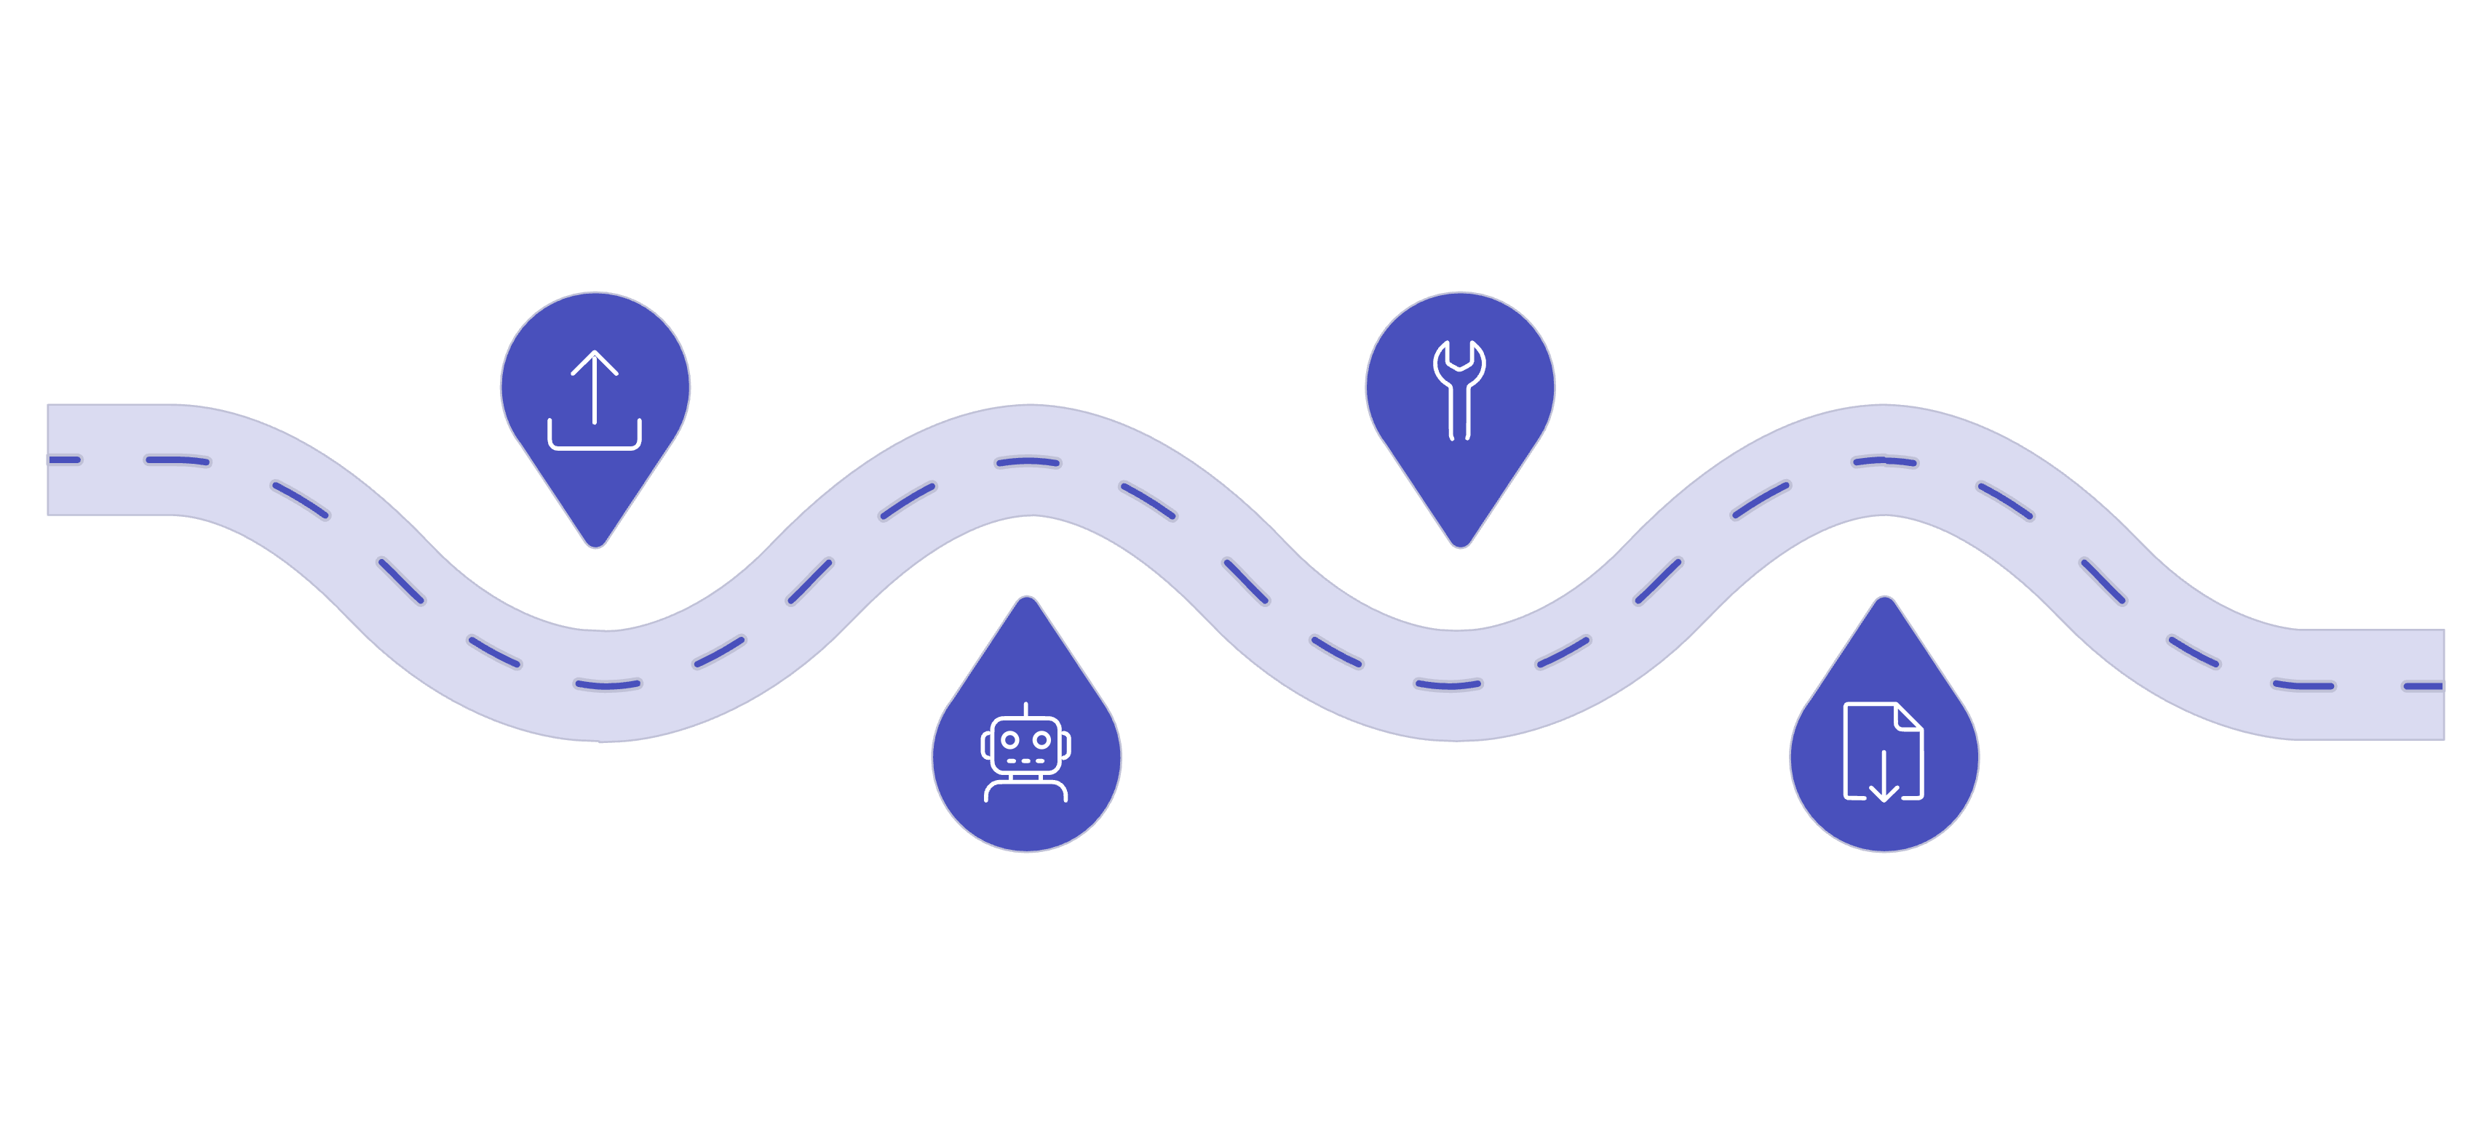
Workflow
Upload
Fixes
Link or upload your repo
Auto fixes and tests proposed
Analysis
Report
AI agents run parallel scans
Download reviewable diff and report
An engineer uploads or links a repo — CodePilot runs analysis agents in parallel, consolidates fixes and tests, and emits a reviewable Git diff plus a downloadable report.

Slide 7
Key Features
GitHub Import
ZIP Upload
OAuth multi‑repo and organization support.
Private repos and offline bundles supported.
Bug Detection
Security Scan
Multi‑language static analysis powered by LLMs + rules.
Dependency scanning, secret detection, and SCA integration.
Performance Analysis
Automatic Code Fix
Heuristics for regressions and hotpath optimizations.
Patch proposals with tests and CI checks.
Git Diff
Documentation & Reports
Ready PRs, review commentary, and changelogs.
Markdown & PDF exports with executive summary.

Slide 8
Technology Stack
Frontend
AI
React • TypeScript • Tailwind • Monaco Editor
OpenAI Codex / GPT ensembles, fine‑tuned agents
Backend
Deployment
FastAPI • Python • Async pipelines
Docker • GitHub Actions • Vercel / Render for hosting
Database
Infra
PostgreSQL • Redis for queues & caching
Isolated sandboxes, secure secrets handling, audit trails

Slide 9
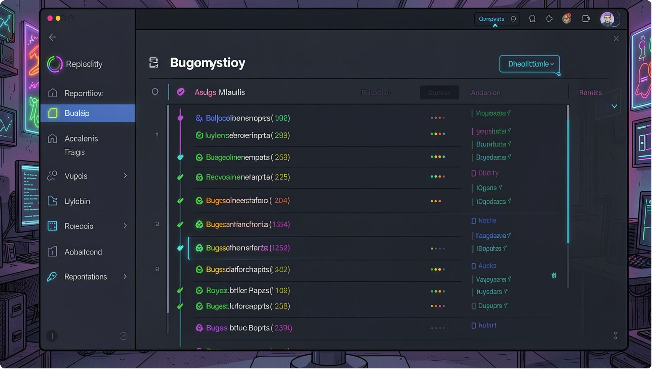
Live Demo Flow
Upload GitHub repository (OAuth)
AI analyzes repository structure and tests
Finds bugs and explains root causes
Generates fixes and unit tests
Creates PR with Git diff & downloadable PDF report
Live demo will show end‑to‑end: repo -> analysis -> PR in under 2 minutes.

Slide 10
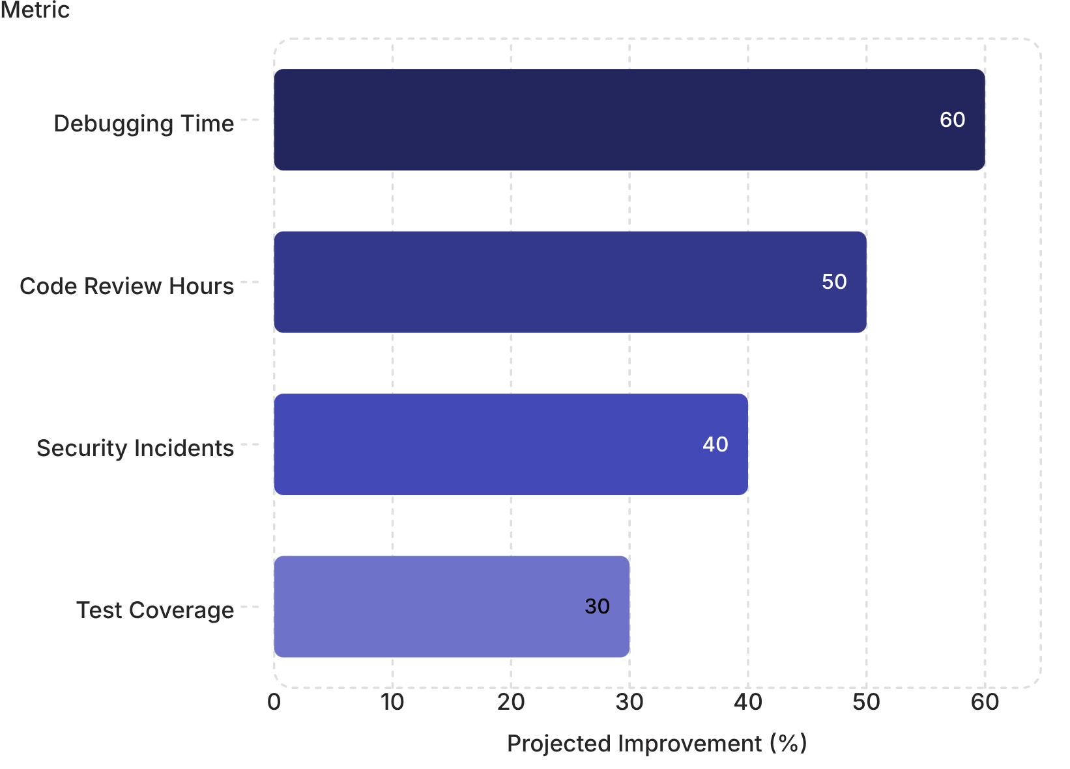
Impact
Reduce Mean Time To Repair
Faster triage and fixes.
Improve Code Quality
Automated tests + reviewable PRs.
Scale Security
Proactive vulnerability detection.
Large numbers reflect projected efficiencies for engineering teams and lowered operational risk.

