Slide 1
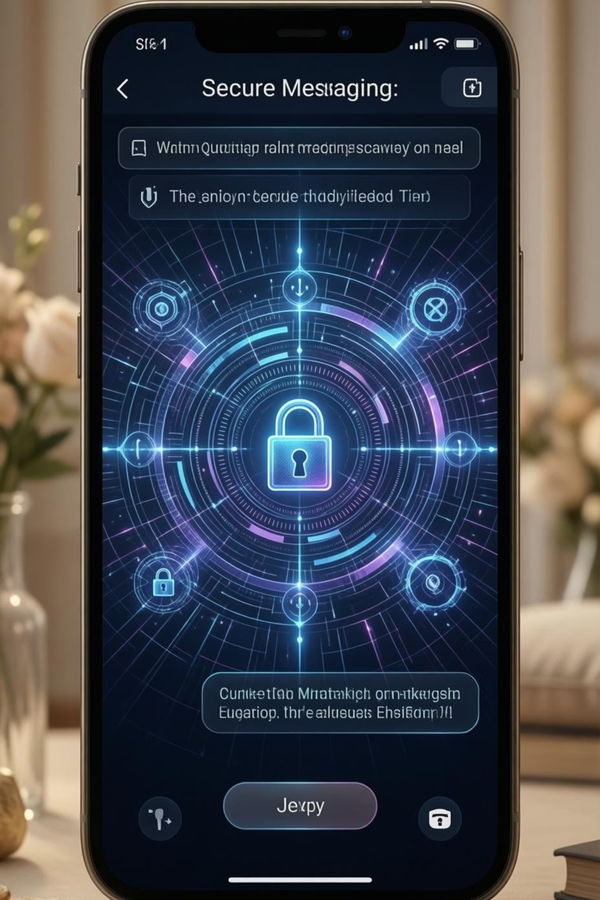
QuantumSecure Chat System
Secure Real-Time Messaging using BB84 with Shor’s Algorithm Extension
Presented by:
1.Paleti.Bhanu Prakash (22H71A05B3)
2.Batchu.Harika (22H71A075)
3.Namala.Venkata Sivamani (22H71A05A9)
4.Yaradla.Yaswanth Reddy (22H71A05D3)
Guide: Ms.J.Sravani
CSE/ DVR &Dr.HS MIC COLLEGE OF TECHNOLOGY

Slide 2

Introduction to QuantumSecure Chat
Chat apps are common today, but future security is a challenge. Our project addresses this using quantum cryptography.”
Chat applications are widely used for personal and professional communication
Protecting message privacy is an important
Most existing chat systems use classical encryption techniques
Quantum computing introduces new security threats to classical encryption
This project proposes a QuantumSecure Chat System for safer communication
This project introduces a robust quantum-safe chat system, meticulously designed to counteract these advanced threats. It ingeniously combines the principles of quantum cryptography, specifically the BB84 protocol, with established classical encryption techniques like AES, creating a hybrid solution for unparalleled security.

Slide 3

Problem Statement
People use chat apps to send important messages
Messages should be private and safe
Some chat systems do not provide strong security
Old encryption methods may fail in the future
Quantum computers can break old security methods
So, a better and safer chat system is needed

Slide 4





Project Objectives
Secure Chat Design
To create a real-time chat application
To ensure messages are safe and private
BB84 Implementation
To generate secure keys using BB84 protocol
To safely exchange keys between users
AES Encryption
To encrypt messages before sending
To protect messages from unauthorized access
Shor’s Demonstration
To show how RSA encryption can be broken
To explain future security risks using quantum computing
Docker Deployment
To run the project using Docker containers
To make the system easy to deploy and manage

Slide 5

Scope of the QuantumSecure Project
The project supports one-to-one real-time chat between users
It uses BB84 protocol to securely generate and share encryption keys
Messages are encrypted and decrypted to protect privacy
The backend server logs messages for monitoring and learning purposes
The project includes a Shor’s Algorithm demo to show how classical
encryption can be broken
The system is designed mainly for academic and research purposes.
This project focuses on delivering a robust, secure messaging platform, designed primarily for academic and research exploration into quantum-safe communication methodologies.

Slide 6
Difference Between Real-Time WhatsApp and QuantumSecure Chat System
Feature | Real-Time WhatsApp | QuantumSecure Chat System
Purpose | Commercial messaging application for daily communication | Academic and research-oriented secure chat system
Encryption Type | Classical end-to-end encryption (Signal Protocol) | Quantum-based security using BB84 + AES
Key Exchange | Classical key exchange methods | Quantum Key Distribution (BB84)
Quantum Safety | Not fully quantum-safe | Designed to be quantum-safe
Vulnerability to Shor’s Algorithm | Potentially vulnerable in future | Resistant due to quantum key distribution
Shor’s Algorithm Usage | Not used | Included as a demonstration module
Message Visibility on Server | Messages are encrypted and not readable | Encrypted mode: secure, Normal mode: visible for comparison
Target Users | General public | Students, researchers, faculty
Deployment | Large-scale global servers | Local / cloud deployment using Docker

Slide 7
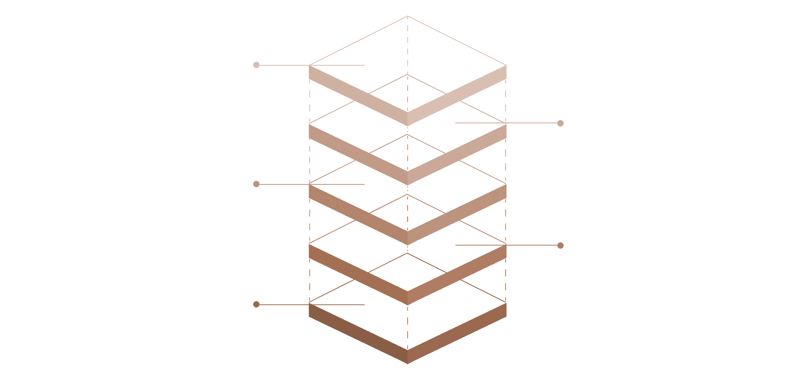
System Architecture Overview
Docker Deployment
Containers for all services
Shor's Module
Performs quantum computation
BB84 QKD Module
Generates quantum keys
Backend Server
Orchestrates message flow
Frontend Chat
User interface for messaging
Our system integrates several critical components to achieve quantum-safe communication. The Frontend Chat Interface provides user interaction, while the Backend Server orchestrates message flow and interactions with the quantum modules. The BB84 module handles key distribution, and Shor’s Algorithm is used for analytical purposes. Docker facilitates seamless deployment and scalability of the entire system.

Slide 8





Functional Requirements
Real-time Messaging
BB84 Key Generation
AES Message Encryption
Users can send and receive messages instantly, Supports one-to-one communication.
The system generates secure keys using BB84, Keys are shared safely between users.
Messages are encrypted before sending, Advanced Encryption Standard (AES), Only the receiver can read the message
Backend Chat Logging
Quantum Security Analyzer
The server records chat messages, Used for monitoring and learning purposes
Includes Shor’s Algorithm module,Shows how classical encryption can be broken,

Slide 9




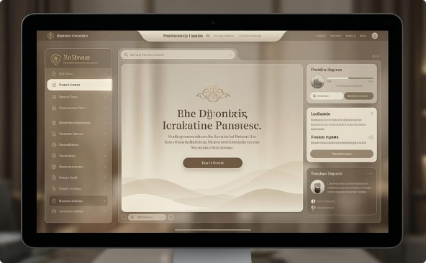
Non-Functional Requirements
High Security
Real-time Performance
High Reliability & Availability
Scalability
The system provides strong protection for messages.
Safe from normal hacking and future quantum attacks
Messages are delivered very fast
No noticeable delay while chatting
Can support more users and more messages., Uses container technology (Docker)
System works continuously without crashing.
Available to users at all times
Usability & Maintainability
Easy for users to understand and use..
Easy for developers to update and maintain
Beyond its core functions, the QuantumSecure Chat System prioritises performance, robustness, and ease of management.

Slide 10

BB84 – Quantum Key Distribution (QKD)
BB84 is the first and most famous quantum cryptography protocol, proposed by Bennett and Brassard in 1984.
It is used to securely share encryption keys between two users using quantummechanics..
Traditional key exchange methods can be broken by powerful computers or quantum computers,BB84 solves this by using quantum properties of particles
Detects any hacking attempt automatically, Keys cannot be copied or predicted, Provides unconditional security
BB84 is the security backbone of the system, It generates secure encryption keys, These keys are later used with AES encryption for messages
This innovative approach guarantees that the encryption keys used are truly random and cannot be compromised without immediate detection.

Slide 11

Shor’s Algorithm – Role as a Quantum Security Analyzer
Shor’s Algorithm is a quantum algorithm used to break classical public-key cryptography, especially RSA encryption.
Why Shor’s Algorithm is used
To analyze and demonstrate security weaknesses
To show how quantum computers can break RSA
Role in This Project
Works as a Quantum Security Analyzer
Takes small RSA values for safe demonstration
Shows how classical encryption can fail
Simple Analogy
RSA = Strong lock
Quantum Computer + Shor’s Algorithm = Master key
BB84 = Lock that breaks if someone touches it

Slide 12
THANK YOU

